Slide 1
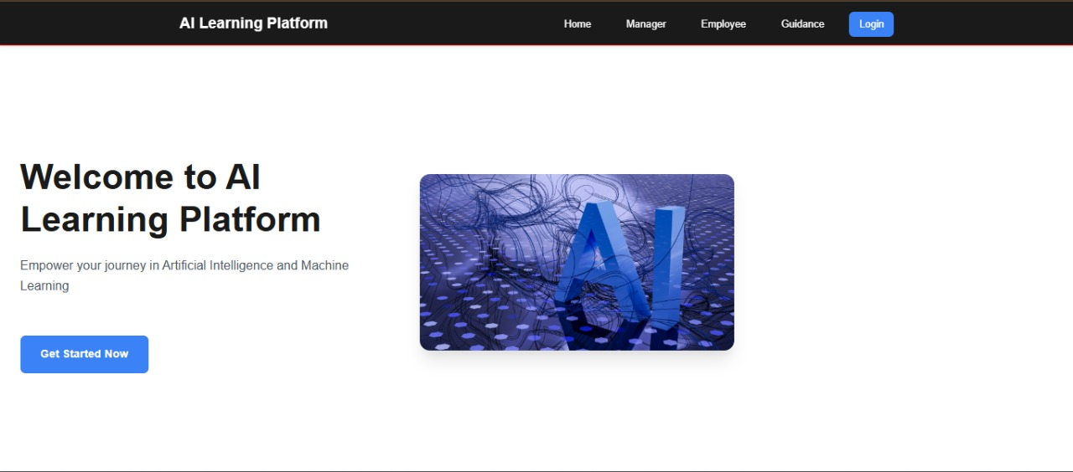

UpScale – Ai Personalised Learning
(Amateur Coders)Its Never Late to Raise your Bar

Slide 2


Problem Statement
Lack of Personalization: Training programs are often too generic, not catering to individual learning needs or goals.
Poor Progress Tracking: Employees and managers struggle to track learning progress and identify skill gaps.
Overwhelming Choices: Employees find it difficult to choose relevant courses from a large pool of resources.
Low Engagement: Traditional training methods can be monotonous, lacking interactivity and motivation.

Slide 3
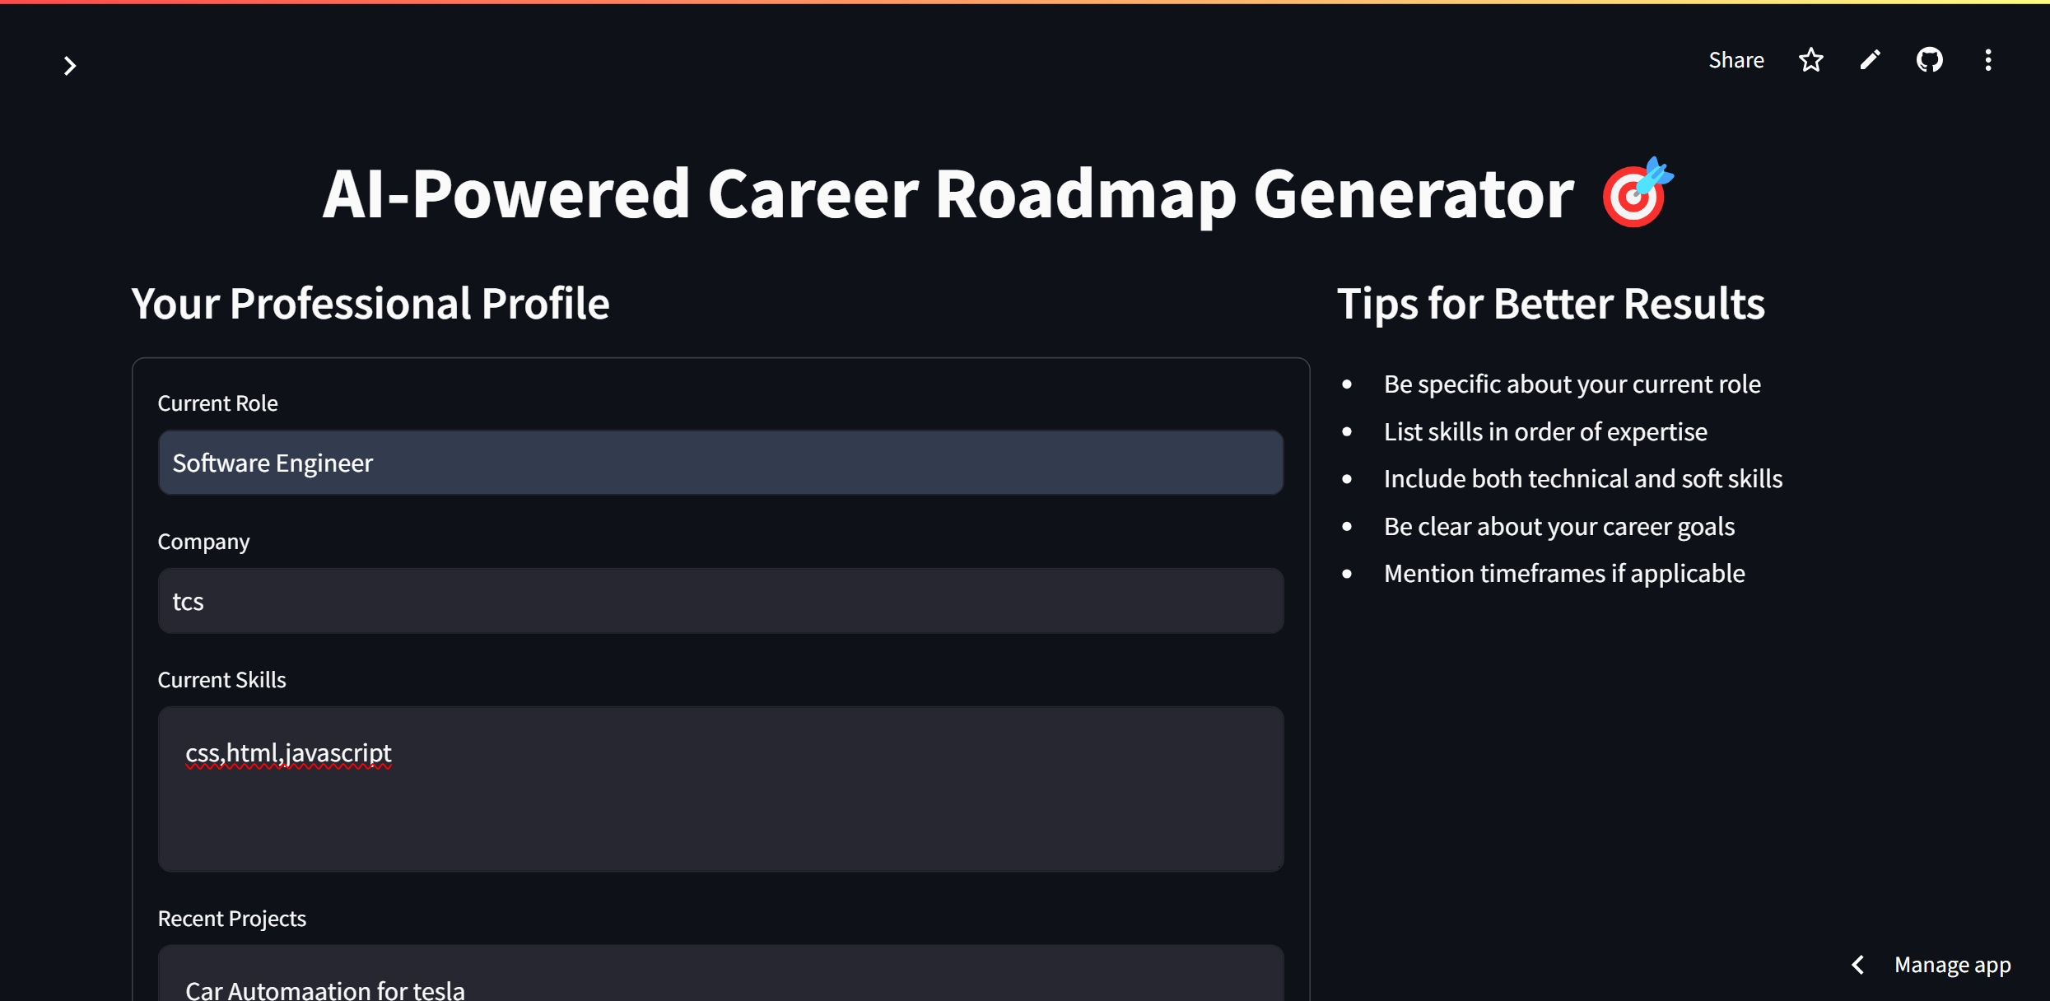
Stakeholders and Competitors
Stakeholders
Employees
Managers
HR Teams
Learning & Development (L&D) Teams
IT/Technical Teams
Organizational Leaders/Executives
Training Providers
AI/Tech Solution Providers
Competitors
Coursera
LinkedIn Learning
Udemy for Business
Pluralsight
Skillsoft
EdCast
Degreed

Slide 4
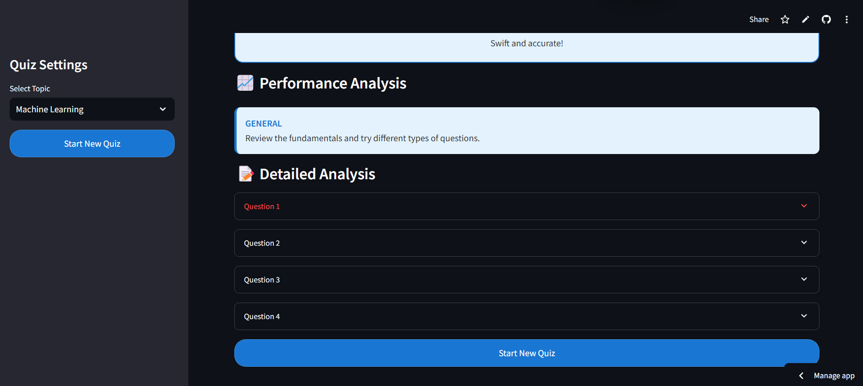
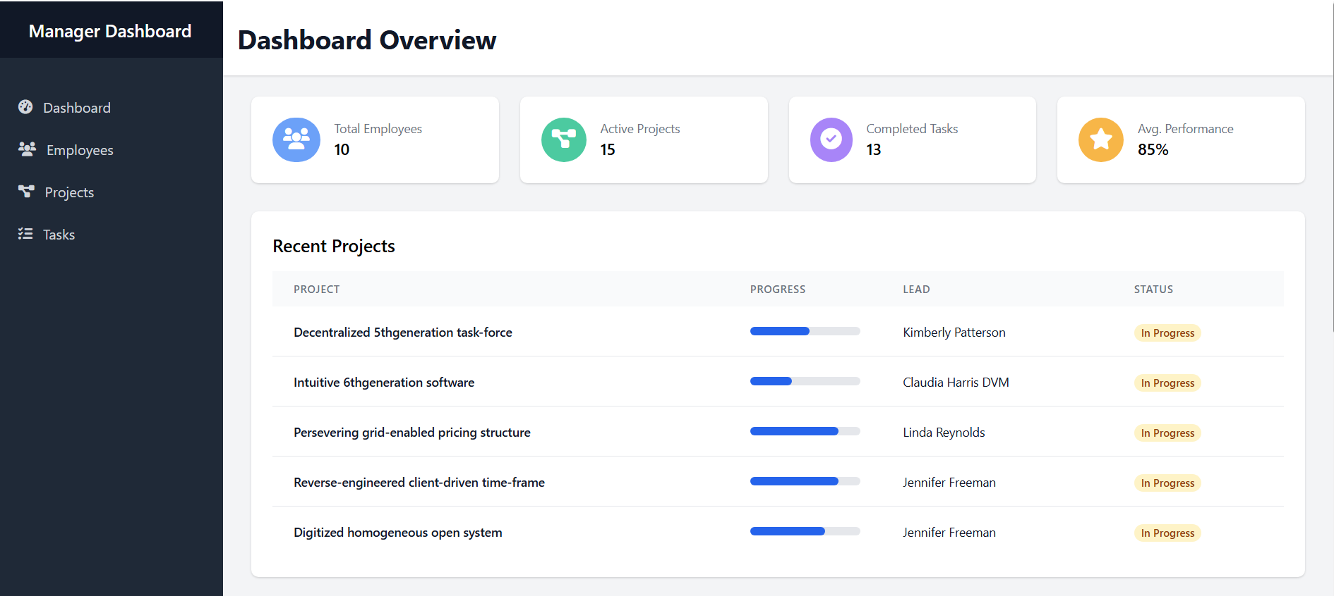
Present Scenario
Current Solutions
Generic Learning Platforms: Platforms like Coursera and LinkedIn Learning offer broad courses but limited personalization.
Manual Progress Tracking: Companies rely on managers and HR to manually track and adjust employee learning.
No Integration with Work Projects: Learning is often separate from real-time job tasks, missing contextual application.
Static Learning Paths: Training programs typically follow fixed paths, without adaptability to individual progress or goals.

Slide 5
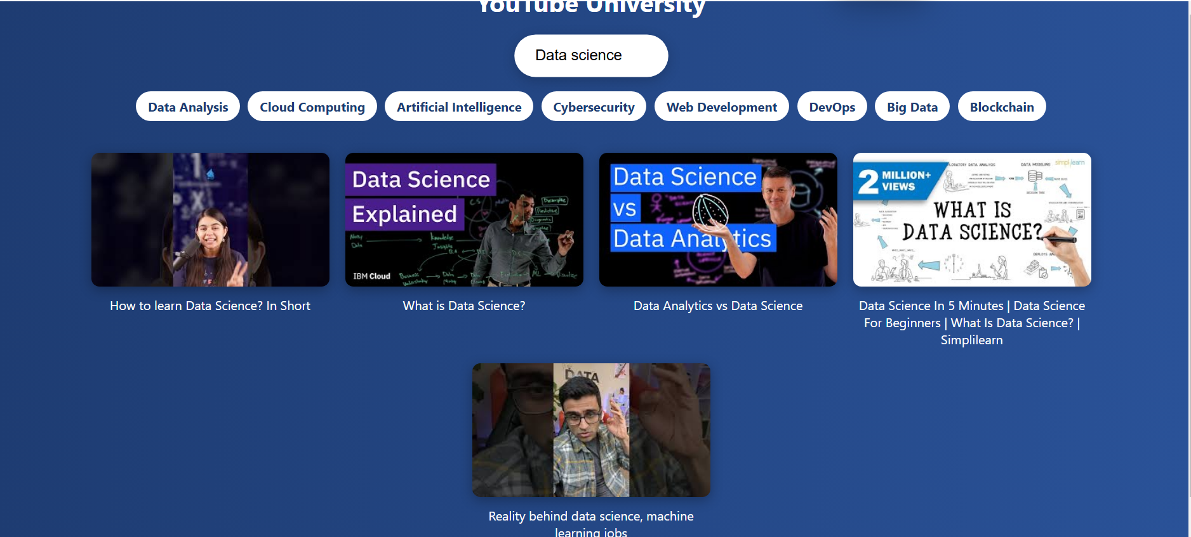
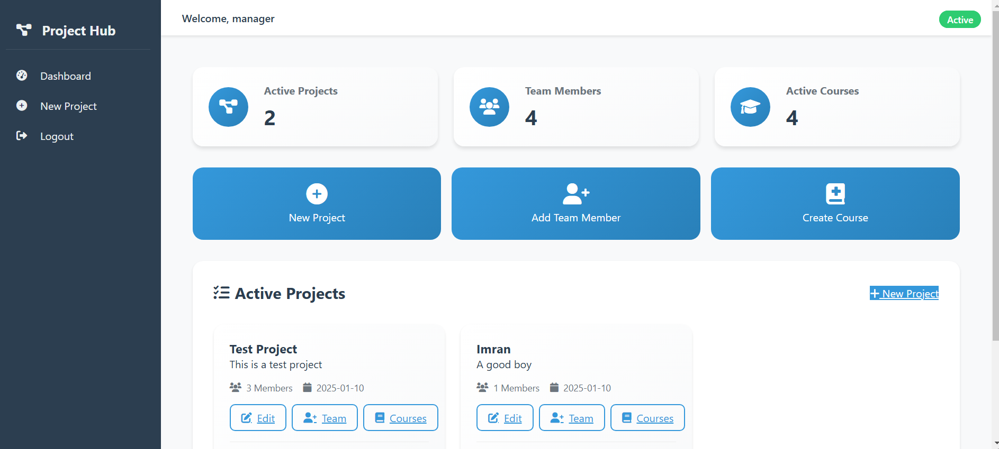
Proposed Solution
Personalized Learning: Tailored roadmaps for employees based on skills and goals, with feedback-driven updates and access to courses and quizzes.
Task Management for Managers: AI agents automate project task creation and assignment, with progress tracking and mandatory course assignments.
Interactive Quizzes & Feedback: Adaptive quizzes with difficulty adjustments, analysis, feedback, and badges for employees' profiles.
Collaboration & Support: Forum for Q&A with upvote/downvote, plus an AI coach for personalized assistance.

Slide 6
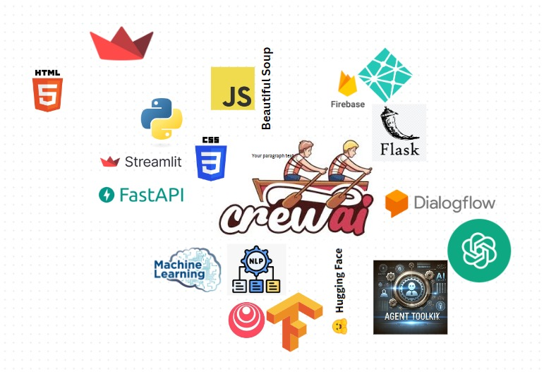
Features
Tech Stack
Roadmap Generator
YouTube University
Quiz Time
Project Course Assignment
Manager Task Management
Status Dashboard
Forum
AI Coach
Learning Progress Tracking
Mandatory Course Management for Managers

Slide 7
Unique Selling Point
Personalized Learning: Tailored roadmaps and quizzes that adapt to individual progress and goals.
AI-Driven Task Management: Automation of project tasks and employee assignments using AI agents and CrewAI.
Real-Time Feedback: Adaptive quizzes with instant feedback and badges to track learning progress.
Integrated Learning & Work: Seamless connection between learning, projects, and performance.
Employee Engagement: Forum and AI Coach for interactive Q&A and personalized assistance.

Slide 8

Deployment Links
Github Link : https://github.com/ashoksuthar14/UpScale---ISTD-Hackathon/tree/main
Website Link : https://upscale-amature-coder.netlify.app/
Youtube Link : https://youtube.com/watch?v=Ip8Mago4hqA&feature=shared

