Slide 1
OR 568 (Final Project) Home Depot Product Search Relevance -Ashok Vardhan Kari

Slide 2
1.
Objective
Predicting the relevance of search results to the search terms on homedepot.com.

Slide 3
DataSet
Data Source - https://www.kaggle.com/c/home-depot-product-search-relevance/data
Observations – 74,068 and 5 Predictors (given) 5 Predictors (newly created)
Response – Relevance Score
Summary Of Predictors – All text predictors.

Slide 4
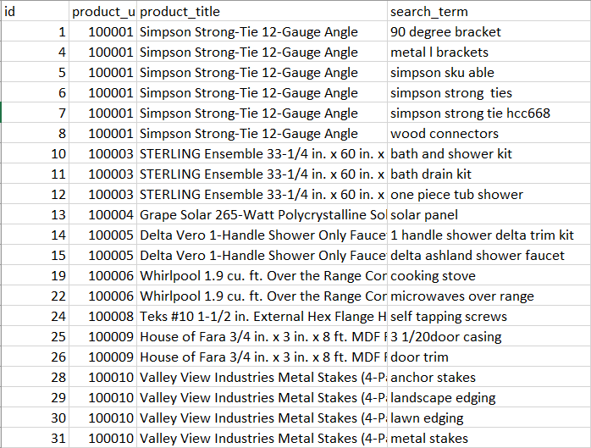
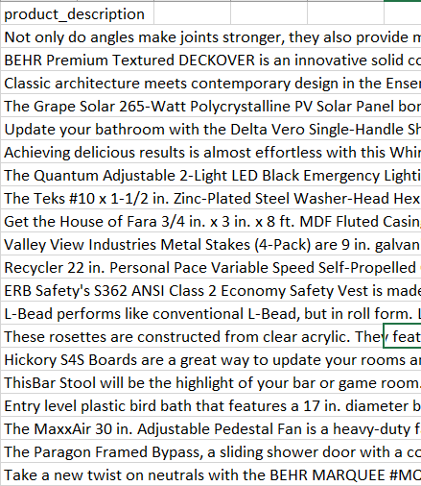
Sample Predictor Variables

Slide 5

Response Variable
Relevance – Relevance score of search terms used to search a particular product.
Relevance Score is given in the range of 1-3. 1 being not relevant and 3 being highly relevant.
Eg - Weber Spirit E-210 2-Burner Propane Gas Grill
Search terms
Outdoor Grill (Highly Relevant - 3)
Grill (Moderately relevant - 2)
Induction Stove (Not relevant - 1)

Slide 6
Data Cleaning
Lower case
Removing Punctuation
Removing Stop Words
Stemming
Once Numerical Predictors are created, centering and scaling is done.

Slide 7
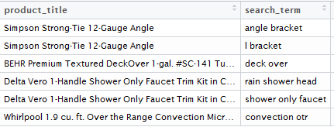
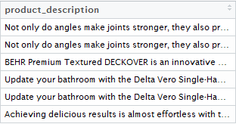
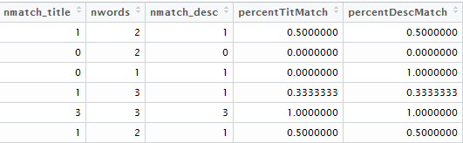
Text Predictors -> Numerical Predictors

Slide 8
Predictive Models
Linear Models
Model | RMSE | Rsquared | RMSE SD | Rsquared SD
LM (3 Predictors) | 0.5032457 | 0.1118881 | 0.003922922 | 0.005915459
LM (5 Predictors) | 0.4985872 | 0.1283324 | 0.003780619 | 0.008842439
GLM | 0.4984968 | 0.1282527 | 0.0048818 | 0.01166843
GBM | 0.4904631 | 0.1564513 | 0.003483352 | 0.007641151
RLM | 0.4994083 | 0.128146 | 0.00470332 | 0.007401202
PLS | 0.5001331 | 0.12285665 | 0.003615514 | 0.006737014
PCR | 0.5017411 | 0.11719877 | 0.003092877 | 0.006253774
LASSO | 0.4985888 | 0.1282516 | 0.003010145 | 0.006822792

Slide 9
Predictive Models
Non-Linear Models
Other Tried Models
KNN – Response variable has very low variance. So model gave errors saying “Too many ties in KNN”.
Model | RMSE | Rsquared | RMSE SD | Rsquared SD
SVM Linear | 0.5048327 | 0.1272532 | 0.003515008 | 0.003633967
MARS | 0.4917758 | 0.15307302 | 0.001918254 | 0.003231567

Slide 10
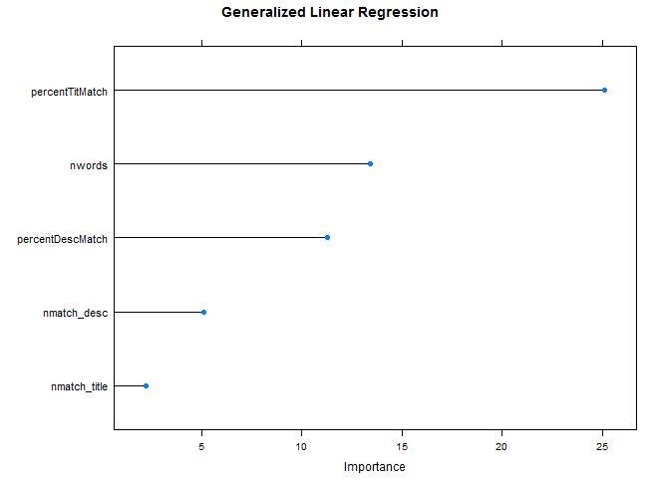
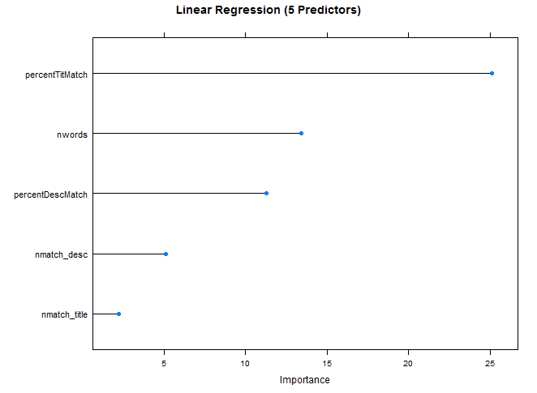
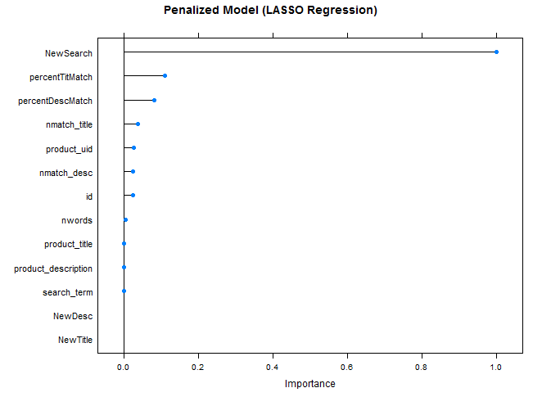
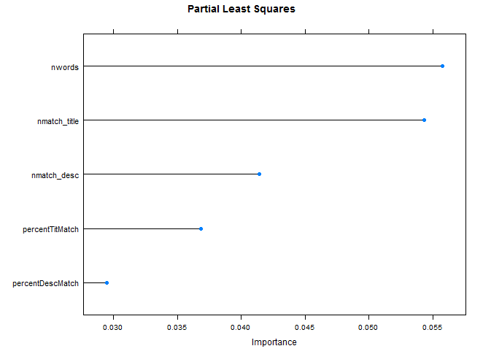
Variable Importance

Slide 11
Citations
Project Host - https://www.kaggle.com/c/home-depot-product-search-relevance
https://stat.ethz.ch/R-manual/R-devel/library/base/html/is.finite.html
http://stackoverflow.com/questions/12188509/cleaning-inf-values-from-an-r-dataframe

Slide 12
Thanks!
Any suggestions/ questions?

