Slide 1
Understanding Is Not Observable
Why you can't tell if two minds actually connect — and what to do instead
Review 1
Ashok Pasala · Snigdha Gorai · VIT-AP University · August 2026

Slide 2
The Founding Question
Where this started — July 19, 2026
Speech is a very narrow pipe for a very fast brain.
≈10⁹ : 10 bits/s
the gap between what the senses take in and what behaviour outputs
Sensory intake: roughly 10⁹ bits/second
Deliberate behaviour: roughly 10 bits/second (Zheng & Meister, Neuron)
Speech: roughly 39 bits/second, remarkably stable across 17 languages, 9 families (Coupé et al., Science Advances)
8 orders of magnitude
of apparent loss — the premise that motivates every brain-interface project
The obvious idea: wire two brains directly, skip the mouth and the ear, and let two minds finally exchange information near their true internal speed.
Understanding Is Not Observable · Review 1
2

Slide 3
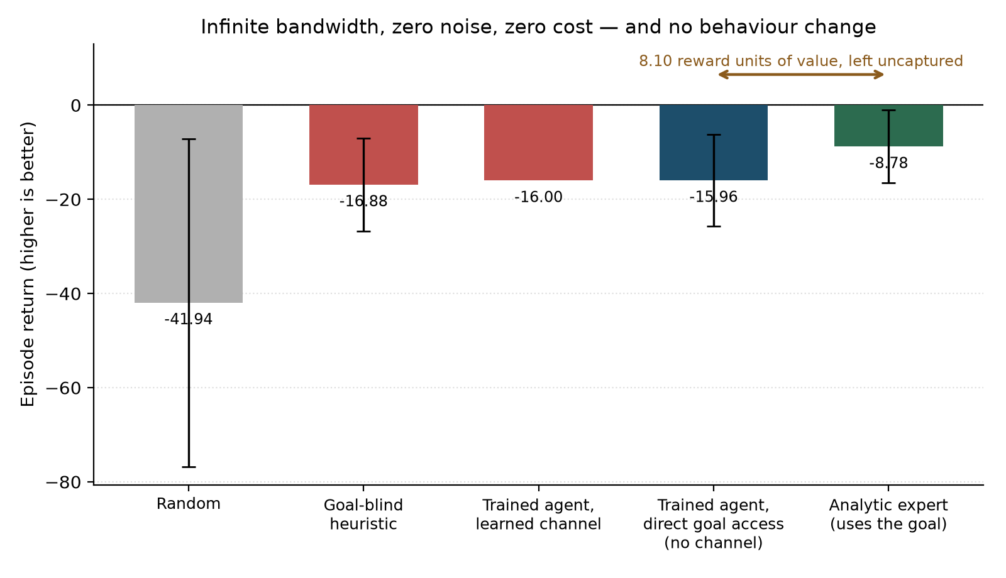
We Tested It — And It Broke The Premise
The infinite-bandwidth control
• Two learning agents, one holding private information, one that must act on it, connected by a channel we fully control.
• We didn't widen the channel — we deleted it. The sender's private information handed to the receiver directly: free, instant, perfect, zero noise.
• The physical ceiling no interface of any kind could ever exceed.
Handing over the information changed nothing. Behaviour was statistically identical to receiving nothing at all.
Understanding Is Not Observable · Review 1
3

Slide 4
The Bottleneck Was Never The Channel
What was actually missing
• Two systems can only communicate if they already agree, in advance, on what a signal means — a shared convention, not a wire.
• That same agreement is what makes it impossible to tell from outside whether real communication is happening right now.
• A system genuinely tracking a partner's signal, and one merely running the same shared code on autopilot, look identical to every outside measurement.
Genuinely tracking the live signal
Running the same code on autopilot
From every outside measurement — synchrony, decodability, agreement — these look exactly the same.
0.0017
reconstruction error — the partner's private goal, read almost perfectly from the receiver's own hidden layer, while its behaviour used essentially none of it
Understanding Is Not Observable · Review 1
4

Slide 5
So How Much Faster, Really?
The honest answer to the question everyone asks
≈10⁹ vs ≈10 bits/s
senses vs. deliberate behaviour — up to a hundred-million-fold gap, unrealised
0%
of that gap captured in the most direct test physically possible — zero channel, zero noise, information handed over free
That hundred-million-fold number is what has quietly motivated a decade of brain-interface research. The honest answer to “how much faster without the mouth” isn't a percentage above zero — it's zero, measured, because the mouth was never what was limiting it.
What's still open: whether a different kind of gain exists — not from widening the channel, but from an interface that grows a shared convention between two systems over time. Nobody has measured how much of that gap such an interface could recover, because nobody has built and tested one yet.
Understanding Is Not Observable · Review 1
5

Slide 6
A Formal Result, Not Just an Intuition
Theorem 1 and its consequences
Non-identifiability (Theorem 1). Two dyads — one genuinely coupled, one not — produce identical observational statistics: mutual information, synchrony, transfer entropy, behavioural agreement. No functional of the observational distribution tells them apart.
What does work (Theorem 2). Three conditions identify functional coupling: adjustment when the convention is observed, instrumental variation (ordinary channel noise qualifies), or direct intervention.
What doesn't (Propositions 2–3). Temporal precedence does not identify it — transfer entropy and Granger causality inherit the full negative result despite being called “directional.” Nor does observing the receiver's internal state — it fails Pearl's front-door criterion, for structural reasons no recording resolution repairs.
Understanding Is Not Observable · Review 1
6

Slide 7
You Can See the Gap, With Real Numbers
Proposition 1 — the state–behaviour dissociation
R² = 0.90
sender encodes its private goal into the message
0.0017
reconstruction error — goal recoverable almost perfectly from receiver's hidden state
z ≈ 0
receiver's behaviour, statistically indistinguishable from getting no information
≤ 12%
share of the value of the information actually captured, even after the best fix
State-level coupling sits at ceiling — every current interpretability and hyperscanning measure would call this system “coupled.” Functional coupling sits at floor. Same system, same moment, completely different answer depending on what you measure.
This is the artificial, provable version of the Clever Hans problem: a horse that appeared to do arithmetic by reading unconscious cues, not by understanding numbers.
Understanding Is Not Observable · Review 1
7

Slide 8
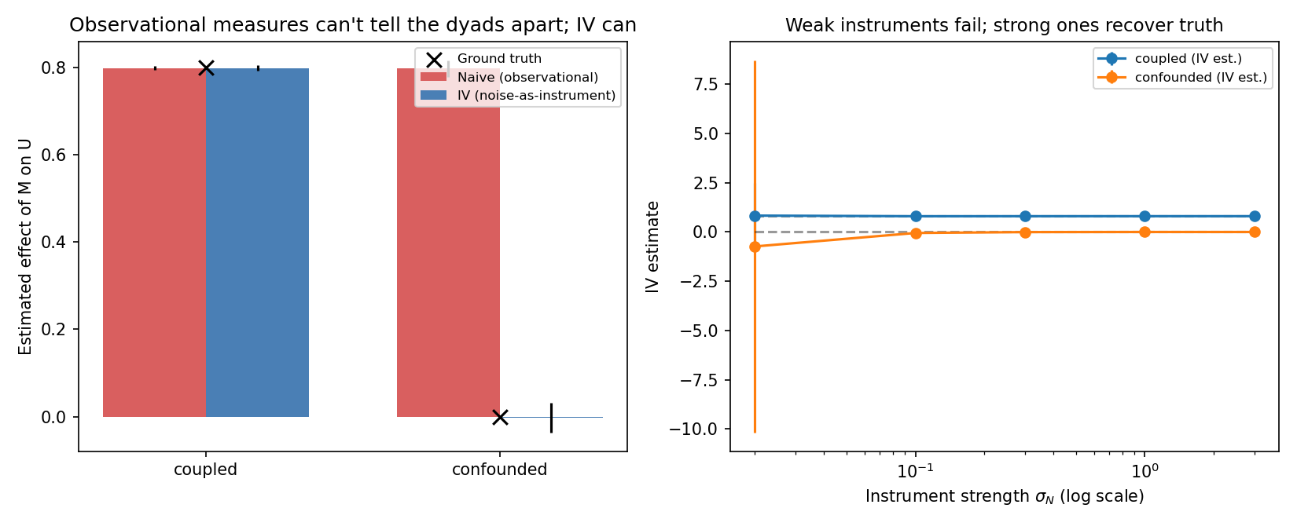
Ablate It, or Scramble It — Then You'll Know
The remedy: interventional measurement
• You cannot find this gap by watching more carefully. You have to intervene: remove the signal, or scramble it, and see whether behaviour actually changes.
• Randomising a signal is roughly 3× more sensitive than simply removing it, on the identical system — predicted on theoretical grounds, confirmed empirically.
• But even the residual sensitivity does no real work — the test must be calibrated against the value of the information, not against zero.
Noise as an instrument: ordinary channel noise recovers exact ground truth — inverting the usual impulse to denoise.
Understanding Is Not Observable · Review 1
8

Slide 9
It Explains a Decade-Old Mystery
Brain-to-brain interface throughput, 2014–2019
0.25–0.81
bits/trial — Rao et al. 2014, 64-channel EEG
0.336
bits/trial — Jiang et al. 2019 “BrainNet,” far more sophisticated hardware
Still nothing new
in 7 more years — confirmed by today's literature scan, through 2026
• Throughput went down, not up, across the field's biggest hardware jump — and BrainNet's own authors say so, in their own paper, without an explanation.
• On a channel-centric account, this is unexplained. On this account, it's forced: convention is installed from outside, by ordinary language, before the experiment begins — and that ceiling doesn't move when the hardware improves.
Understanding Is Not Observable · Review 1
9

Slide 10
Independent Support, Found This Week
A same-day literature sweep, six passes, ahead of Review 1
Zheng & Meister, Neuron 2024/25. Independently confirms the ~10 bits/s behavioural ceiling, with no reference to interfaces or coupling at all.
Meyer & Zamani, J. Neural Engineering 2026. Peer-reviewed: mainstream BCI's real constraint is an “input/output disparity,” not raw channel count.
Varlet & Grootswagers, 2024. Real EEG hyperscanning data: brain synchrony barely moves even when researchers directly control whether two people share real information.
Comparative cognition. “Clever Hans effect” is already a named, standing methodological concern there — and playback/ablation experiments have been the field's default method for decades. The waggle-dance debate was settled with a robot bee built to manipulate the signal directly.
Understanding Is Not Observable · Review 1
10

Slide 11
Checked Hard for Prior Art
Novelty check, not just a literature review
• The two closest relatives — Kolchinsky & Wolpert (2018) and Lowe et al. (2019) — read in full from primary sources, not memory.
• Six independent research passes today, 17+ distinct search angles targeting the exact combination this claim needs.
• No paper found combines all four: two interacting systems, a formal impossibility result, shared convention as the confounder, and a named class of defeated observational measures.
Novelty: holds
checked from every angle available — not disprovable, but genuinely not found elsewhere
One same-day preprint on multi-agent LLM communication runs a conceptually similar audit — close enough in framing to read in full and cite, not close enough to threaten the claim.
Understanding Is Not Observable · Review 1
11

Slide 12
Where We Stand
Established vs. open, honestly separated
Established
Open
• The impossibility proof
• A working demonstration with real numbers
• Why the gap exists
• A fix that works — tested honestly, including where it hits a real wall on a real system
• Survives contact with the closest prior work
• The human–AI experiment — fully designed, not yet run
• A second empirical system outside this toy
• Hyperscanning re-analysis on existing public EEG data
• The hysteresis test — predicted, untested
Understanding Is Not Observable · Review 1
12

Slide 13
The Highest-Leverage Next Step
Fully designed. Cheap. Not yet run.
• Real AI system, real person. A follow-up request whose wording never changes — only what was actually said beforehand changes.
• Four conditions: intact · the earlier statement removed · swapped for an equally fluent but different statement · one specific detail flipped.
• Watch whether the answer tracks what was truly meant, or only the shape of the sentence.
If it tracks real meaning: the theory narrows, honestly. If it doesn't: the same gap shown in something people use every day — and the argument becomes a result.
Understanding Is Not Observable · Review 1
13

Slide 14
You cannot tell whether two systems
understand each other by watching them.
You can only find out by testing it.
— and almost nobody currently tests it that way.
Thank you — questions

