Slide 1
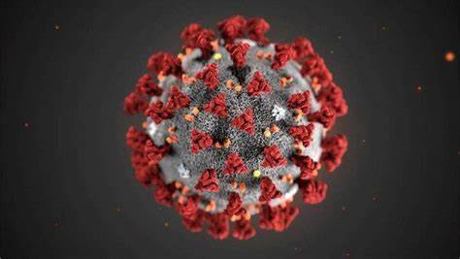
COVID-19: Cases and Vaccinations in Arizona
Jason Wang, Kellen Quinn, Ashley Patricia Parra (AP), Kimberly Norman

Slide 2
How accessible are Covid-19 Vaccines in Arizona?
We decided that this was something we wanted to look into at a deeper level than just what was available on the AZDHS Covid-19 dashboard. We wanted to compare case count and vaccine count side by side to see if areas hit the hardest were also a focus for vaccine distribution. We also wanted to compare vaccine sites to the income of the area to see if higher income areas had more access to the vaccine like we’ve been told is happening in many states.
H0: Income plays a role in infection rate and vaccination rate, reflected by zip code.
H1: Income does not play a role in the infection rate and vaccination rate.
Notes:
Ashley

Slide 3
Questions
There’s been a concern since vaccines started rolling out about how accessible they would be to the areas that need it most. We were curious to see what the accessibility looked like for Arizona. The areas we were most concerned about were the high covid case count areas and low income areas.
What do COVID-19 case percentages look like compared to the percent of the population vaccinated in Arizona?
Are vaccines being distributed where the cases are highest?
Do wealthier zip codes have more access to the vaccine?
Notes:
Ashley

Slide 4
Data Sources
COVID-19 Case Count by Zip code (Arizona)
Arizona Department of Health
https://www.azdhs.gov/covid19/data/index.php
COVID-19 Vaccine Count by Zip code (Arizona)
Arizona Department of Health
https://www.azdhs.gov/covid19/data/index.php
Median Income by Zip Code (Arizona)
census.org
Total Population by Zip Code (Arizona)
census.org
Notes:
Ashley

Slide 5
Data Cleaning
Notes:
Kim

Slide 6
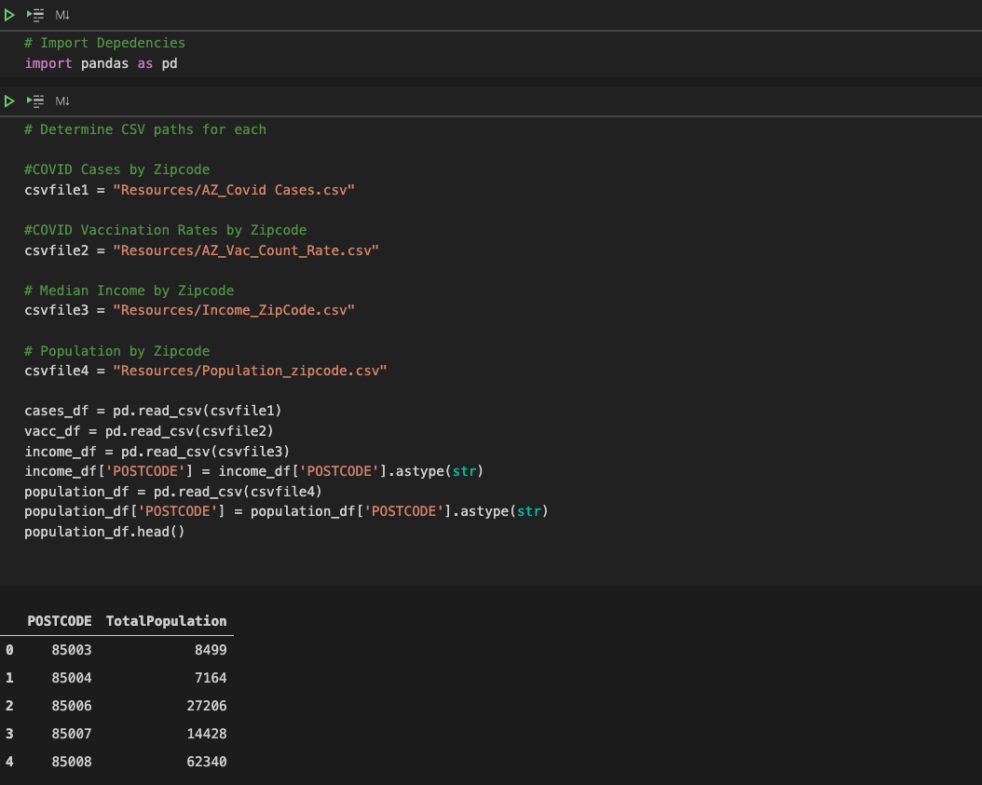
Merging Datasets Together

Slide 7
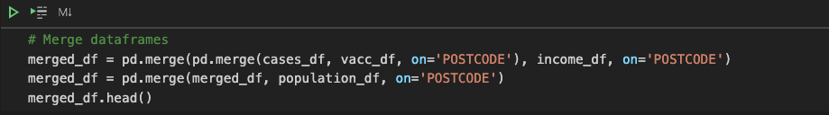

Merging Datasets Together

Slide 8
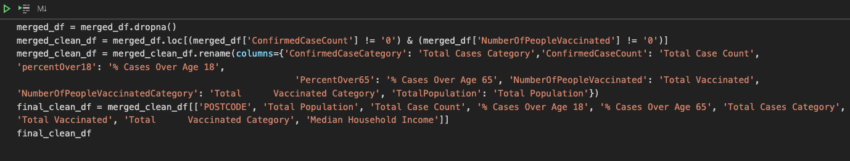
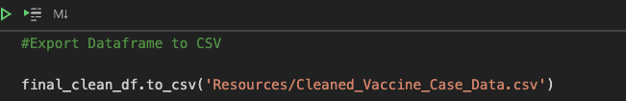
Cleaning Dataframe

Slide 9
Overview
Notes:
Jason

Slide 10
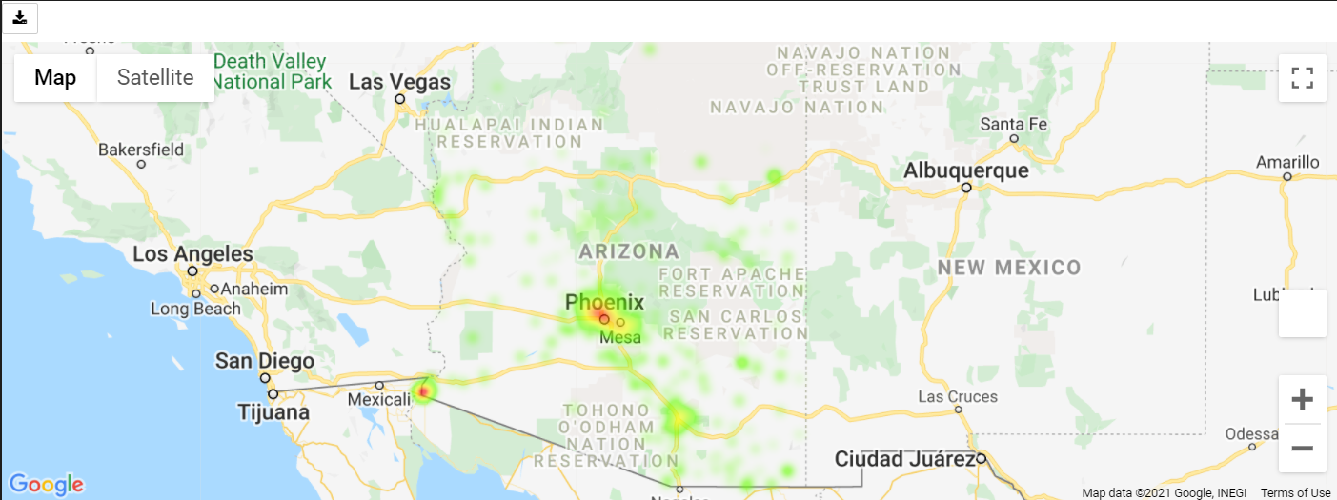
A Look at Arizona Cases by Zip Code
Notes:
Jason

Slide 11
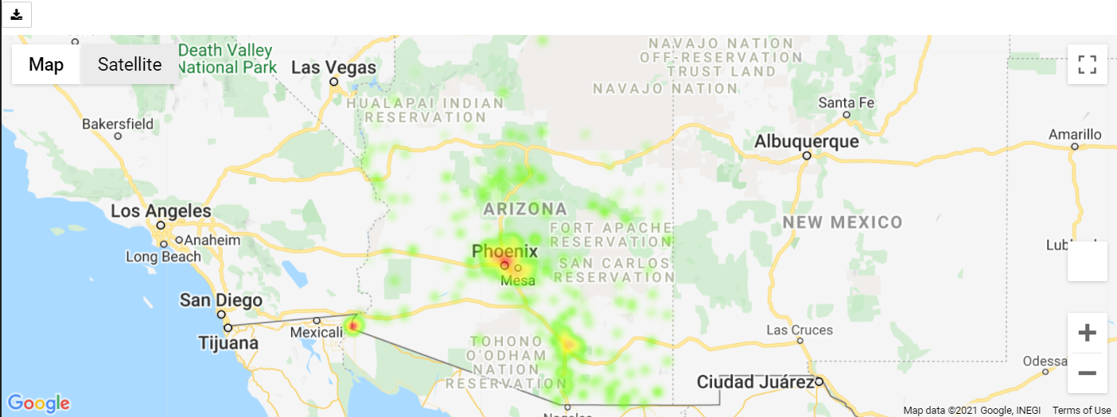
A Look at Arizona Vaccination by Zip Code
Notes:
Jason

Slide 12
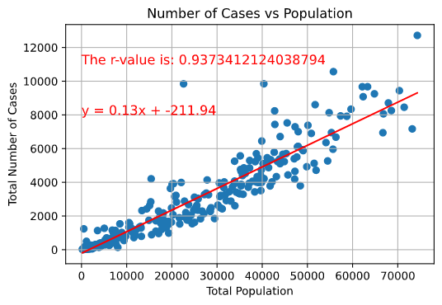
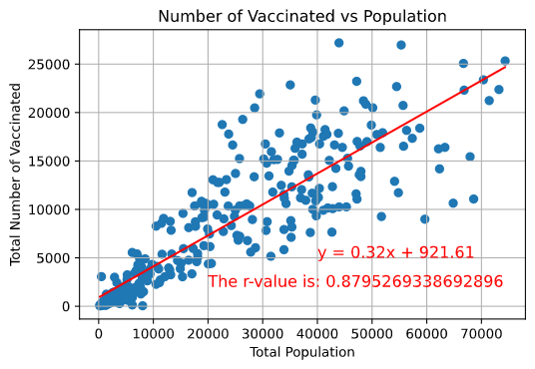
Case and Vaccination Rate vs Population
Notes:
Jason

Slide 13
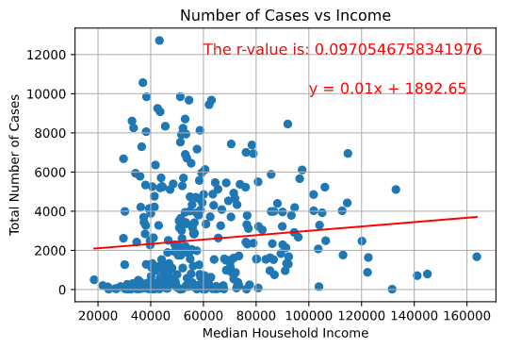
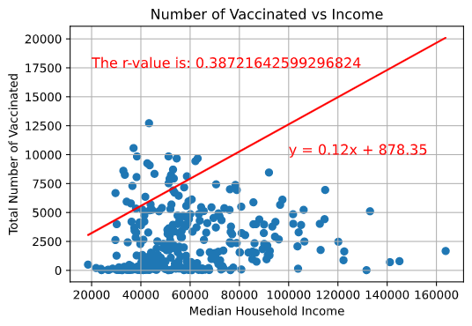
Case and Vaccination Rate vs Income
Notes:
Jason

Slide 14
Question 1
What do COVID-19 case percentages look like compared to the percent of the population vaccinated in Arizona?
Notes:
Ashley

Slide 15
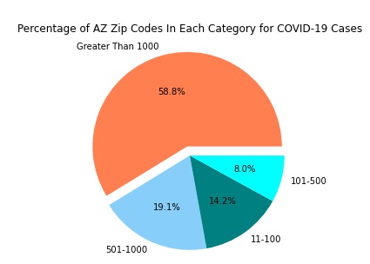
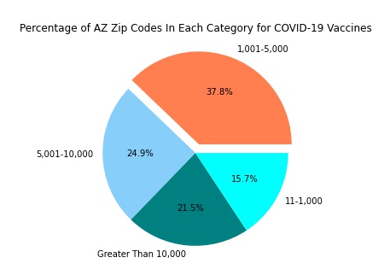
Percentage of Zip Codes in Case/Vaccine Categories
Notes:
Ashley

Slide 16
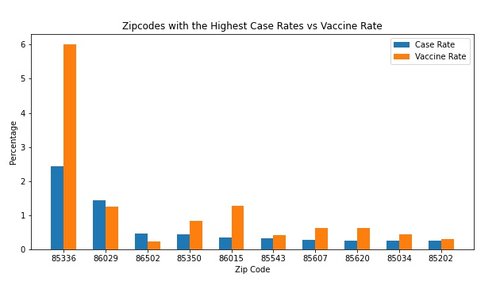
Zip Codes with Highest Case Rates
Notes:
Ashley
85336 and 85350 which is in Yuma County
86015 is in Coconino County (Flagstaff area)
86029 is in Navajo County
More rural...maybe not that high access to vaccines
86502 in Apache County
Also rural

Slide 17
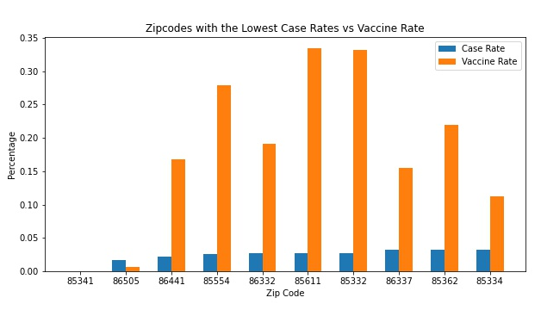
Zip Codes with Lowest Case Rates
Notes:
Ashley
86332 Yavapai County

Slide 18
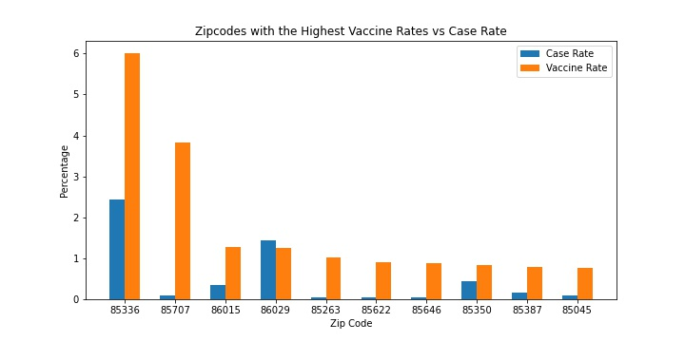
Zip Codes with Highest Vaccine Rates
Notes:
Ashley
85336 which is in Yuma County
85707 in Pima County (Davis Monthan Air Force Base)

Slide 19
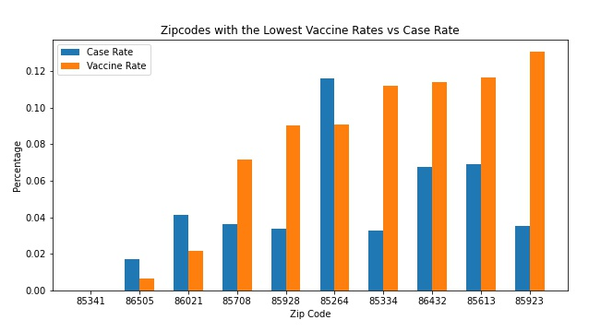
Zip Codes with Lowest Vaccine Rates
Notes:
Ashley
86505 Apache County
86505 Mohave County
85264 is in Maricopa County (Scottsdale)

Slide 20
Question 2
Are vaccines being distributed where the cases are highest?
Notes:
Kellen

Slide 21
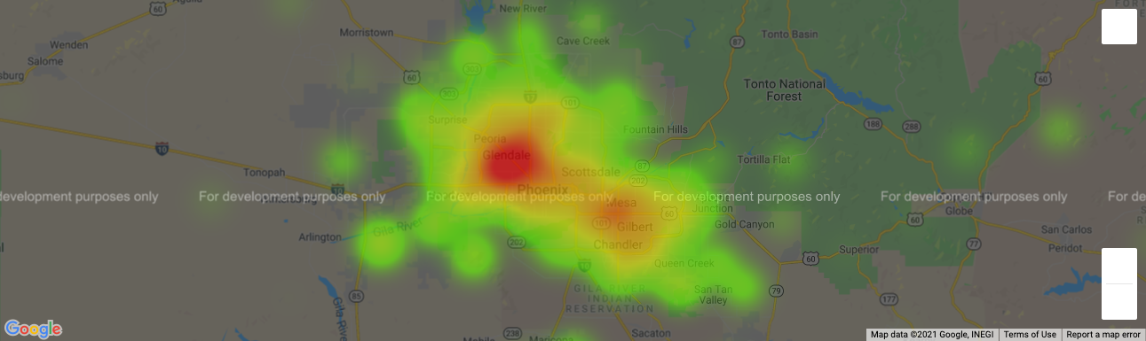
Maricopa County Case Counts

Slide 22
Maricopa County Cases Cont’d
Analysis from the AZ Dept. of Health of Health Services suggests that Mesa and Glendale are valley’s hotspots.
Con of data is that it is unclear how ADHS obtained the data and to what degree of uniformity.
Both Mesa and Glendale were locations of State’s early pandemic drive through testing centers.
Assuming presence of early drive through testing sites are not skewing the data, it would appear that Arizona strategically chose those venues (both due to ease of use) and due to hot spot indications.
Hard data alone cannot account for why these two locales in the valley were hardest hit.
Making inferences, however, had we looked at voter registration data, Mesa may be a more politically conversative area of the valley.

Slide 23
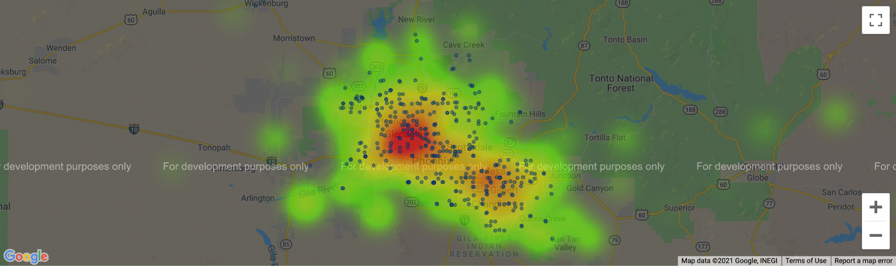
Maricopa County Vaccine Sites

Slide 24
Maricopa County Vaccine Site Analysis
Overall, governmental and non-governmental distribution sites appear to be well placed within areas of case counts.
However, it does appear that there are many areas in Maricopa County with confirmed case counts with minimal to no vaccination site coverage.
‘Hot Spots’ seem particularly well-covered.
Lacking Coverage
Extreme NW Valley
Extreme SW Valley
Fountain Hills
Queen Creek/San Tan Valley areas.
Unincorporated areas of Maricopa Co. in Tonto Nat’l Forest.
Salt River Pima Maricopa Indian Community
Being sovereign nation, vaccine sites not listed, but since areas of Scottsdale fall under their jurisdiction, data is lacking for the entirety of the City of Scottsdale.

Slide 25
Question 3
Do wealthier zip codes have more access to the vaccine?
Notes:
Kim

Slide 26
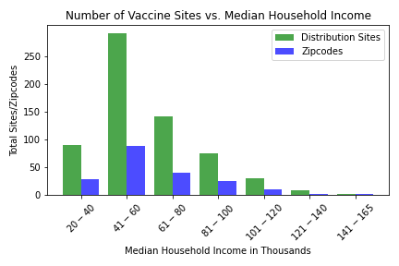
Number of Vaccine Sites vs. Median Household Income for Arizona Zip codes
We can see in this chart that the locations for the majority of vaccine distribution sites are in zip codes where the median household income falls in the $41k - $60k range. This makes sense since the majority of zip codes also fall in this range. According to this chart, the vaccine distribution sites are relative to the total number of zip codes that fall in each income bin. We can conclude that vaccines are accessible to the lower income communities.
Notes:
Ashley

Slide 27
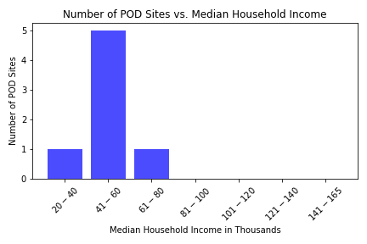
Number of POD Vaccine Sites vs. Median Household Income for Arizona Zip codes
We can see from this chart that the state PODs are located in areas that have a lower median household income. The zip codes that fall in these income ranges are likely in heavily populated areas of cities such as Tucson and Phoenix. These locations make sense for vaccine accessibility. It is also likely that the population of the higher income areas are able to travel farther distances to get a vaccine if they want one.
Notes:
Ashley

Slide 28
Post Mortem
-Difficulties/Limitations
-Additional questions
Zip Code Data
Minimal tribal postcode data
Additional questions if we had more time:
What percent of each race/ethnicity has been vaccinated?
What does the case count look like 4 months before vaccines were being administered in December compared to now?
Notes:
All

Slide 29
Questions??

