Slide 1
CS-410
Text Information Systems
Final Project
Improving Educational Web System
Text Miners
Ashish Kumar Pradhan (apradh6@illinois.edu)
Kirti Magadum (magadum2@illinois.edu)
Bhuvaneswari Periasamy (bp14@illinois.edu)

Slide 2
Background
Educational Web System created by U of I students and faculty
Create links between slides to connect otherwise scattered slides
Single Source for all the lecture slides of courses provided online
Ease of search, navigate and find related slides
Hosted as a Flask Web based application written in Python which can be accessed using any browser

Slide 3
Software Installation (In Windows OS)
Download the code from git repository
Download and Install ElasticSearch
Download and copy tfidf_outputs to specified directory
Create Index (Needs to be done only once)
Download the lecture slides for CS 410
Install gulp server and run it from specified directory
Run the python script app.py
Launch the application in http://localhost:8096/ using any browser

Slide 4
Web Crawler
Takes the subject name and the lecture homepage URL as input
Crawls the given page to find out lecture pdf URLs
Uses Beautiful Soup, Requests and Urllib libraries to parse the webpage.
Extracts relevant texts and links to the lecture pdfs
Handle exceptions during extraction of URLs using BS
Focused on 3 courses : CS 425, CS 554 and ECE 313 from UIUC course websites

Slide 5
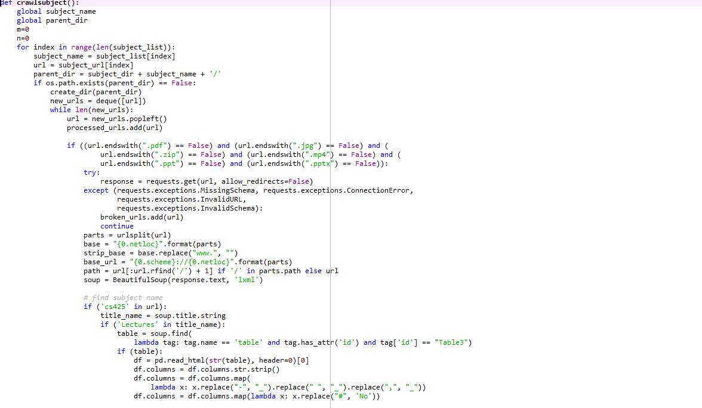

Slide 6
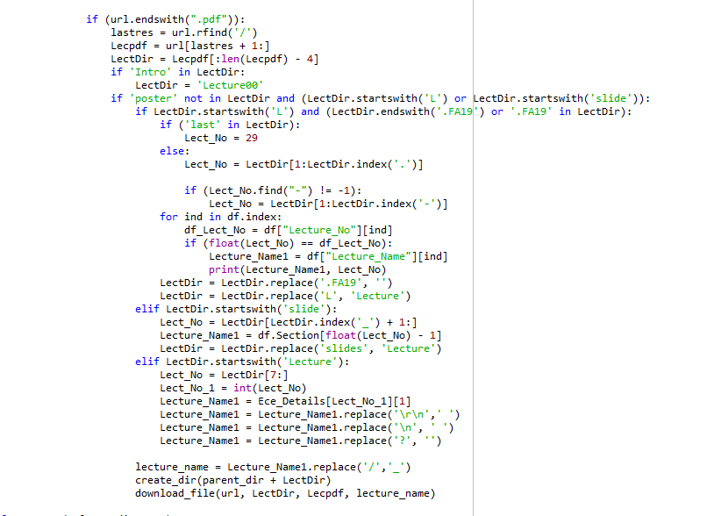

Slide 7
PDF Generation for Display
Generate PDFs according to the compatibility of the system
Create Subject Directory
Get the Lecture Name from the URL
Create Lecture Directory
Download the PDF to the respective directory
Split the PDF into single pages to work with existing script
Delete the original PDF file
Handle Exceptions if Lecture PDF URL encounters errors

Slide 8
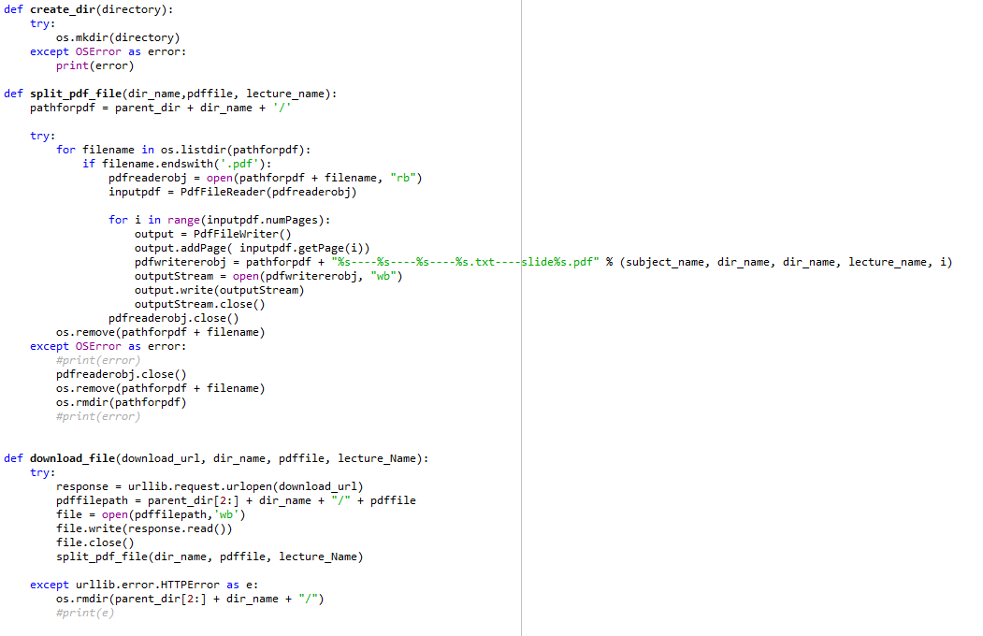

Slide 9
Add Subject Names in Model
Update model.py
Include the newly added subjects into the existing structure
Done to display Lecture Names, Recently visited slides and all the lectures of the courses loaded

Slide 10
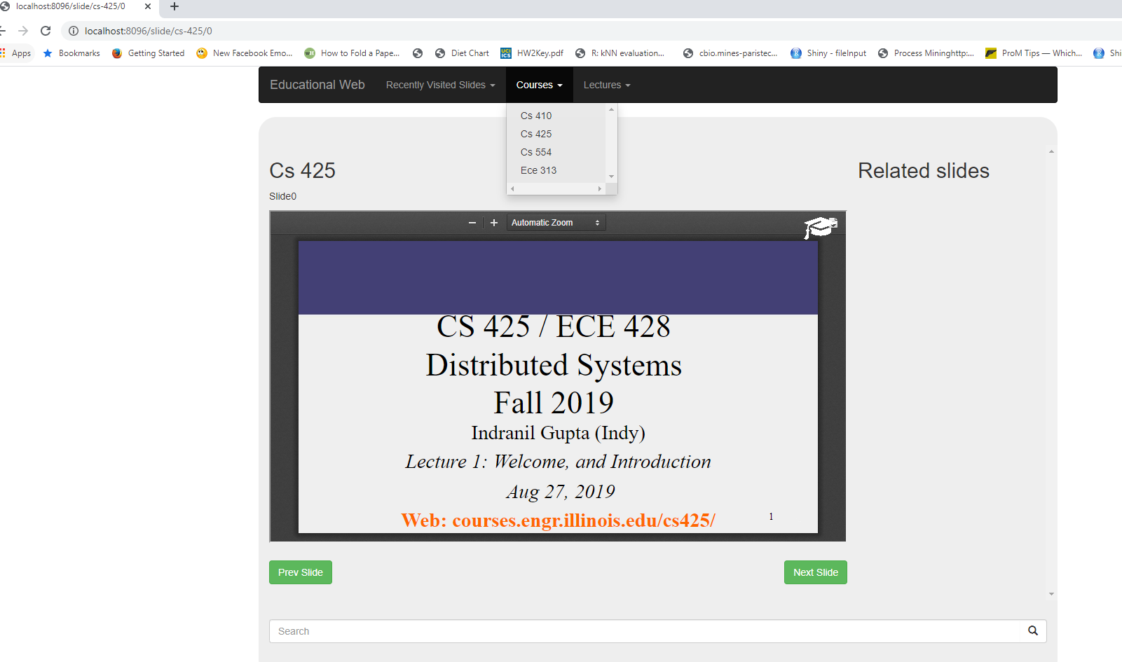
Added Courses in EducationalWeb

Slide 11
Scope for Further Work
Classification Model could automate the web crawling
Allow more courses as an administrator input
Proper provenance of the data and code so that it could be replicated easily by other users
Periodic refresh of existing course slides to maintain the latest version

Slide 12
Conclusion
Useful tool for online learners to search, navigate and find similar content across various courses
Modification to the existing code was done to add more courses into the system
Web Crawling avoids manually downloading the course lectures from a webpage
PDF split incorporates the downloaded content to the system
Update the modal to display the slides into the web application

