Slide 1
Deliverable one presentation on
Computerization of Library Activities
(GROUP - PENGUINS)
Ashraf syed
Deepna Thalanki
Padmini Kuchukulla
Raghu Vamsi Kondapalli
Vamsi Venkat Manepalli
Sai Vishwak Jadala
Abhijith Reddy Mandagiri

Slide 2
Abstract
.
This is a web-based online system, developed for computerizing all library activities.
The system mainly focuses on basic library operations, such as
Add new book
Automatic categorization of book
Search book
Issue book
Return book
Check the availability of book
Developed with the help of Django framework and postgreSQL database
2

Slide 3
Introduction
In essence, it converts a manual library system into an online application.
It assists both student and staff of library in borrowing and supervising the books, respectively
This system is built to help not only the students but also the staff of library, which helps to maintain the library with minimal human effort and make the system efficient.
3

Slide 4
Problem Statement
Create a library management system with voice-based book searching and automatic genre classification based on book titles. Based on the book's title, authors, and information gathered online, the system should search the internet for information on the book and classify it appropriately.
4

Slide 5
Objectives
Distinct product users based on their roles and permissions
Admin
student
Authentication of users at their login
Create a staff interface so they can view registered students, add books, and issue books.
Status page for students to view the books borrowed by them
Availability of voice-based book searches
Automatic categorization of books in genres based on title.
5

Slide 6
Scope
➢
As all manual work is now computerized and also system categorizes the book by itself, Librarian no longer needs the knowledge of genres of all books. Hence, workload is decreased.
All educational institutions can make use of this system to manage their books and it’s transactions.
This project can be further extended by adding the facility for students to reserve a book in advance.
6

Slide 7
Technology Review
Front end is designed using:
Html
Css
Bootstrap
Backend:
Django - Python Web Framework
Database:
PostgreSQL
7

Slide 8
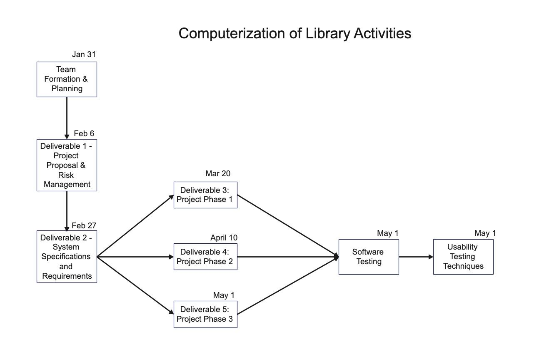
Initial Plan
Pert Chart

Slide 9
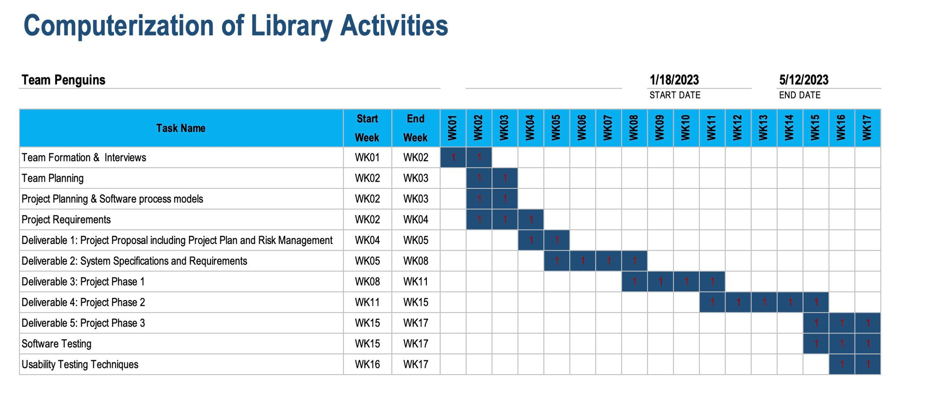
Gantt Chart

Slide 10
Risks
Data Redundancy with inappropriate search
Detailed search for required results
Voice search not recognizing the said statement as it has unique words and names
File type not supported because of external source

