Slide 1

Hospital Operation Analytics

Slide 2





About Me
Mohammed Ashraf
(Team Leader)
Munnuru Saikumar
B.Tech - CSE
B.Tech - CSE
To extract meaningful insights from data and support decisions.
To extract meaningful insights from data and support decisions.
Experience: Fresher
Experience: Fresher
https://www.linkedin.com/in/ashraf-mohammed-03a95a294
www.linkedin.com/in/sai-kumar-munnuru-3b252a2b9
https://github.com/ashrafmohd259
https://github.com/saikumarmunnuru28-jpg

Slide 3
Table of contents
Project Overview
Business Scenario
Business Objectives
Dataset & Database Overview
ER Diagram & Database Structure
Analysis of the Objectives
Overall Key Findings
Business Recommendations
Conclusion

Slide 4
Project Overview
This project focuses on analysing hospital operational data to understand patient behaviour, appointment patterns, treatment outcomes, doctor performance, and room utilisation.
The project uses five datasets: Patients, Doctors, Rooms, Appointments, and Treatments. Using SQL, and data analysis techniques, we examine the data to identify trends, measure operational performance, and discover areas that need improvement.
The main goal is to help hospital management make data-driven decisions, improve patient satisfaction, reduce waiting times, optimise hospital resources, and improve the overall efficiency of hospital operations

Slide 5
Business Scenario
A hospital manages a large number of patients, appointments, doctors, treatments, and rooms every day. However, managing these operations efficiently can be challenging due to increasing patient demand, appointment cancellations, no-shows, long waiting times, and uneven utilisation of hospital resources.
Hospital management needs a data-driven approach to monitor operational performance, understand patient behaviour, evaluate doctor performance, and identify areas of inefficiency.
This project analyses hospital data to identify these challenges and provide meaningful insights that can help management improve appointment scheduling, reduce waiting times, optimise room utilisation, enhance treatment efficiency, and deliver better patient care

Slide 6
Business Objectives
Analyse Patient Behaviour
Understand patient demographics, patient types, and appointment frequency.
Monitor Appointment Trends
Identify monthly appointment patterns, popular booking channels, and frequently requested services.
Evaluate Treatment Outcomes
Analyse completed, cancelled, rescheduled, no-show, and in-progress treatments.
Measure Doctor Performance
Evaluate doctors based on treatment volume, completion rates, and average treatment duration.

Slide 7
Dataset & Database Overview
The database consists of five tables, each representing a dataset:
patients: 400 records across 8 columns, covering patient id, patient name, age, gender, city, patient type, preferred time slot and registration date.
doctors: 80 records across 7 columns, covering doctor id, doctor name, specialty, hire date, rating, employment type and is active.
rooms: 50 records across 7 columns, covering room id, room type, floor, equipment type, capacity, last maintenance date and is available.
appointments: 3000 records across 8 columns, covering appointment id, patient id, appointment date, doctor id, service type, priority, estimated cost and booking channel.
treatments: 3500 records across 10 columns, covering treatment id, appointment id, doctor id, room id, treatment date, status, treatment attempt, treatment duration, waiting time and treatment cost.
Data Observation: The database contains no NULL values .

Slide 8
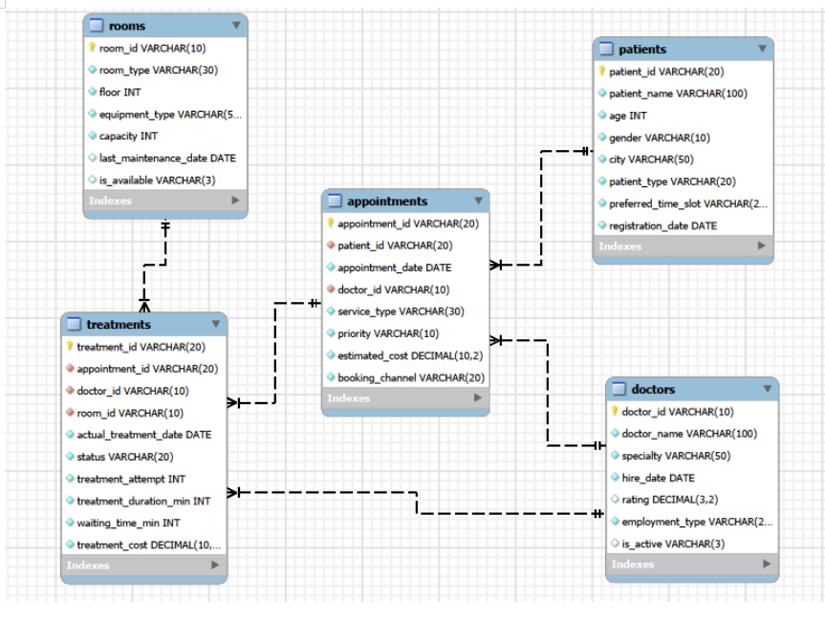
ER DIAGRAM AND DATABASE STRUCTURE

Slide 9
ER DIAGRAM AND DATABASE STRUCTURE
The database contains five tables: patients, doctors, rooms, appointments, and treatments.
Primary Keys: Identifies each record uniquely in the table.
Foreign Keys: Maintain the relationship between tables.
Table Name | Primary Key | Foreign Keys
patients | patient_id | None
doctors | doctor_id | None
rooms | room_id | None
appointments | appointment_id | patient_id, doctor_id
treatments | treatment_id | room_id, doctor_id, appointment_id

Slide 10
ER DIAGRAM AND DATABASE STRUCTURE
TABLE RELATIONSHIPS
Patients – Appointments (1:M): One patient can book multiple appointments, while each appointment belongs to one patient.
Doctors – Appointments (1:M): One doctor can handle multiple appointments, while each appointment is assigned to one doctor.
Appointments – Treatments (1:M): One appointment can have multiple treatment records, while each treatment record belongs to one appointment.
Doctors – Treatments (1:M): One doctor can perform multiple treatments, while each treatment record is assigned to one doctor.
Rooms – Treatments (1:M): One room can be used for multiple treatments, while each treatment record is associated with one room.

Slide 11
Analysis of Objectives
Objective 1: Patient & Appointment Demand
Appointments by city: Kochi leads with 440 appointments in the earlier summary; the supplied joined treatment analysis shows 520 treatment records in Kochi.
Service demand: Consultation leads with 1,183 appointments, followed by Diagnostic Test (627) and Follow-up (539).
Priority mix: Routine 2,169; High 587; Urgent 244.
Booking channels: App 887, Website 612, Phone 559, Walk-in 557, Referral 385.
Insight: Consultation and the App channel account for the largest demand volumes; plan capacity around these high-volume areas.

Slide 12
Analysis of Objectives
Appointment Trends & Value
Monthly demand peaked in July (276 appointments), followed by April (272); February was lowest (219).
Estimated appointment value: General ₹75.66 lakh; Insurance ₹38.18 lakh; Corporate ₹29.48 lakh.
Patient-type appointment volumes: General 1,594; Insurance 791; Corporate 615.
Insight: General patients contribute the largest share of appointment volume and estimated value.

Slide 13
Analysis of Objectives
Objective 2: Patient Appointment Behaviour
397 of 400 patients have more than one appointment.
The highest appointment frequency is 15 appointments for one patient; several patients have 14 appointments.
Patient activity by city: Kochi has 57 patients and 440 appointments in the earlier appointment-level summary; city totals should be interpreted with the correct table grain.
Patient types: General 210, Insurance 107, Corporate 83.
Insight: Most patients return for multiple appointments, making repeat-visit behaviour important for service planning.

Slide 14
Analysis of Objectives
Patient Value & Booking Patterns
General patients generated 1,594 appointments, Insurance 791 and Corporate 615.
The App is the most-used booking channel (887 appointments), followed by Website (612).
July had the highest monthly appointment volume (276); February had the lowest (219).
Use patient-level aggregation to rank cumulative estimated appointment value and identify high-value repeat patients.

Slide 15
Analysis of Objectives
Objective 3: Treatment Performance
Treatment records: 3,500 in total.
Completed: 2,464 (70.4%); Rescheduled: 366 (10.5%); Cancelled: 283 (8.1%); No-Show: 251 (7.2%); In Progress: 136 (3.9%).
Average treatment duration: 38.72 minutes; average waiting time: 15.62 minutes.
Insight: Completion is the dominant outcome, but more than one-quarter of records are cancelled, no-show or rescheduled.

Slide 16
Analysis of Objectives
Treatment Outcomes by City & Service
Kochi recorded the highest treatment activity (520 records), including 46 cancellations and 50 reschedules.
Vijayawada recorded the highest No-Show count (38), while it had the fewest cancellations (22).
Consultation has the highest volume and the highest counts of cancellations (113), no-shows (107) and reschedules (132).
Emergency Care has the longest average treatment duration (88.36 minutes); Follow-up is shortest (19.34 minutes).
Insight: Compare outcome rates as well as counts, because high-volume cities and services naturally have more records.

Slide 17
Analysis of Objectives
Treatment Duration & Waiting Time
Overall average treatment duration is 38.72 minutes; average waiting time is 15.62 minutes.
Treatment performance can be tracked by actual treatment month using duration, waiting time, treatment cost and status.
Treatment records span 2025 to 3 January 2026.
Insight: Monitor waiting time and duration together to identify operational bottlenecks without assuming that longer treatments are poor performance.

Slide 18
Analysis of Objectives
Objective 4: Doctor Performance
Dr. Doctor_080 (D080) handled the highest treatment volume: 66 records.
Dr. Doctor_045 recorded the highest completion rate (84.85%; 33 records).
Dr. Doctor_002 recorded the lowest completion rate among doctors (53.13%; 32 records).
Dr. Doctor_079 had the longest average treatment duration (49.63 minutes); Dr. Doctor_066 had the shortest (29.40 minutes).
Insight: Doctor performance varies by workload, completion rate and treatment duration; interpret results with sample size and case mix.

Slide 19
Analysis of Objectives
Room & Equipment Utilization
Observation rooms had the highest usage (902 treatment records), followed by Consultation (856), Minor Surgery (665), Diagnostic (617) and Procedure (460).
Minor Surgery rooms had the highest average waiting time (16.03 minutes).
Procedure rooms had the longest average treatment duration (41.60 minutes).
Insight: Observation rooms carry the highest workload, while Minor Surgery and Procedure rooms may need closer flow and capacity monitoring.

Slide 20
Analysis of Objectives
Objective 5: Treatment Problems
500 appointments had a second treatment attempt; 2,500 had one attempt.
Average waiting time: 15.96 minutes for multi-attempt appointments vs 15.48 minutes for single-attempt appointments.
Problem statuses: Rescheduled 366; Cancelled 283; No-Show 251.
Insight: Repeat attempts are associated with a small increase in average waiting time.

Slide 21
Analysis of Objectives
Priority vs Waiting Time & Outcomes
Average waiting time: Urgent 15.97 minutes; Routine 15.62 minutes; High 15.47 minutes.
Completed rates are similar: Urgent 70.89%, High 70.70% and Routine 70.26%.
Cancelled rates are also broadly similar across priority levels.
Insight: The dataset shows only small differences by priority; there is no strong descriptive evidence of a substantial priority-related outcome gap.

Slide 22
Analysis of Objectives
City & Service Problem Hotspots
Kochi recorded the most cancellations (46) and reschedules (50) by city.
Vijayawada had the highest No-Show count (38).
Consultation recorded the highest counts: 113 cancellations, 107 no-shows and 132 reschedules.
Insight: Prioritize attendance improvement in Vijayawada and review scheduling capacity in Kochi and Consultation services.

Slide 23
Overall Key Findings
Patient demand — Consultation is the largest service category (1,183 appointments); General patients contribute the most appointments (1,594).
Booking behaviour — App is the leading channel (887); July is the busiest month (276).
Treatment reliability — 70.4% of treatment records are Completed; 25.7% are Cancelled, No-Show or Rescheduled.
Operational hotspots — Kochi has the highest treatment volume; Vijayawada has the most no-shows.
Resource use — Observation rooms are most used (902); Procedure rooms have the longest average duration (41.60 min).

Slide 24
Overall Key Findings
Treatment outcomes — 2,464 completed records out of 3,500; rescheduling is the largest non-completed category.
Doctor variation — Completion rates range from 53.13% (Dr. Doctor_002) to 84.85% (Dr. Doctor_045) in this dataset.
Waiting time — Overall average is 15.62 minutes; multi-attempt appointments average 15.96 minutes.
Priority — Average waiting times and outcome percentages are close across High, Routine and Urgent groups.
Interpretation — Counts and averages are descriptive; compare rates, sample sizes and case mix before judging performance.

Slide 25
Overall Key Findings
City patterns — Kochi has 520 treatment records; Vijayawada has the highest no-show count (38).
Service patterns — Consultation leads in volume and in absolute counts of cancellations, no-shows and rescheduling.
Room patterns — Observation rooms have the highest use; Minor Surgery has the longest average wait.
Doctor patterns — Workload and outcome rates vary; further review should account for case complexity and treatment mix.

Slide 26
Overall Key Findings
Data coverage — 400 patients, 3,000 appointments, 3,500 treatments, 80 doctors and 50 rooms.
Repeat attempts — 500 appointments have a second treatment attempt, so treatment-record counts are not the same as unique appointment counts.
Outcome distribution — Completed 70.4%; Rescheduled 10.5%; Cancelled 8.1%; No-Show 7.2%; In Progress 3.9%.
Data note — The files are synthetic project data; conclusions apply to this learning dataset.

Slide 27
Business Recommendations
Reduce cancellations and no-shows — Introduce appointment reminders, confirmation messages and follow-up for missed visits.
Improve rescheduling — Review doctor rosters, room availability and appointment slot allocation, especially for Consultation.
Focus city-level interventions — Investigate Vijayawada no-shows and review Kochi's high treatment workload.
Manage repeat attempts — Review causes of second attempts and monitor their impact on waiting time.

Slide 28
Business Recommendations
Balance room capacity — Monitor Observation room demand and assess capacity during peak periods.
Improve room flow — Review waiting times in Minor Surgery and treatment duration in Procedure rooms.
Monitor doctor performance — Compare completion rates, workload, duration and waiting time with adequate case-mix context.
Use a dashboard — Track treatment status, average waiting time, duration, attempts and outcomes by city, service, doctor and room.

Slide 29
Business Recommendations
Use outcome rates, not raw counts alone, when comparing cities and service types.
Review priority workflows — Urgent appointments have a slightly higher average wait; investigate individual cases rather than assuming a broad systemic gap.
Create monthly operational reviews — Track completed, cancelled, no-show, rescheduled and in-progress records.
Set improvement targets only after validating baselines and understanding operational causes.

Slide 30
Conclusions
CarePlus Hospital's dataset shows a strong majority of treatments completed, but cancellations, no-shows and rescheduling remain important operational concerns.
Demand is concentrated in Consultation services and Observation rooms, while city, doctor and room performance varies.
Targeted scheduling improvements, patient reminders, workload monitoring and outcome dashboards can help improve patient flow and operational efficiency.
Data-driven decisions should consider treatment attempts, sample sizes and case mix.

Slide 31

THANK YOU

