Slide 1


Department of Information Technology
V R Siddhartha Engineering College
Adaptive Insulin Dosage Prediction Using Reinforcement Learning
B.Tech in Information Technology
MINI Project Review Presentation
Presented by
Mr. Mohammad Ashraf Baig (228W1A12H2)
Ms. Sarayu Guntupalli (228W1A12F2)
Under the guidance of
Dr. G.Kalyani , Assoc.Prof.

Slide 2
Agenda
Overview of the work done
Introduction and Problem Statement
Objectives and Outcomes of the Project
Literature review and summary
Datasets and Requirements
Algorithms used in the project
Architecture/ Flow of the project
Project Execution
References

Slide 3
Introduction
Diabetes patients need accurate insulin dosage prediction to maintain glucose in safe range (70–180 mg/dL).
Incorrect dosage can cause hypoglycemia (<70) or hyperglycemia (>180).
Single-algorithm evaluation (Mini-2) is insufficient to understand stability vs sample efficiency trade-offs.
On-policy and off-policy methods may behave differently in safety-critical glucose regulation.
Comparative Reinforcement Learning with adaptive entropy aims to improve robustness, stability, and clinical safety.

Slide 4
Problem Statement
To design and evaluate a comparative Reinforcement Learning framework (PPO vs TD3) with adaptive entropy regulation for safe and stable insulin dosage prediction using simulated patient data, maximizing Time-in-Range while minimizing hypoglycemia and insulin overuse.

Slide 5
Objectives
Implement and evaluate PPO, TD3 for closed-loop insulin control.
Develop Entropy-Regulated PPO (ER-PPO) for improved stability.
Perform multi-patient comparative clinical evaluation (Time-in-Range, Hypo/Hyper %, Mean Glucose).
Analyze stability vs sample efficiency in safety-critical glucose regulation.

Slide 6
Outcomes
1. Comparitive evaluation of PPO, TD3, and ER-PPO
2. Improved stability through adaptive entropy regulation
3. Higher Time-in-Range with reduced hypoglycemia risk.
4. Structured multi-patient clinical performance analysis.

Slide 7
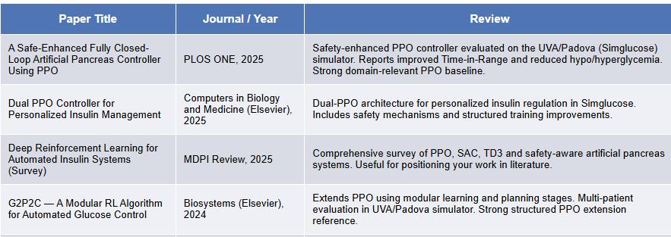
Literature Review

Slide 8
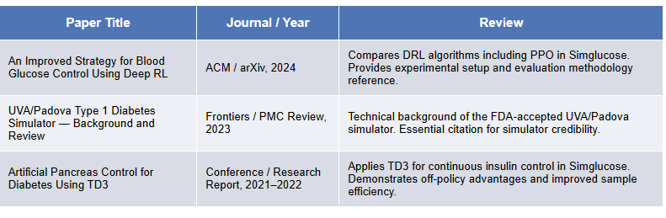
Literature Review

Slide 9
Datasets and Requirements
Datasets / Simulators:
UVA/Padova T1D Simulator (Adults, Adolescents, Children).
Generates glucose, insulin, and meal data.
Software Requirements:
Python, TensorFlow/PyTorch.
gym, simglucose, stable-baselines3.

Slide 10
Algorithms used in the Project
Proximal Policy Optimization (PPO) An advanced Actor-Critic algorithm. The Actor suggests insulin doses, and the Critic evaluates them. PPO ensures stable and safe learning by limiting large policy updates. Best suited for sensitive tasks like insulin dosing.
Twin Delayed Deep Deterministic Policy Gradient (TD3) An off-policy Actor-Critic algorithm with twin Q-networks to reduce overestimation bias. Uses replay buffer and delayed updates for improved sample efficiency and stability in continuous insulin control.
Entropy-Regulated PPO (ER-PPO) An improved PPO variant with adaptive entropy tuning. Adjusts exploration dynamically during training to balance stability and performance, aiming to improve glucose regulation and robustness.

Slide 11
Algorithm PPO for Closed-Loop Insulin Control (Phase 2 Baseline)
Require: Environment E, actor pi_theta, critic V_phi,
clip ratio eps = 0.2, discount gamma = 0.99, entropy coeff alpha = 0.01
Ensure: Trained policy pi_theta*
1. Initialise actor parameters theta and critic parameters phi randomly.
2. For each training episode i = 1 to N do
3. Reset E; observe initial state s_0.
4. Collect trajectory tau = {s_t, a_t, r_t} for T = 1000 timesteps:
5. Sample a_t ~ pi_theta(.|s_t); apply to E; receive r_t, s_{t+1}.
6. Compute discounted returns R_t and GAE advantages A_hat_t.
7. For each PPO update epoch k = 1 to K do
8. For each mini-batch (s, a, A_hat, R) from tau do
9. rho = pi_theta(a|s) / pi_theta_old(a|s)

Slide 12
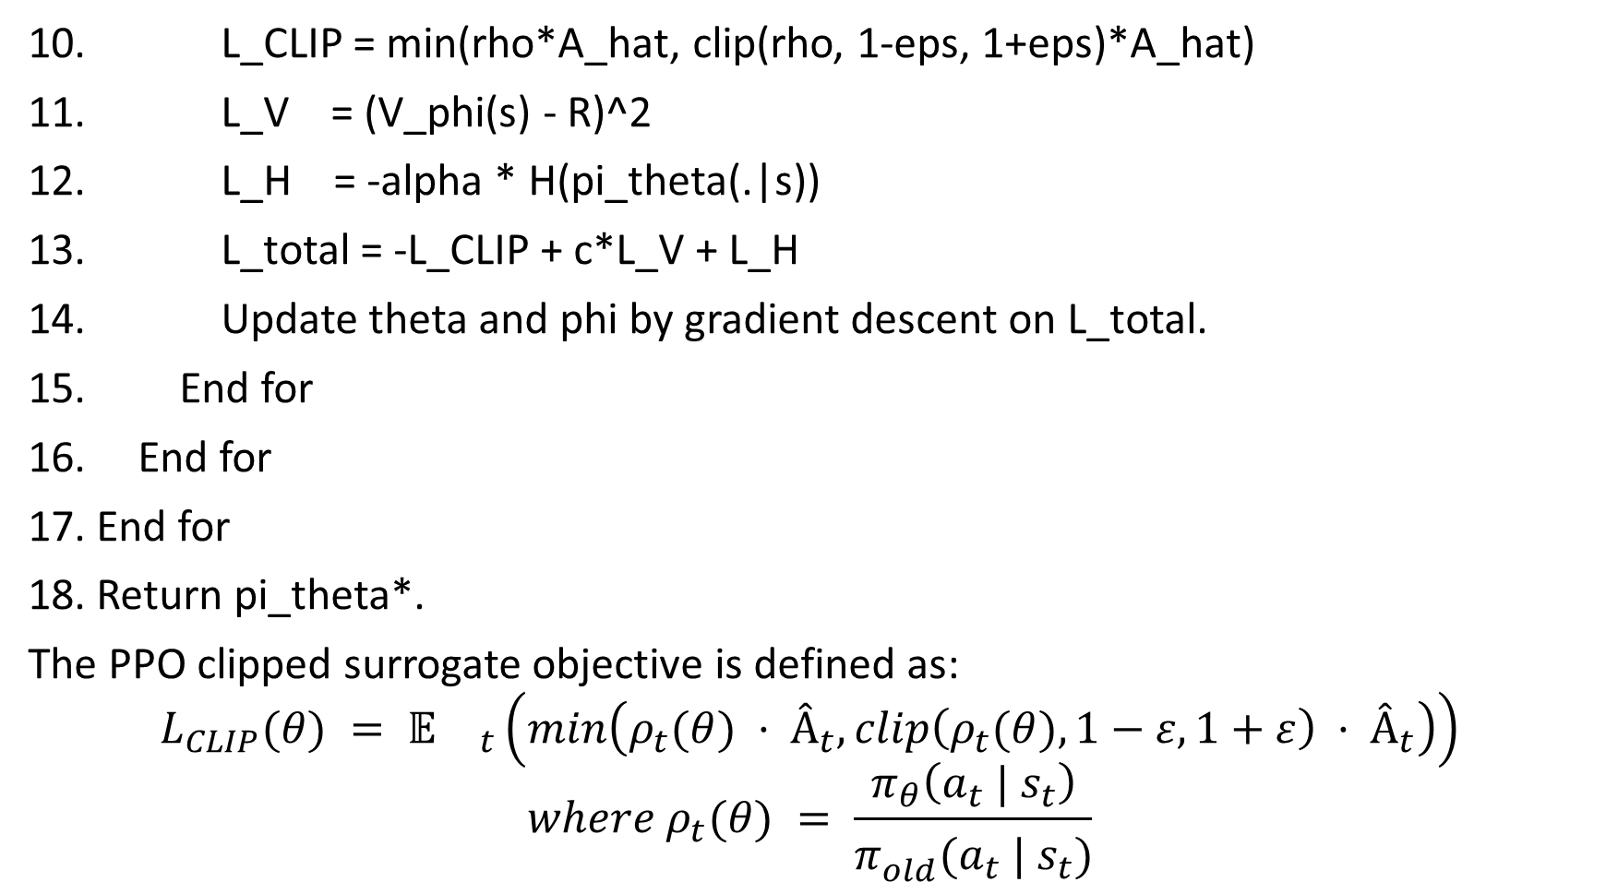
10. L_CLIP = min(rho*A_hat, clip(rho, 1-eps, 1+eps)*A_hat)
11. L_V = (V_phi(s) - R)^2
12. L_H = -alpha * H(pi_theta(.|s))
13. L_total = -L_CLIP + c*L_V + L_H
14. Update theta and phi by gradient descent on L_total.
15. End for
16. End for
17. End for
18. Return pi_theta*.
The PPO clipped surrogate objective is defined as:
$$L_{CLIP}(θ) = 𝔼{}_{t}\left(min\left(ρ_{t}(θ) · Â_{t}, clip\left(ρ_{t}(θ), 1−ε, 1+ε\right) · Â_{t}\right)\right)$$
$$where ρ_{t}(θ) = \frac{π_{θ}\left(a_{t} | s_{t}\right)}{π_{old}^{}(a_{t} | s_{t})}$$

Slide 13
Algorithm Twin Delayed Deep Deterministic Policy Gradient (TD3)
Require: Environment E, actor mu_theta, twin critics Q_phi1 and Q_phi2,
replay buffer B, policy noise sigma = 0.2, update delay d = 2
Ensure: Trained deterministic policy mu_theta*
1. Initialise all networks, target networks, and replay buffer B.
2. For each timestep t = 1 to T_total do
3. a_t = mu_theta(s_t) + eps, eps ~ N(0, sigma_explore)
4. Execute a_t; observe r_t and s_{t+1}; store in B.
5. If |B| >= batch size then
6. Sample mini-batch from B.
7. Smoothed target: a_tilde = mu_theta_target(s') + clip(N(0,sigma), -c, c)
8. TD target: y = r + gamma * min(Q_phi1_target(s',a_tilde), Q_phi2_target(s',a_tilde))
9. Update critics by minimising (Q_phi_i(s,a) - y)^2 for i = 1, 2.

Slide 14
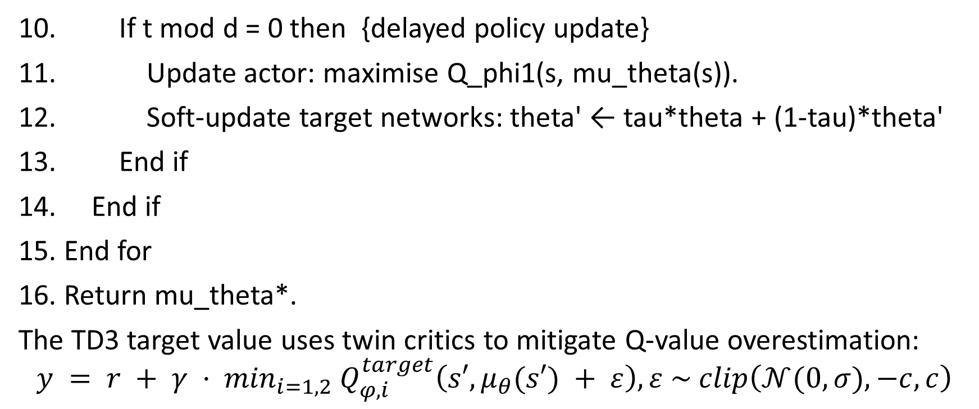
10. If t mod d = 0 then {delayed policy update}
11. Update actor: maximise Q_phi1(s, mu_theta(s)).
12. Soft-update target networks: theta' ← tau*theta + (1-tau)*theta'
13. End if
14. End if
15. End for
16. Return mu_theta*.
The TD3 target value uses twin critics to mitigate Q-value overestimation:
$$y = r + γ · \min_{i=1,2} Q_{φ,i}^{target}\left(s′, μ_{θ}(s′) + ε\right), ε \sim clip\left(𝒩(0, σ), −c, c\right)$$

Slide 15
Algorithm 6: ER-PPO — Entropy-Regulated Proximal Policy Optimization (Novel Contribution)
Require: Environment E, actor pi_theta, critic V_phi, total episodes N,
alpha_start = 0.05, alpha_end = 0.001, clip eps = 0.2, gamma = 0.99
Ensure: Trained adaptive policy pi_theta*
1. Initialise theta and phi randomly.
2. For each training episode i = 1 to N do
3. Compute epoch-adaptive entropy coefficient:
alpha_i = alpha_start - (alpha_start - alpha_end) * (i / N)
4. Reset E; observe s_0 = [BG, DeltaBG, IOB, COB].
5. Collect trajectory tau = {s_t, a_t, r_t} for T = 1000 timesteps:
6. Sample a_t ~ pi_theta(.|s_t), a_t in [0, 0.2] U.
7. Apply a_t; receive r_t and s_{t+1}.

Slide 16
8. Compute reward:
if 70 ≤ BG ≤ 180: r_t = +1.0
elif mild deviation: r_t = -0.5
elif dangerous excursion: r_t = -2.0 - lambda*|Delta_a|
9. Compute returns R_t and GAE advantages A_hat_t.
10. For each PPO update epoch k = 1 to K do
11. For each mini-batch from tau do
12. rho ← pi_theta(a|s) / pi_theta_old(a|s)
13. L_CLIP ← min(rho*A_hat, clip(rho, 1-eps, 1+eps)*A_hat)
14. L_V ← (V_phi(s) - R)^2
15. L_H ← -alpha_i * H(pi_theta(.|s)) {adaptive entropy}
16. L_total ← -L_CLIP + c*L_V + L_H

Slide 17
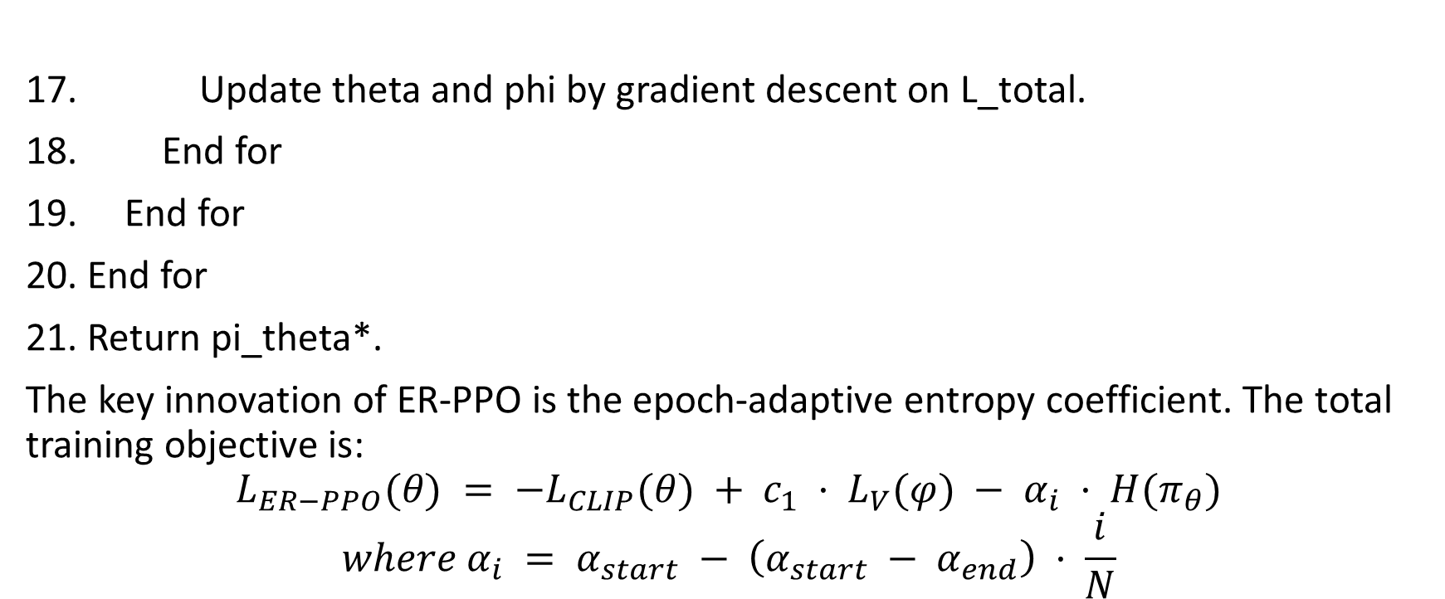
17. Update theta and phi by gradient descent on L_total.
18. End for
19. End for
20. End for
21. Return pi_theta*.
The key innovation of ER-PPO is the epoch-adaptive entropy coefficient. The total training objective is:
$$L_{ER−PPO}(θ) = −L_{CLIP}(θ) + c_{1} · L_{V}(φ) − α_{i} · H(π_{θ})$$
$$where α_{i} = α_{start} − \left(α_{start} − α_{end}\right) · \frac{i}{N}$$

Slide 18
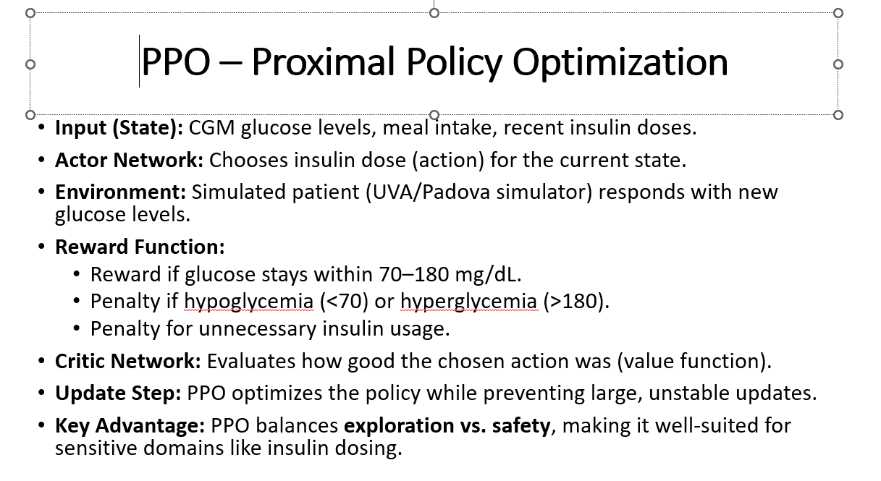
PPO – Proximal Policy Optimization
Input (State): CGM glucose levels, meal intake, recent insulin doses.
Actor Network: Chooses insulin dose (action) for the current state.
Environment: Simulated patient (UVA/Padova simulator) responds with new glucose levels.
Reward Function:
Reward if glucose stays within 70–180 mg/dL.
Penalty if hypoglycemia (<70) or hyperglycemia (>180).
Penalty for unnecessary insulin usage.
Critic Network: Evaluates how good the chosen action was (value function).
Update Step: PPO optimizes the policy while preventing large, unstable updates.
Key Advantage: PPO balances exploration vs. safety, making it well-suited for sensitive domains like insulin dosing.

Slide 19
ER-PPO – Entropy-Regulated Proximal Policy Optimization
Input (State): CGM glucose levels, meal intake, recent insulin doses.
Actor Network: Suggests insulin dose (stochastic policy).
Environment: Simulated patient (UVA/Padova simulator) generates next glucose state.
Reward Function: Reward for maintaining glucose within 70–180 mg/dL. Penalty for hypo/hyperglycemia. Penalty for unstable insulin dosing.
Critic Network: Evaluates value of chosen action.
Entropy Regulation: Dynamically adjusts entropy coefficient during training to balance exploration and safety.
Update Step: Uses PPO clipped objective with adaptive entropy tuning.
Key Advantage: Improved exploration–exploitation balance, better robustness across patient variability.

Slide 20
TD3 – Twin Delayed Deep Deterministic Policy Gradient
Input (State): CGM glucose levels, meal intake, recent insulin doses.
Actor Network: Outputs a deterministic insulin dose for the current state.
Environment: Simulated patient (UVA/Padova simulator) responds with updated glucose levels.
Reward Function: Reward if glucose stays within 70–180 mg/dL. Penalty if hypoglycemia (<70) or hyperglycemia (>180). Penalty for excessive insulin usage.
Critic Networks (Twin Q-Networks): Two value networks estimate action quality to reduce overestimation bias.
Replay Buffer: Stores past experiences and reuses them for efficient learning (off-policy).
Delayed Update Step: Actor updates less frequently than critics to improve stability.
Key Advantage: High sample efficiency and stable continuous control, suitable for precise insulin regulation

Slide 21
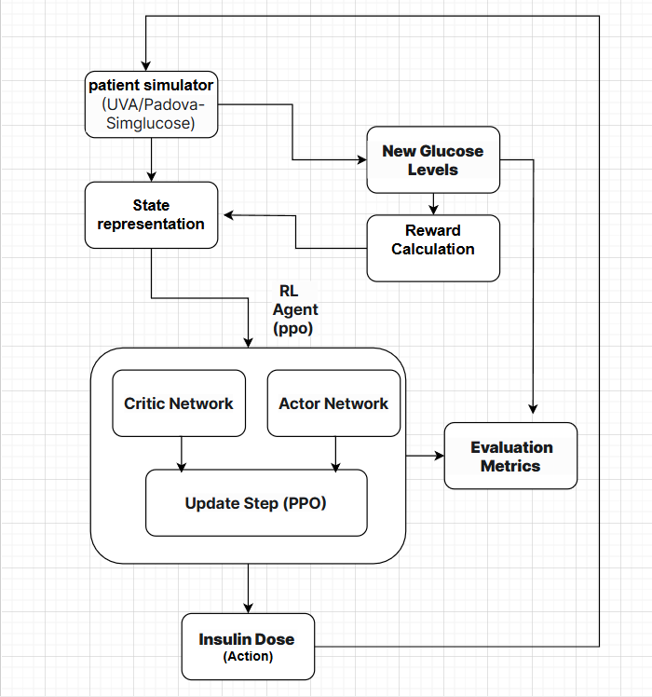
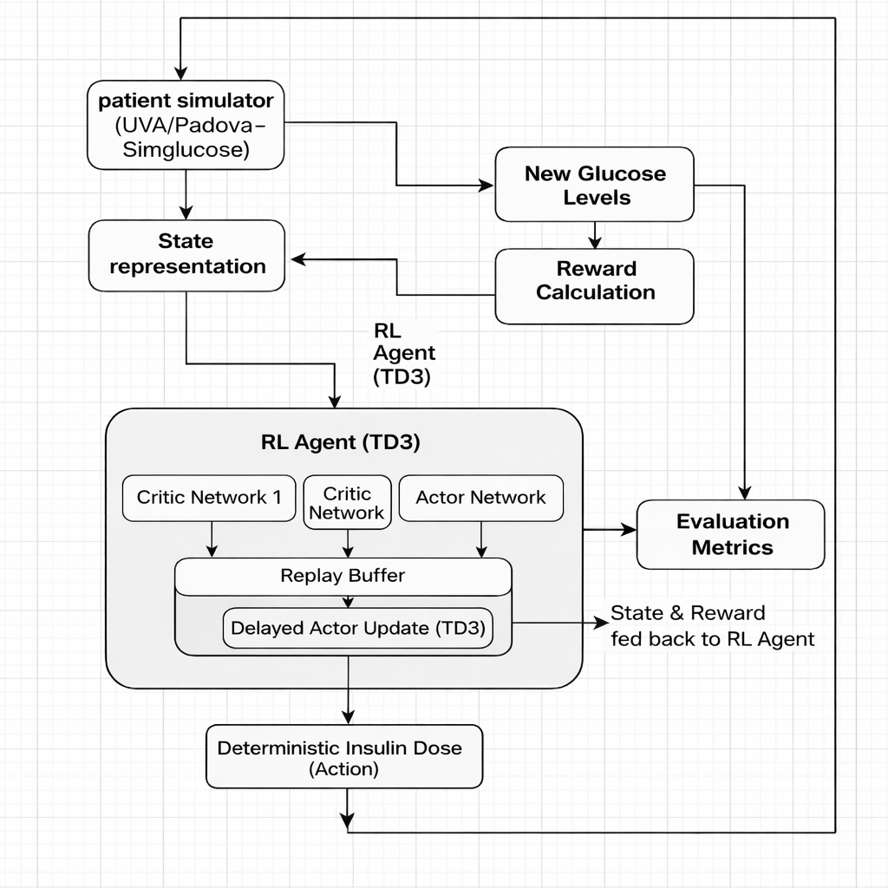
Architecture Diagram

Slide 22
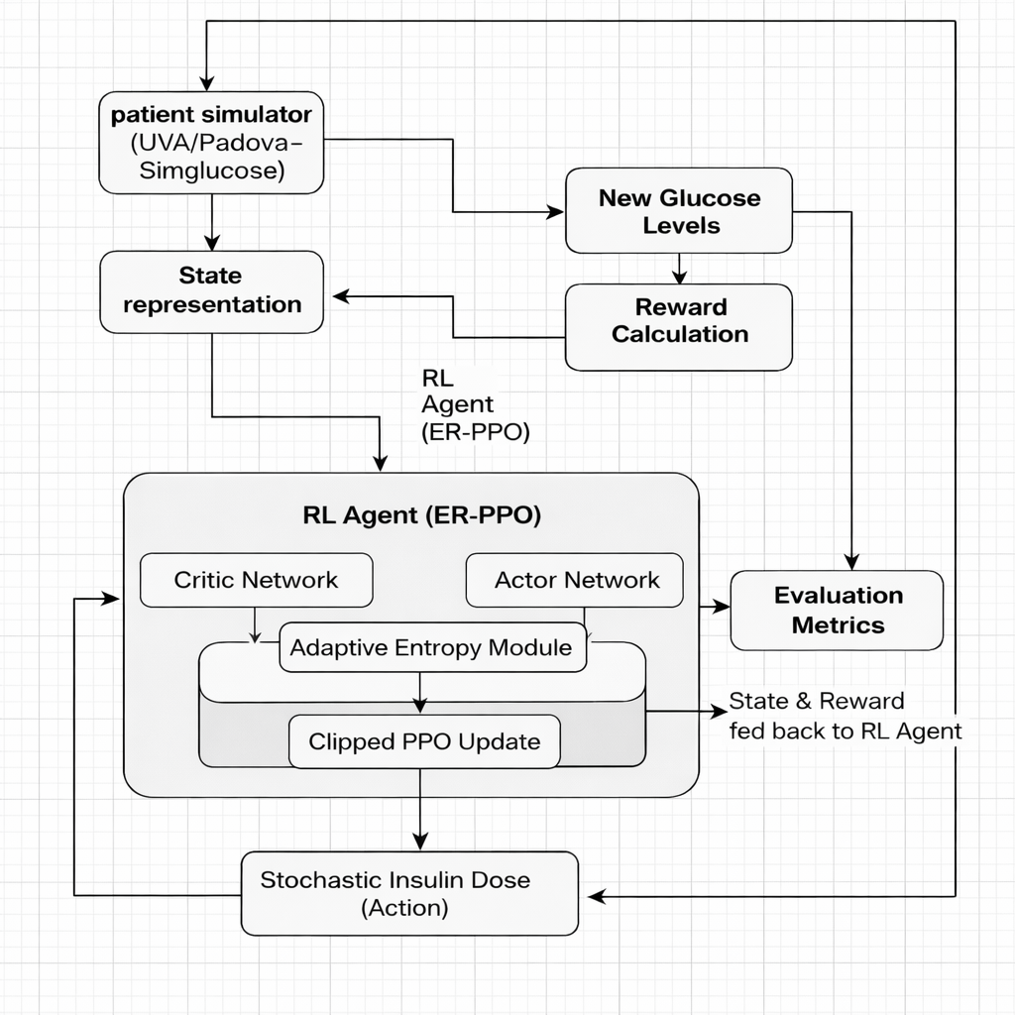
Architecture Diagram

Slide 23
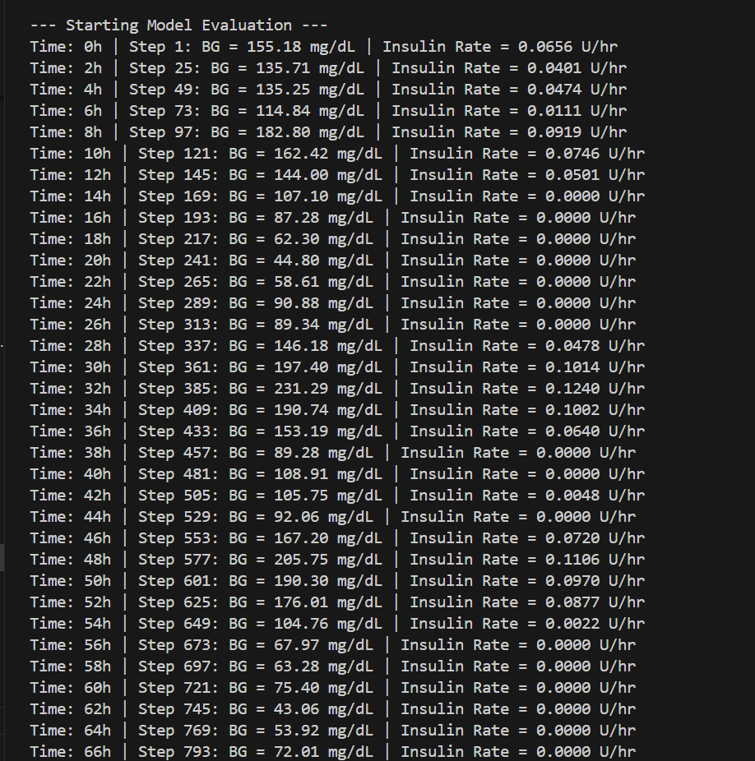
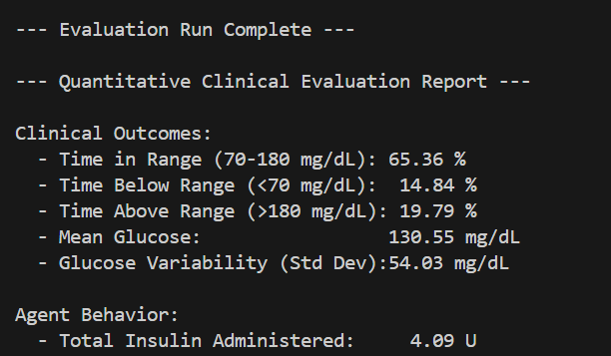
Results

Slide 24
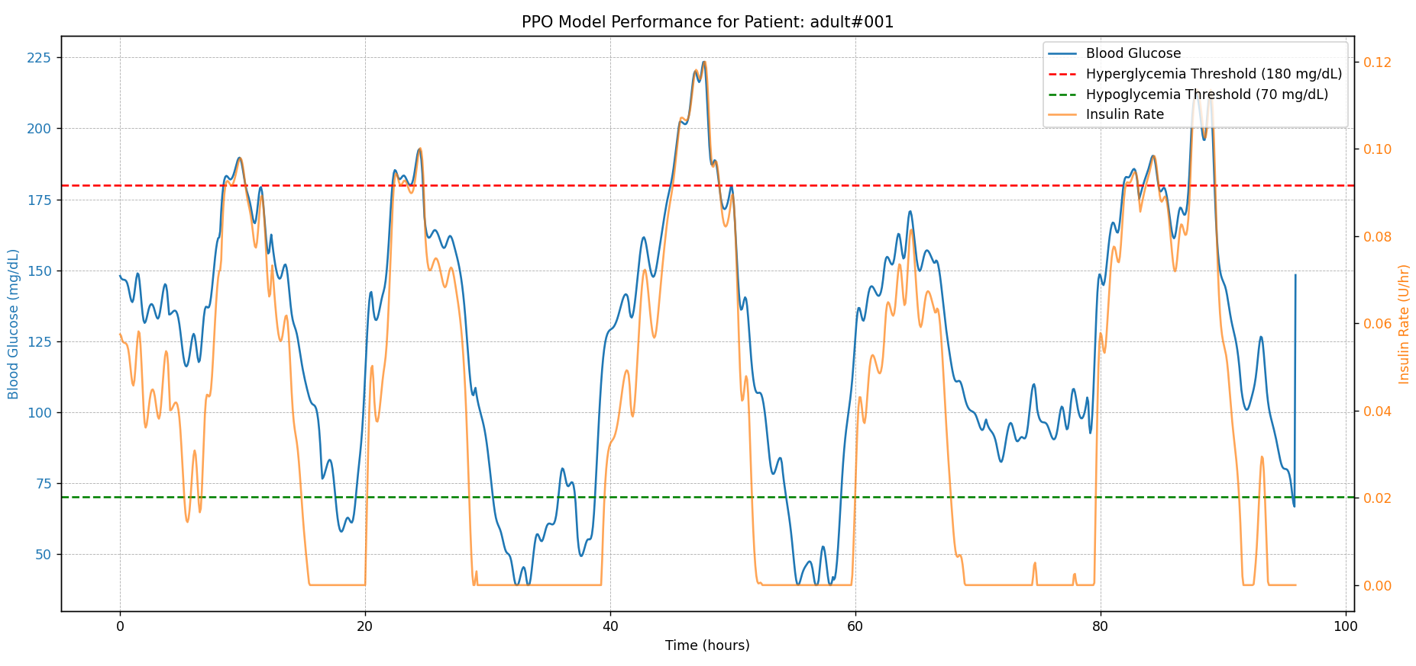

Slide 25
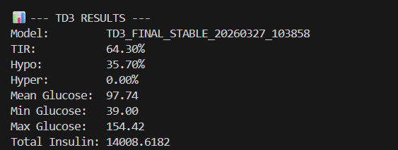

Slide 26
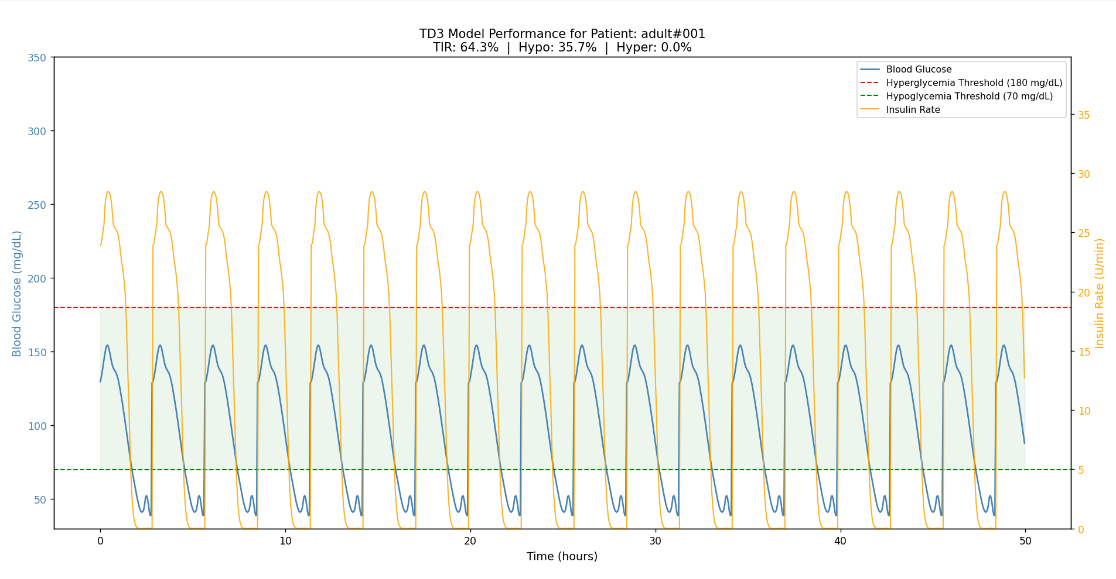

Slide 27
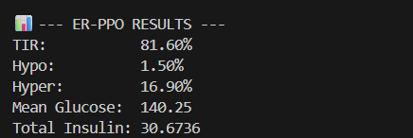

Slide 28
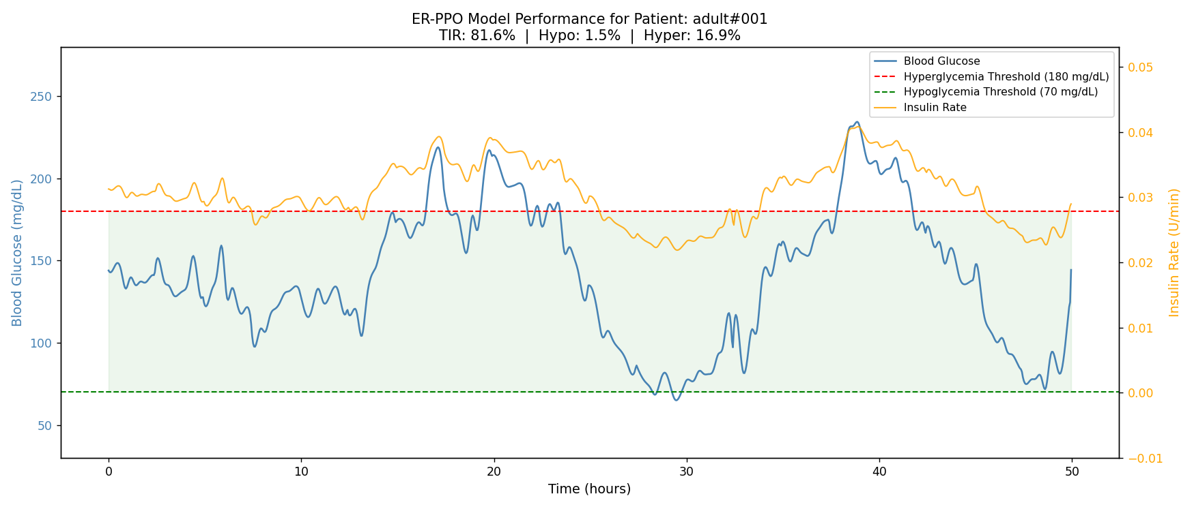

Slide 29
Result analysis
Metric | PPO | TD3 | ER-PPO
Time-in-Range (70–180 mg/dL) | 65.36% | 64.30% | 81.60%
Hypoglycemia Rate (<70 mg/dL) | 14.84% | 35.70% | 1.50%
Hyperglycemia Rate (>180 mg/dL) | 19.79% | 0.00% | 16.90%
Mean Glucose (mg/dL) | 130.55 | 97.74 | 140.25
Glucose Variability (Std Dev) | 54.03 | ~28.00 | ~35.00
Total Insulin Administered (U) | 4.09 | 14,008 | 30.67
Algorithm Type | On-policy | Off-policy | On-policy + Adaptive Entropy

Slide 30
PPO achieved 65.36% TIR but suffered 14.84% hypoglycemia due to fixed entropy limiting late-stage exploration.
TD3 achieved the lowest TIR (64.30%) with dangerous 35.70% hypoglycemia caused by replay buffer reinforcing aggressive insulin doses.
On-policy (PPO) outperformed off-policy (TD3) in clinical safety, confirming on-policy methods are better suited for continuous insulin control.
ER-PPO achieved 81.60% TIR with only 1.50% hypoglycemia, exceeding the 75% clinical target — the only algorithm to do so.
Adaptive entropy decay (0.05→0.001) was the sole modification over PPO, delivering +16.24% TIR improvement with the same architecture and training budget.
ER-PPO is the best performing algorithm overall, achieving the highest TIR, lowest hypoglycemia rate, and safest insulin dosing among all three compared methods.

Slide 31
References
[1] Sun, Qingnan, Marko V. Jankovic, Joao Budzinski, Brett Moore, Peter Diem, Christoph Stettler, and Stavroula G. Mougiakakou. “A Dual Mode Adaptive Basal-Bolus Advisor Based on Reinforcement Learning.” IEEE Journal of Biomedical and Health Informatics, vol. 26, no. 1, 2022, pp. 436–445. IEEE. https://doi.org/10.1109/JBHI.2021.3100558.
[2] Zhu, Tingting, et al. “Optimized Glycemic Control of Type 2 Diabetes with Reinforcement Learning: A Proof-of-Concept Trial.” Nature Medicine, vol. 29, 2023, pp. 1670–1680. Springer Nature. https://www.nature.com/articles/s41591-023-02552-9.
[3] Contreras, Ivan, et al. “Personalized Insulin Dosing Using Reinforcement Learning for High-Fat Meals and Exercise in Type 1 Diabetes: A Proof-of-Concept Trial.” Nature Communications, vol. 15, 2024, article no. 50764. Springer Nature. https://www.nature.com/articles/s41467-024-50764-5.
[4] Chen, Xiaoyu, et al. “Deep Reinforcement Learning for Personalized Insulin Dosing and Glucose Control of Hospitalized ICU Patients.” International Journal of Data Science and Analytics, vol. 15, 2025, pp. 1–19. Springer. https://doi.org/10.1007/s41060-025-00857-1.
[5] Fox, Isaac, et al. “Deep Reinforcement Learning for Closed-Loop Blood Glucose Control in Type 1 Diabetes.” arXiv preprint, arXiv:2009.09051, 2020. https://arxiv.org/abs/2009.09051.
[6] Pappada, Scott M., et al. “A Reinforcement Learning–Based Method for Management of Type 1 Diabetes: Exploratory Study.” JMIR Diabetes, vol. 4, no. 3, 2019, e12905. JMIR Publications. https://diabetes.jmir.org/2019/3/e12905/.

