Slide 1
Quiz Management System
Course Code: CSC 2210
Object Oriented Analysis and Design
Dept. of Computer Science
Faculty of Science and Technology
ID | Name
20-43710-2 | 1. Md. Ashraful Islam Emad
20-42970-1 | 2. Fahim Mahmud Bhuiyan
20-43248-1 | 3. Muntaqa Maliyat

Slide 2
Outline
Introduction
Problem Statement(Objectives)
Analysis of the System
Design
Conclusion(Future work)
References

Slide 3
Introduction
The Quiz Management system allows students to take quizzes online, provided by their respective teachers without the need to be present physically which acts as the main objective for creating this application, due to the pandemic. Overcoming manual errors, saving time and making a computerized system which is both efficient and easy to use is the goal. The process starts off with the teacher logging in and then he/she uploads the quiz making it accessible to the students. The teacher has the authority to modify or add any question, alter the scores each question carries, limit the time within which the students have to submit the quiz and while entering the question he/she will be able to select the right answer for the questions. In their assigned time, the students log in to the system, take the quiz when the teacher starts it and then submit it, failing to submit on time will provoke auto submission of the quiz. The application will be able to evaluate each question by comparing its correct answer. Online quiz management system can be implemented in colleges, universities or at home to check the preparation of students and revise contents of different courses.

Slide 4
Problem Statement
Due to the epidemic, everyone is performing their duties from their own position, so this application is being created for the convenience of the students. Through this application, he/she will be able to participate in the online exam even if he/she is not present in the classroom, which will be controlled by his/her teacher. In addition, this application reduces the waste of time as well as the answer sheet can be checked and selected accurately.
From the above discussion, we can say that the problem of “Quiz Management System” is important to consider.

Slide 5
Objectives
Proposed Solution
To deal with the problem we are going to propose some solutions which is given below:
The project is to be focused on developing a “Quiz Management System” to ensure the effectiveness of taking online exam.
Quiz can be done online without the need of paper or physical presence anymore. It is also helping the users to ensure the best use of time.
Teachers will get easier way to check answers of the students. Students can also join the exam from anywhere.

Slide 6
Analysis of the System
Functional Requirements: Quiz Management System provides an online interface to the users where they can log in and give or take quizzes online. The administrator concerned with the log in issue. Teachers and students can use the system. Provide a platform for the students and teachers to ensure online based exam.
Non Functional Requirements: Quiz Management proposed system is very efficient. Now a student can take a quiz from anywhere. The person can even get the exam details. They don’t need to go outside and have to give exam in the classroom. So, because of easy access they can complete their exam process staying anywhere with just one device and internet connection. Sometimes students might face some issues because of their poor network connection. Besides this sometimes server may show down because of too much traffic in the system. But we can say this issue can take into the consideration. As the issue is worth to solve so this is a good side of this project. Also, for the teachers, this project is helpful because it’s easy to control. This kind of project might be available in the market but we can assure that we’ve got the best solution for the problem which can be solved easily.

Slide 7
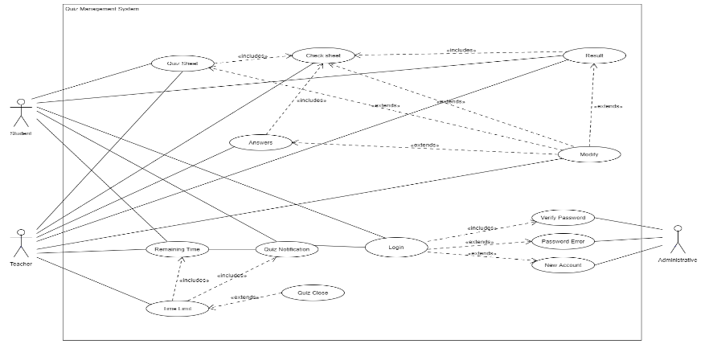
Design
Use Case Diagram

Slide 8
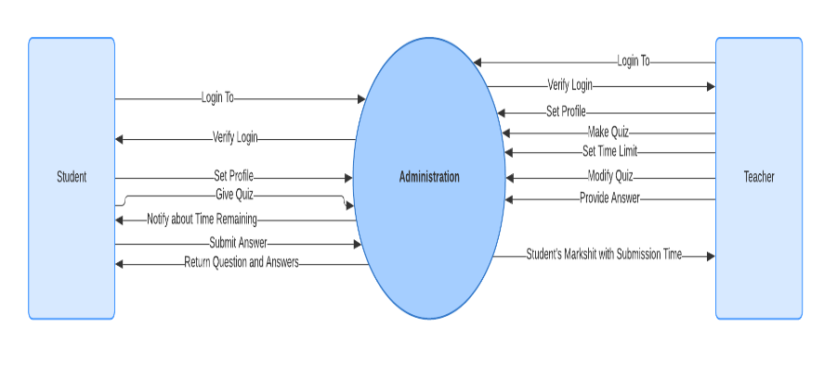
Data Flow Diagram

Slide 9
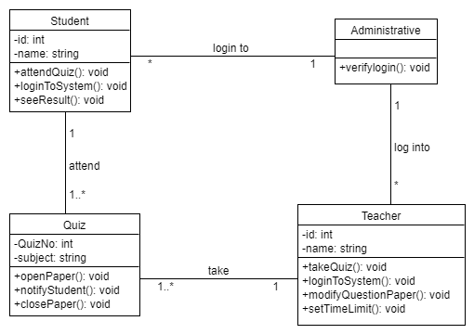
Class Diagram

Slide 10
CRC Card
Class: | Student
Description: | Keep track of Student's info and gives the user ability to log in and give quiz.
Responsibilities | Collaborators:
Set Profile | Student’s Profile
Give Quiz
View Remaining Time | Time
Submit Answer Script
View Result
Class: | Teacher
Description: | Keep track of Teacher's info and gives the user ability to log in, make quiz, set time limit, modify quiz and enter answer for auto check.
Responsibilities | Collaborators:
Set Profile | Teacher’s Profile
Make Quiz
Set Time limit | Date and Time
Modify Quiz
Set Answers

Slide 11
Class: | Administrator
Description: | Keep track of Student and Teacher’s login and verify their password.
Responsibilities | Collaborators:
Verifying Student and Teacher’s password
Notify Remaining Time to Student | Date and Time
Return question and answers | Auto Check

Slide 12
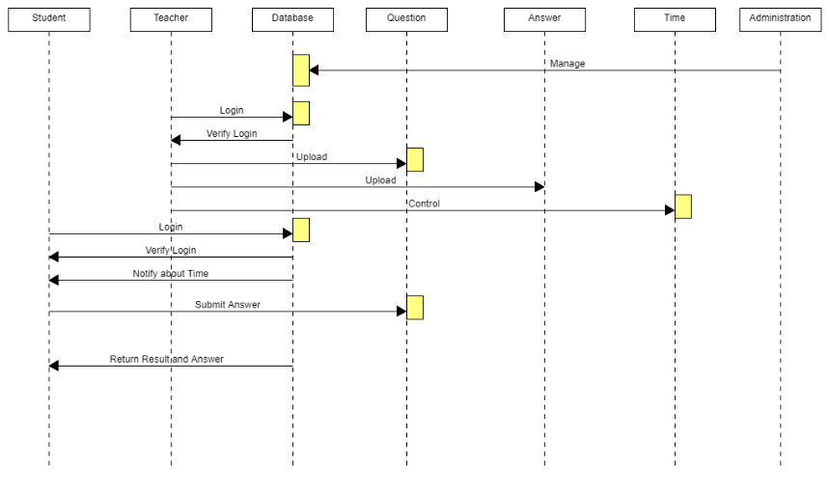
Sequence Diagram

Slide 13
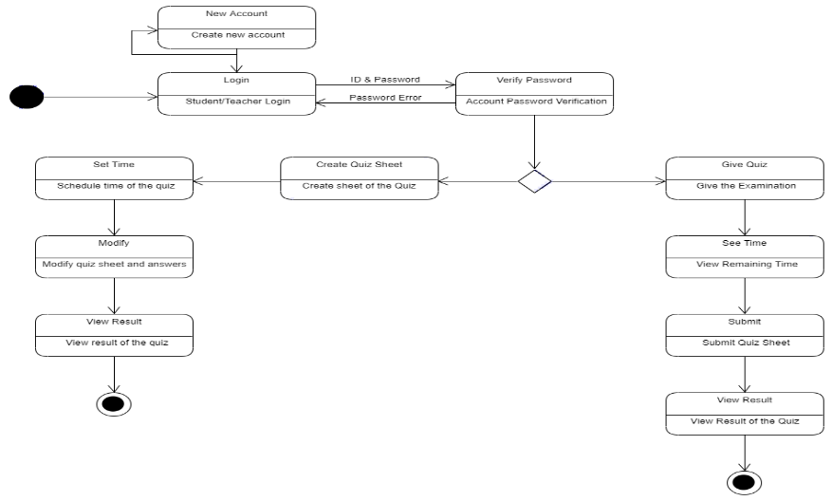
State Chart Diagram

Slide 14
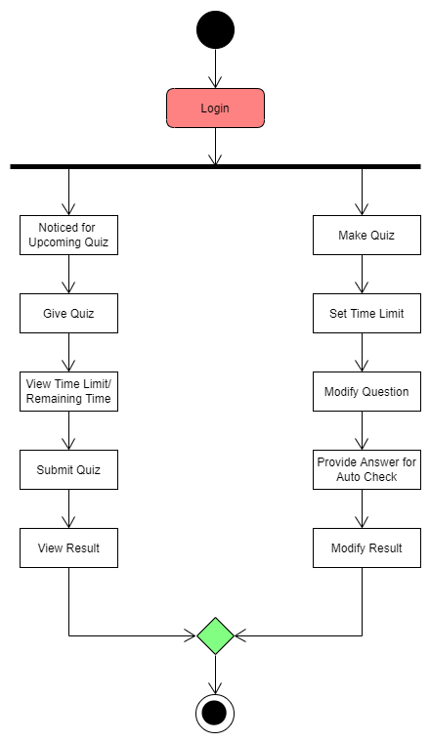
Activity Diagram

Slide 15
Conclusion
The online quiz management project helps the students and teachers to know the procedures followed in universities to perform online exam through quizzes. The limitations of the existing system are: the system is not efficient to meet all the needs, the time consuming, have to be present physically. The problems that are overcome are the existing system uses paper as backend now the proposed system uses access as backend, the basic requirement of the system has been improved, it has become user friendly. The proposed system is very efficient. Now a student can take a quiz from anywhere. The person can even get the exam details. They don’t need to go outside and have to give exam in the classroom. So, because of easy access they can complete their exam process staying anywhere with just one device and internet connection. Sometimes students might face some issues because of their poor network connection. Besides this sometimes server may show down because of too much traffic in the system. But we can say this issue can take into the consideration. As the issue is worth to solve so this is a good side of this project. Also, for the teachers, this project is helpful because it’s easy to control. We concentrated on the automated system that substitutes the manual quiz method in this thesis. The thesis, however, is more than just an online quiz system; it also has its own intellectual capability. This was the feature of our theory that we wanted to emphasize. Essentially, we attempted to introduce the student-performance evaluation method as well as student feedback in the online quiz. The questions appear in this section based on the student's prior response. We used it in our thesis and found that it works well in our system. An educational institute can use this method to automate their examination process. It allows the authorities to register teachers for various disciplines, as well as providing students with the ability to register their courses for examinations via the Quiz Management System. Though this is an MCQ-based quiz system, it is a fantastic MCQ-based online quiz system with all of the features that a modern quiz system should have. This method is primarily intended for educational institutions, but it may also be customized for other types of examinations such as job interviews, quiz contests, and other criteria. This kind of project might be available in the market but we can assure that we’ve got the best solution for the problem which can be solved easily. Finally, we can say this project is totally new, innovative, interesting, and distinct from other similar projects in the market.

Slide 16
References
[1] https://www.quora.com/What-difficulties-will-students-face-due-to-online-exams
[2] https://blog.epravesh.com/top-4-challenges-manage-online-exam-process/
[3] https://techcommunity.microsoft.com/t5/microsoft-forms/quot-sorry-something-went-wrong-quot-error-had-to-switch-to/m-p/293305
[4] https://techcommunity.microsoft.com/t5/microsoft-forms/microsoft-forms-not-working-on-chrome/m-p/1926704
[5] https://answers.microsoft.com/en-us/msoffice/forum/all/microsoft-forms-is-not-working-for-me-on-both/fd281d53-b890-47f9-af3d-e558cac7fd97
[6] https://www.alphr.com/google-forms-vs-microsoft-forms/

Slide 17


