Slide 1
DevOps First Class Assignment By Ashraful Islam

Slide 2
What is ARP?
Address Resolution Protocol (ARP) is a protocol or procedure that connects an ever-changing Internet Protocol (IP) address to a fixed physical machine address, also known as a media access control (MAC) address, in a local-area network (LAN)
What is Rout table? A route table contains a set of rules, called routes, that are used to determine where network traffic from your subnet or gateway is directed.

Slide 3
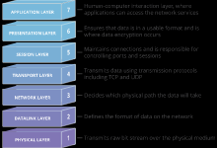
What is OSI model? The Open Systems Interconnection (OSI) model is a conceptual model created by the International Organization for Standardization which enables diverse communication systems to communicate using standard protocols. In plain English, the OSI provides a standard for different computer systems to be able to communicate with each other. The OSI model can be seen as a universal language for computer networking. It’s based on the concept of splitting up a communication system into seven abstract layers, each one stacked upon the last.

Slide 4
Some Commands practiced with screenshots.
cd, tcpdump -I enp0s3
pwd , telnet 65.20.223.24 443
ll , dig localhost , nslookup localhost
ls , sudo vi /etc/hosts
fdisk –l
free –m
curl localhost:80
ipaddr show , ifconfig
dig facebook.com
netstate, nc -l 8000
top, tcpdum -I enp0s3 dst 65.20.223.24 and port 443
mkdir , touch
scp , ssh , yum install update , vim , cat etc.

Slide 5
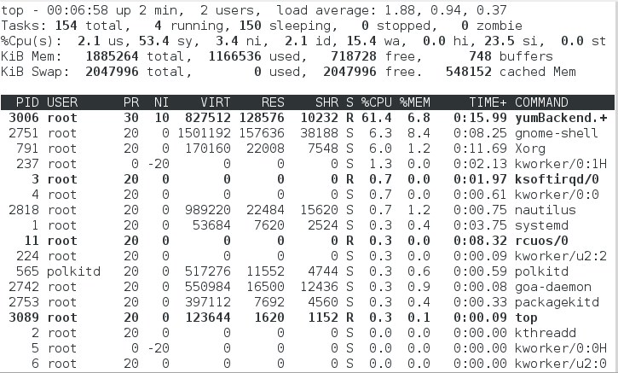

Slide 6
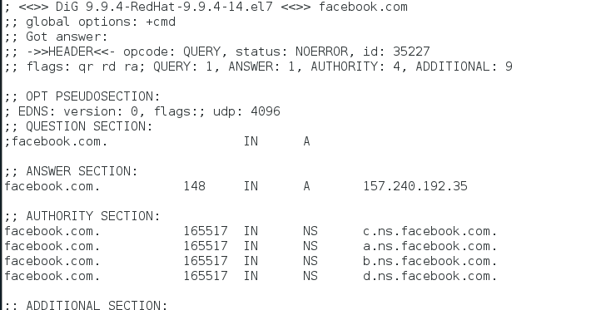

Slide 7
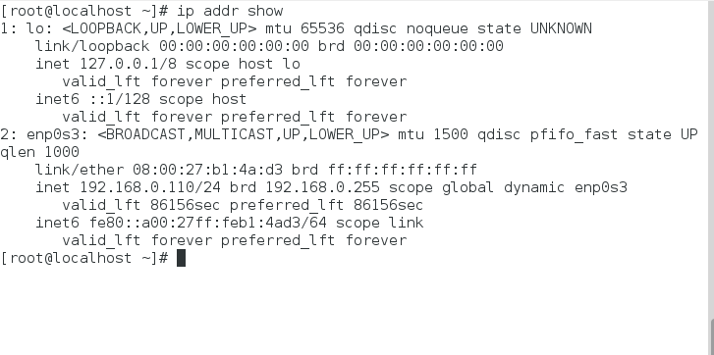

Slide 8
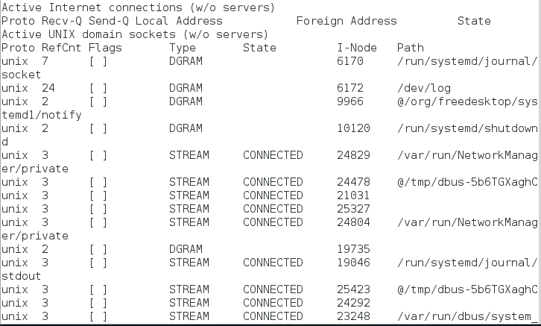

Slide 9
