Slide 1

Masters Colloquium A
Project Title: “Site to Site IPsec VPN Design and Simulation”
Prof. Dr. Ing. Marcus Purat
Berliner Hochschule für Technik
Group-4 Members:
Aklima Begum Mitu
Md Ashraful Hakim Khan Siddiquee
Md Easin

Slide 2

Contents:
Objective
Introduction to VPN
History of PPTP or VPN
Types of VPN
Protocols
Benefits of VPN
VPN Configuration on Cisco Packet tracer.
Tracing the traffic with Sniffer.

Slide 3
Project Objective :
The project's objective is to design & simulate a site-to-site VPN service between two branches using IPsec tunnel protocol in Cisco Packet Tracer and to sniff the packets using sniffer through Internet Control Message Protocol (ICMP). However, we have used both ICMP and ISAKMP (Internet Security Association and Key Management Protocol) tools for packet sniffing.

Slide 4
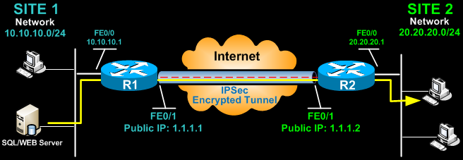
Introduction to VPN:
A Virtual Private Network or VPN, is an encrypted connection over the internet which extends a private network across a public network and enables users to send and receive data across shared or public networks as if their computing devices were directly connected to the private network. The logical connections can be made at either Layer2 ( Data link layer) or Layer 3(Network layer) of the OSI model. Layer 3 VPNs can be point-to-point site connections, or they can establish any-to-any connectivity to many sites

Slide 5
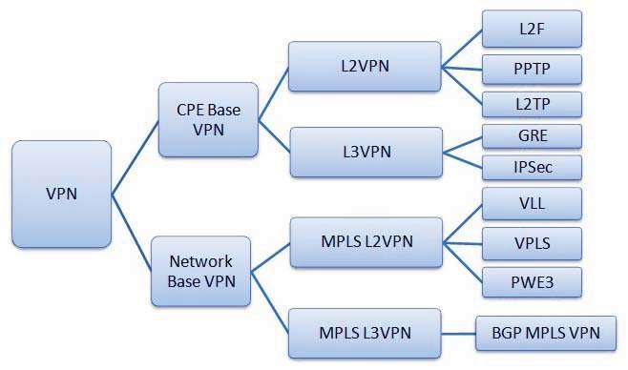
The VPN classification tree diagram based on topology and Technology is shown in Figure

Slide 6
IPsec
Internet Protocol Security (IPsec) is a secure network protocol suite that authenticates and encrypts packets of data to provide secure encrypted communication between two computers over an Internet Protocol network.
IPsec includes protocols for establishing mutual authentication between agents at the beginning of a session and negotiation of cryptographic keys to use during the session.

Slide 7
History of PPTP or VPN:
VPN technology was first used in 1996 when a Microsoft employee developed the PPTP(Peer-to-Peer Tunneling Protocol). The protocol created a more secure private connection between a user’s device and the internet.
Initially, VPNs were used almost exclusively in a business. However, the rash of high-profile security breaches occurring in the early 2000s was a key moment in the history of VPN technology. With this, everyday internet users became aware of the true risks of working online and began looking for more secure ways to do so.
Today, VPNs are used to secure internet connections, prevent malware and hacking, ensure digital privacy, unlock geo-restricted content and hide users’ physical locations. Easier to use and more affordable than ever, a VPN is essential for staying safe and secure online.

Slide 8
Types of VPN:
Virtual Private Network (VPN) is basically of 2 types:
VPN
Site-to-Site VPN
Remote Access VPN
Extranet-based VPN
Intranet-based VPN

Slide 9
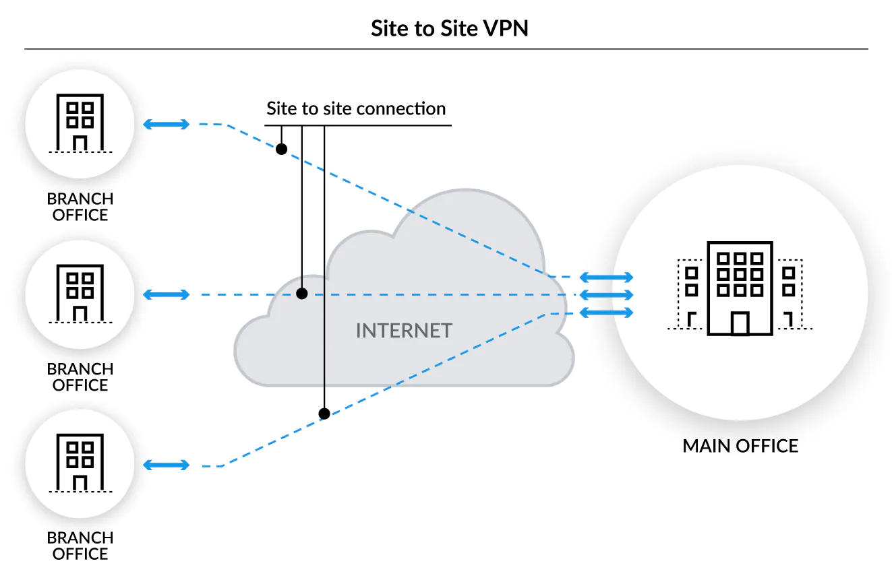
Site-to-Site VPN:
Site-to-Site VPN: A Site-to-Site VPN is also called as Router-to-Router VPN and is mostly used in corporates. Companies, with offices in different geographical locations, use a site-to-site VPN to connect the network of one office location to the network at another office location. Communication between the server and client starts after the authentication is validated from both ends.

Slide 10
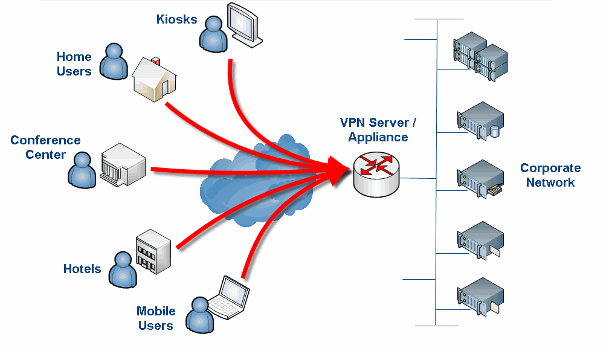
Remote-access VPN:
Remote-access VPN : A remote access virtual private network (VPN) enables users who are working remotely to securely access and use data from a corporate data center. A remote user or private user uses this VPN to access blocked websites. A corporate employee, while traveling, uses a VPN to connect to his/her company’s private network and remotely access files and resources on the private network.

Slide 11
Protocols
Types of Virtual Private Network (VPN) Protocols:
PPTP - Point-to-point tunneling protocol
L2TP – Layer 2 Tunneling Protocol
IPsec - Internet protocol security IPsec runs in 2 modes:
(i) Transport mode
(ii) Tunneling mode
SSL & TSL - SSL (Secure Sockets Layer) and TLS (Transport Layer Security).
SSH – Secure Shell
Open VPN

Slide 12
Benefits of VPN:
Whether you’re considering a VPN for personal use or your company, there are various benefits to a VPN. such as,
Secure encryption: To read the data, you need an encryption key. Without one, it would take millions of years for a computer to decipher the code.
Disguising your whereabouts: VPN servers essentially act as your proxies on the internet. Because the demographic location data comes from a server in another country, your actual location cannot be determined.
Access to regional content: Regional web content is not always accessible from everywhere. With VPN location spoofing , you can switch to a server to another country and effectively “change” your location.
Secure data transfer: If you work remotely, you may need to access important files on your company’s network. VPN services connect to private servers and use encryption methods to reduce the risk of data leakage.

Slide 13
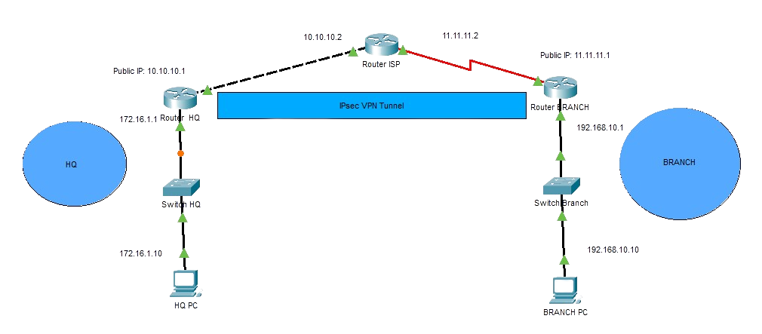
VPN Configuration on Cisco Packet tracer
The Configuration of a VPN Site to Site network using cisco packet tracer. There are two different sites HQ( PC) & Branch(PC) are connected through IPsec VPN tunnel.

Slide 14
VPN Configuration on Cisco Packet tracer
Device | Interface | IP Address | Subnet Mask | Default Gateway
HQ | fa0/0 / fa0/1 | 172.16.1.1/ 10.10.10.1 | 255.255.255.0 | -
ISP | fa0/0 / Se0/3/1 | 10.10.10.2 / 11.11.11.2 | 255.255.255.0 | -
Branch | fa0/0 / Se0/3/1 | 192.168.10.1 / 11.11.11.1 | 255.255.255.0 | -
PC-A | FastEthernet0 | 172.16.1.10 | 255.255.255.0 | 172.16.1.1
PC-B | FastEthernet0 | 192.168.10.10 | 255.255.255.0 | 192.168.10.1
The connections between the PCs, switches, and the two routers HQ (2811), and Branch (2811) with ISP router (2811) using straight through & serial cable and following the addressing table.

Slide 15
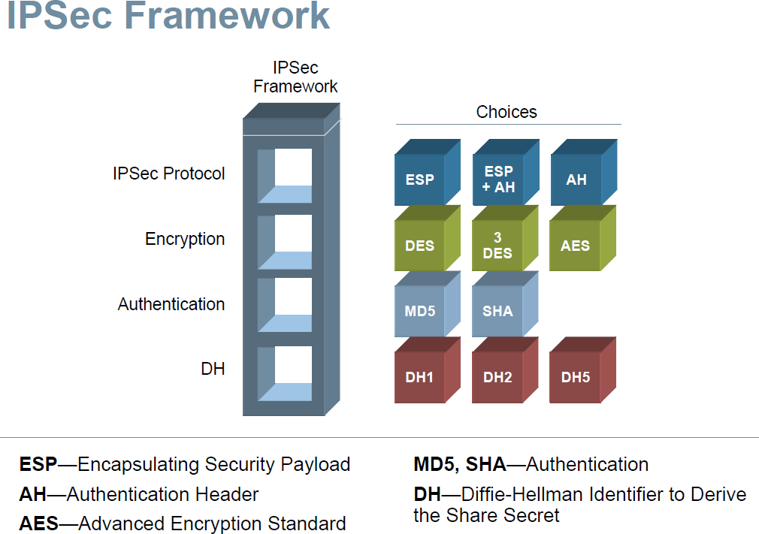
ISAKMP (Internet Security Association Key Management Protocol) policies
CONFIGURE ISAKMP (IKE) - (ISAKMP PHASE 1)
IKE exists only to establish SAs (Security Association) for IPsec. Before it can do this, IKE must negotiate an SA (an ISAKMP SA) relationship with the peer.
To begin, we’ll start working on the Site 1 router (HQ).
First step is to configure an ISAKMP Phase 1 policy:
HQ(config)# crypto isakmp policy 20 HQ(config-isakmp)# encr 3des
HQ(config-isakmp)# hash md5
HQ(config-isakmp)# authentication pre-share
R1(config-isakmp)# group 1
R1(config-isakmp)# lifetime 3600

Slide 16
To configure IPSec we need to setup the following in order: - Create extended ACL - Create IPSec Transform - Create Crypto Map - Apply crypto map to the public interface
CONFIGURE IPSEC - 4 SIMPLE STEPS:
In phase 2, security associations for other security protocols (AH or ESP) are established.
The Pre-shared keys will be exchanged.
A transform set is a combination of algorithms and protocols that endorse a security policy for traffic.
transform set named ‘myset, which supports esp-aes encryption and the esp-sha-hmac (hash-based message authentication code) hashing algorithm.
For IPsec to succeed between two IPsec peers, the crypto map entries of both peers must contain compatible configuration statements
The crypto map which ties together all the elements in our IPsec configuration and applies that to an interface.

Slide 17
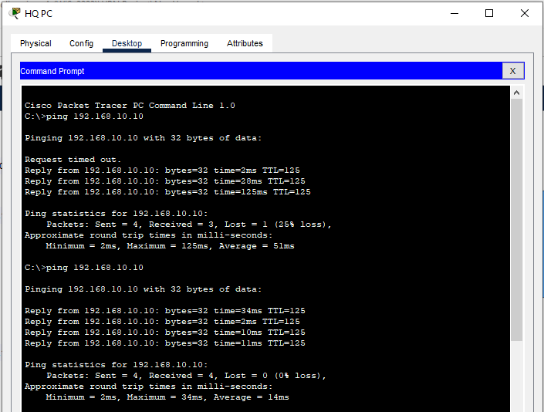
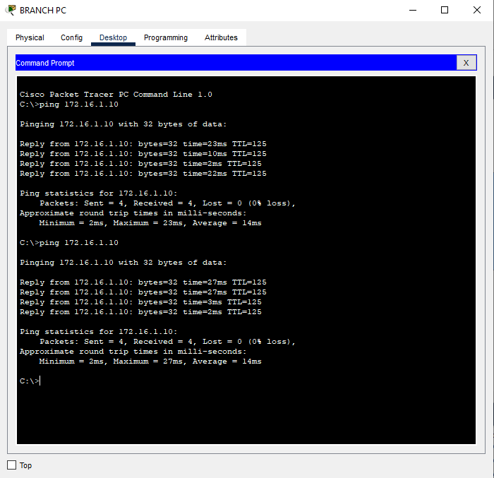
The Result of VPN connection for HQ PC and Branch PC

Slide 18
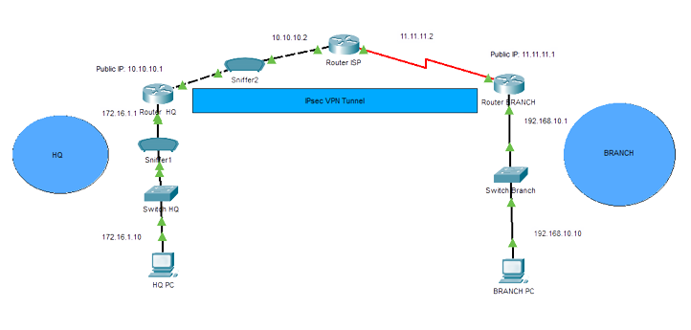
Tracking Network with Sniffer on Packet Tracer
Wireshark is also a sniffer tool, but Cisco packet tracer is a simulation app, and it can’t track with Wireshark.

Slide 19
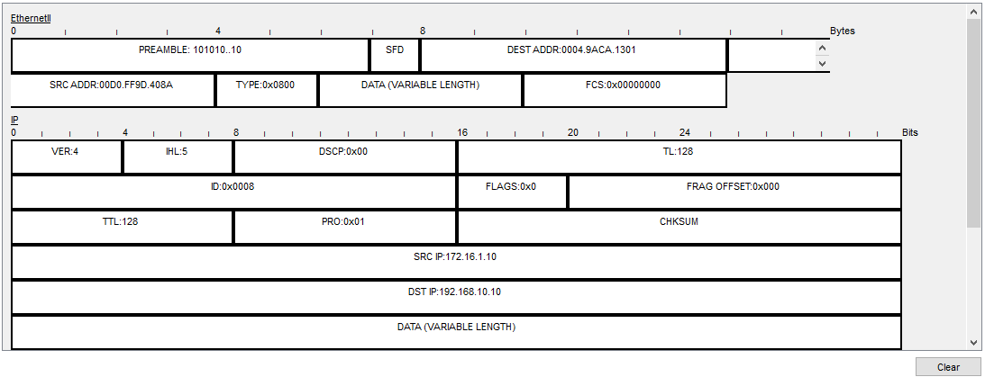
Result of ICMP request between PCs :
In VPN tunnel, ICMP requests (simple ping) HQ PC to Branch PC and protocol info can be observed.
At Sniffer1-ICMP, sniffer1 only can track ICMP protocol without showing any info about VPN.

Slide 20
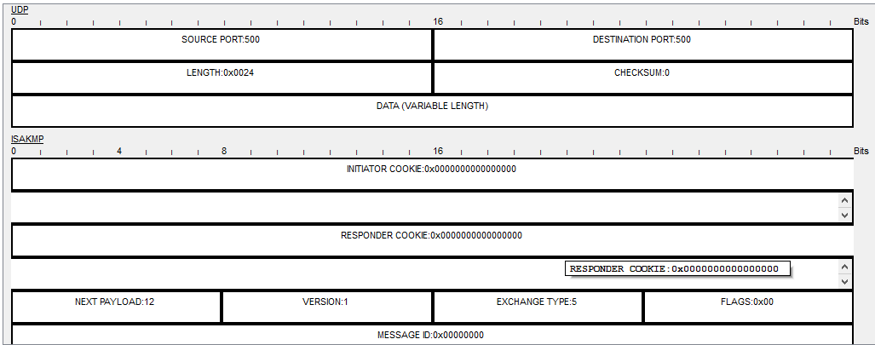

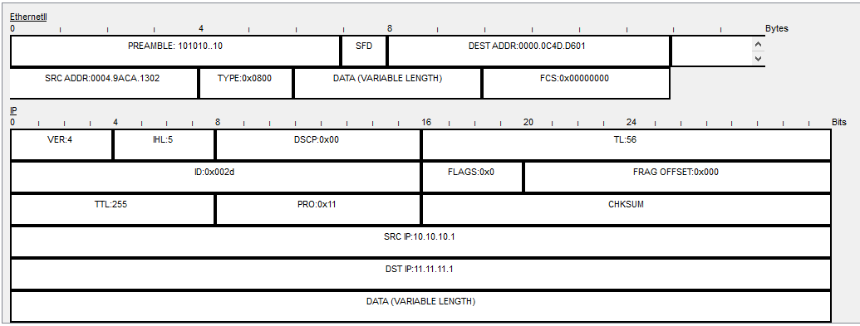

Result of ICMP request between PCs :
At Sniffer2-ISAKMP: Sniffer2 tracked 2 different protocol for one ping request.
There are new information about User Datagram Protocol- UDP (port 500) protocol which ISAKMP using for VPN tunneling.

Slide 21

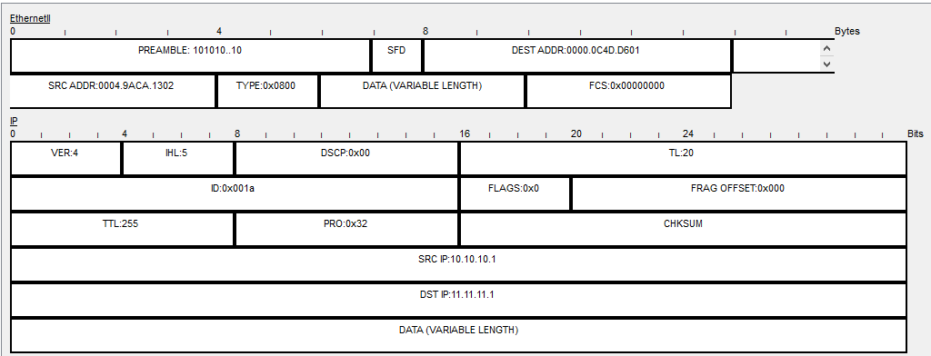
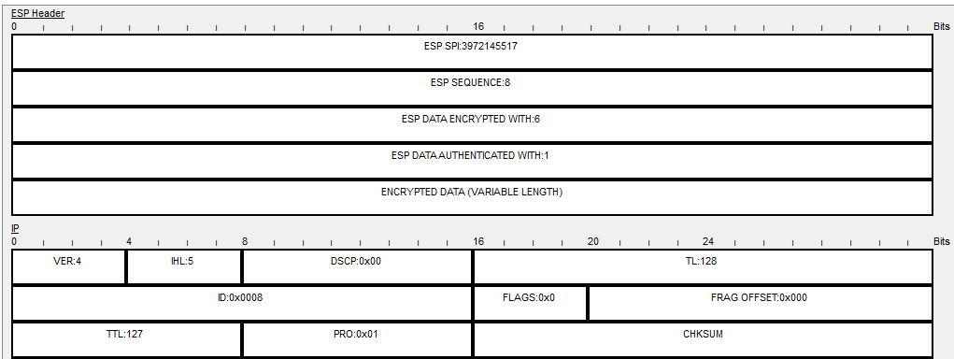
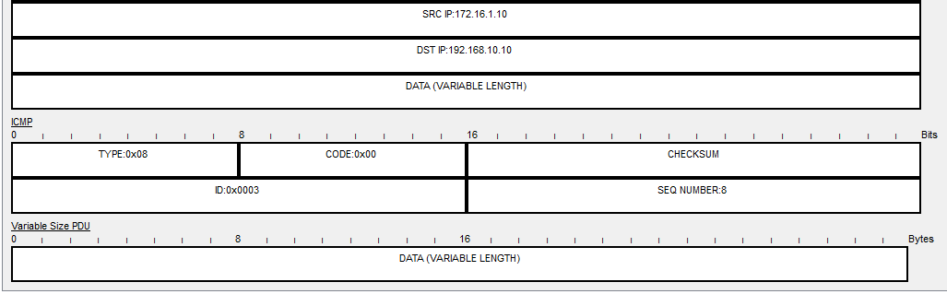
Result of ICMP request between PCs :
At Sniffer2-IPsec: Sniffer2 tracked is IPsec protocol and ESP Header can been seen which means IPsec VPN tunnel successfully working .

Slide 22
References:
https://www.kaspersky.com/resource-center/definitions/what-is-a-vpn
https://www.geeksforgeeks.org/types-of-virtual-private-network-vpn-and-its-protocols/
https://vpnpro.com/guides-and-tutorials/vpn-firewall/
https://www.cisco.com/c/en/us/solutions/small-business/resource-center/security/how-does-a-vpn-work.html
https://en.wikipedia.org/wiki/Virtual_private_network
https://csrc.nist.gov/glossary/term/virtual_private_network
https://www.cloudflare.com/learning/network-layer/what-is-ipsec/

Slide 23


