Slide 1
Basic of Shell Scripting

Slide 2
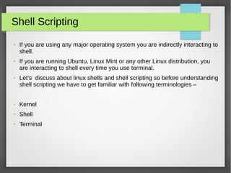
Introduction

Slide 3
Basic Terminology
Shell is a command-line interface to run commands and shell scripts. Shells come in a variety of flavors, much as operating systems come in a variety of flavors.
A terminal, also known as a shell, is a program that allows users to interact with their operating system through a command-line interface.
Note:
Shell is an interface between the user and the operating system.
sh implements the shell interface.
bash is a superset of sh.

Slide 4
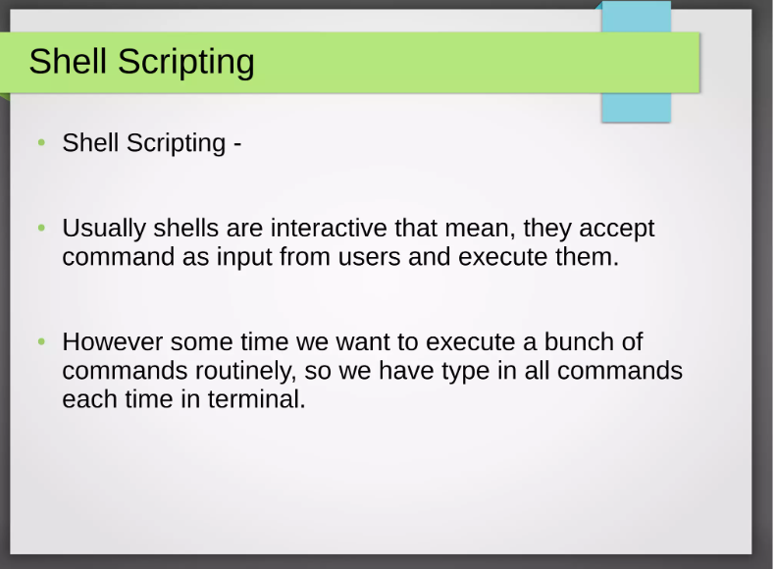
Introduction Now a shell can accept a number of commands through a file, known as a shell script. A shell script contains a number of commands that are executed by a shell.

Slide 5
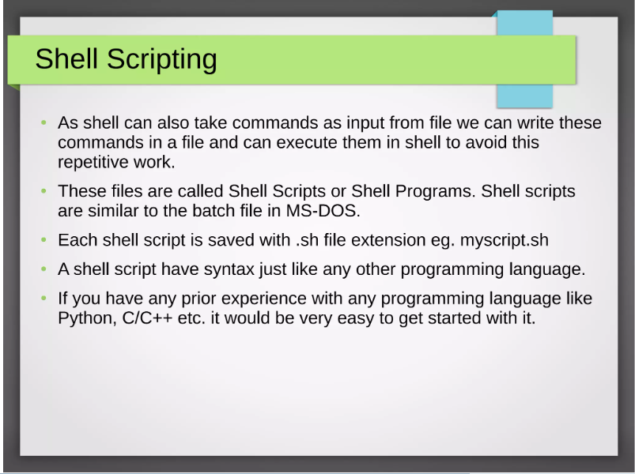
Introduction

Slide 6
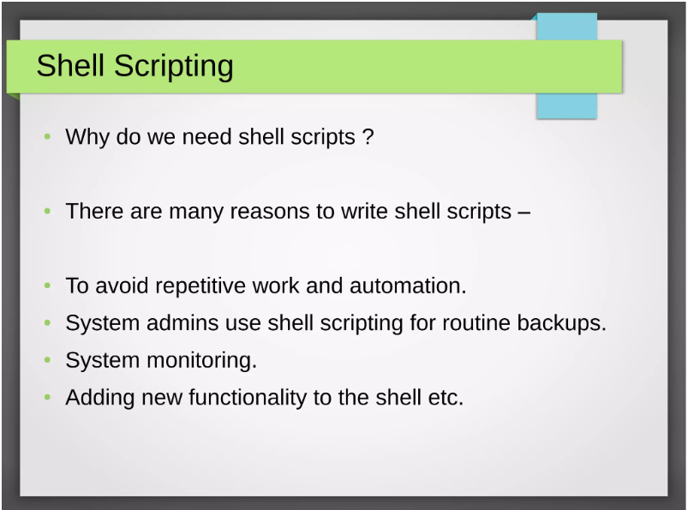
Introduction

Slide 7
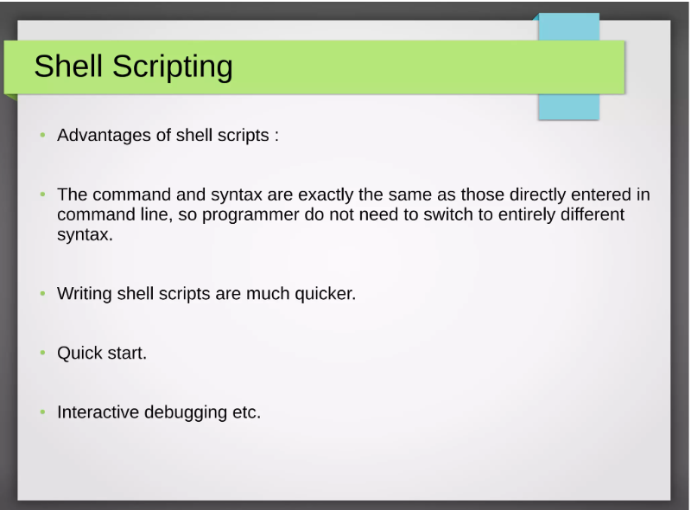
Introduction

Slide 8
Introduction to Bash
The Linux Bash is also known as 'Bourne-again Shell.' It is a command language interpreter for the Linux based system. It is a replacement of Bourne shell (sh). It was developed under the GNU Project and written by Brian Fox. Nowadays, Bash is the default user shell of most of the Linux distributions.
The Linux/Unix shell allows us to interact with the Linux system through the commands. It let us invoke an executable file to create a running process. Moreover, it also allows us to interact with the Linux file system. It is designed in such a way that we can perform all the Linux operations through Bash.
The Bash is a command language interpreter as well as a programming language. It supports variables, functions, and flow control, like other programming languages. It can also read and execute the commands from a file, which is called a shell script.

Slide 9
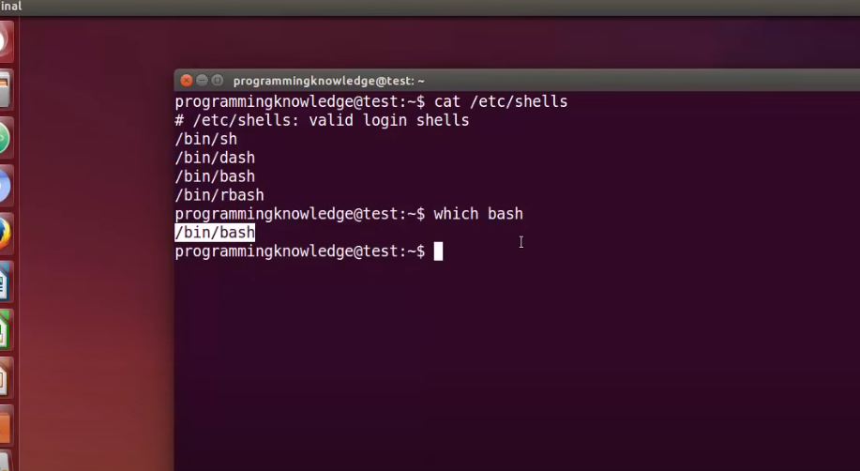
Introduction

Slide 10
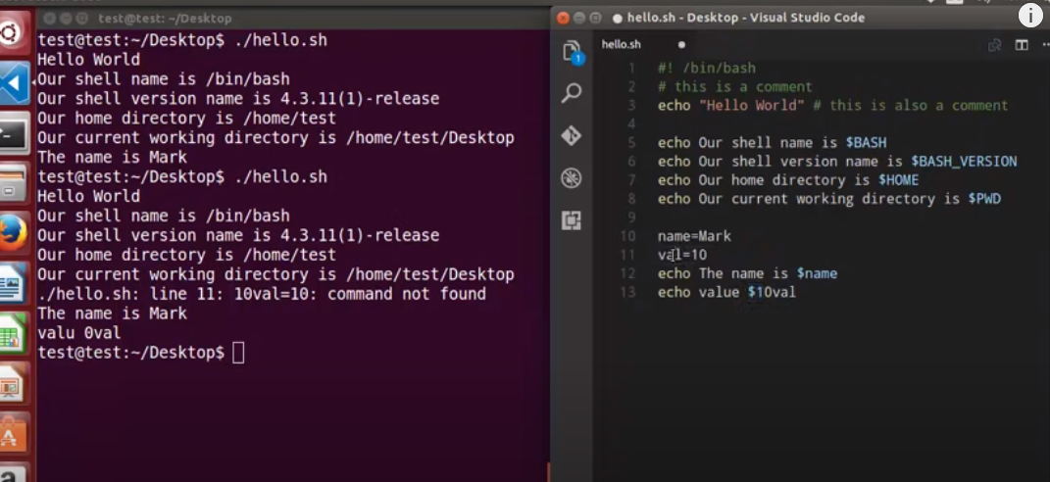
1st Shell Scripting Code

Slide 11
Explanation
Adding the Shebang
Bash scripts start with a shebang. Shebang is a combination of bash # and bang ! followed by the bash shell path. This is the first line of the script. Shebang tells the shell to execute it via bash shell. Shebang is simply an absolute path to the bash interpreter.
You can find your bash shell path using the command: which bash

Slide 12
Running the script
You can run the script using any of the mentioned methods:
sh run_all.sh
bash run_all.sh
./run_all.sh

Slide 13
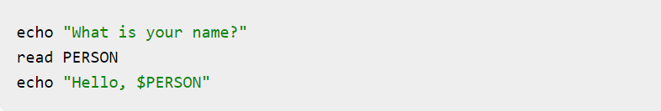
2nd Example
To read the output from the user.

