Slide 1
Recursion
Prepared by: Azizur Rahman Anik
Lecturer, department of CSE, UIU

Slide 2
What is Recursion?
Solving a big problem by solving smaller versions of the same problem.
Examples:
Suppose you want to find 5! and someone has already calculated 4! for you. You then just do 4!*5 = 5!
Suppose you want the sum of first 10 numbers and someone already calculated the sum of first 9 numbers. Then you just do: Sum(10) = Sum(9) + 10

Slide 3
Dive into Recursion through Factorial
4! = 3! * 4 = 2! * 3 * 4 = 1! * 2 * 3 * 4 = 0! * 1 * 2 * 3 * 4
So we stop unfolding when we reach to 0! - this is called the base condition.
When we write 4! = 3! * 4, this is same as 4! = (4-1)! * 4
In general, factorial(n) = factorial(n-1) * n , till we reach to factorial(0)

Slide 4
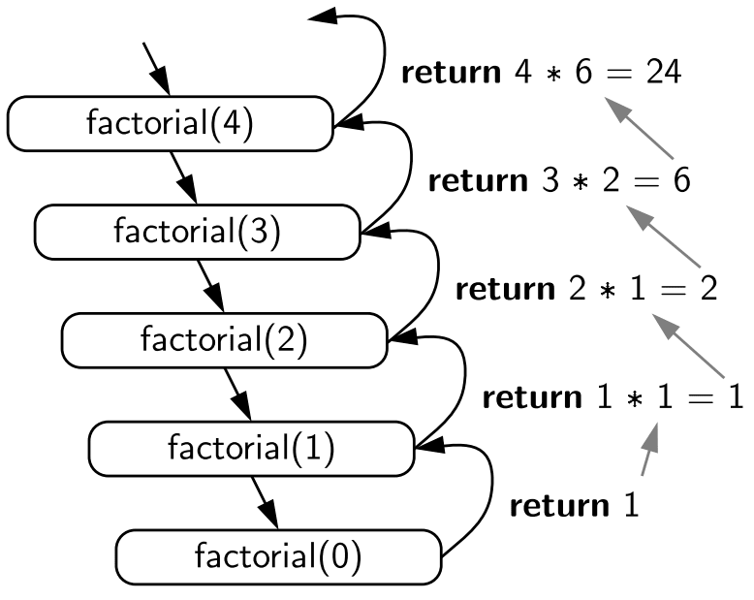
Illustration of Recursive calls

Slide 5
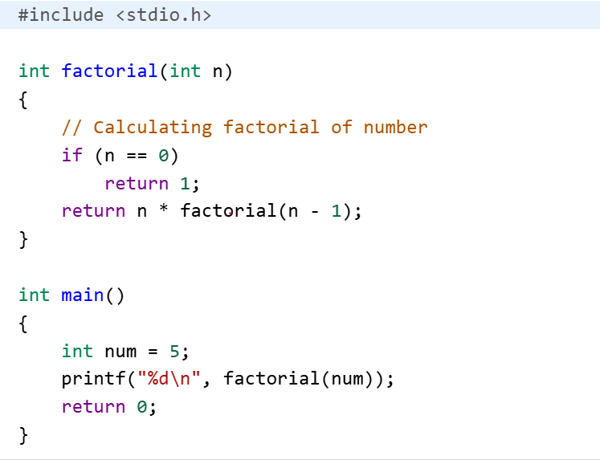
Putting pieces together…
Base Case
Recursive call: function calls itself

Slide 6
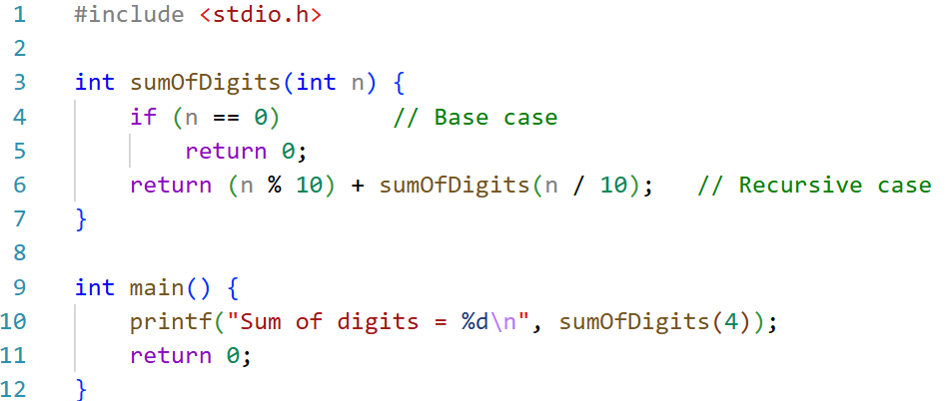
Finding Sum of Digits

Slide 7
Illustration of Sum of Digits
sumOfDigits(527)
Thus we get the sum = 14
7 + 7 =14
527 % 10
7 + sumOfDigits(52)
2 + 5 = 7
527 / 10
2 + sumOfDigits(5)
5 + 0 = 5
5 + sumOfDigits(0)

Slide 8
Adding elements of Array
Recursive Idea
If someone has already calculated the sum of the first (n-1) elements, you can simply add the last element.
int sumArray(int arr[], int n) { if (n == 0) // Base case: no elements left return 0; return arr[n - 1] + sumArray(arr, n - 1); }

Slide 9
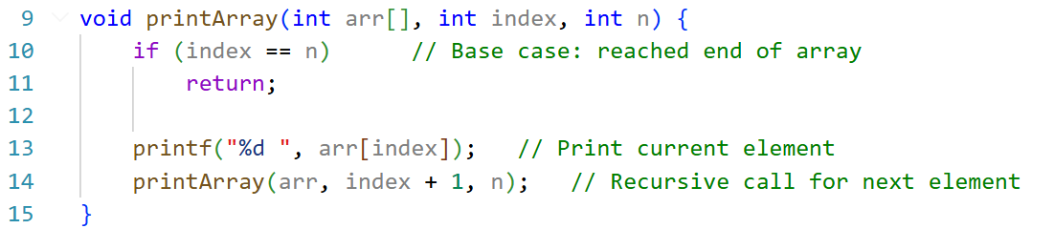
Printing Elements of Array

Slide 10
Greatest Common Divisor (GCD)
Euclidean Algorithm for GCD
The algorithm is based on the below facts.
If we subtract a smaller number from a larger one (we reduce a larger number), GCD doesn't change. So if we keep subtracting repeatedly the larger of two, we end up with GCD.
Now instead of subtraction, if we divide the larger number, the algorithm stops when we find the remainder 0.

Slide 11
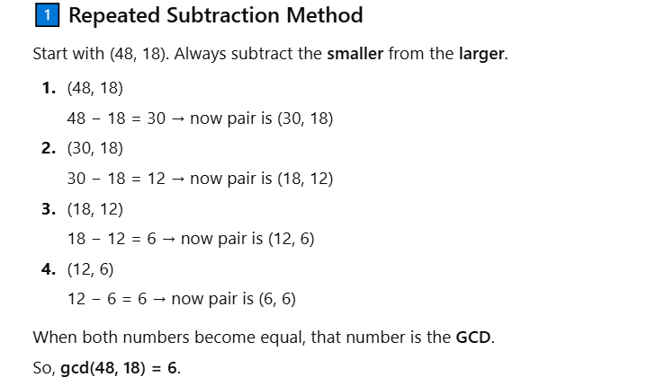
Greatest Common Divisor (GCD)

Slide 12
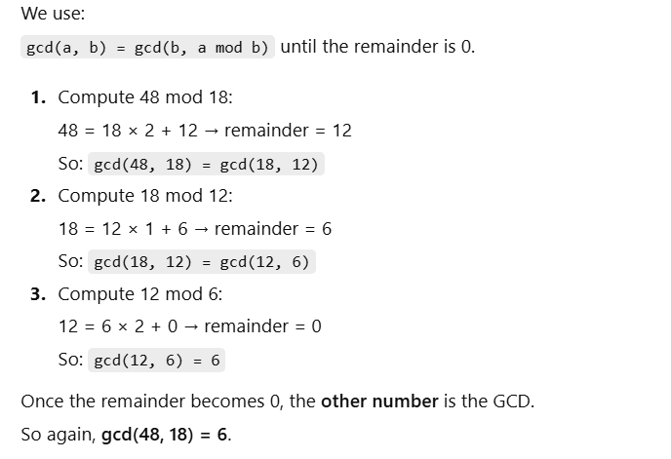
Greatest Common Divisor (GCD)
Division (Remainder / Mod) Method – Euclidean Algorithm

Slide 13
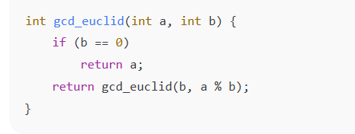
Greatest Common Divisor (GCD)
The recursive idea
We need gcd (48, 18) but someone has already figured out gcd (18, 48%18 = 12) or gcd (18, 12), which is now a smaller problem.

Slide 14
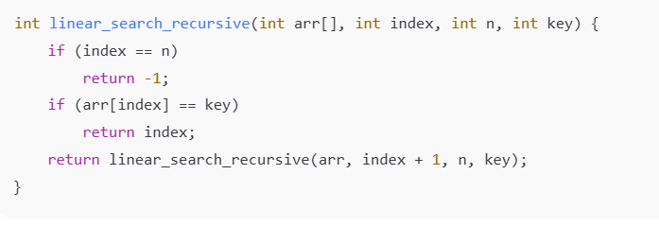
Linear Search

