Slide 1
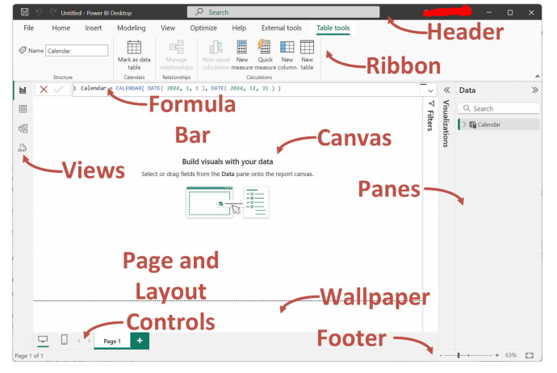

Slide 2
Home Tab
1. Clipboard
Cut, copy, and paste visuals to another location within the report.
2. Data
Import data from multiple sources.
Instantly import using Excel Workbook option.
Connect live to semantic models, data marts, Warehouses, and Lakehouse.
3. Queries
Uses Power Query Editor as the backend.
Transform data using Transform Data option.
Clean, rectify anomalies, and connect multiple data sources.
4. Insert
Add new visuals and text boxes.
Import custom visuals from AppSource or local system.
5. Calculations
Create New Measures using DAX expressions.
Use Quick Measure for complex calculations.
6. Sensitivity
Apply sensitivity labels to protect and classify report data.
7. Share
Publish and broadcast reports to Power BI Service for collaboration.

Slide 3
Insert Tab
Pages − You can add new pages either blank or duplicate pages into the report by using the Pages group.
Visuals − You may utilize the Visuals group to add new visuals or more visuals from appsource or my files to the report to make interactive reports.
AI visuals − Natural languages are used by AI visual groups, and metric influencers are added to the report by choosing key influences, a decomposition tree indicates how data is represented hierarchically, and narrative generates intelligent summaries of data automatically.
Power Platform − This group is used to integrate paginated reports, Power Automate to automate complex tasks and Power apps.
Elements − You can add distinct elements like Text boxes, Buttons, Shapes, and Images to the report.
Sparklines − You can embed a sparkline (small chart) in either a matrix or table visuals.

Slide 4
Modelling Tab
Relationships − You may choose the "Manage relationships" option if you wish to append, alter, or delete relationships among tables.
Calculations − You can employ DAX expressions to generate new tables and new columns, and new measures can be developed through this calculation group.
Page Refresh − It permits you to refresh pages relying on identifying changes in the dataset to enhance the performance of the report.
Parameters − We may add parameters to the visuals and also use slicers to adjust the inputs and predict the output.
Security − Managers and higher-level authority use the "Security" option to ensure the row level of security.
Q&A − You may use this group to understand the dataset and alter the language utilized to ask questions to know more about terms and data.

Slide 5
View Tab
Themes − You can create a theme, change the default theme of the report, and customize the present theme for stunning reports.
Scale to fit − Depending on your needs, you can choose from alternatives like "fit to width," "fit to page," and "actual size" of the page.
Mobile − You may also create a report for mobile phones.
Page options − You can automatically or manually align the objects either by selecting the "Snap to grid" option or "Gridline" option and also lock objects while showcasing the presentation.
Show Panes − The filter pane can either be visible or hidden by using the filter option. Bookmarks can be added or viewed to capture the data.

Slide 6
Optimize Tab
Queries − This group permits you to stop or resume visuals during changes in the report.
Report − You may optimize the report settings to enhance the performance of the report for better interaction and to minimize queries.
Review − You inspect the report performance and enhance the areas that require further improvement.
Apply − You may add an "Apply all slicers button" in the report if there are multiple slicers on a page and this control will apply to all slicers.

Slide 7
Help Tab
Info − This group assists users in knowing the version of downloaded Power BI tools and acquiring the session information while submitting a ticket.
Help − You may take help from the training videos, support, and documentation to learn more about Power BI.
Community − You may join the Power BI community to collaborate with other experts and read the blog, get to know the recent updates of the tools, and also download the external tools that are compatible with Power BI.
Resources − You may explore examples and workshops provided by the consulting service to enhance your skills.

Slide 8
