Slide 1
Development Containers
Dev Containers

Slide 2
Agenda
Docker
Dev Containers with Docker
Docker Compose
Dev Containers with Docker Compose
What’s More…

Slide 3
What is Docker
Lightweight, secure platform
Simplifies building, packaging and running apps
Provides sandboxed environment
Built primarily on Linux
Main components are:
Docker Daemon (Server)
REST API (Docker Engine)
Docker CLI (Client)
Registry
Docker Objects
Notes:
Daemon is a background process that runs persistently and is responsible for managing all the Docker objects - Images, Containers, Volumes, Networks. It listens to the Docker API for instructions in the form of requests, processes them, and acts accordingly. Docker daemon does the heavy lifting of creating, running, and sharing Docker containers. This occurs when a Docker user executes commands in the command line
The API acts as a middleman between the server and the client. The client application uses it to interact with the server (Daemon). The REST API is accessed only by the HTTP clients.
Clients are used to interacting with the Docker daemon. It can be as simple as a Command Line Interface.

Slide 4
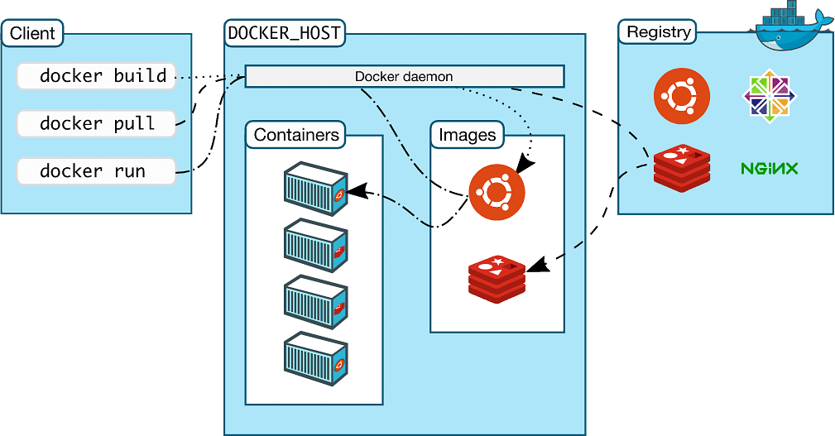
Docker Architecture

Slide 5
Primary Docker Objects
Images
Containers
Volumes - Storage
Networks

Slide 6
Docker Images
Docker Images are read-only templates that are built using multi-layers of file
Built using a simple text file typically called Dockerfile
Contains INSTRUCTIONS on how to build these images
First instruction, FROM which can pull a base image from any Docker registry
Each instruction adds a new layer on top of the previous one
docker image pull/push/build/inspect/ls/rm

Slide 7
Docker containers
Created by using an image
A container is where the application runs
Complete running environment for the application:
OS packages
Dependencies
Frameworks
Application Code
docker container [command]
create/rm start/stop pause/restart rm/kill exec port logs run …
Notes:
Containers have access to the resources defined by the Dockerfile, network connections, storage, CPU, memory, ports, etc.

Slide 8
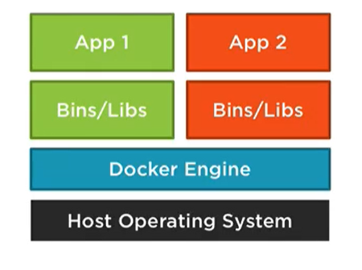
Running Containers
Notes:
Can be created, started and stopped quickly
Adds a writable layer on top of base image layers
Ephemeral

Slide 9
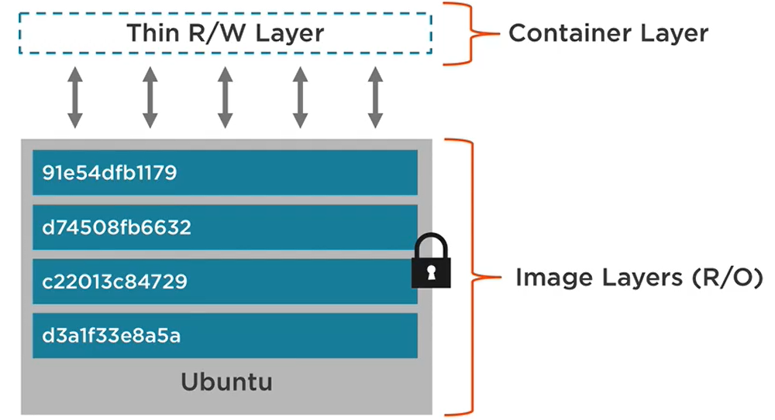
Images, Containers & Layers
Notes:
Deleting the container removes the changes made to it
Not good for logs, database file or any persistence storage
That is where volumes comes into play

Slide 10
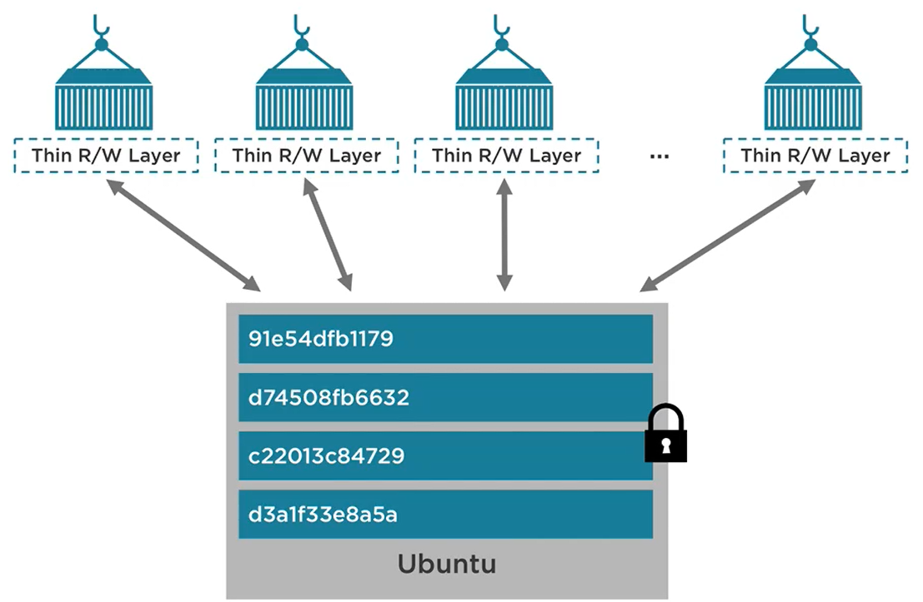
Containers share image layers
Notes:
docker run -it --name alpine1 alpine:latest /bin/sh # --rm
touch file1
exit
docker ps
docker run -it --name alpine2 alpine:latest /bin/sh # --rm
ls # and file is not there

Slide 11
Docker volumes
Special type of directory associated with a container
Also referred to as data volume
They are persisted across container lifecycle
Two options:
Docker Managed
An alias to path created on the host
User Managed called Bind Mounts
Path given by user
Mounts a folder on the host to docker
docker volume create/rm ls inspect
Notes:
docker volume create myfiles
docker run -it --name alpine1 -v myfiles:/var/files alpine:latest ash
touch /var/files/file1
exit
docker run -it --name alpine2 -v myfiles:/var/files alpine:latest ash
docker inspect alpine1 # inspect volumes
------------- Bind Mounts ------------------
docker run –p 8080:8080 –v $(pwd):/var/www node

Slide 12
Docker network
Containers run in an isolated network
Supports multiple network drivers
None
Bridge - default
Host – available on Linux only
Overlay
Bridge network is used to allow multiple containers connect to each other on the same docker instance
docker network create/rm connect/disconnect ls inspect
Notes:
docker run -dit --name alpine1 alpine ash
docker run -dit --name alpine2 alpine ash
docker container ls
docker network inspect bridge
docker attach alpine1
ip addr show
ping -c 2 172.17.0.3 # ping the second container
ping -c 2 alpine2 # ping by name
docker container stop alpine1 alpine2
docker container rm alpine1 alpine2

Slide 13
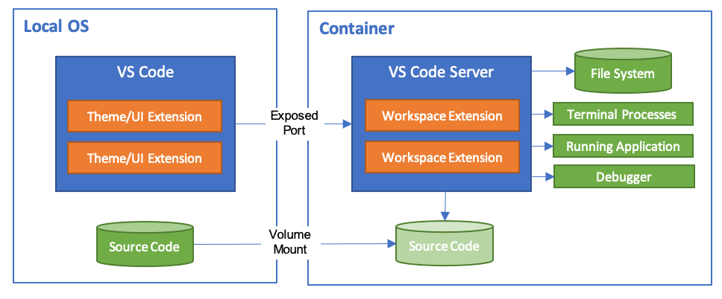
Dev Containers – VS Code
A full featured development environment
Let's you develop application in an isolated container
Runs in VS Code with all its features

Slide 14
Devcontainer.json file
Describes how VS Code should start the container and what to do after it connects
This file defines a schema which allows you to:
Install additional tools such as Git in the container
Automatically install extensions
Forward or publish additional ports
Set runtime arguments
Reuse or extend your existing Docker Compose setup
Add more Advanced container configuration

Slide 15
Devcontainer.json file
Ways to configure:
image - directly specify the docker image
Dockerfile – specify a custom docker file
Configure multiple containers through Docker Compose
VS code displays ‘Open in Container’ if this file is present inside .devcontainer folder

Slide 16

Demos - Single Containers
Notes:
alpine
azure-cliu
azure-bicep
azure-functions-dotnet – inprocess & isolated
dotnet
typescript-node
aspnet repo as a docker managed volume for performance

Slide 17
Docker compose
A tool for defining and running multiple containers
Configured via a yaml file – docker-compose.yaml/yml
Containers are called services
Docker compose cli commands allows to:
Start, stop, and rebuild services
View the status of running services
Stream the log output of running services
Run a one-off command on a service
docker-compose build start/stop rm run up down ...
Notes:
Open up the example-compose.yaml file
The example application is composed of the following parts:
- 2 services, backed by Docker images: webapp and database
- 1 secret (HTTPS certificate), injected into the frontend
- 1 configuration (HTTP), injected into the frontend
- 1 persistent volume, attached to the backend
- 2 networks
The Compose application model
Application components and dependencies are defined as Services
Services communicate with each other through Networks
Services store and share persistent data into Volumes
Some services require configuration data that is dependent on the runtime or platform
A Secret is a specific flavour of configuration data for sensitive data

Slide 18
Demos - Multiple Containers
Notes:
dotnet-mssql
javascript-node-mongo
Show Symphony project
Show how to get started with development containers
Try a dev containers
Add dev container configuration files

Slide 19
Using extensions
Notes:
.NET Interactive Jupiter notebooks

Slide 20
What’s More…
Remote Development
WSL
SSL
GitHub Codespaces
Microsoft Dev Box
Notes:
docker run --rm -it jturpin/hollywood hollywood

Slide 21
Thank you
Ashraf Ali

