Slide 1

AI HACKDAY -2025
Problem Statement Title: Design an AI tool that helps rural students access local job market trends and provides career guidance aligned with regional industries.
Team Name: CODE SCULPTORS
Team Leader Name: M.BHUVAN
Institute Code :Q9
Institute Name: MALLA REDDY COLLEGE OF ENGINEERING(MRCE)

Slide 2


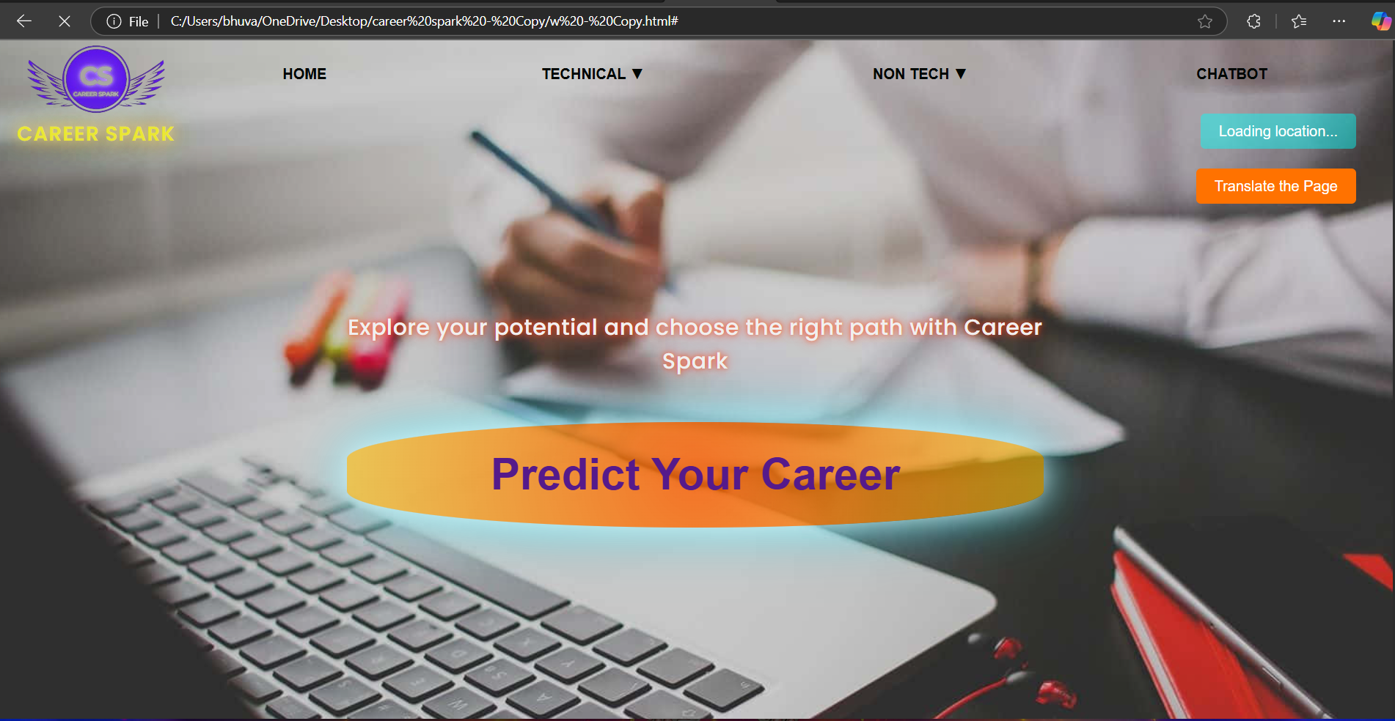
Idea Details
Describe your Idea/Prototype here:
A user-friendly platform combining job market trends and career guidance.
AI-powered tools for personalized career insights.
Integration with local employers for job postings and internships.
Multilingual support to ensure inclusivity and reach.
Website design for accessibility in low-resource settings.
WEBSITE:https://cozy-tapioca-bd0d31.netlify.app/ -

Slide 3
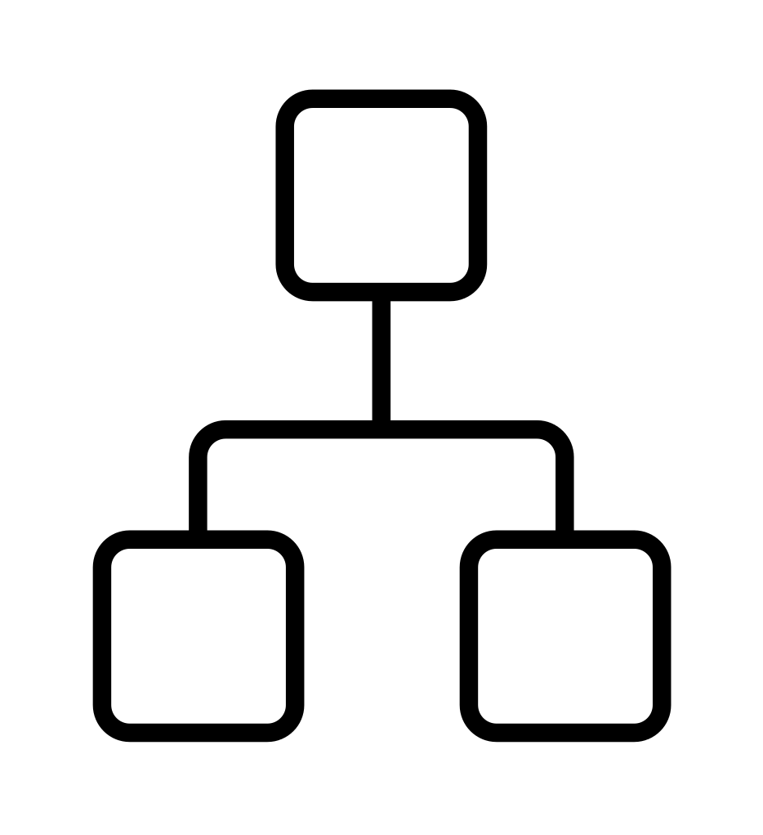
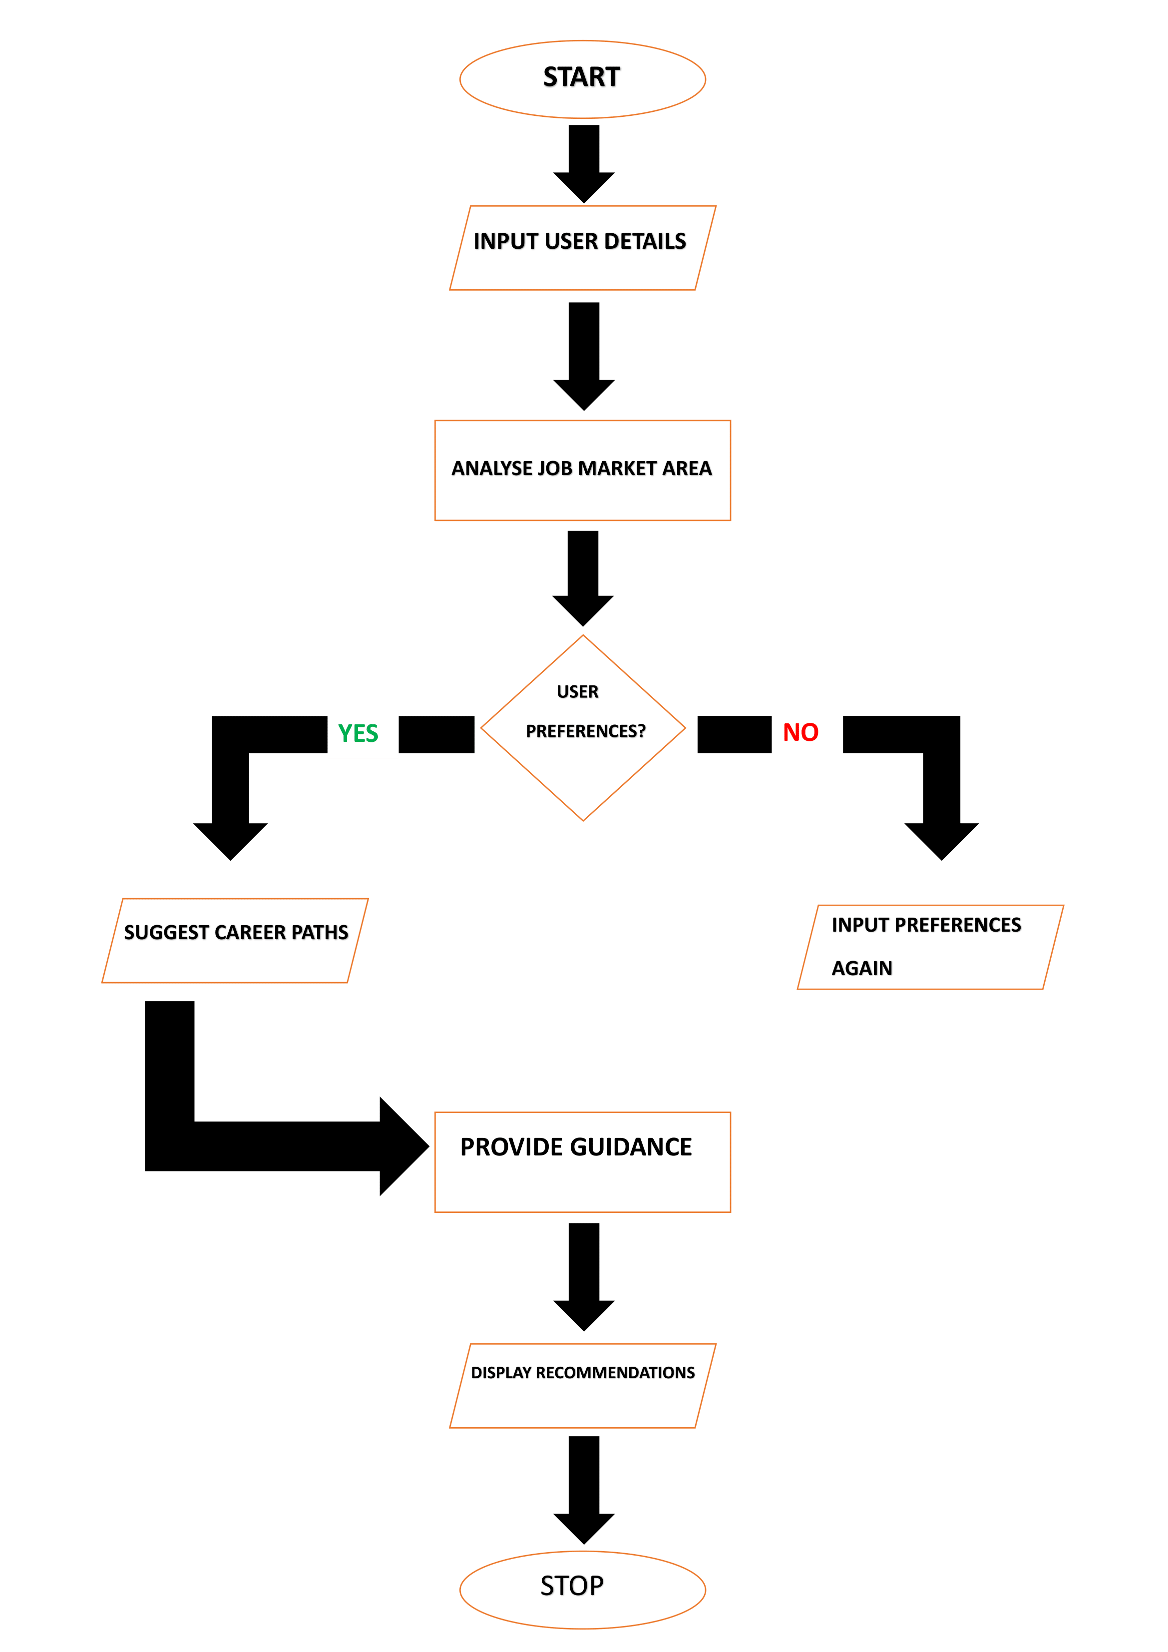
Flow Chart

Slide 4


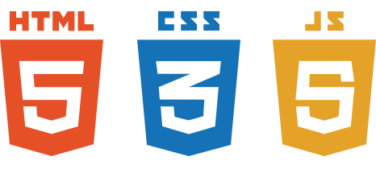








Technology Stack
Application
Front End
Database
Mongo
DB
Backend
Node JS
GOOGLE AI STUDIO
OPEN AI

Slide 5
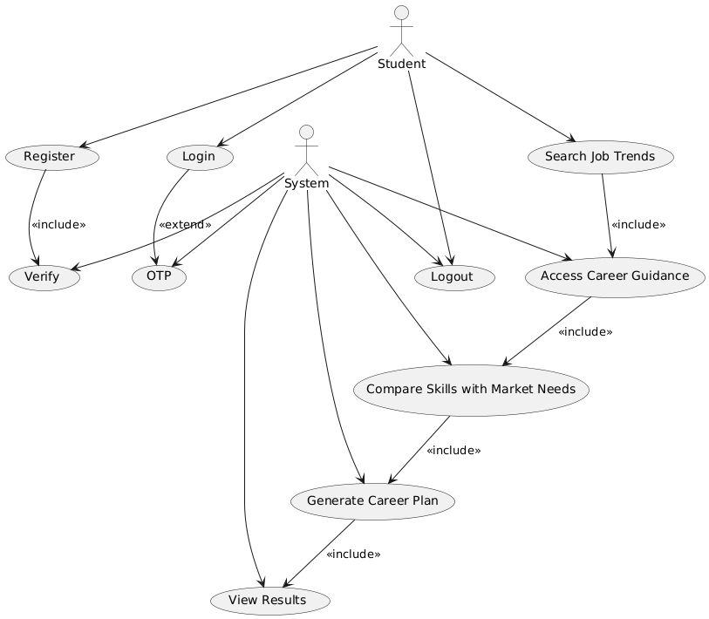
USECASE
DEPENDENCY
Reliable internet connectivity for rural regions..
Collaboration with local industries and educational institutions.
Access to up-to-date labor market data and analytics tools.

Slide 6
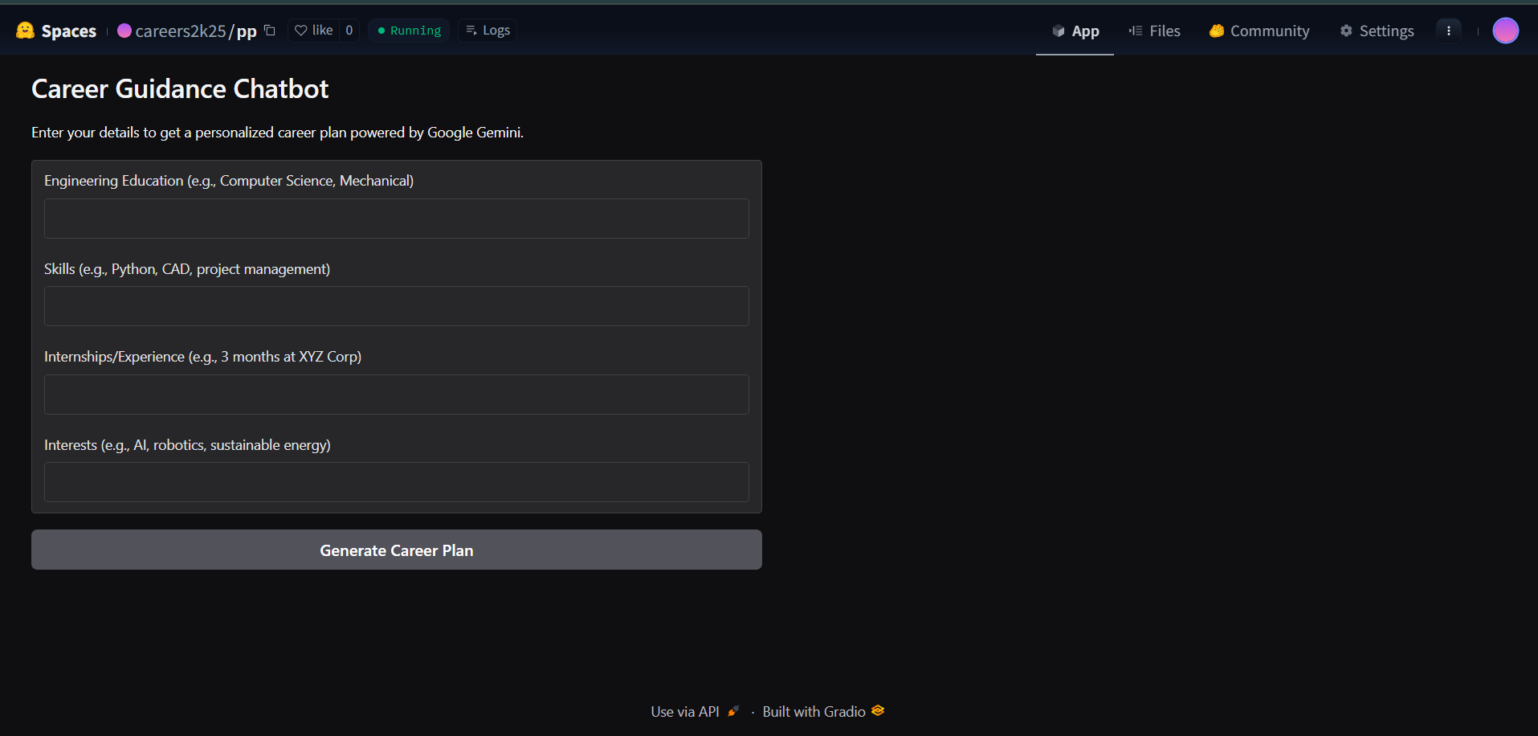
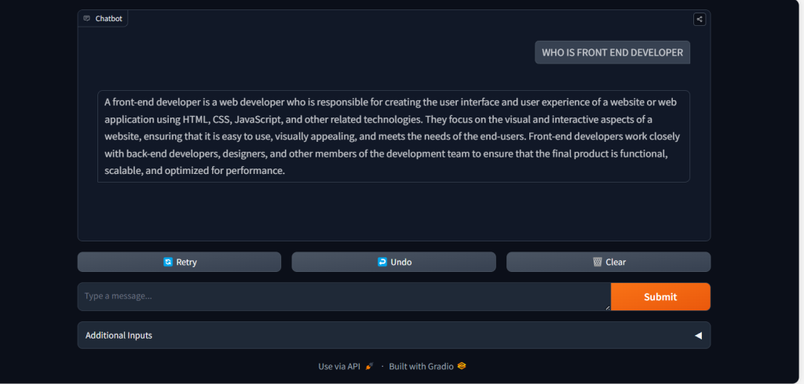
AI CHATBOTS

Slide 7
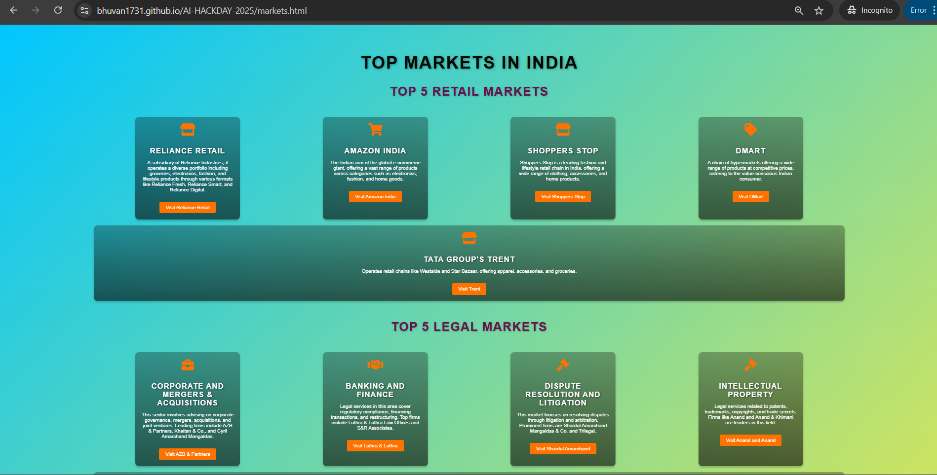
Market Insights
AI scans job trends from LinkedIn, Indeed, etc.
Market data by domain, location, salary
Skill heatmaps (most in-demand skills per domain)
Competitive analysis

Slide 8
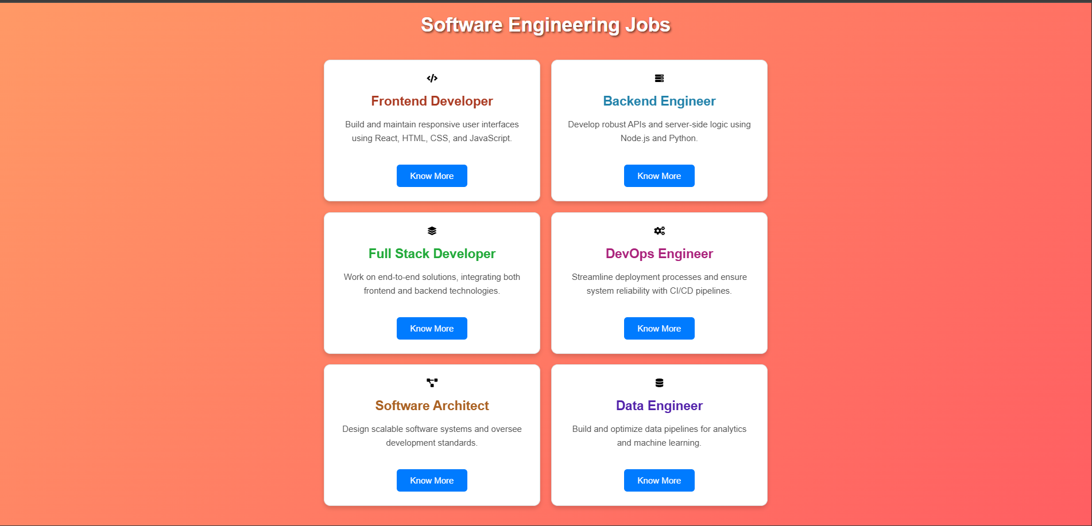
Job Roles
AI-recommended job roles:
Jobs→ Software Engineer → FrontEnd Developer
Insights on:
Salary ranges
Skill requirements
Future demand
Visual mind maps / roadmaps

Slide 9
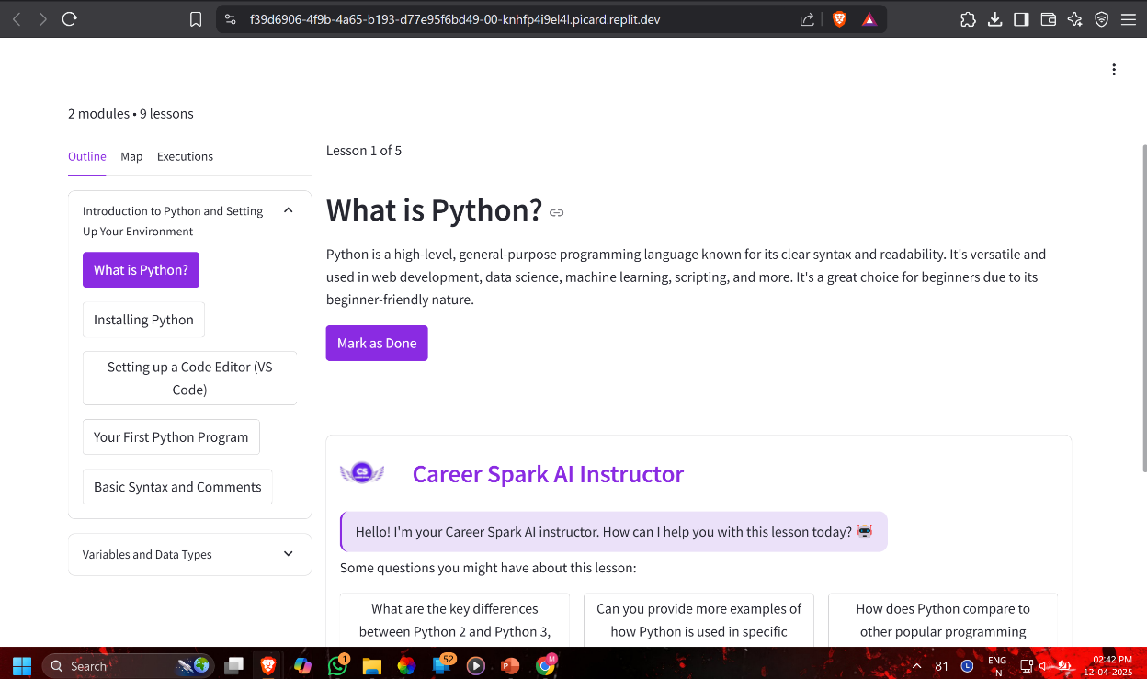
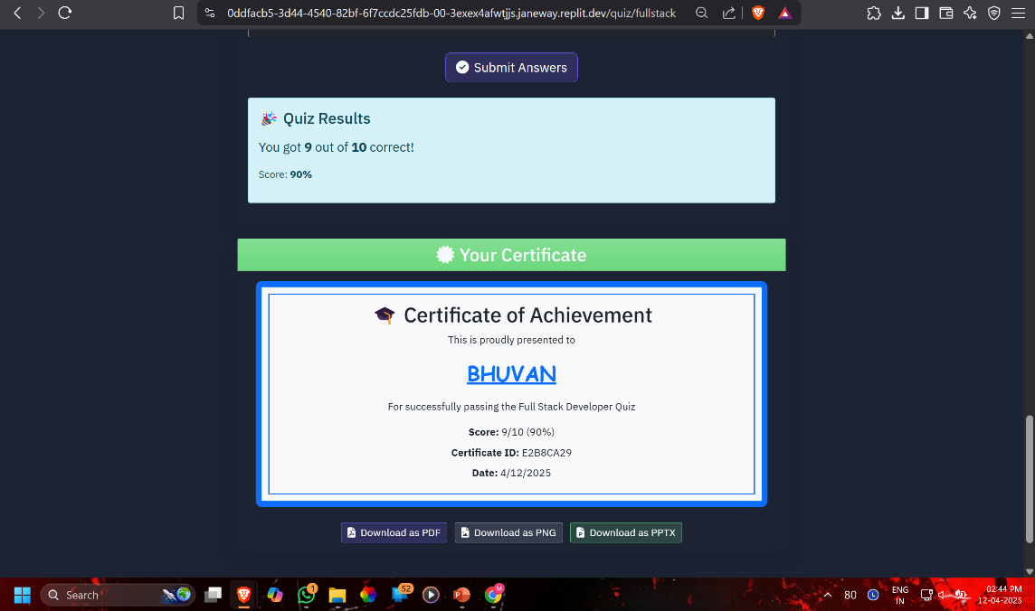
COURSES
Personalized, data-driven guidance
Scales to millions of users
Bridges gap between education and employability
High engagement through interactive UI

Slide 10
Team Member Details
Team Leader Name: M.BHUVAN
Branch : CSE
Team Member 1 Name: BAGGI RISHIKA
Branch : CSE
Team Member 2 Name: MD ASHRAF
Branch : CSE
Year :II
Year :II
Year :II

