Slide 1

AIRPORT MANAGEMENT SYSTEM
Alp Emir BİLEK
Mohammad Ashraf YAWAR
İlkan Mert OKUL
Rahmet Ali ÖLMEZ
Bilal BAYRAKDAR
Nevzat SEFEROĞLU
Ece ERER
Elif KELEŞ
Seniha Sena TOPKAYA

Slide 2
Problem Definition
Airport Management System is a system which provides communication between clients and Airline Companies.
It organizes whole flight operations.

Slide 3
Users of the System
Users
Airport Users
Airline Users
Airport Administrator
Airline Administraton
Airport Personnel
Airline Personnel
Customer
Shop Manager

Slide 4
Data Structures
~ Client ~
ArrayList Airport Personnel. Operations may be easier.
TreeMap Customer. They have keys and values. Methods of this structure are more efficient than others.
PriorityQueue Shop Manager. Shops will be prioritized according to their fees.
Queue Airline Personnel. To keep pilots and personnels working consecutively.

Slide 5
~ Airline~
Map Ticket. Map is ideal to use when we have an identifying value and a key value linked to it.
ArrayList Aircraft. Since our frequent operation is get(), ArrayList is more efficient to keep our data.
MapGraph Destination. We represent flight destinations as graph since it is practical, when calculating paths/ distance.

Slide 6
~ Airport~
TreeMap Airline, Flights and Customer. They have keys and values. Methods of this structure are more efficient than others.
PriorityQueue ShopManager. Shops will be prioritized according to their fees.
ArrayList Place and AirportPersonnel. Operations may be easier.

Slide 7
These structures are implemented and used in this project:
Abstract Graph
Breadth First Search
Depth First Search
Edge
Graph
List Graph
Map Graph
Skip List

Slide 8
Users Of The System
Airport Users
Airport Administrator can add/ remove an Airport personnel, Airline Company, Shop in airport, destination, and set commission rate. Manages the administrative users.
Airport Personnel can dismiss a customer.
Customer can display flights, buy tickets.
Shop Manager can open and close Shops.
Airline Users
Airline Administraton can recruit/ dismiss a personnel and add/remove destination, flight and aircraft.
Airline Personnel can login and the system.

Slide 9
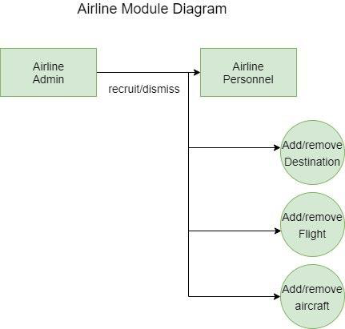
Module Diagrams

Slide 10
