Slide 1


MYSHOPPIE
January 16, 2017

Slide 2
MYSHOPPIE TEAM
MENTORS
EMMANUEL GOSULA
PRAKASH CHITIMELLA
TEAM MEMBERS
SHRAVYA ANCHURU
MAHESH CHITTIMELLI
ANKITA NATEKAR
SRINIVAS AYACHITULA
SWATI JOSHI

Slide 3
AGENDA
Abstract
Features
Technologies Used
Project Logic Flow
Technical Challenges
Learnings
Demo

Slide 4
ABSTRACT
Electronic Commerce is process of doing business through computer networks. Unlike traditional commerce that is carried out physically with effort of a person to go & get products, ecommerce has made it easier for human to reduce physical work and to save time.
The main advantage of e-commerce over traditional commerce is the user can browse online shops, compare prices and order merchandise sitting at home on their PC.
For increasing the use of e-commerce in developing countries the B2B e-commerce is implemented for improving access to global markets for firms in developing countries.

Slide 5
FEATURES
SignUp
New user has to register here in order to order products from site.
Login
Valid user credentials must be entered to navigate to home page with a ‘Welcome username’ text note on the navbar.
My Account
User details and ordered product details will be displayed.
Search Box
User can search the products present in the categories, subcategories, product name and the corresponding searched products would be displayed.

Slide 6
FEATURES
Categories
Our ecommerce site offers products related to Electronics, Fashion, Beauty, Home & Living and Accessories.
Product Description
Product details such as product image, description, price will be displayed once the product or more info button is clicked.
Add Products to Cart
The application will allow the customer to add individual products or group of products from the shopping cart, and the user can confirm the order or delete the order and quantity can be given depending on the product availability.
Checkout
The customer confirms the address by clicking the Confirm Address and the billing details will be displayed once the customer clicks on the invoice button.

Slide 7
TECHNOLOGIES USED
TECHNOLOGIES | DESCRIPTION
Nodejs | back-end platform / web framework
Html | Creates electronic documents.
Angularjs | front-end framework
Bootstrap | Makes the website device responsive.
Express | back-end web framework
CSS | define styles for documents
Mongojs | To connect to the MongoDB server
Mongodb | Document oriented database

Slide 8
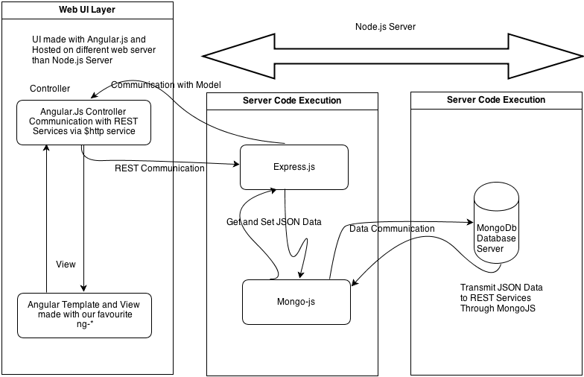
PROJECT LOGIC FLOW

Slide 9
TECHNICAL CHALLENGES
Learning New Technologies
Working with non relational database.
Setting up Cloud Environment.
Working with front-end Javascript, server side Javascript.
Interrelation between user, server and database

Slide 10
LEARNINGS
Scope Definition
Ensuring Data Integrity
Validating the data both front-end and back-end

Slide 11

DEMO

Slide 12
