Slide 1
ModMaven
The Complete NUS Module Visualization and Planning Tool

Slide 2
Plan for Sprint 1 (June 2013)
Implement a module search which returns a page with module details
Display a basic module tree, where nodes link to module page
Implement a facebook login feature to enable a custom user experience which we plan to add later

Slide 3
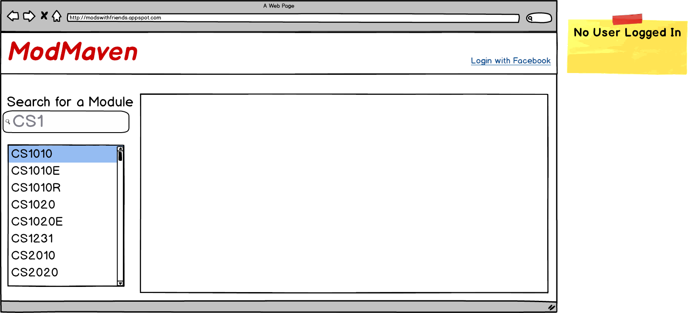
Module Search

Slide 4
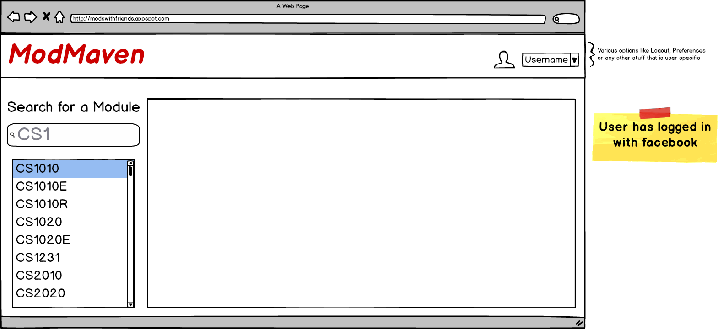
Post-Login Page

Slide 5
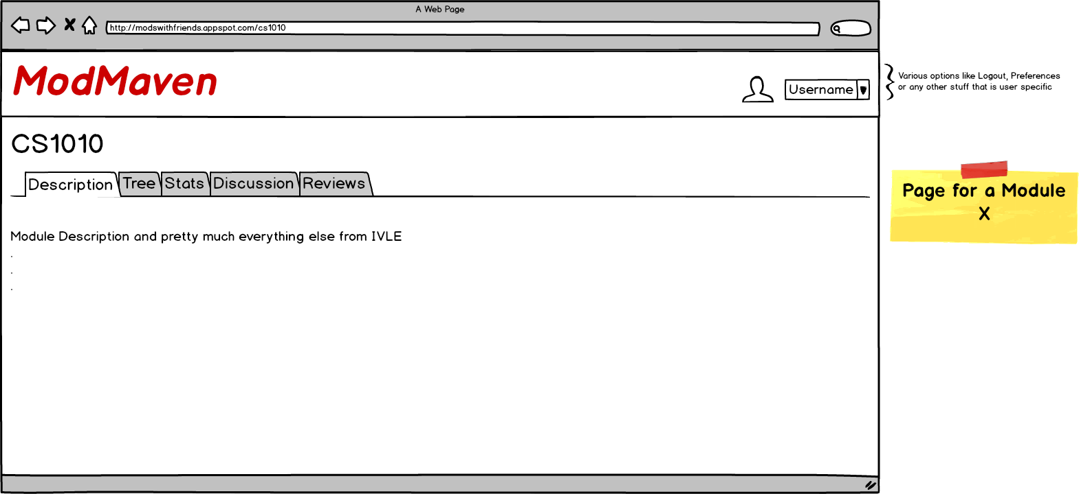
Module Page (Post-Login Scenario)

Slide 6
User Stories for Sprint I
“As a student or potential student at NUS, I wish to be able to quickly find all relevant details about a module I am interested in, as this will help me plan my modules better.”
“As a student at NUS, I wish to have a custom user experience based on what modules I am interested in, and those my friends are interested in, so we can plan together if we have common interests.”
“As a student or potential student at NUS, I wish to be able to visualize module dependencies as a tree, so I can plan for later semesters based on what depth modules I am planning to complete as well as the route I can take.”

