Slide 1
AgentFlow
Multi-Agent AI System for Automated Customer Support Ticket Management
Agentic AI Proof of Concept
Ashrith Reddy | AIML A | PRN 24070126040
Symbiosis Institute of Technology, Pune
AGENTFLOW • CA-3 | 01

Slide 2
Problem & Domain
Customer Support • Business Automation
• Tickets require repeated reading, categorization and urgency evaluation.
• Manual knowledge lookup and drafting add effort and inconsistency.
• Important incidents, such as suspected fraud, need timely escalation.
• Goal: standardize triage and draft generation with transparent, human-reviewed decisions.
AGENTFLOW • CA-3 | 02

Slide 3
Proposed Solution
Offline, rule-based mock-agent workflow
• Streamlit form supports individual tickets and synthetic CSV batches.
• Six agents coordinate sequentially, sharing structured outputs.
• Rule evidence, knowledge IDs and critic flags make decisions inspectable.
• Drafts are never sent automatically; risky cases are escalated.
AGENTFLOW • CA-3 | 03

Slide 4
Six Specialized Agents
Task decomposition and responsibilities
• Planner — creates workflow plan.
• Classification — predicts issue category using match scores.
• Priority — identifies critical fraud/security and high urgency.
• Research — retrieves approved example guidance from local KB.
• Resolution — drafts response and assigns support team.
• Critic — validates and routes for human review.
AGENTFLOW • CA-3 | 04

Slide 5
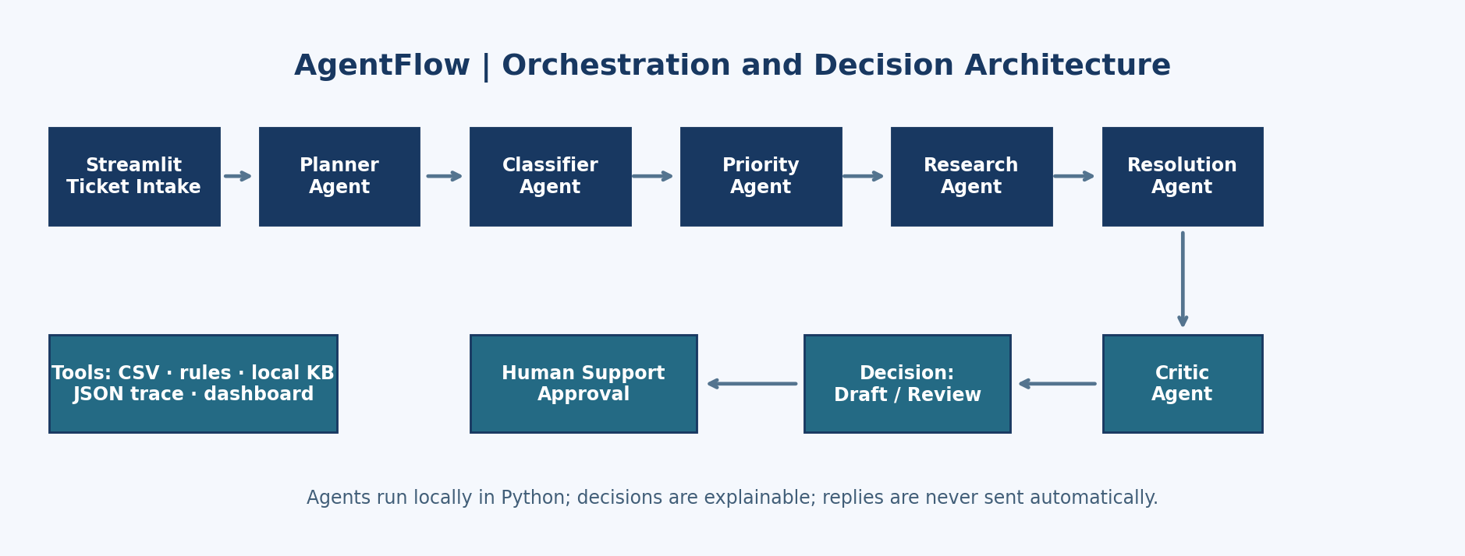
Architecture & Data Flow
Each stage receives outputs from the previous stage
AGENTFLOW • CA-3 | 05

Slide 6
Decision Logic
Why this is more than a chatbot
• A structured orchestrator executes specialized agent tasks.
• Conditional branching: critical/high risk, low confidence or weak details → Human Review.
• Other cases → Draft Ready (still not automatically sent).
• JSON decision trace preserves steps, evidence, KB lookup and validation.
AGENTFLOW • CA-3 | 06

Slide 7
Technology & Repo
Python • Streamlit • Pandas • pytest
• app.py — UI, batch processing and dashboard.
• agentflow/core.py — agent implementations and orchestration.
• data/sample_tickets.csv — 10 entirely fictional complaints.
• tests/test_core.py — six unit tests.
• No paid APIs, external LLMs or credentials required.
AGENTFLOW • CA-3 | 07

Slide 8
Live Demo Script
2 cases + batch dashboard
• Case 1: TKT-1006 (unauthorized transaction) → Critical → Human Review.
• Case 2: TKT-1003 (late delivery) → Delivery & Shipping → Draft Ready.
• Open each agent section and show matched evidence, KB article and safe draft.
• Process 10 synthetic rows, inspect metrics, export results CSV and JSON trace.
AGENTFLOW • CA-3 | 08

Slide 9
Validation & Results
Observed locally on synthetic demonstration inputs
• Tickets processed: 10; route counts: {'Human Review': 6, 'Draft Ready': 4}.
• Category distribution: {'Billing & Refund': 4, 'Account & Login': 1, 'Delivery & Shipping': 2, 'Product & Returns': 1, 'General Inquiry': 2}.
• Priority distribution: {'High': 2, 'Medium': 6, 'Critical': 1, 'Low': 1}.
• Six unit tests passed; no automatic external reply is possible.
• No real-world speed, quality or business impact claims are made.
AGENTFLOW • CA-3 | 09

Slide 10
Limitations and Future Scope
What an actual deployment would require
• Rule heuristics can misclassify complex, overlapping or multilingual tickets.
• Confidence is not a learned or statistically calibrated probability.
• No persistent storage, helpdesk integration, authentication or live policy data.
• Future: local LLMs, versioned RAG, evaluated datasets and secure human-approval integrations.
AGENTFLOW • CA-3 | 10

Slide 11
Conclusion
An explainable agentic workflow, not just a chatbot
• Six cooperating roles cover planning, decision-making, tool use and validation.
• Critical cases receive an explicit human-review gate.
• Ready to demonstrate locally with synthetic inputs and testable code.
• Next step: evaluate quality and integrate with real services only after controls are added.
AGENTFLOW • CA-3 | 11

