Slide 1
Phase 2- Amazon Reviews
Ashreen Kaur Oberoi

Slide 2
Terms that are used in my Dataset
• Items CSV
• ASIN : stands for Amazon Standard Identification Number. It's a unique identifier of 10 letters and/or numbers for a product that's assigned by Amazon.com. It's primarily used for product-identification within their product catalog of billions of items.
}Brand : What is the brand name or the manufacturing company of the product
}Title :The name given to the product by the Brand
}URL : The URL of the product on the amazon site
}Image : Image of the product
} Ratings : The average rating of the product
}Ratings URL : The URL where the rating are given
}Total Reviews : How many reviews does the product have
}Prices : Price of the produuct
}
}Reviews CSV:
}ASIN : It is the same as the Items CSV
}Name : It is the same as the Items CSV
}Rating : Particular rating for that product
}Date : Date of the ratings
}Verified : An "Amazon Verified Purchase" review means we've verified that the person writing the review purchased the product at Amazon and didn't receive the product at a deep discount
}Title : It is the same as the Items CSV
}Body : Any comments added by the user
}Helpful Votes : Amazon allows buyers to vote up a review on a product to show how helpful they think that particular review is. Vote up Amazon reviews is to click on the "Helpful" button below a review which moves up its ranking position among all reviews

Slide 3
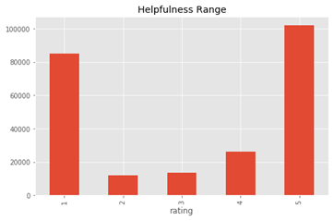
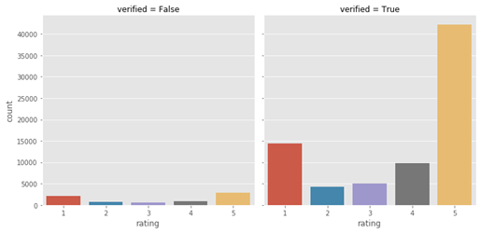
First,I have tried to use the helpful votes provided by the customer corresponding to all the levels of rating i.e. 1 to 5.
EDA
Then, I plotted the verified/unverified attribute of the reviews against all rating levels to understand the importance of the verified column in the analysis

Slide 4

LEARNING RATINGS FROM REVIEWS TEXT
Step 1 :First, I performed some Data cleaning by dropping unnecessary columnsand the null values to perform vectorization and further analysis.
Step 3: For these predictions I have used TF-ID vectorizer to vectorize and LinearSVM classifier,Logistic regression classifier and MultinomialNB classifier with the dataset split into test and train dataset
And the rating predictions for the first 10 reviews in the dataset were like this:
Step 2:For this analysis ,I have only used the reviews column and the correspond rating value, for predicting the rating from text

Slide 5
Models Used and Accuracy Rates
Models | Accuracy
SVM Classifier | 52%
Logistic Regression | 54%
MultinomialNB | 51%

Slide 6
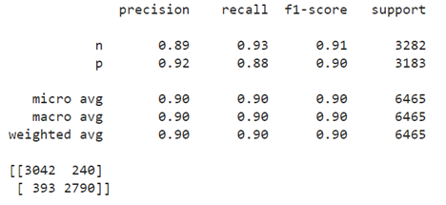
Remodelling the problem and removing neutral comments
Finally,I have modelled a simpler problem for the same analysis, and instead of trying to predict the exact star rating I have tried to classify the reviews into positive or negative, but I have removed the 3-star values to avoid confusion and improve the accuracy of the model. The accuracy results for this remodeled problem is
The accuracy increased to 90%

Slide 7
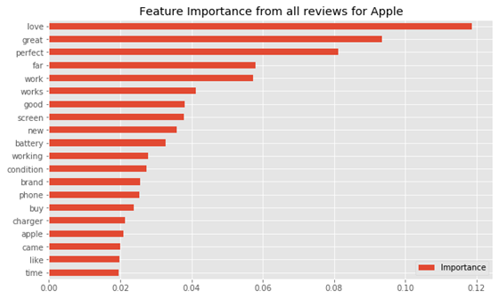
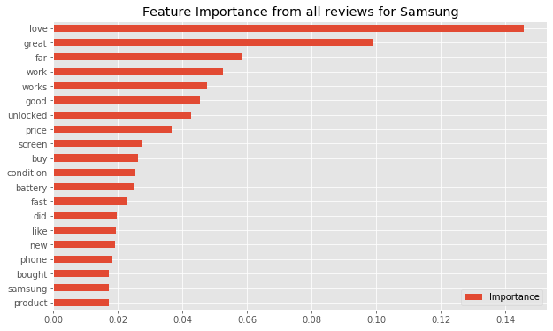
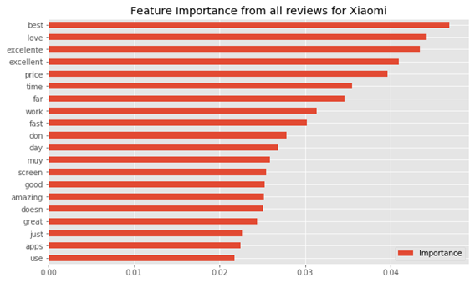
Topic Modelling : Plotting of features
Apple
Xiaomi
Samsung

Slide 8

Contact
Ashreen Kaur Oberoi
oberoiashreen15@gmail.com

