Slide 1



Con Edison Internship
Intern: Ahshreyah Ross – ahshreyah.ross93@bcmail.cuny.edu
Supervisor: Travis Fonseca – fonsecat@coned.com
Team: AMI (Advanced Metering Infrastructure) Team
Company: Con Edison
02/17/2025 | CISC 4900

Slide 2


Abstract
As a Computer Aide Intern at Con Edison, my project focuses on improving the AMI team’s documentation and system monitoring. I am responsible for organizing and maintaining the team’s wiki, ensuring that essential documentation is structured and easily accessible. Additionally, I will be verifying SQL queries in the SQL Server SIT environment to confirm accurate data output. Another key task involves working with Grafana dashboards to monitor system performance, helping the team quickly identify and resolve issues. Through this project, I aim to enhance documentation efficiency, support data validation, and improve system reliability.

Slide 3
AMI Team Organization Chart
Chairman of The Board & CEO
Officers And Executives Dept.
Senior Vice President & CIO
Officers And Executives Dept.
Vice President
Officers And Executives Dept.
Director
AMI Implementation Team IT
Department Specialist
AMI Implementation Team IT
Department Manager
AMI Implementation Team IT
Systems Manager
AMI Implementation Team IT
Systems Manager
AMI Implementation Team IT
Systems Manager
AMI Implementation Team IT
Technical Specialist
AMI Implementation Team IT
IT Architect
AMI Implementation Team IT

Slide 4
AMI Team Organization Chart
Systems Manager
AMI Implementation Team IT
Systems Manager
AMI Implementation Team IT
Systems Manager
AMI Implementation Team IT
Technical Specialist
AMI Implementation Team IT
IT Architect
AMI Implementation Team IT
Systems Specialist
AMI Implementation Team IT
Systems Specialists
AMI Implementation Team IT
Systems Specialists
AMI Implementation Team IT
Systems Specialist
AMI Implementation Team IT
Systems Specialists
AMI Implementation Team IT
Sr System Analyst
AMI Implementation Team IT
Sr System Analyst
AMI Implementation Team IT
Sr SQL Server DBA
AMI Implementation Team IT
System Analyst
AMI Implementation Team IT

Slide 5
AMI Team Organization Chart
Systems Specialists
AMI Implementation Team IT
System Analyst
AMI Implementation Team IT
EP Associate
AMI Implementation Team IT
Computer Aide
AMI Implementation Team IT

Slide 6
AMI Business Applications

Slide 7
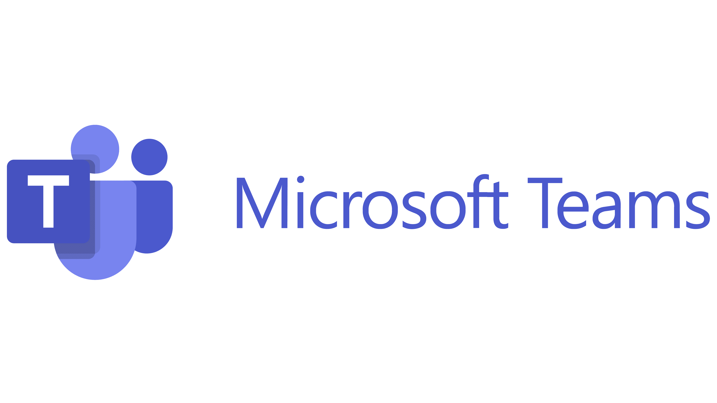

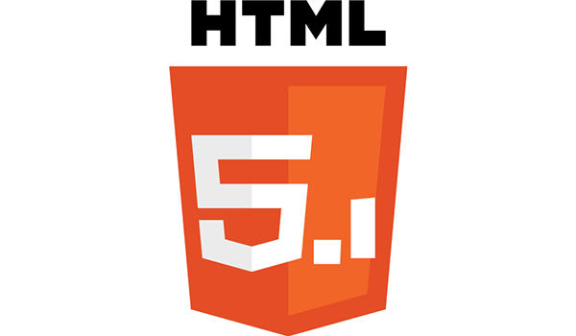
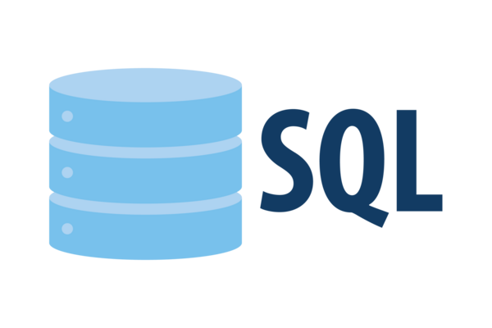


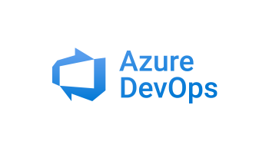


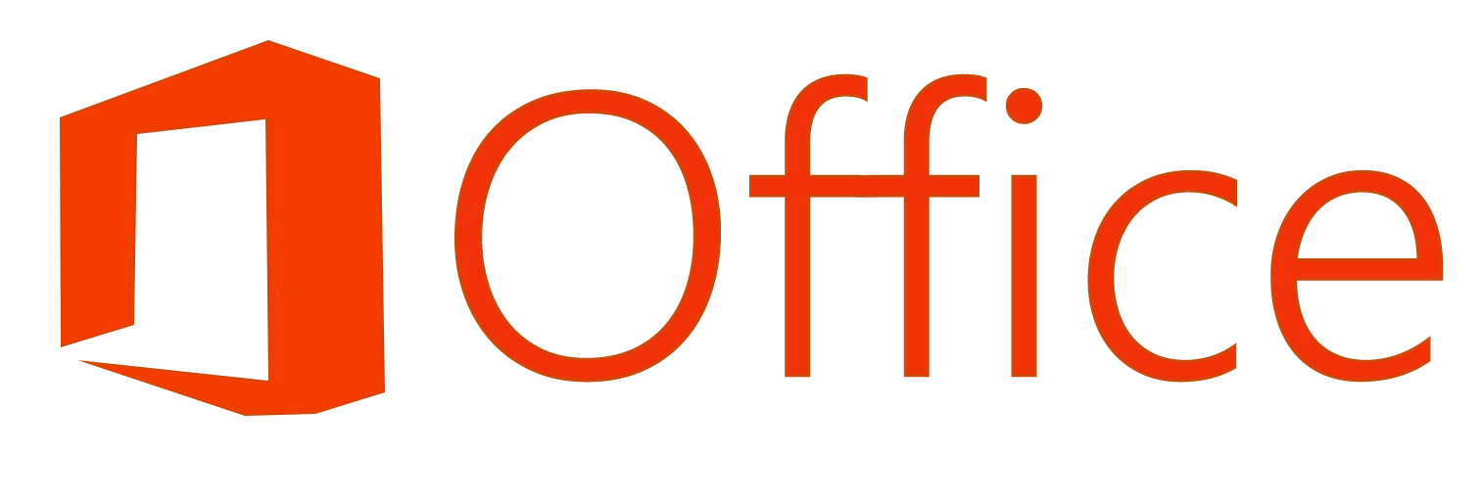
Tech Stack
Frontend
Observability
Collaboration & OS
Databases

Slide 8
How My Time is Distributed

Slide 9
Task Distribution Process
Does the task involve other parties?
Start
Weekly Meeting
with Supervisor
Yes
Invite All Required Parties to a Meeting
No
Supervisor Shares Resources
Supervisor Provides Demo
Supervisor Introduces Task
End of Task Assignment

Slide 10
User Experience on the AMI Wiki Database Website
Does User Browse Folders or Search for File?
User Opens AMI Wiki Database Website
User Chooses Mode (Light/Dark)
User Searches for File
User Reads Document
User Browses Folders/Subfolders
Does User Want to Follow File Page?
User Follows File for Updates
Yes
End
No

Slide 11
Digitizing Documentation for Better Access and Usability
I am transferring and formatting technical documentation into Azure DevOps Wiki for easy online access.
Using HTML and CSS, I ensure the wiki pages mirror the original Word documents, maintaining formatting and readability.
The goal is to create a user-friendly, well-organized database that simplifies access for engineers and analysts.
This transition improves searchability, reduces time spent looking for information, and makes updates easier.

Slide 12
Why Technical Documentation Matters
Knowledge Preservation: Prevents loss of critical information when employees leave and consistency in business processes.
Efficiency: Quick access to structured information saves time and reduces errors, ensuring all teams work with accurate and up-to-date information.
Collaboration: Standardized documentation ensures teams across different departments stay aligned.
Compliance: Helps companies meet regulatory and operational requirements.
Helps new and existing employees understand systems, reducing training time and dependency on specific individuals.

Slide 13
Driving Efficiency and Accessibility in Technical Documentation
My role supports the AMI team at Con Edison by digitizing and centralizing technical documentation on Azure DevOps Wiki.
Previously, important documents were scattered in Word files, making it hard to access and update information.
By transferring 60+ technical documents (some over 100+ pages long) into an online wiki, I am improving accessibility, reducing redundancy, and ensuring consistency across the department.
This saves time for engineers, analysts, and business team members who rely on these documents daily, enhancing overall efficiency and collaboration.

Slide 14
Optimizing KPI Reporting Through Automation
Task Assigned: My supervisor tasked me with finding a way to automate AMI’s KPI report to improve efficiency and accuracy.
Why It Matters: The KPI report is essential for tracking the performance of the AMI teams, specifically monitoring planned vs. unplanned outages.
Challenges:
The previous process relied on manual data entry, which was time-consuming and prone to human errors.
The yearly report required manual updates from multiple monthly reports, increasing the risk of inconsistencies.
My goal was to develop a solution that would streamline the process, reduce errors, and save time for the team.

Slide 15
Finding the Best Approach for Automating the KPI Report
To develop an effective solution, I conducted research on Excel features that could automate reporting.
I explored Google searches and YouTube tutorials to understand best practices for using formulas, tables, and automation techniques in Excel.
My focus was on finding a way to automatically transfer monthly report data into the yearly report without manual input.
Key Excel features I learned about:
Formulas & Functions (SUM, AVERAGE, IF statements, etc.)
Linked Sheets & Cell References for dynamic updates
Data Validation & Formatting for consistency
This research phase was crucial in shaping my final approach to streamlining the KPI report process.

Slide 16
streamlining KPI Tracking with Smart Excel Automation
I created a centralized Excel file that consolidates all KPI reports from four teams into one structured workbook with:
Separate sheets for each team’s monthly data
A yearly summary sheet that auto-populates data from
the monthly reports
Using formulas, the yearly report now updates automatically, reducing manual work and eliminating errors.
Employees only need to enter monthly data, and all calculations—including total planned/unplanned outages and KPI performance—are handled instantly.
This solution saves time, improves accuracy, and ensures the AMI team can efficiently track and meet performance targets.

Slide 17
Learning Experience During Internship
4 hours per week dedicated to learning new technologies, methodologies, and best practices.
Agile Methodologies: Explored different frameworks (Scrum, Kanban), their benefits, and how Agile contrasts with Waterfall in project management.
Software Development Life Cycle (SDLC): Gained a deeper understanding of how IT projects move from planning to deployment.
Collaboration between IT and Business Teams: Learned how technical teams align with business goals, how requirements are gathered, and the role of effective communication.
Advanced HTML & CSS Formatting: Improved my ability to structure and style data from working on the technical documentation within Azure DevOps Wiki.
Excel for Automation: Learned how to optimize Excel features like formulas, tables, and automation techniques to enhance reporting processes.
Grafana & System Monitoring: Gained hands-on experience with Grafana, understanding how AMI uses it to create dashboards for monitoring system performance, identifying trends, and visualizing key operational metrics.

Slide 18
Key Skills for Future Interns
Advice for future interns:
Agile vs. Waterfall: Be prepared to discuss the differences, advantages, and when to use each methodology.
SQL & Database Concepts: Basic understanding of databases, querying data, and how SQL integrates with business operations.
Strong Programming Fundamentals: Confidence in your primary coding language, as it may come up in technical discussions.
Problem-Solving & Adaptability: Be ready to showcase how you approach learning new tools and solving challenges on the job.
Networking Opportunity: Attend the Spring Career Fair, visit the Con Edison booth, and leave your resume with recruiters to increase your chances of securing an internship.

Slide 19
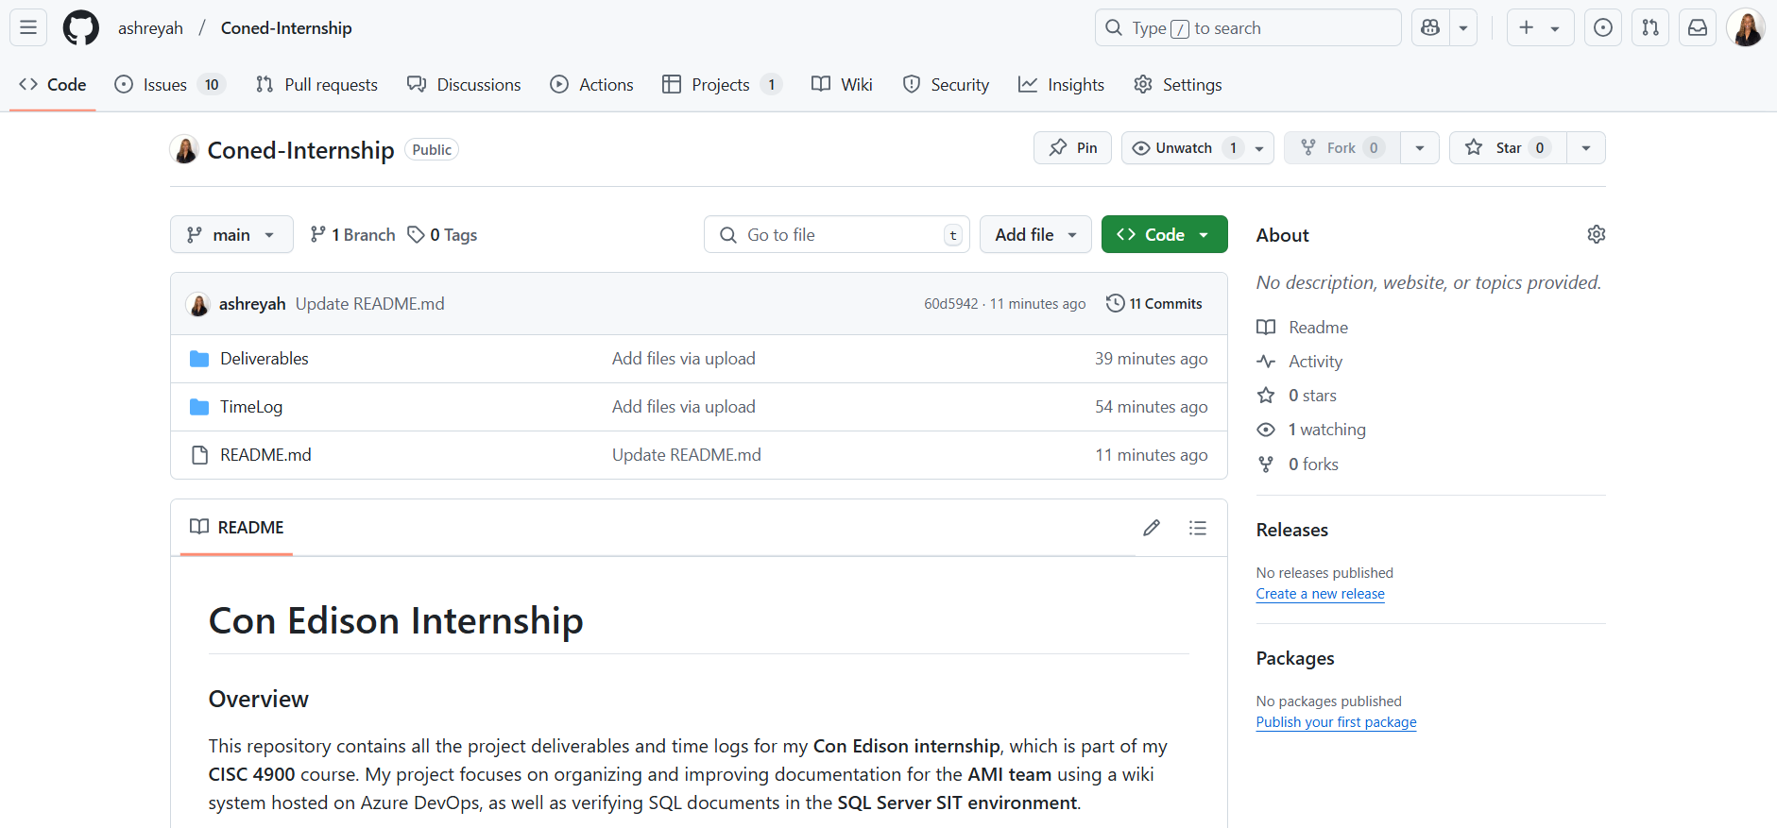
Github Repository
https://github.com/ashreyah/Coned-Internship

Slide 20
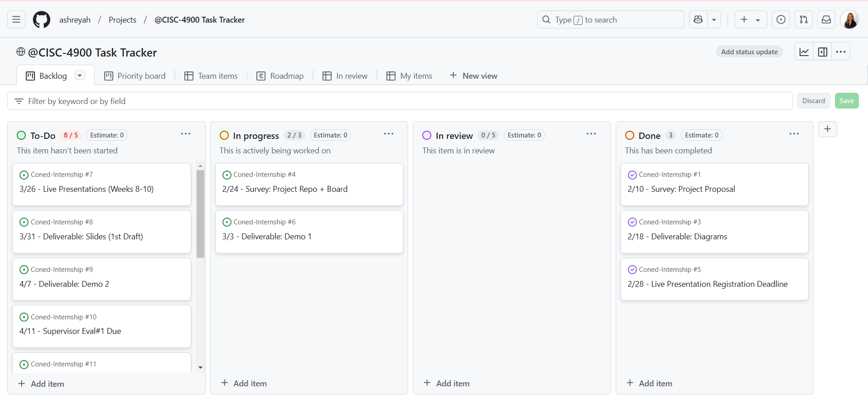
Project Management
https://github.com/users/ashreyah/projects/1

