Slide 1



Con Edison Internship
Intern: Ahshreyah Ross – ahshreyah.ross93@bcmail.cuny.edu
Supervisor: Travis Fonseca – fonsecat@coned.com
Team: AMI (Advanced Metering Infrastructure) Team
Company: Con Edison
02/17/2025 | CISC 4900

Slide 2


Abstract
As a Computer Aide Intern at Con Edison, my project focuses on improving the AMI team’s documentation and system monitoring. I am responsible for organizing and maintaining the team’s wiki, ensuring that essential documentation is structured and easily accessible. Additionally, I will be verifying SQL queries in the SQL Server SIT environment to confirm accurate data output. Another key task involves working with Grafana dashboards to monitor system performance, helping the team quickly identify and resolve issues. Through this project, I aim to enhance documentation efficiency, support data validation, and improve system reliability.

Slide 3
AMI Team Organization Chart
Chairman of The Board & CEO
Officers And Executives Dept.
Senior Vice President & CIO
Officers And Executives Dept.
Vice President
Officers And Executives Dept.
Director
AMI Implementation Team IT
Department Specialist
AMI Implementation Team IT
Department Manager
AMI Implementation Team IT
Systems Manager
AMI Implementation Team IT
Systems Manager
AMI Implementation Team IT
Systems Manager
AMI Implementation Team IT
Technical Specialist
AMI Implementation Team IT
IT Architect
AMI Implementation Team IT

Slide 4
AMI Team Organization Chart
Systems Manager
AMI Implementation Team IT
Systems Manager
AMI Implementation Team IT
Systems Manager
AMI Implementation Team IT
Technical Specialist
AMI Implementation Team IT
IT Architect
AMI Implementation Team IT
Systems Specialist
AMI Implementation Team IT
Systems Specialists
AMI Implementation Team IT
Systems Specialists
AMI Implementation Team IT
Systems Specialist
AMI Implementation Team IT
Systems Specialists
AMI Implementation Team IT
Sr System Analyst
AMI Implementation Team IT
Sr System Analyst
AMI Implementation Team IT
Sr SQL Server DBA
AMI Implementation Team IT
System Analyst
AMI Implementation Team IT

Slide 5
AMI Team Organization Chart
Systems Specialists
AMI Implementation Team IT
System Analyst
AMI Implementation Team IT
EP Associate
AMI Implementation Team IT
Computer Aide
AMI Implementation Team IT

Slide 6
AMI Business Applications

Slide 7










Tech Stack
Frontend
Observability
Collaboration & OS
Databases

Slide 8
How My Time is Distributed

Slide 9
Task Distribution Process
Does the task involve other parties?
Start
Weekly Meeting
with Supervisor
Yes
Invite All Required Parties to a Meeting
No
Supervisor Shares Resources
Supervisor Provides Demo
Supervisor Introduces Task
End of Task Assignment

Slide 10
User Experience on the AMI Wiki Database Website
Does User Browse Folders or Search for File?
User Opens AMI Wiki Database Website
User Chooses Mode (Light/Dark)
User Searches for File
User Reads Document
User Browses Folders/Subfolders
Does User Want to Follow File Page?
User Follows File for Updates
Yes
End
No

Slide 11
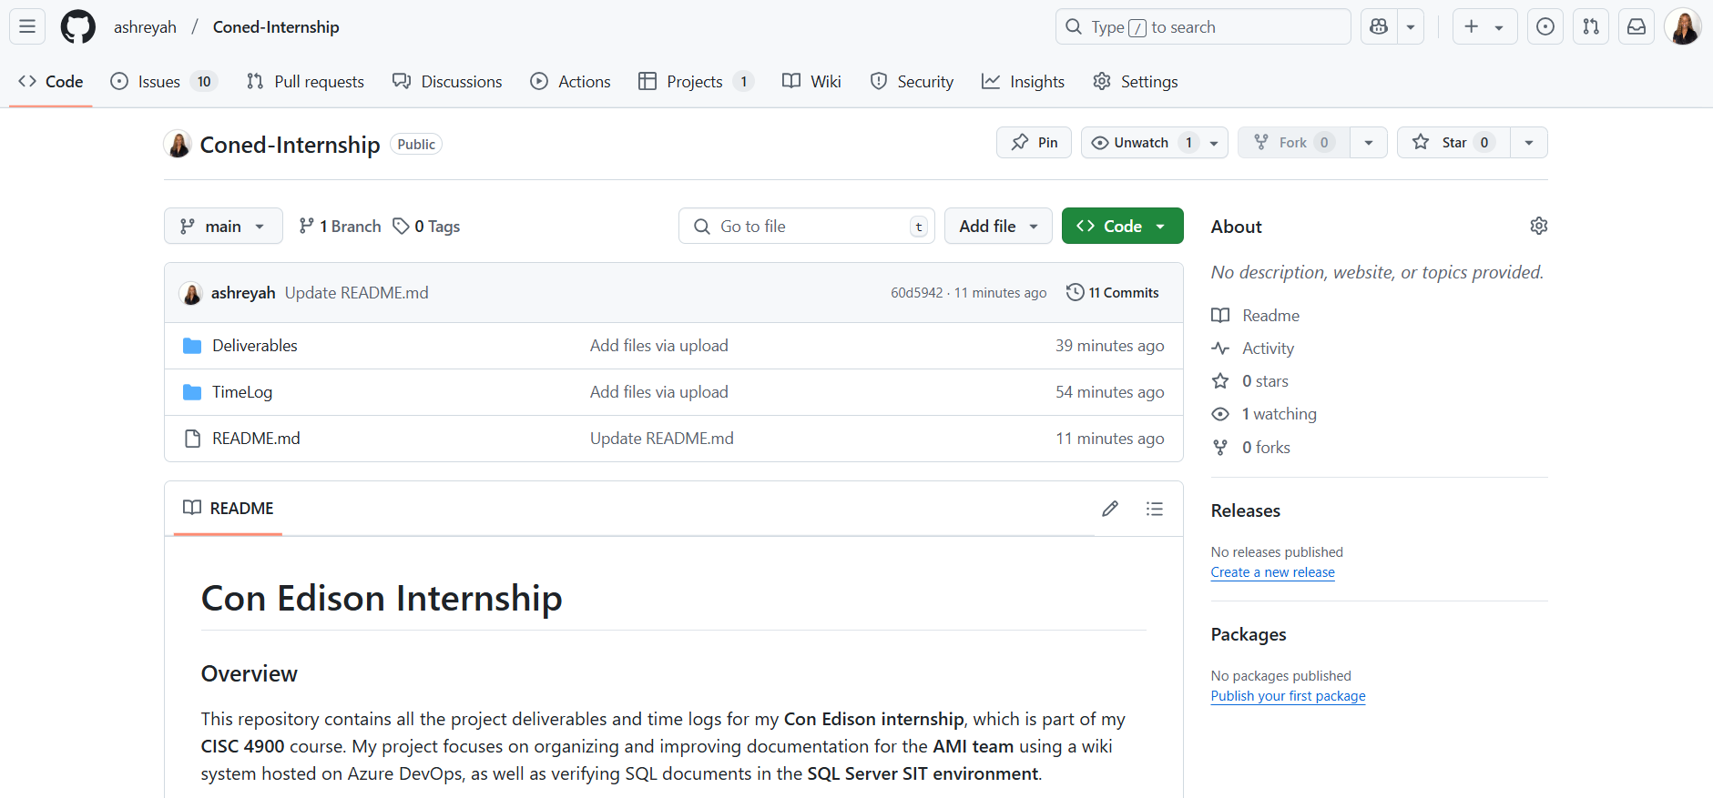
Github Repository
https://github.com/ashreyah/Coned-Internship

Slide 12
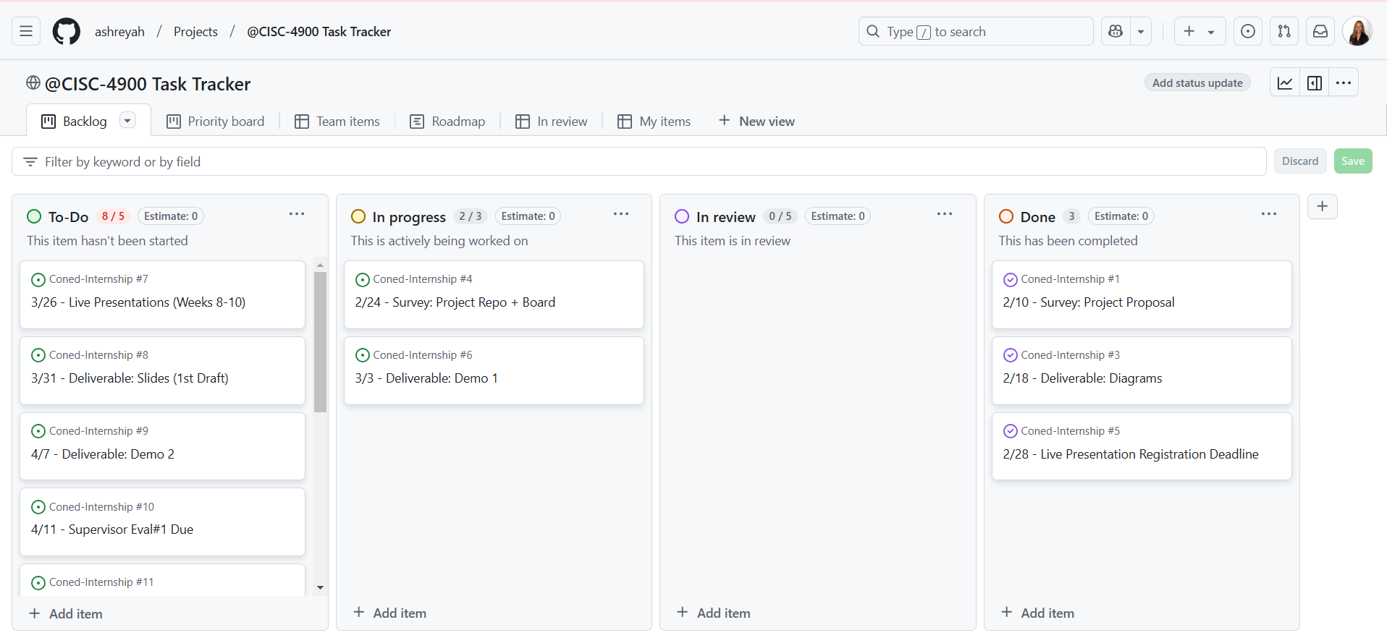
Project Management
https://github.com/users/ashreyah/projects/1

