Slide 1

CHAINSAW Von-Neumann Accelerators To Leverage Fused Instruction Chains
Amirali Sharifian, Snehasish Kumar, Apala Guha, Arrvindh Shriraman

Slide 2


AXC Challenge 1: Idleness
Application
DFG
Spatial Fabric
1
8
1
2
9
12
2
3
3
Fabric Size Dataflow graph size
More dataflow dependencies More Idleness
Notes:
As the accelerator size keep growing, keeping all the nodes busy like using pipelining techniques becomes challenging. Therefore, making fabric bigger leads idleness and static power issue

Slide 3

AXC Challenge 2: Data movement
Compute
8
1
30%
70%
9
12
2
3
Communication
50-70% energy for moving data
Spatial Data movement
Notes:
Traditionally moving data was free in compare to computation, but that’s not true anymore.

Slide 4



Von-Neumann Features
DFG
Ins. Buffer
Reg
1
1
2
2
3
ALU
3
Temporal Mapping = Less Idleness
Central Register File
Fetch and Decode
Notes:
Central register file is the core problem we could solve. We also could manage to reduce fetch and decode cost by adopting our architecture to only acceleratable region of the code.

Slide 5
Our Approach : Fused Instruction Chains
CHAIN DFG
Von-Neumann + Chains
Reg.
1
1
Compiler
exposed
Bypass
2
2
3
3
Temporal Mapping = Less Idleness
Bypass = Internalize communication

Slide 6
Our Approach : Fused Instruction Chains
CHAIN DFG
Von-Neumann w/ Chains
Do chains exist in a DFG?
How to form the chains?
What are the challenges?
Modeling and Evaluation
Reg.
1
1
Compiler
exposed
Bypass Reg.
2
2
3
3
Temporal Mapping = Less Idleness
Central Register File

Slide 7
CHAINs vs VLIW
Chains
VLIW
Finding dependent instructions
Vertical Fusion
Finding independent instructions
Horizontal Fusion

Slide 8
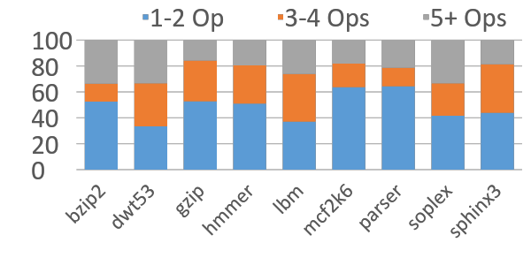
Do chains exist in a DFG ?
50–80% of DFG part of 3+ op chains

Slide 9
How to form chains? Reduce Communication
Chained DFG
Schedule
C1
C1
1
C2
1
4
2
2
C2
3
5
4
3
5
6
6
Internalize communication
May fail to discover ILP

Slide 10
How to form chains? Optimize for ILP
Chained DFG
Schedule
C1
C1
1
C2
1
C2
C3
4
C3
4
2
5
2
5
3
6
3
6
Same ILP as the prog.
Increased communication

Slide 11
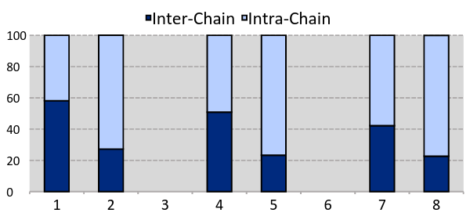
How much communication is within chains?
ILP+ Size+
ILP+ Size+
ILP+ Size+
dwt53, soplex ...
parser, crafty ...
gcc, namd ...
40-60% of communication localized

Slide 12
How to extract – longer – Chains
Control Flow

Slide 13

How to extract – longer – Chains
GUARD
Control Flow

Slide 14
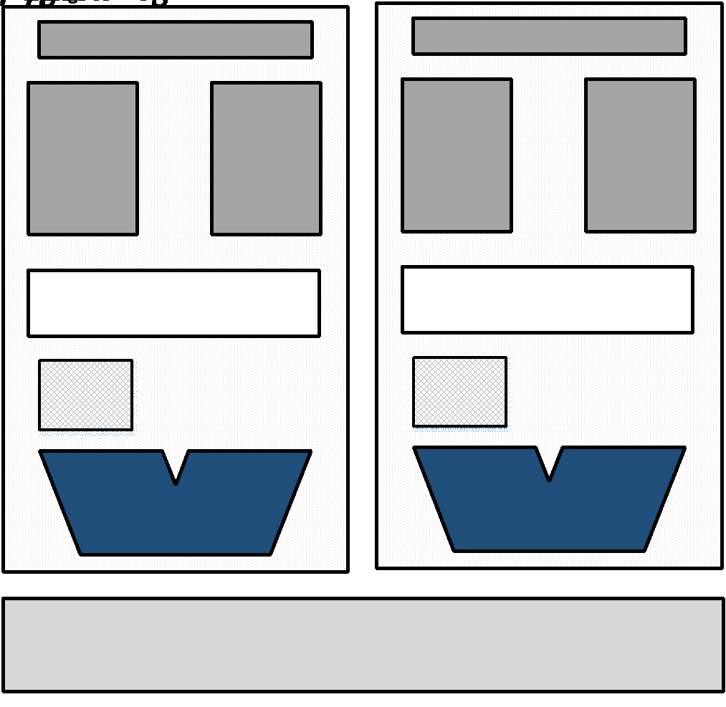
CHAINSAW is an Accelerator
WORKLOAD
HOT PATH
Control free
Only hot paths
Limited inst. buffer
OOO Core
CHAINSAW
Cache Mem.
Notes:
Chainsaw is an accelerator and only focuses on hot paths.
The rest of the program runs on the main processor

Slide 15
Multi-Lane CHAINSAW Execution
Dataflow Graph
Lane 1
Lane 2
C0
Ins. Buffer
1
Ins. Buffer
D1
C1
4
D2
4
3
5
C2
2
1
6
2
5
3
C2
C1
C0
6
D1
D2
Register file

Slide 16
Chainsaw – Fetch and Decode
Dataflow Graph
C1
Instruction Fields
D1
4
Op
IN
0
/
1
WR
FWD
L/R
OUT
0
/
1
4
1
0
0
X
0
5
0
1
1
1
1
5
6
X
0
1
X
0
Only 13bits is needed to decode!
6

Slide 17
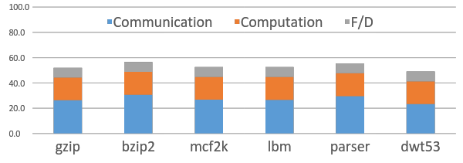
Evaluation – Dynamic Energy
Chainsaw adds Fetch/Decode cost for dynamic energy
CGRA network overhead dominate Chainsaw F/D cost
OOO-4
F/D cost = 8%
45% less than 4-way OOO
14% less than CGRA8x8

Slide 18
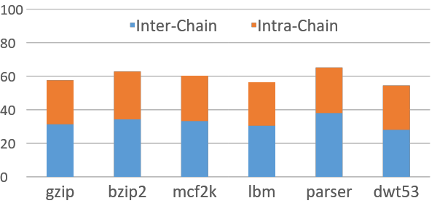
Evaluation – Data movement energy
CGRA 8X8
Chainsaw reduces 40% of energy

Slide 19
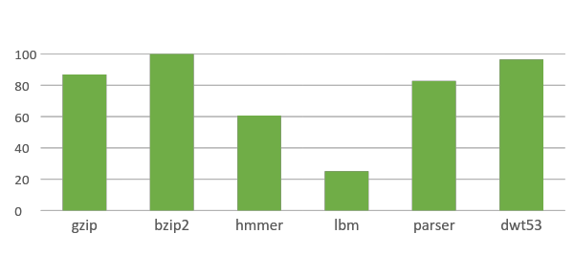
Evaluation – Performance
CGRA 8X8
Within 73% of CGRA8x8 20% better than OOO core

Slide 20
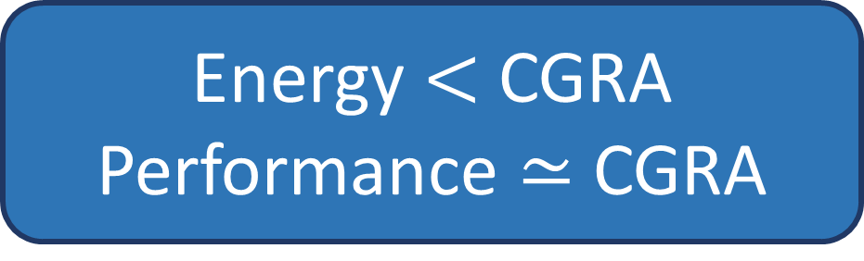
Chainsaw is a Von-Neumman accelerator
Chains sequentially dependent
operations.
Chainsaw Accelerator:
Exploit lack of ILP
Reduce communication energy
Reuse functional units
8
1
9
2
3

Slide 21

Q&A
github.com/sfu-arch/chainsaw

Slide 22
AXC Challenge 2: Data movement
Spatial Fabric
8
1
COMPUTE
9
12
2
3
SWITCH
50% Energy overhead for data movement
Spatial Data movement
Notes:
Traditionally moving data was free in compare to computation, but that’s not true anymore.

Slide 23
CHAINSAW is an Accelerator
CHAINSAW limited by FETCH energy
CHAINSAW only runs HOT paths limits instruction buffer
Limited Instruction Buffer = Limited FETCH energy
Application
Hot Paths
OOO Core
CHAINSAW
Cache Mem.
Notes:
Chainsaw is an accelerator and only focuses on hot paths.
The rest of the program runs on the main processor

Slide 24
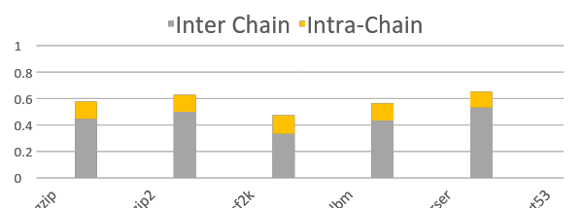
Evaluation – Data movement energy
Reduced energy in Chainsaw
Chainsaw internalizes 50%+ of comm.

Slide 25
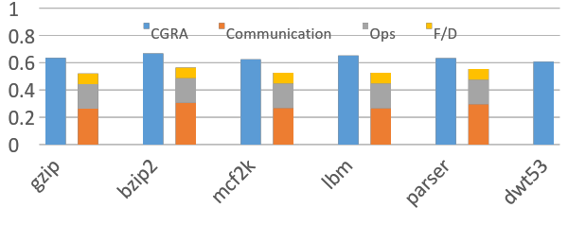
Evaluation – Dynamic Energy
Chainsaw adds Fetch/Decode cost for dynamic energy
CGRA network overhead dominate Chainsaw F/D cost
CGRA 8X8
OOO-4
13% less than CGRA
45% less than 4-way OOO

