Slide 1


An Integrated Hardware-Software Approach to Flexible Transactional Memory
Arrvindh Shriraman, Michael F. Spear, Hemayet Hossain, Virendra J. Marathe, Sandhya Dwarkadas, and Michael L. Scott
www.cs.rochester.edu/research/synchronization

Slide 2
Transactional Memory Implementation
Hardware Transactional Memory (HTM)
  + library compatible, fast if no pathologies
  - rigid policy, virtualization support expensive, no migration path
Software Transactional Memory (STM)
  + flexible policy (conflict ,escape actions), hardware compatibility
  - slow (always ?), library compatibility hard
Best-effort TMs
  + simplifies future hardware, runs on current hardware
  - rigid policy, hardware inflexible, performance cliffs
e.g., TCC, UTM, LogTM, VTM, PTM, BulkTM
e.g., RSTM, DSTM, McRT, TL2, SXM
e.g., HyTM, Intel Hybrid TM

Slide 3
Our Approach
Hardware-Software Transactions
  hardware to accelerate STMs and support your favorite policy
  hardware that supports flexible software implementation
  software routines to support uncommon events (i.e., overflows, context switches, paging)
  + flexible policy, supports today’s hardware, accelerates STMs, multiple uses for acceleration hardware
  - slower than HTMs, library compatibility (compiler support?)
e.g., RTM (this talk), AOU_N (yesterday at SPAA 2007)

Slide 4
Data Structures in TM
HTM cache entry
STM organization
R
W
TAG
Data
Meta
Data
Data
Conflict
resolution
Version
management
Conflict
resolution
Version
management
&
Flexible Transactional Memory
A
TAG
Meta
Data
R
W
TAG
Data
Alert-On-Update
for conflict detection
Programmable-Data-Isolation
for data versioning
Notes:
kmp

Slide 5
Why ?
Decoupled conflict detection and version management for flexible policy and usage
Conflict detection
  Eager, at first read/write to a shared data
  Lazy, prior to commit of speculative updates
  Mixed, eager write-write and lazy read-write
  and more.....
Flexible software contention managers
  arbitrate among conflicting transactions

Slide 6
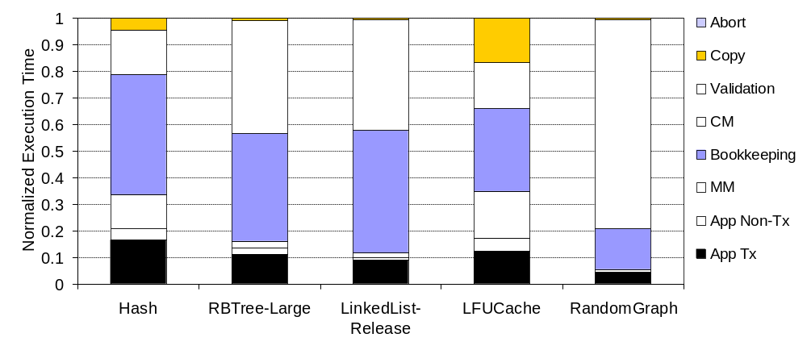

STM Overheads
RSTM [TRANSACT ’06]
Overheads targeted
79%
21%
34%
43%
42%
RBTree
Runtime SW
Copying : Buffering of speculative modifications to ensure isolation
Validation: Verifying consistency of accessed locations
For workload description, please see the paper

Slide 7
Flexible Transactional Memory
Leave policy decisions in software
  multiple-writer coherence for data isolation at software’s behest
  HW provides conflict detection, SW specifies resolution policy
Minimize the validation overhead
  Alert-on-update provides fast event based communication of remote memory operations
Eliminate copying overhead
  Programmable data isolation allows software to employ private caches as thread local buffers
Use software mechanisms to accommodate virtualization (i.e., cache overflows, paging, thread switches)
Notes:
Why keep policy in SW

Slide 8
Alert-On-Update (AOU)
ISA includes an instruction, ALoad, that loads an address and marks the cache line
A-tagged line on invalidation
  jumps to a software handler
  masks further alerts until exit from alert handler
Alerts can be due to
  capacity, cache cannot track update events on evicted line
  coherence, remote processor has acquired exclusive access
Cache Entry
A
TAG
Data
Caveat: AOU support cannot extend across events that exhaust space and time
Advantages: general, lightweight, simple, and fine-grained

Slide 9
Programmable Data Isolation (PDI)
ISA provides TStore and TLoad to isolate data in cache line
TMI buffers/isolates TStores
  supports concurrent speculative writers; BusTRdX ignored
  supports concurrent readers; BusRd threatened and data response suppressed
TI isolates concurrent readers from speculative writers
  values written by other TStores are isolated;
  a threatened read results in dropping to TI

Slide 10
Programmable Data Isolation (PDI)
TI lines isolate concurrent readers from speculative writers
  are dropped without alerting processor
  allow caching; drop to I on revert or commit
TStored (TMI) lines buffer speculative stores
  must remain in cache or HW alerts active thread
  drop to M on commit, I on revert
Support R-W and W-W concurrent sharers (if SW wants)
no global consensus in HW required for committing
  commit is entirely local; SW responsible for correctness
For details on coherence protocol and tag encoding, please see TR 910

Slide 11
Putting things together
Decoupled hardware for
  version management (PDI) and conflict detection (AOU)
  accelerating common TM operations
Many feasible software libraries to
  implement and export transaction constructs
  handle time and space exhaustion
  control runtime policy
RTM is an object-level, indirection based TM.

Slide 12
RTM Data Structure
Runtime SW associates a metadata header with every object.
An Object can denote a semantic entity or a group of memory locations.
Conflict detection
Metadata per Object
Transaction Descriptor
Owner
Status
Serial #
Serial #
New Data
uncommitted
Current Data
(if versioning in SW)
Overflow
Readers
committed
reader bitmap to track transactions not using HW support
Data Versioning
N cache lines

Slide 13
FastPath Transactions
(Validation + Copying)
Program
Data
Begin_hw_t abort_pc
ALD TxD_2
ALD OH(A)
TLD A
TST A
CAS OH(A)
CAS-Commit TxD_2
TxD_1
TxD_2
COMMIT
ACTIVE
COMMIT
OH(A)
CAS
AOU
Owner
#S
PDI
In Cache
Overflow
Readers
A
(current)
Do not overflow time or space resources
ALoad descriptor to detect concurrent active transactions
ALoad object header to detect ownership changes
TStore updates are isolated in private cache

Slide 14
Overflow Transactions
Program
Data
Begin_sw_t abort_pc
ALD TxD_2
LD OH(A)
...........
ST A’
CAS OH(A)
CAS-Commit TxD_2
TxD_1
TxD_2
COMMIT
COMMIT
ACTIVE
OH(A)
CAS
AOU
Owner
In Cache
#S
A
current
A’
new version
Overflow
Readers
ALoad descriptor to detect concurrent active transactions
To Read, update overflow-reader list to notify future requestors
To Write, copy current version and buffer speculative updates

Slide 15
TMESI Prototype
SPARC v9
1.2GHz
64KB I&D, 4-way
2-cycle access
32 entry VB
MESI coherence protocol
1P
2P
……….
16P
4-ary ordered tree
1-cycle link delay
64 bytes/cycle
I$
D$
I$
D$
I$
D$
Snoopy Interconnect
8MB,8way,4banks
20-cycle bank delay
Shared L2$
Memory
100-cycle DRAM access
The simulation infrastructure is based on the SIMICS + Multifacet GEMS framework
Our thanks to the Wisconsin Multifacet group for distributing the GEMS toolset

Slide 16


Runtime Systems
CGL (Coarse Grain Lock)
RTM-F(astpath) - Validation, Copying
RTM-O(verflow) - Validation, Copying
RTM-Lite* - Validation, Copying
RSTM (Invisible + Eager) [Transact’06]
Benchmarks
33% lookup, 33%insert, 33%delete operations on
HashTable (256 buckets), RBTree
RBTree-Large (256byte entry), LinkedList-Rel,
LFUCache (255 queue + 2048 array), RandomGraph
* For a detailed description of Lite transactions, please see the paper
Notes:
What is invisible

Slide 17
RTM-F Scales
RBTree-Large
2
1.9X
1.75
1.5
CGL
1.25
RTM-F
Normalized Throughput
CGL, 1thread = 1
1
RTM-Lite
0.75
2X
RTM-O
0.5
RSTM
2X
0.25
0
1
2
4
8
16
Threads
RTM-F improves performance and provides good scalability
  - at 2 threads its 50% slower than CGL1 but at 16 threads its 1.8X faster
RTM-O’s performance is as good as RSTM on a CMP (Avg: 6% variation)

Slide 18
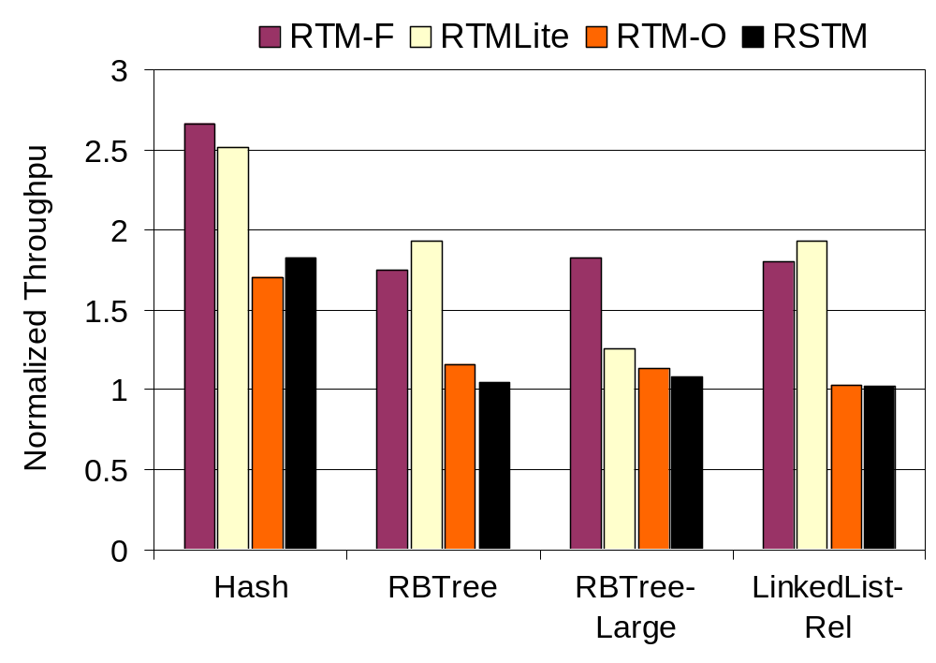
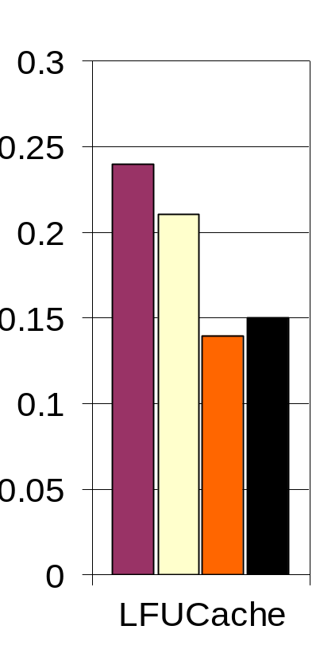
Hardware accelerates Software
16 Threads
CGL, 1thread = 1
1.5X
1.6X
1.7X
1.7X
1.8X
RTM-F’s speedup over RTM-Lite is proportional to copying overhead
  - HashTable (5%), LFUCache (14%), RBTree-Large(45%)
RTM-Lite presents an attractive HW cost/performance tradeoff
  - 45% slower than RTM-F on our most copy heavy benchmark

Slide 19

Conflict Policy Important!
6
Hash
5
4
Eager
Normalized Throughput
3
2
1
X-Axis, Threads
0
1
2
4
8
16
RandomGraph
1
0.8
Lazy
Normalized Throughput
0.6
0.4
0.2
Livelock
0
1
2
4
8
16

Slide 20
Conflict Policy Important!
In applications with low degree of sharing
  Eager as good as lazy
  Lazy imposes higher bookkeeping overheads
In applications with high degree of sharing
  Lazy eliminates livelock anomalies
  Lazy exploits R-W and W-W sharing
  Lazy narrows conflict window to attain more commits
HashTable (Eager is 21% faster) and RBTree (Eager is 10% slower)
LFUCache (Lazy is 28% faster) and RandomGraph (lazy eliminates livelocks)

Slide 21

To Take Home
Decouple hardware for versioning and conflict detection to enable
  flexible software TM policy and
  non-TM uses
Flexible conflict detection and management to eliminate performance anomalies
Use software to handle the uncommon cases

Slide 22





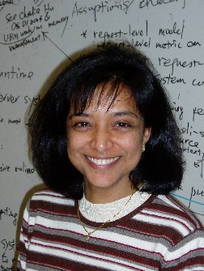

Questions
Arrvindh
Mike
Hemayet
Virendra
Sandhya
Michael
Download RSTM version 3.0 at
http://www.cs.rochester.edu/research/synchronization/

Slide 23
Backup

Slide 24
Future Work
How to enable flexible usage of hardware ?
  semantics, concurrent use, programmer interface
Simplify metadata organization
Extend to scalable protocols and compare with pure HTM system
Strong Isolation and Privatization

Slide 25

RTM Interface
4. Acquire ownership of written objects in their metadata at either
- open (i.e. eager)
+ reduces wasted work,
- possible livelock, reduced concurrency (not even R-W sharing)
- end_tx (i.e. lazy)
+ increased concurrency, livelock freedom
- more wasted work, requires lazy versioning
5. If Active, switch status to commited.
2. Open object metadata before reading/writing object data
3. Read and speculatively update objects
1. Start transaction in (Fastpath/Overflow) mode and save abort-handler PC
BEGIN_TX (handler_ptr, mode [H/S])
const integer* rd_X = X → open_RO()
const integer* rd_Y = Y → open_RO()
integer* wr_Z = Z → open_RW()
*wr_Z = (*rd_X) x (*rd_Y)
END_TX
Z = X + Y
≡

Slide 26
Protocol Animation
P0
T0
P1
T1
P2
T2
1
TLoad A
4
TLoad A
3
2
L1
TStore B
L1
TStore A
L1
5
AE: OH(A)
TLoad B
AS: OH(A)
AS: OH(A)
AS: OH(A)
TEE: A
TII: A
TMI: A
TII: A
AE: OH(B)
AS: OH(B)
AS: OH(B)
TMI: B
TII: B
TGetX
Shared L2
Cache line size objects: A,B Object Metadata: OH(A), OH(B)

Slide 27
Protocol Animation
Commit
Commit
Abort
P0
T0
P1
T1
P2
T2
1
TLoad A
4
TLoad A
3
2
L1
TStore B
L1
TStore A
L1
5
TLoad B
AS: OH(A)
I: OH(A)
AS: OH(A)
M: OH(A)
AS: OH(A)
S: OH(A)
TII: A
7
I: A
M: A
TMI: A
TII: A
Acquire OH(A)
CAS-Commit
I: A
6
AS: OH(B)
CAS-Commit
S: OH(B)
AS: OH(B)
S: OH(B)
TMI: B
I: B
TII: B
I: B
GetX
Shared L2
Cache line size objects: A,B Object metadata: OH(A), OH(B)

Slide 28
Lite Transaction
(Validation)
To read
  ALoad object header to detect object ownership acquisition
To write
  ALoad descriptor to detect concurrent transactions stealing ownership
  Clone object and buffer modifications
  Acquire ownership and pointers to perform logical update

Slide 30
What is the serial number for ?
How does A-tags differ from Intel-HASTM
Privatization
2X is not enough, why are you slow ?
What about strong isolation ?
What about 2 modified lines

