Slide 1
Nonblocking Transactions Without Indirection Using Alert-on-Update
Michael Spear
Arrvindh Shriraman
Luke Dalessandro
Sandhya Dwarkadas
Michael Scott
University of Rochester

Slide 2
Software Transactional Memory
Memory transactions
  Code regions identified
  by the programmer
  Guaranteed to be atomic,
  consistent, and isolated
  An alternative to locks
    Speculative parallelism
Under the hood:
  Rollback / retry mechanism
  Frequent checks ensure
  consistency of reads
Simple 2-phase locking STM
Attach version# to every location
To read:
  remember {location, version#}
To write:
  store in private buffer
To commit:
  lock all write locations
  check version#s of reads
    abort/retry on conflict
  replay writes from private buffer
  release locks, update version#s

Slide 3
Nonblocking STM
How can we commit speculative writes atomically
without locking?
Tx 1
Active
Tx₁
Committed
O₁
AAAAA
Tx₁ will modify O₁…O₄
Tx₁ generates speculative writes
Tx₁ acquires O₁…O₄
Single atomic operation
  Changes Tx₁ to Committed
  Makes writes permanent
  Releases O₁…O₄
O₁’
11111
O₂
BBBBB
O₂’
22222
O₃
CCCCC
O₃’
33333
O₄
DDDDD
O₄’
44444

Slide 4
Indirection-Based Nonblocking STM
Locator object
  Lists last version
  Lists next version
  Choice depends on
  state of owner
Costs of indirection:
  Increased working set
  More capacity/coherence
  misses
Existing indirection-free solutions are complex
Tx 1
Active
Owner
Old Version
New Version
O1
AAAAA
DSTM-style Metadata
[Herlihy et al. PODC 03]
O1’
BBBBB

Slide 5
Outline
Background
Alert-on-Update (AOU)
AOU for indirection-free STM
AOU for lightweight validation
Evaluation
Future work
Conclusions

Slide 6
Alert-on-Update
Claim: some cache coherence events are interesting
Alert-on-Update (AOU)
  Special instruction marks cache lines of interest
  Cache controller notifies processor when marked line is evicted
  Processor immediately jumps to user-mode handler
No O/S involvement or context switching
  (but can be virtualized across context switches)

Slide 7
AOU Hardware Requirements
Registers:
  Address of handler, PC at time of alert
  Extra status bits for cause of alert, disabling alerts
  Extra entry in interrupt vector table
Cache:
  One extra bit per cache line
Instructions:
  Set/clear handler
  Mark and load line (aload)
  Un-mark line (arelease)
  Un-mark all lines
  Enable/disable alerts
Lightweight implementation supporting only one AOU line adds one register, removes need for extra bits in cache

Slide 8
Current Implementation Limitations
Virtualization is the responsibility of user code
  Context switch clears all alert bits, calls handler on return
    Handler can re-aload lines
  Alerts are deferred on other kernel calls
Limited by size of cache
Limited precision
  Alerts masked within handler
  Location causing alert not currently provided

Slide 9
Simple, Nonblocking, Indirection-Free STM
Only one AOU line required per processor
STM stores speculative writes in per-object buffers
To write (after commit), use AOU revocable locks
  Lock the object, replay stores, release lock
  Only lock/replay one location/object at a time
Version#/Owner/Lock
Old Version#
Redo Log
Master Copy
Object Contents
In-Progress
Modifications
Data Pointer

Slide 10
Revocable Locks with AOU
Our lock protects an idempotent operation
  Anyone can replay stores; none may use object until replay is complete
Use AOU to guard lock
  Revocation immediately
  halts replay in current
  thread
  Wait (briefly) before
  re-acquire
  Lock release
  immediately visible to
  waiting threads
try
set_handler({throw A})
aload(lock)
if (version changed)
arelease(lock)
goto bottom
if (lock->locked)
wait; overwrite lock
replay writes
release lock (version++)
arelease(lock)
catch (A)
goto top
Notes:
Don’t describe the code, instead talk about the idea

Slide 11
AOU for Lightweight Validation
Attach version# to every location
To read:
  remember {location, version#}
  aload(location)
To write:
  store in private buffer
To commit:
  lock all write locations
  check version#s of reads
  replay writes from private buffer
  release locks, update version#s
Suppose we can aload
many lines
Recall 2PL STM
algorithm
On read, don’t store
{location, version#}
  Instead,
  aload(location)
At commit, don’t validate
  Any conflict would have
  caused an alert
On alert, rollback/retry

Slide 12
AOU for Lightweight Validation
Many TMs validate on every load of a new location
  O(n²) overhead
AOU eliminates this overhead for
n < sizeof(cache)
  Limited by associativity
Fallback to validation only for additional locations

Slide 13
Evaluation
6 Runtime Systems
  RSTM
  (nonblocking, indirection,
  software only)
  RTM-Lite (RSTM + AOU)
  LOCK_TM
  (indirection free, no AOU)
  AOU_1
  (indirection-free, 1 AOU line)
  AOU_N
  (indirection-free, many AOU lines)
  CGL
  (coarse locks)
Simulator
  Simics/GEMS
  16-way CMP
  (1.2GHz in-order, single issue)
  Private 64KB L1
  (1 cycle latency)
  Shared 8MB L2
  (20 cycle latency)

Slide 14
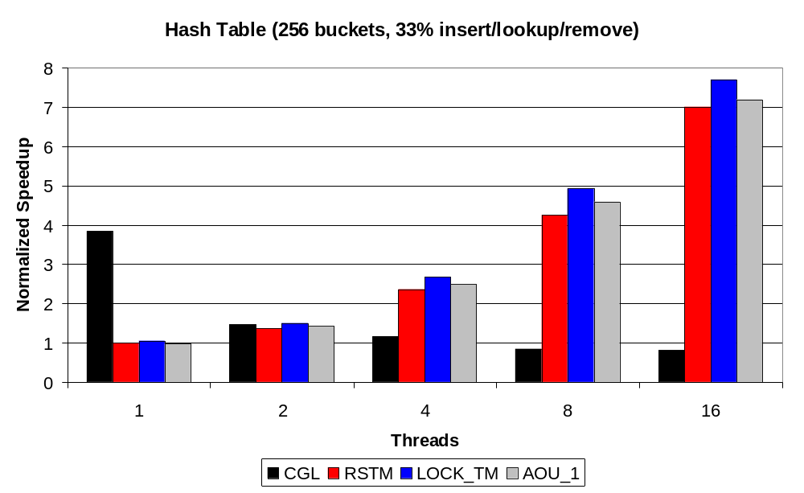
Indirection Reduction
Reducing indirection has marginal impact
- Working set is small
- Fewer cache misses at high thread counts
AOU adds some overhead
In-order exaggerates try/catch cost
(normalized to RSTM, 1 thread)
Notes:
maybe note that we’re doing no multiprogramming here -- no preemption that would benefit nonblocking algs.

Slide 15
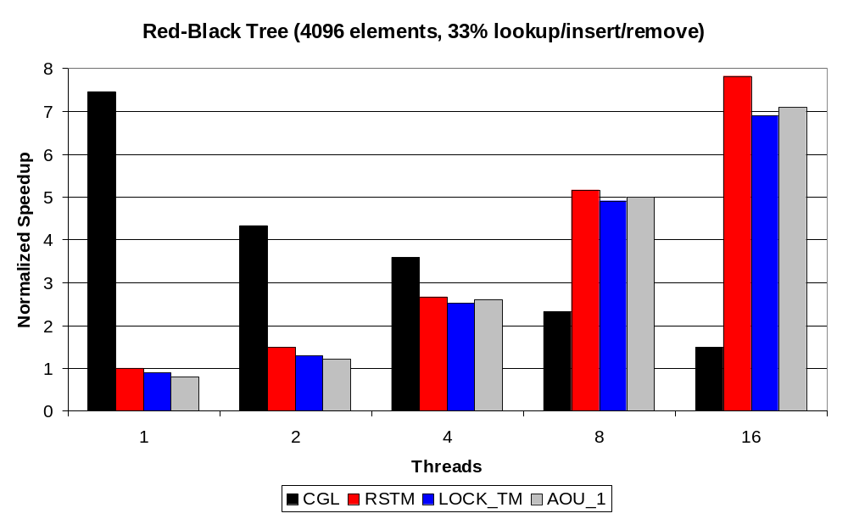
Indirection Reduction
Reducing indirection can hurt
- Additional validation required
(could reduce with compiler support)
Quadratic validation still dominates
(normalized to RSTM, 1 thread)
Notes:
This is really counter-intuitive. Be sure to carefully explain.
For larger data sets the indirection is crucial
Compiler support would help a lot here

Slide 16
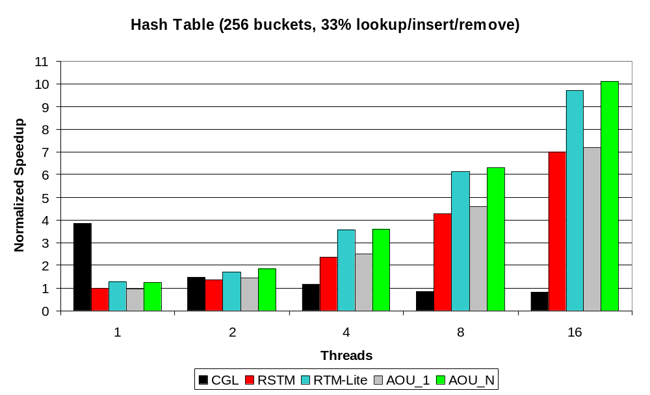
Validation Reduction
AOU scales, doesn’t admit false positives
Outperforms other validation heuristics
(normalized to RSTM, 1 thread)

Slide 17
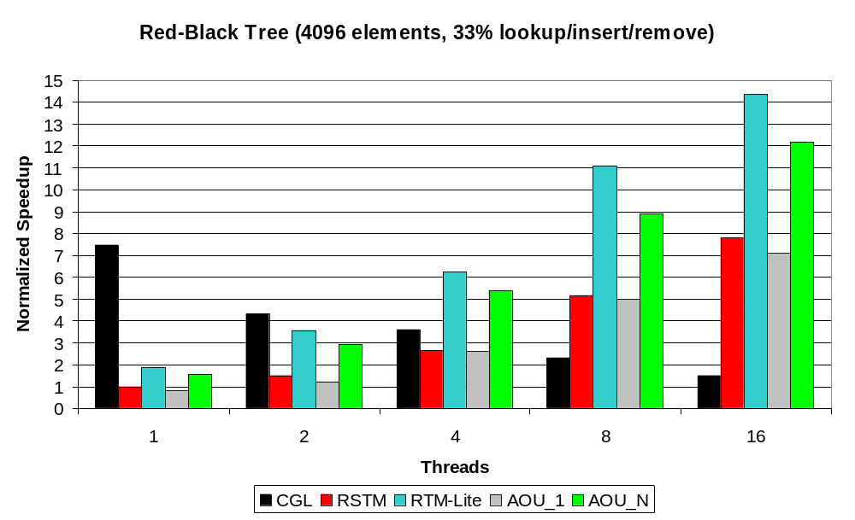
Validation Reduction
Indirection-free has excess validation
- Could reduce by cloning code paths
Still almost 2x speedup, scalable
(normalized to RSTM, 1 thread)

Slide 18
Future Work
Non-TM uses (may require AOU for local writes)
  Fast user-mode thread wakeup
  Active messages
  Debugging, watchpoints, code security
  Poll-free asynchronous I/O
Additional hardware acceleration for STM
  Programmable Data Isolation
  (see our paper at ISCA tomorrow)

Slide 19
Conclusions
Alert-on-update is a simple, promising extension to modern ISAs
  Enables low overhead, indirection-free nonblocking STM
  Effectively removes O(n²) validation overhead
  Potential benefit to many shared memory algorithms
The effect of indirection on STM is complex
  Read-only objects are no longer immutable
  Extra validation can be reduced with compiler support
  Effect exaggerated by small objects, in-order simulator
http://www.cs.rochester.edu/research/synchronization

Slide 20
Additional Performance Charts

Slide 21
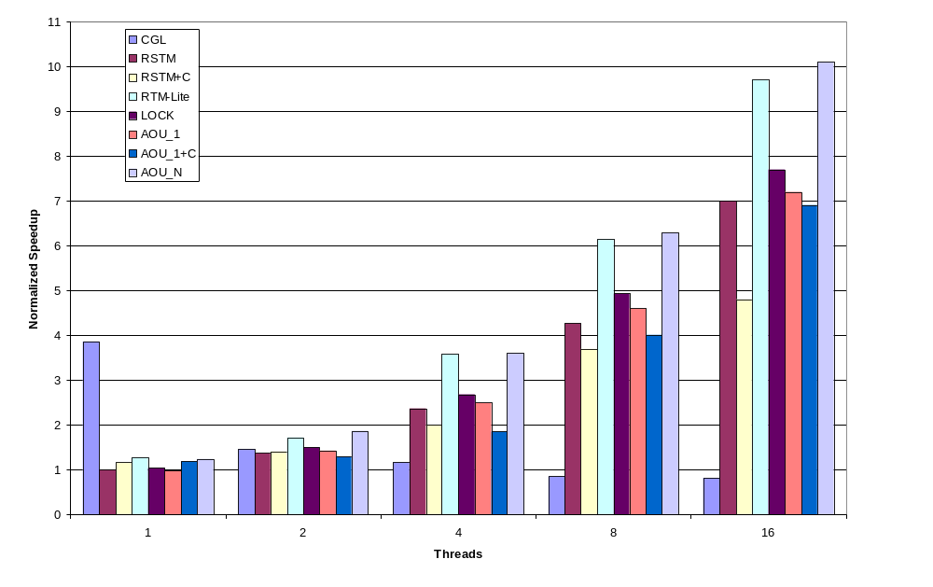
Hash Table

Slide 22
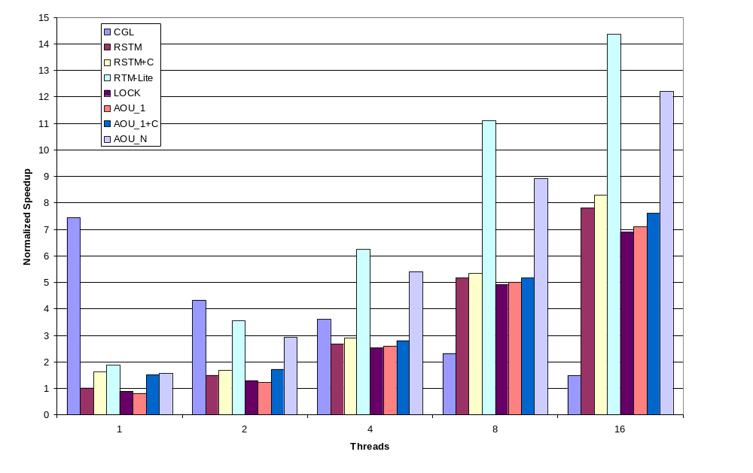
Red-Black Tree

Slide 23
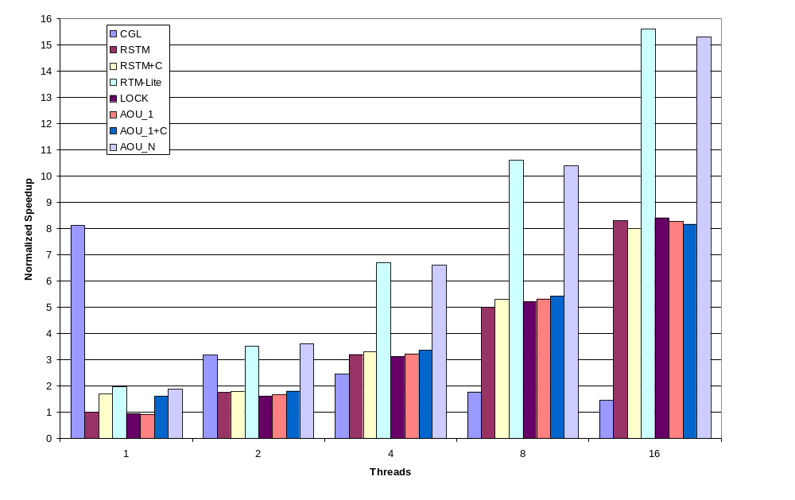
Linked List with Early Release

Slide 24
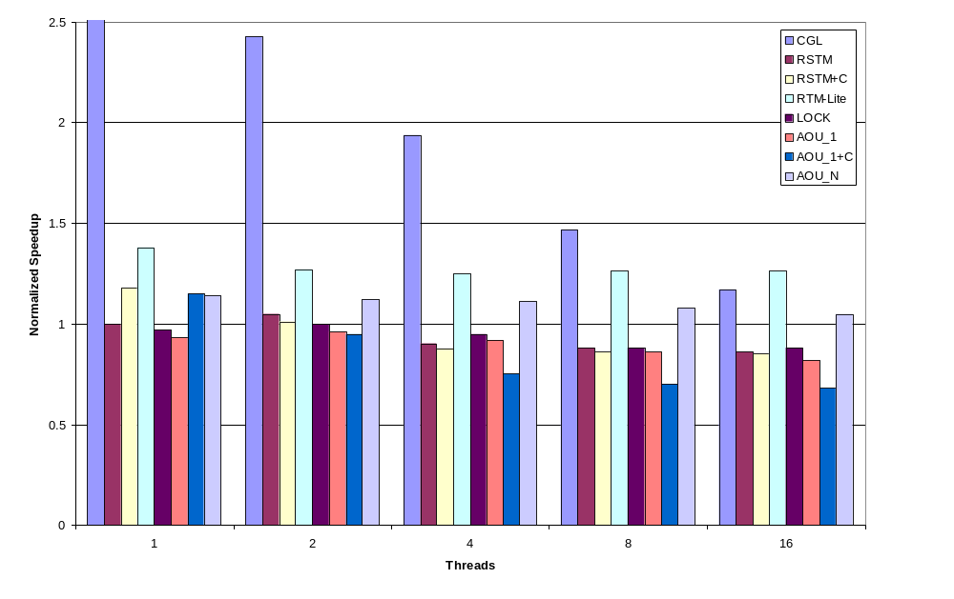
LFUCache

Slide 25
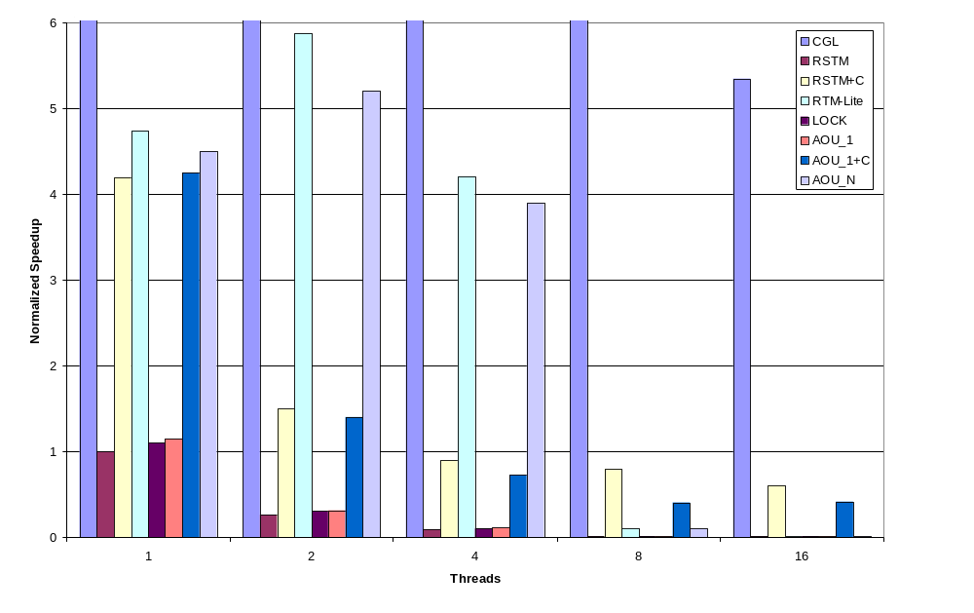
Random Graph

