Slide 1

SPACE: Sharing Pattern-based Directory Coherence for Multicore Scalability
Hongzhou Zhao Arrvindh Shriraman Sandhya Dwarkadas

Slide 2

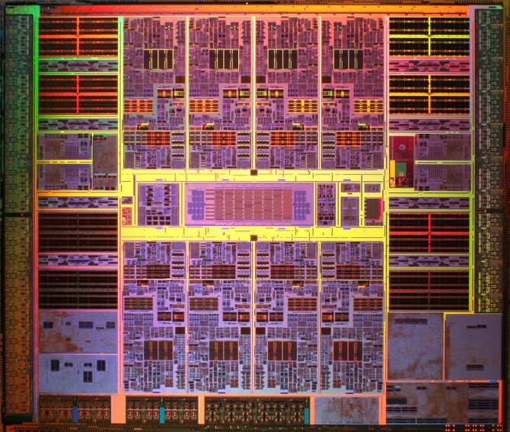
Directory-based cache coherence
Directory:
maintains sharing information to save bandwidth
Current designs:
Shadow tags: duplicate L1 tags, look up to create sharing vector
+ less area - high lookup energy
Full map: associate sharing vector
with tags of shared L2
+ negligible lookup energy - large area
Notes:
When scaling up to tens hundreds of cores, snoopy based cache coherence will lead to excessive bandwidth overhead

Slide 3
Scaling directory designs
e.g., Tagless [MICRO’09]
e.g.,
Directory cache[ISCA’90];
Coarse vector[ICPP’90];
Pointers[ISCA’88]
Tag
Sharing vector
FIXED imprecision at
design time
Notes:
Concentrate on the sharing vectors side. Although all these design,… none of them tried to leverage sharing patterns dynamically. TODO: CI

Slide 4
Conventional full map directory
1
0
1
1
0
0
0
1
!
Tag Data Vector of sharing processors
(Sharing pattern)
1 bit per processor per cache line
64-Byte cache line size, for 128 cores,
directory is 25% of the shared cache size
Notes:
Sharing pattern: the bit vector of sharing processors of the cache line
Multiple blocks in the cache having the same set of sharers
Could we organize the directory based on sharing patterns?

Slide 5
Sharing patterns of applications
Conventional full map directory
Tag Data Pattern
1
0
1
1
0
0
0
1
Observation:
Duplicate sharing patterns waste
space in the directory
Multiple blocks in the cache may have the same sharing pattern
Notes:
Sharing pattern: the bit vector of sharing processors of the cache line
Multiple blocks in the cache having the same set of sharers
Could we organize the directory based on sharing patterns?

Slide 6
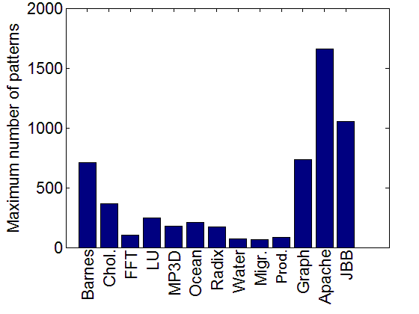
Sharing patterns of applications (16P)
Max number of sharing patterns
during execution
Number of patterns in the directory is much less than the possible maximum (75-1700 << 65536)
Notes:
The first question is, is the opportunity really there?
So if the sharing pattern is limited, and lots of blocks has the same sharing patterns, it would be ideal for our pattern-based design.
We carry the trial on a number of applications…. Interestingly, although the max possible… the actual max number never exceed …
Scientific workloads have a much lower number with the regular sharing patterns…

Slide 7

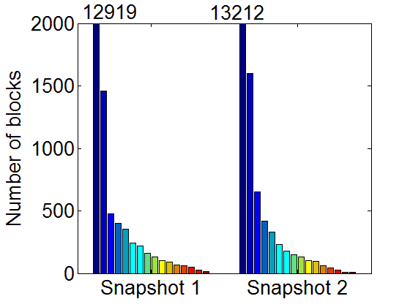
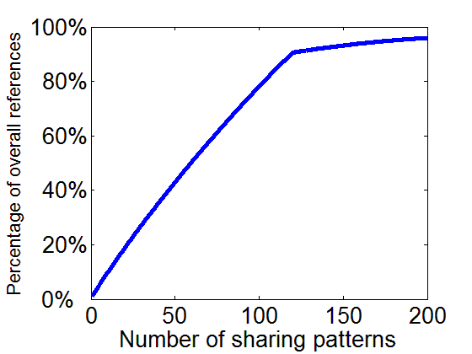
Sharing patterns of applications(Apache, 16P)
Number of cache blocks for each of N sharers
Cumulative distribution
Of references over patterns
Many cache lines have a common sharing pattern
(86% percent of blocks go to less than 150 patterns)
Notes:
Although the max sharing patterns being …., most of the cache lines will goes to a few of them
Private is the dominant patterns, and the number of blocks of other patterns tails off quickly.
The third trial is about how often the patterns get referenced. culmulative

Slide 8
Sharing patterns of applications(Apache, 16P)
Number of cache blocks for each of N sharers
Cumulative distribution
Of references over patterns
The number of patterns frequently referenced is small (90% go to less than 100 patterns)
Notes:
Although the max sharing patterns being …., most of the cache lines will goes to a few of them
Private is the dominant patterns, and the number of blocks of other patterns tails off quickly.
The third trial is about how often the patterns get referenced. culmulative

Slide 9
Sharing pattern commonality
Number of patterns in the directory is much less than the possible maximum
Many cache lines have a common sharing pattern
The number of patterns frequently referenced is small

Slide 10
GOAL
Leverage sharing pattern commonality to compress the directory
full map directory (8P multicore)
1
1
1
1
1
1
1
1
1
0
0
0
0
0
0
0
1
1
1
1
1
1
1
1
1
1
1
1
1
1
1
1
1
1
1
0
0
0
0
0
0
0
1
1
0
0
0
0
0
0
1
1
0
0
0
0
0
0
0
1
1
0
0
0
0
0
0
0
1
1
1
1
1
1
1
1
1
1
1
0
0
0
0
0
0
0
1
1
8+8+8 = 24 bits
8*8 = 64 bits

Slide 11
SPACE: Sharing PAttern-based CoherencE
Decouple the sharing patterns from cache blocks
to compress the
directory
Represent only patterns present in the applications
1
0
1
1
1
1
1
1
1
1
1
0
0
0
0
0
0
0
1
1
0
0
1
0
Notes:
TODO: Bullet about benefits
The table only needs to have a relative small number of entries, which can hold the most frequently accessed patterns.
There is a pointer per cache line…. Because the table size is much smaller than the max possible patterns, we would have a shorter vector as the pointer

Slide 12
SPACE design
A separate directory table to store the patterns
Replace vector per cache line with pointer to the pattern in the table
Cache lines
SPACE pointers
SPACE directory table
Sharing pattern
Set i, Way j
N _{Dir. ways}
Ref. counter
N _{Dir. sets}
…
…
…
…
…
Log₂(N_{Dir. entires} )
Notes:
TODO: Remove cache lines to SPACE pointers
And the space saving is roughly log_2{patterns}

Slide 13
SPACE design: challenges
How to insert patterns into the directory table?
How to recycle entries?
What to do when the capacity is exceeded?

Slide 14
SPACE design: lookup and insertion
A set-associative
pattern table for energy
efficiency
Mapping considers all
the bits, tries to map similar sharing patterns to the same set
Incoming pattern
1
1
0
1
0
0
0
0
Encode
Direct
1
0
0
0
SPACE directory table
…
N _{Dir. ways}
11010000
Notes:
There does not exist locality in the sharing patterns to make use of, so we try to make max use of the space by distributing the patterns evenly on the table

Slide 15
SPACE design: challenges
How to insert patterns into the directory table? √
How to recycle entries?
What to do when the capacity is exceeded?

Slide 16
SPACE design: recycle entries
Associate a counter
with each directory entry
to remove stale patterns
Pathological case being all the cache lines
pointing to the same entry
Cache lines
Table entry
0
0
0
0
0
0
0
0
0
0
0
0
0
0
0
0
0
0
1
0
0
1
0
0
00
01
10
01
00
Ref. Counter
Notes:
Garbage collection – eagerly need, otherwise harm the performance. Keep merging, fall back to broadcast
The directory table – low latency, can not enforce complex complex pointer based manipulation.
Sweep the cache is costly.

Slide 17
SPACE design: challenges
How to insert patterns into the directory table? √
How to recycle entries? √
What to do when the capacity is exceeded?

Slide 18
SPACE design: merge patterns
Merge with the pattern having the least Hamming distance when the set is full
Always record private and shared-by-all accurately
Incoming pattern
1
1
0
1
0
0
0
0
Encode
1
0
SPACE pattern table
2 way
00110000
10010000
11010000
3>1
Notes:
Map to the same set will have the same sharing pattern in clusters, thus the extra bits for merging is minimum
See benefit later on, because same pattern in term of clustering to the same set

Slide 19
SPACE design: challenges
How to insert patterns into the directory table? √
How to recycle entries? √
What to do when the capacity is exceeded? √

Slide 20
Evaluation methodology
Simics-based full system execution driven simulation, Ruby for cache and memory
Tile 0
Tile
1
Tile
2
Tile
3
Tile 0
Tile
1
Tile
2
Tile
3
CPU
64KB L1
4MB Shared L2
Full
Map Dir.
Ptr
Table
Tile 0
Tile
1
Tile
2
Tile
3
2 cycles
Router
Tile 0
Tile
1
Tile
2
Tile
3

Slide 21
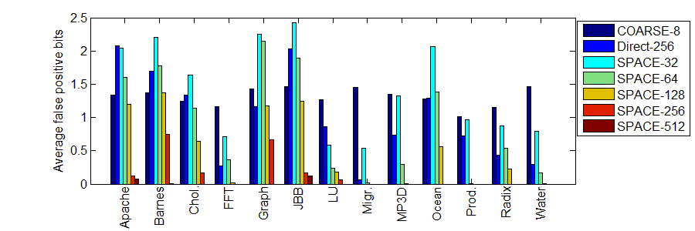
Evaluation: Accuracy (16P)
False Positive bits per reference to directory
Reduce false positives in sharing vector significantly compared to coarse vector

Slide 22
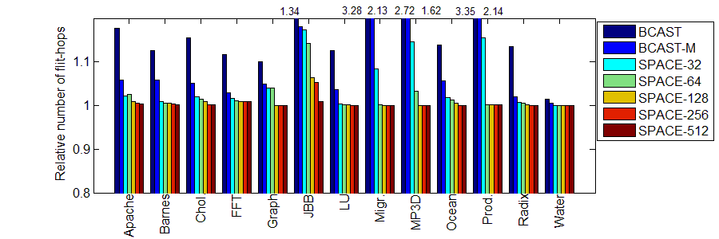
Evaluation: Network overhead (16P)
Interconnect traffic relative to full map directory
Notes:
BCAST, BCAST-M optimized on BCAST that record private accurately.
SpecJbb is challenging with the hotspots in network

Slide 23
Evaluation: Area (16P)
SPACE conf. | Area (relative to FULL) | Performance penalty (relative to FULL)
SPACE-32 | 31.4% | 2.7%
SPACE-64 | 37.7% | 2.1%
SPACE-128 | 44.1% | 1.4%
SPACE-256 | 50.8% | 1.2%
SPACE-512 | 57.8% | 0.7%
SPACE area = Pointer per L2 cache line + Directory table
Pointer is the dominant overhead in practice
Notes:
BCAST, BCAST-M optimized on BCAST that record private accurately.
SpecJbb is challenging with the hotspots in network

Slide 24
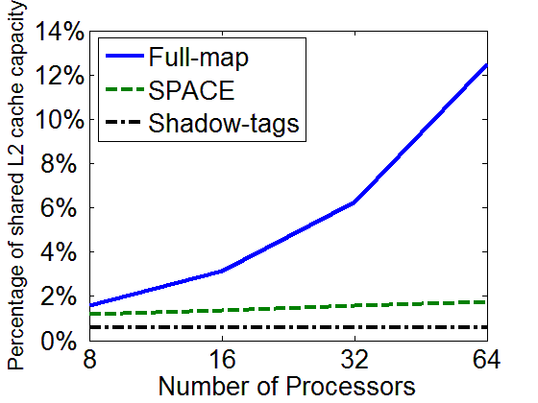
Evaluation: Scalability of space consumption
Sharing pattern scales
linearly
Scalable to
large number of cores
Shadow tags ~57% area, ~50X energy of SPACE at 16 cores

Slide 25
Summary
Applications typically exhibit a small number of sharing patterns
Directory can be compressed leveraging sharing pattern commonality (~2X at 16P, ~7X at 64P)
Performance penalty less than 2%
Future work
Sharing pattern locality could be applied on tagless-lookup, directory cache approaches

Slide 26
Thanks!

Slide 27
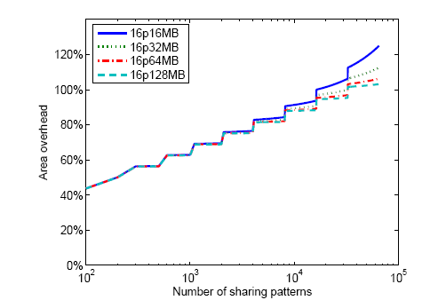
Why are we saving space?
Two components
Saving even with
large number
of patterns
Pointer being
the dominant overhead
in design space
Notes:
And the space saving is roughly log_2{patterns}

Slide 28
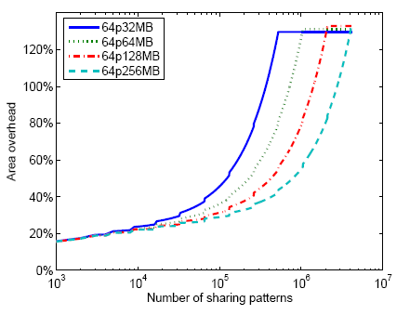
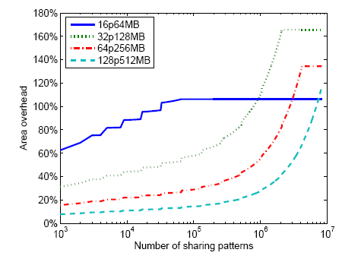
Why are we saving space?

