Slide 1
Hardware Acceleration of Software Transactional Memory
Arrvindh Shriraman, Virendra J. Marathe
Sandhya Dwarkadas, Michael L. Scott
David Eisenstat, Christopher Heriot, William N. Scherer III, Michael F. Spear
Department of Computer Science
University of Rochester

Slide 2
Hardware and Software TM
Software
  High runtime overhead
  Policy flexibility
    conflict detection
    contention management
    non-transactional accesses
Hardware
  Speed
  Premature embedding of policy in silicon

Slide 3
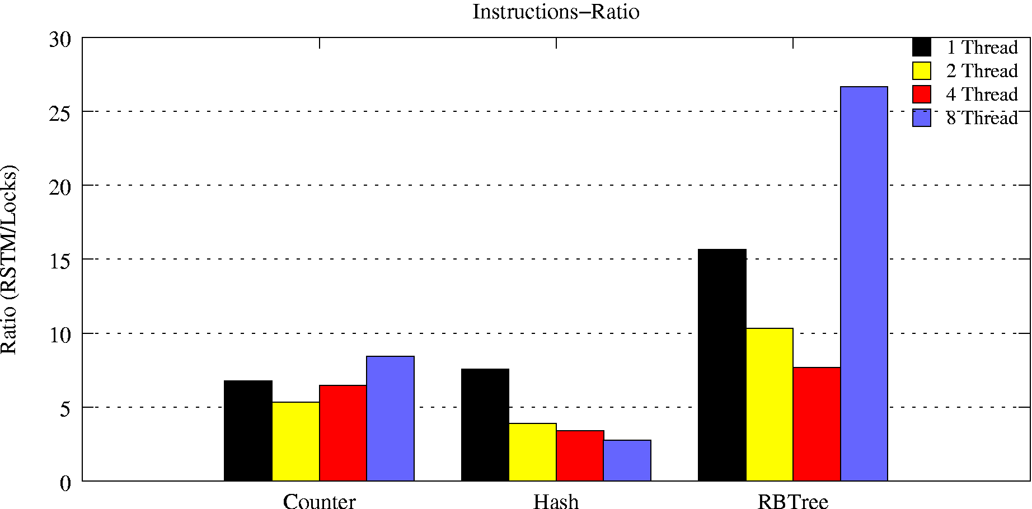
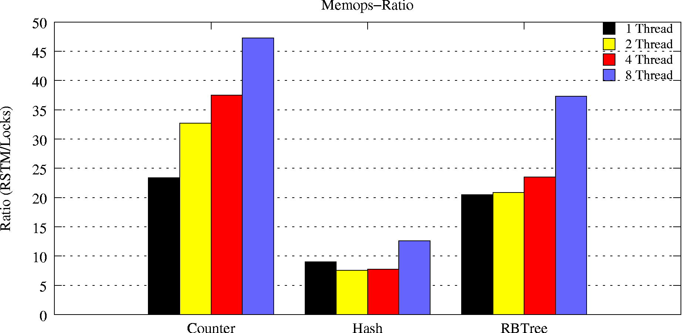
RSTM Overhead w.r.t. Locks per Txn
Instruction Ratio
Ratio (RSTM/Locks)
Counter Hash RBTree
Memops Ratio
Ratio (RSTM/Locks)
Counter Hash RBTree

Slide 4
STM Performance Issues
Memory management overhead
  Garbage collection, object cloning/buffering of writes
  Multiple pointer chasing required to access object data
Validation overhead
  Visible readers require 2N CASs to read N objects
  Invisible readers need to perform bookkeeping and validation – O(N²) operation with N objects

Slide 5
RTM: HW-Assisted STM
Leave (almost) all policy in SW
  don’t constrain conflict detection,
  contention mgmt, non-transactional accesses, irreversible ops
HW for in-place mutation
  eliminate copying, memory mgmt
HW for fast invalidation
  eliminate validation overhead

Slide 6
Outline
RTM API and Software Metadata
Support for isolation
  TMESI coherence protocol with concurrent readers and writers
Abort-on-invalidate
Policy flexibility
Preliminary results

Slide 7
RTM API and Object Metadata
Threads define a set of objects as shared with associated metadata headers
Transactions involve
(1) Indicating start of transaction and registering abort-handler PC
(2) Opening object metadata before reading/writing object data
(3) Acquiring ownership of all objects that are written
(4) Switching status atomically to committed, if still active.
HW/SW
Aborted
Transaction
Descriptor
Cache Line
Serial #
Serial #
New Data
Old Data
(if SW Txn)
. . .
Reader 1
Reader 2

Slide 8
RTM Highlights
Leave policy decisions in software
  A multiple writer hardware coherence protocol (TMESI) to achieve isolation, along with lightweight commit and abort
  Hardware conflict detection support and contention management controlled by software
Eliminate the copying overhead
  Employ caches as thread local buffers
Minimize the validation overhead
  Provide synchronous remote thread aborts
Fall back to SW on context switch or overflow of cache resources

Slide 9
Prototype RTM TMESI
Chip Multiprocessor (CMP)
P
P
P
P
I$
D$
I$
D$
I$
D$
I$
D$
Snoopy Interconnect
Shared L2
Prototype system
  CMP, 1 Thread/core
  Private L1 caches
  Shared L2 cache
  Totally-Ordered network
Additions to the base MESI coherence protocol
  Transactional and abort-on-invalidate states

Slide 10
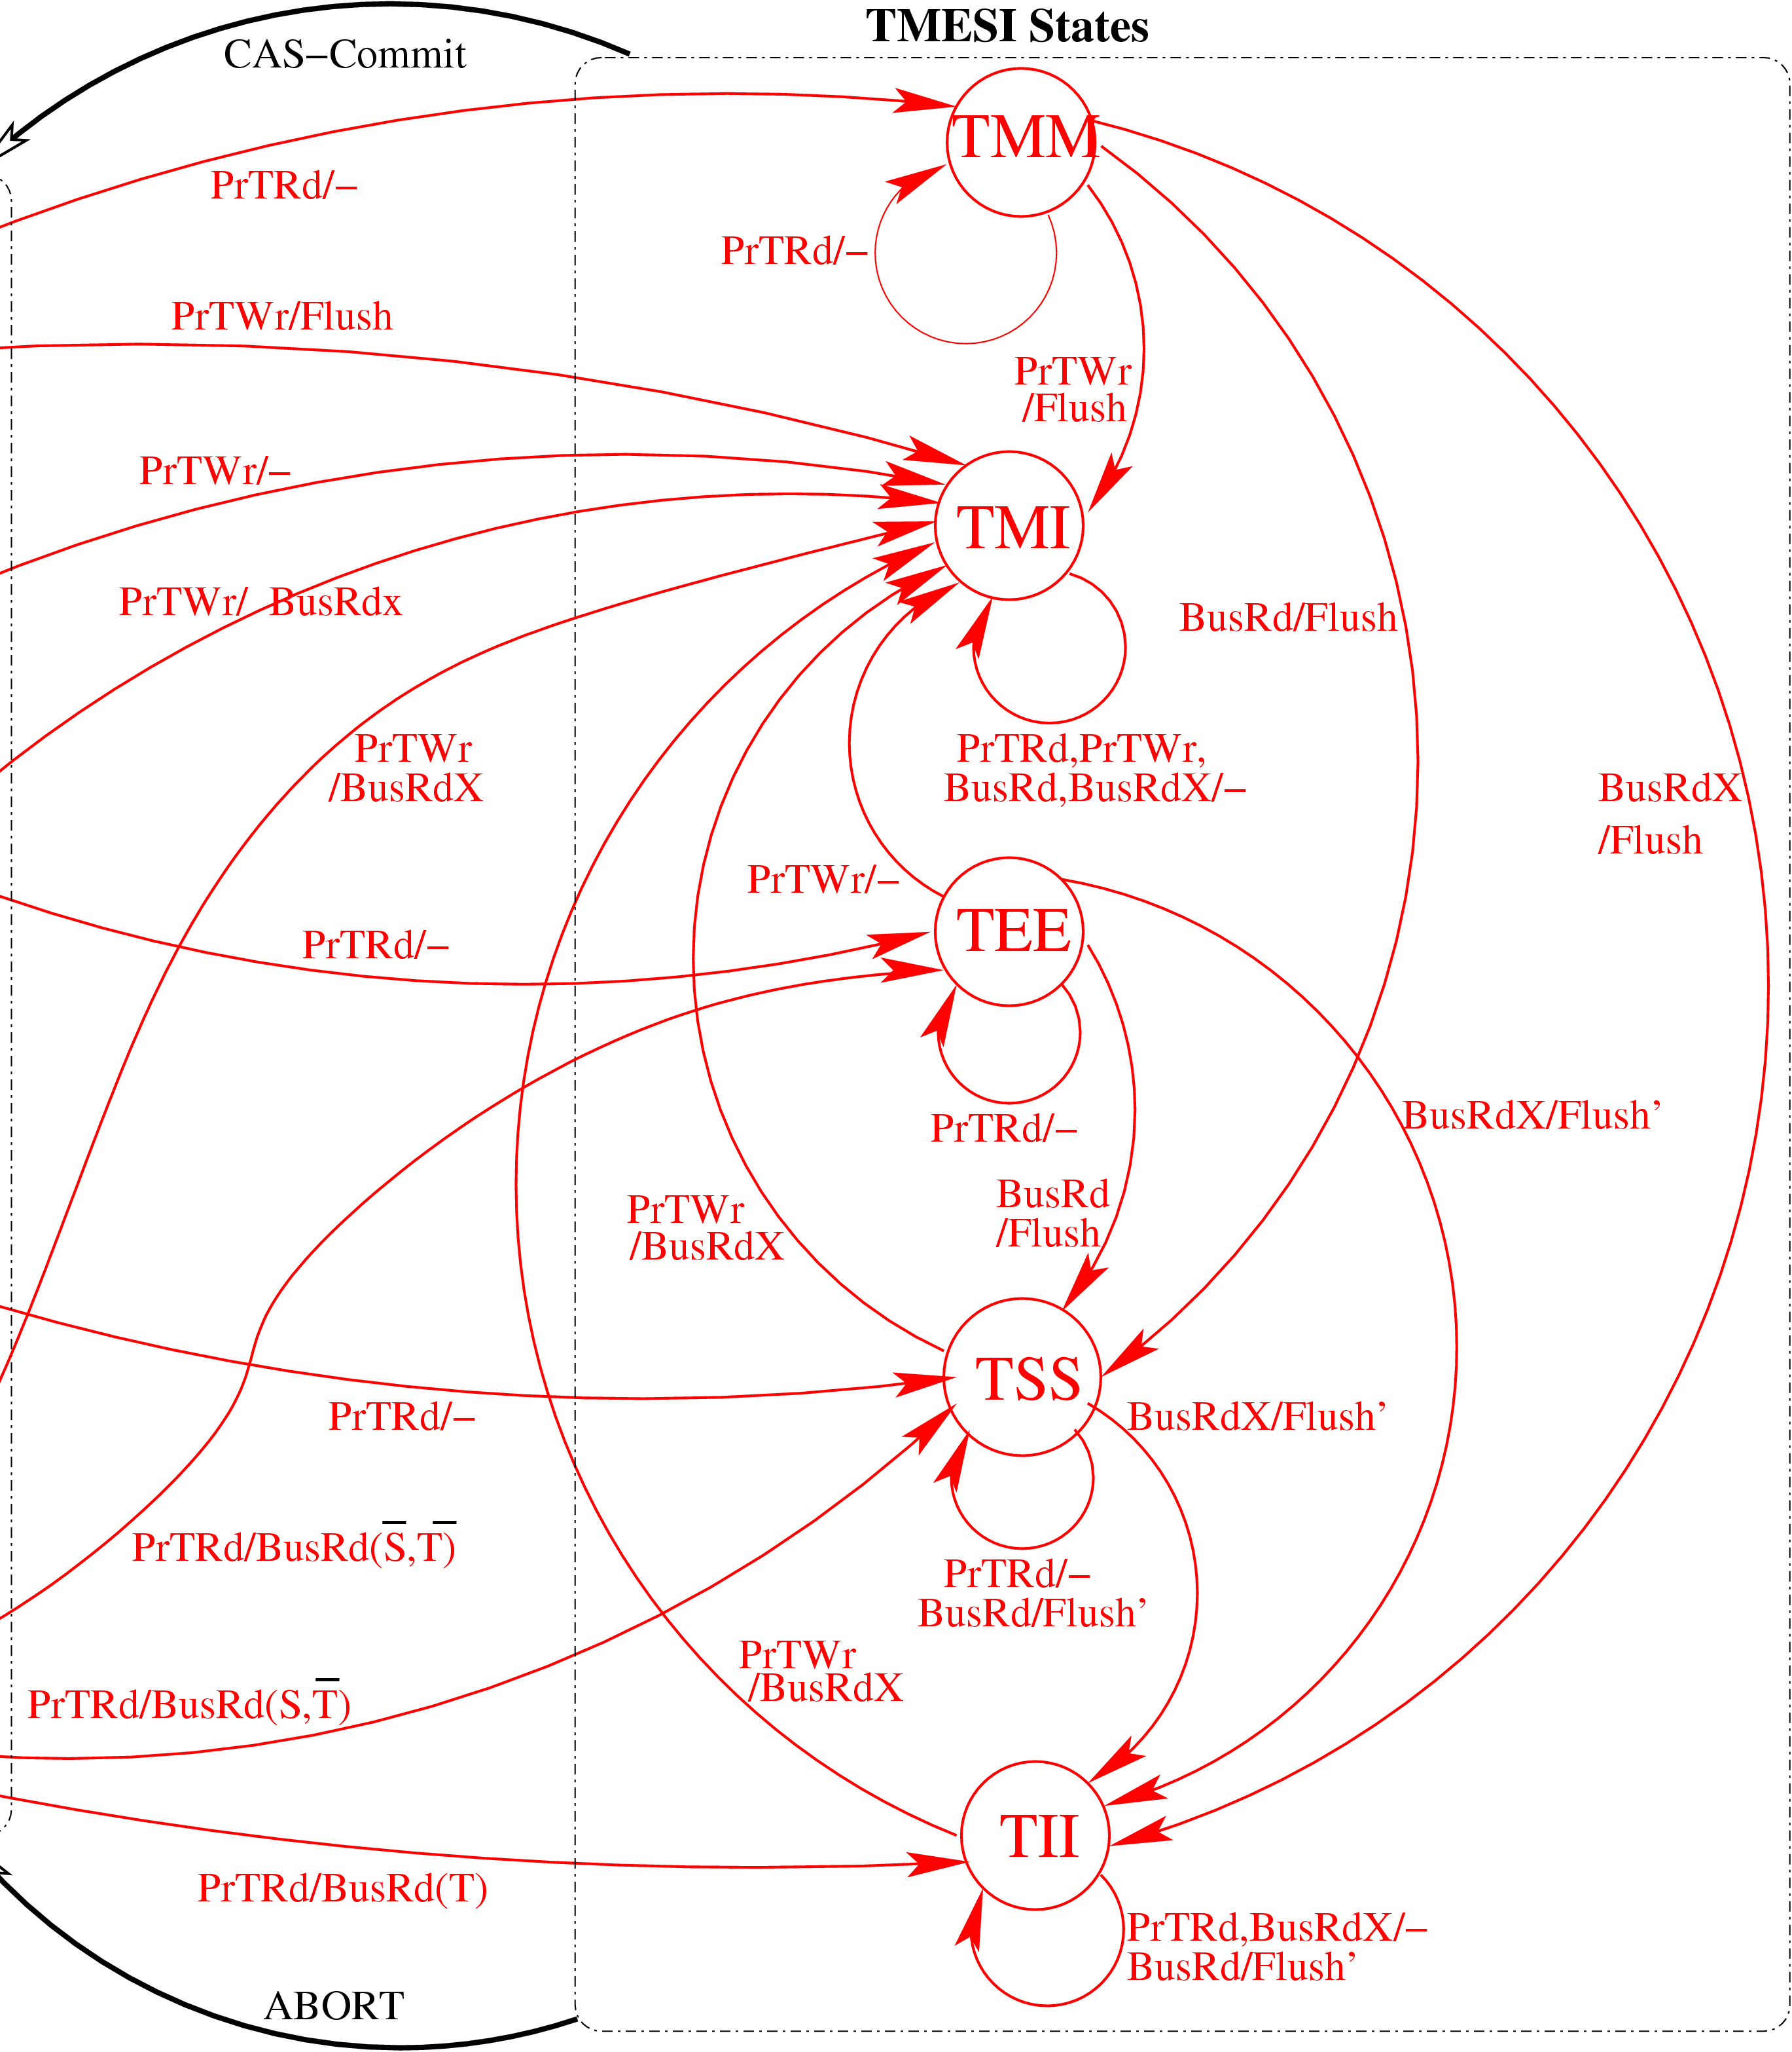
Transactional States
T-MM/EE/SS analogous to M/E/S
  Writes from other transactions are isolated; BusRdX results in dropping to TII
TMI buffers/isolates transactional stores
  supports concurrent writers; BusRdX ignored
  supports concurrent readers; BusRd threatened and data response suppressed
TII isolates concurrent readers from transactional writers
  Threatened cache line reads move to TII
MESI States
All cache lines in TMESI return to MESI on commit/abort.

Slide 11
Transactional (Speculative) Lines
TLoaded lines
  can be dropped without aborting
TStored lines
  must remain in cache (or txn falls back to SW)
  revert to M on commit, I on abort
Support R-W and W-W speculation (if SW wants)
No extra transactional traffic; no global consensus in HW
  commit is entirely local; SW responsible for correctness

Slide 12
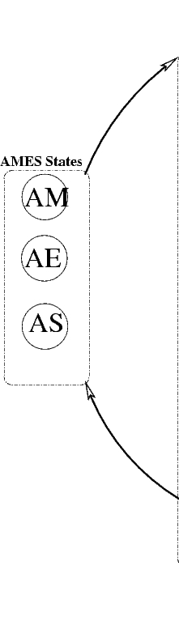
Abort on Invalidate
A-tagged line invalidation aborts a transaction and jumps to a software handler
Invalidation can be due to
  Capacity: Abort since cache cannot track conflicts for object
  Coherence: Remote potential writer/reader of the object cache line has acquired object ownership
Transactional object headers when ALoaded in open() eliminate the need for
  incremental validation
  explicitly visible hardware readers
Transaction descriptors are ALoaded by all transactions, allowing synchronous aborts
Invalid/Abort
MESI States
Aload

Slide 13
ISA Additions
TLoad, TStore — transactional (speculative) load, store
ALoad, ARelease — abort if line is invalidated
SetHandler — where to jump on abort
CAS-Commit — if successful, revert T&A lines
Abort — self-induced, for condition synchronization
2-C-4-S — if compare succeeds, swap 4 words (example, IA-64)

Slide 14
RTM Policy Flexibility
Conflict detection
  Eager (i.e., at open())
  Lazy (i.e., at commit)
  Mixed (i.e., eager write-write detection and lazy read-write detection)
Flexible software contention managers
  Contention managers arbitrate among conflicting transactions to decide the winner

Slide 15
Example
P0
T0
P1
T1
P2
T2
1
TLoad A
4
TLoad A
3
2
L1
TStore B
L1
TStore A
L1
5
TLoad B
AE: OH(A)
AS: OH(A)
AS: OH(A)
AS: OH(A)
TEE: A
TII: A
TMI: A
TII: A
AE: OH(B)
AS: OH(B)
AS: OH(B)
TMI: B
TII: B
GetX
Shared L2

Slide 16
Example
Abort
P0
T0
P1
T1
P2
T2
1
TLoad A
4
TLoad A
3
2
L1
TStore B
L1
TStore A
L1
5
TLoad B
AS: OH(A)
I: OH(A)
AS: OH(A)
M: OH(A)
AS: OH(A)
S: OH(A)
TII: A
M: A
7
I: A
TMI: A
TII: A
Acquire OH(A)
CAS-Commit
I: A
6
AS: OH(B)
CAS-Commit
S: OH(B)
AS: OH(B)
S: OH(B)
TMI: B
I: B
TII: B
I: B
GetX
Shared L2

Slide 17
Simulation Framework
Target Machine:16 way CMP running Solaris 9
  16 SPARC V9 processors
  1.2GHz in-order processors with ideal IPC=1
  64KB 4-way split L1 cache, latency=1 cycle
  8MB 12way L2 with 16 banks, latency=20cycle
  4-ary hierarchical tree
    Broadcast address network and point-point data network
    On-Chip link-latency=1cycle
  4GB main memory , 80 cycle access latency
  Snoopy broadcast protocol
Infrastructure
  Virtutech Simics for full-system function
  Multifacet GEMS [Martin et. al, CAN 2005] Ruby framework for memory system timing
  Processor ISA extensions implemented using SIMICS magic no-ops
  Coherence protocol developed using SLICC [Sorin et. al, TPDS 2002]

Slide 18
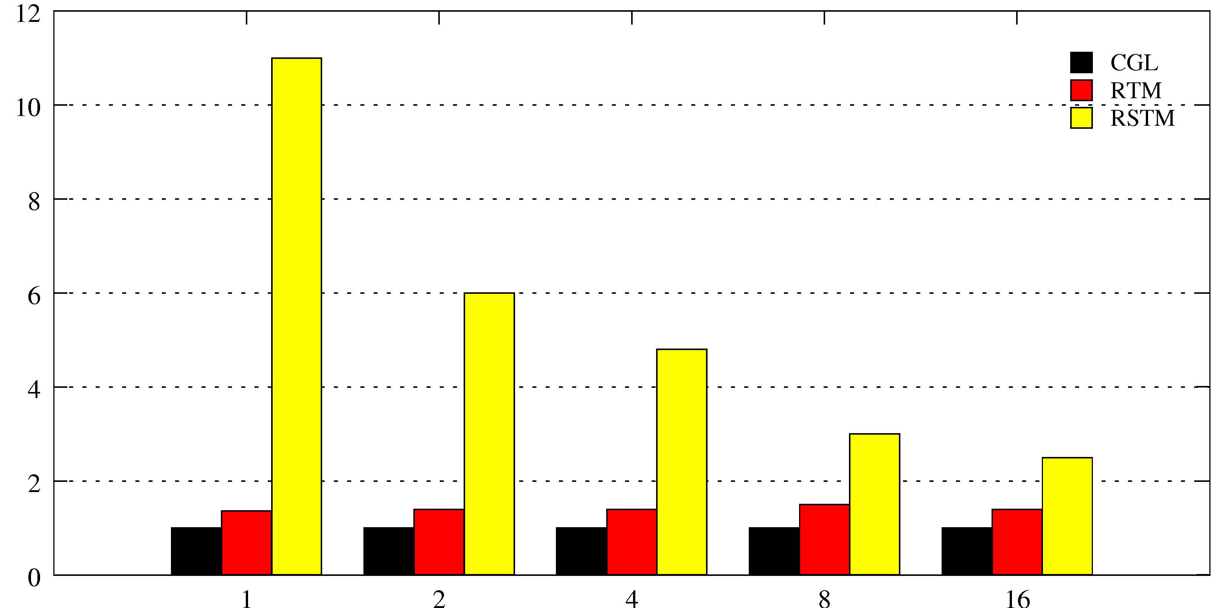
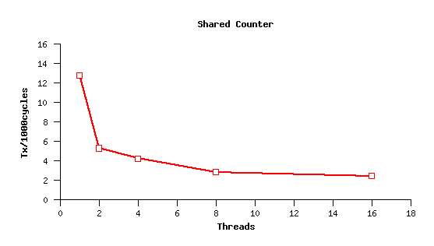
Shared Counter
Normalized Performance w.r.t. Coarse-Grain Locks (CGL)
Lower is better
Normalized Performance Cycles/Tx
Threads
RTM Scalability
Txs/ 1000 cycles
Higher is better
Threads

Slide 19
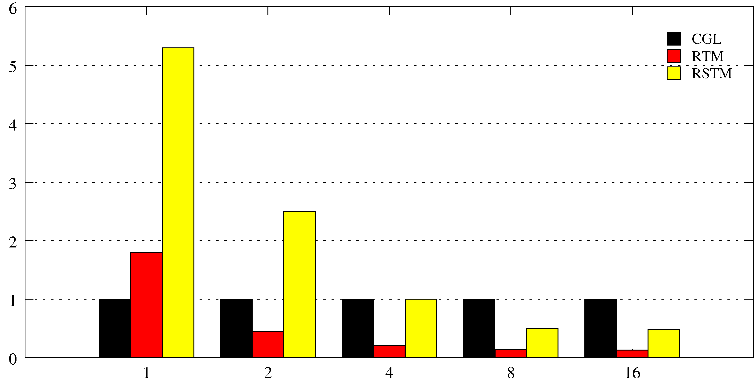
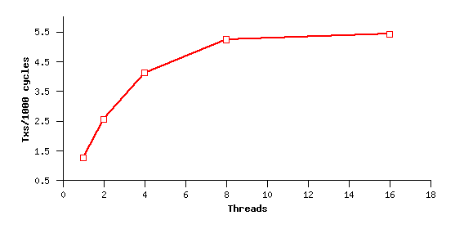
Hash Table
Normalized Performance wrt. Coarse-Grain Locks (CGL)
Lower is better
Normalized Performance Cycles/Tx
Threads
RTM Scalability
Txs/ 1000 cycles
Higher is better
Threads

Slide 20
Conclusions
Coherence protocol additions at the L1 cache allow
  Transactional overhead reductions in copying and conflict detection in order to enforce isolation
  Flexible policy decisions implemented in software that improve the scalability of the system
Allowing software fallback permits transactions unbounded in space and time
Additional features
  Deferred aborts

Slide 21
Future Work
A more thorough evaluation of the proposed architecture including
  Effects of policy flexibility
Extensions to multiple levels of sharing and to directory-based coherence protocols
Incremental fallback to software for only those cache lines that don’t fit in the cache

