Slide 1
Offline Signature Verification
K.Ashrith S20200010098
Y.V.V. Kalyan S20200010237

Slide 2
Agenda
MOTIVATION
INTRODUCTION
RELATED WORK
PROPOSED IDEA
TIMELINE

Slide 3

Motivation
In legal proceedings, such as contracts or legal agreements, offline signature verification can help to ensure that the signature is valid and has not been forged or tampered with.
Offline signature verification is crucial in the banking and financial industry.
It is often used to verify the authenticity of checks and other financial documents, which helps to prevent fraud and ensure the security of financial transactions.​

Slide 4
Introduction
Signature verification is widely used in various applications, such as banking, legal documents, and authentication systems.
Offline signature verification is particularly important in situations where digital devices are not available or practical, or when the authenticity of a signature needs to be verified without access to the signer.
This process involves analyzing the static image of a signature, captured on paper or any other surface, without the need for any digital input device.
The deep learning approach involves model to learn and extract relevant features from the signature image and classify the signature as genuine or forged.

Slide 5
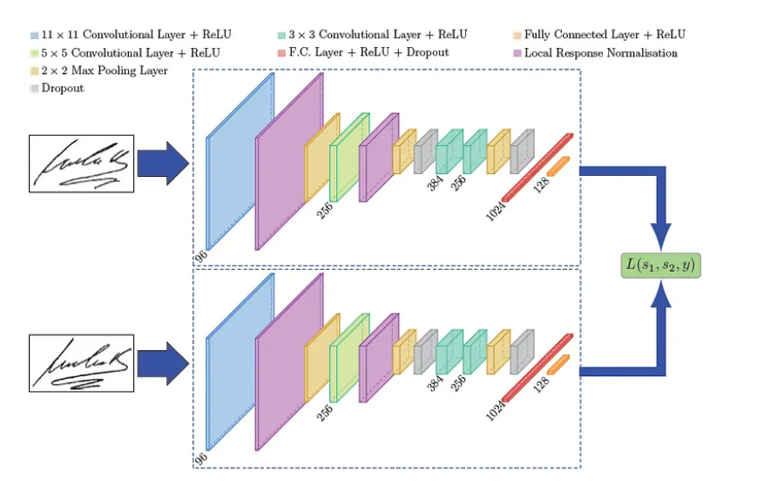
Siamese Network
Siamese networks are a type of neural network architecture that are used for tasks involving similarity or distance measurement between two input examples.
These networks consist of two or more identical sub-networks, which are joined at the end by a similarity function.
The input examples are passed through the sub-networks to extract features, and the similarity function then computes the similarity or distance between the features.
One of the key advantages of siamese networks is that they can be trained on relatively small datasets.

Slide 6
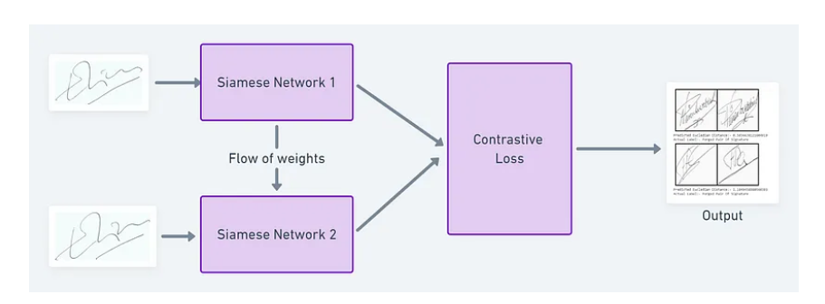
Contrastive Loss
Contrastive loss is a loss function used in Siamese networks that are designed for tasks where the goal is to learn a similarity metric between pairs of input data, such as images or text.
The contrastive loss function aims to minimize the distance between similar pairs of data while maximizing the distance between dissimilar pairs.

Slide 7
Related Work

Slide 8
Kao, Hsin-Hsiung & Wen, Che-Yen. (2020). An Offline Signature Verification and Forgery Detection Method Based on a Single Known Sample and an Explainable Deep Learning Approach. Applied Sciences. 10. 3716. 10.3390/app10113716.
Architecture
The method involves two stages: feature extraction and deep learning-based classification.
In the feature extraction stage, the signature image is preprocessed, and relevant features are extracted using the Scale Invariant Feature Transform (SIFT) algorithm.
The extracted features are then used to train a convolutional neural network (CNN) in the deep learning-based classification stage.
To enhance the interpretability of the system, the proposed method employs a Grad-CAM technique that generates class-discriminative visual explanations for the CNN's classification decision.
Parameters
Parameters for SIFT (Feature extraction).
Layers, activation functions in the CNN network.
Limitations
The proposed method only uses a single known sample for training and testing the system. This limits the generalizability of the approach and may not perform as well when applied to other datasets or signature types.
SIFT is sensitive to noise and may capture unnecessary features may be captured.

Slide 9
Jahandad, & Sam, Suriani & Kamardin, Kamilia & Sjarif, Nilam & Mohamed, Norliza. (2019). Offline Signature Verification using Deep Learning Convolutional Neural Network (CNN) Architectures GoogLeNet Inception-v1 and Inception-v3. Procedia Computer Science. 161. 475-483. 10.1016/j.procs.2019.11.147.
Architecture
Architecture: The GoogleNet architecture is based on the Inception-v1 model, while the proposed modified architecture is based on Inception-v3. Inception-v3 is a deeper and more complex architecture than Inception-v1, with improved performance on various image recognition tasks.
Performance: Inception-v1 has an accuracy of 97.3% whereas v3 has 98.4%.
Preprocessing: Both the models have different preprocessing methods, inception v-3 has image resizing whereas inception v-1 does’t
Parameters
Layers: Inception v-1 has 22 layers whereas Inception v-3 has 42 layers.
Conclusion
The Inception-v3 model outperformed the Inception-v1 model in terms of accuracy, with an overall accuracy of 98.4% compared to 97.3% for Inception-v1.
Both models showed good performance in terms of false acceptance rate (FAR) and false rejection rate (FRR).

Slide 10
Tahir, Nura & Ausat, Adam & Bature, Usman & Abubakar, Kamal & Gambo, Ibrahim. (2021). Offline Handwritten signature verification system: Using Artificial Neural Networks Approach. International Journal of Intelligent Systems and Applications. 13. 10.5815/ijisa.2021.01.04.
Architecture
Architecture: This Paper has used a Artificial neural network approach
Performance: This artificial neural network approach has achieved an accuracy of 82.5%
Preprocessing: The Images are resized and converted to grayscale images
Parameters
Layers: This model has total of 6 layers. The number of nodes in input layer are 25 i.e the images are changed to 5px X 5px.
Optimization: The proposed work has used a gradient descent for optimization
Conclusion
In ANN approach we have problems like high dimensionality and no local connectivity and ANN requires the dataset to be huge.
To overcome this problem This paper has applied data augmentation techniques like rotation and generating more images from the input images.

Slide 11
Proposed Work
Signature_Verification_Dataset : This dataset contains the signature of dutch user both genuine and fraud.
Preprocessing : We have processed the dataset into an array where each row has two images and a label. Then we applied some transformations for the images like resizing , grayscale and to tensors.
Architecture : Siamese networks
Loss Function : Contrastive loss
L = (1-y) * d^2 + y * max(margin - d, 0)^2

Slide 12
Conclusion
Offline signature verification is crucial in the banking and financial industry. It is often used to verify the authenticity of checks and other financial documents, which helps to prevent fraud and ensure the security of financial transactions.​
The deep learning approach involves model to learn and extract relevant features from the signature image and classify the signature as genuine or forged. The model is typically evaluated using metrics such as accuracy, precision, and recall to assess its performance.
Siamese networks are a type of neural network architecture that are used for tasks involving similarity or distance measurement between two input examples. These networks consist of two or more identical sub-networks, which are joined at the end by a similarity function.
Contrastive loss is a loss function used in Siamese networks that are designed for tasks where the goal is to learn a similarity metric between pairs of input data, such as images or text.

Slide 13
Timeline
Mid-1
Literature Review
Mid-2
Preprocessing images
Starting Model implementation
End
Completing the model implementation
Final Report

Slide 14
Thank you

