Slide 1

2048 Game using Deep Reinforcement Learning
21AIE401 – DEEP REINFORCEMENT LEARNING
PERFECT DEALERS
Group Number – 10
Name Registration Number
1. K. Vishnu Sainadh BL.EN.U4AIE19028
2. K. Satwik BL.EN.U4AIE19034
3. V. Ashrith BL.EN.U4AIE19066

Slide 2
Contents
Problem Statement
RL Formulation
Literature Survey
Gaps and Challenges
DRL Models
Neural Network Architecture
System Architecture
Hyper-parameter tuning
Training
Demo Code
Results
Conclusion and Future Scope
References

Slide 3
Problem Statement
To implement an AI to play 2048 game using deep-reinforcement learning.
Construct a game-playing agent that can win this single player puzzle without the input of human skill or the dynamics of the game.

Slide 4
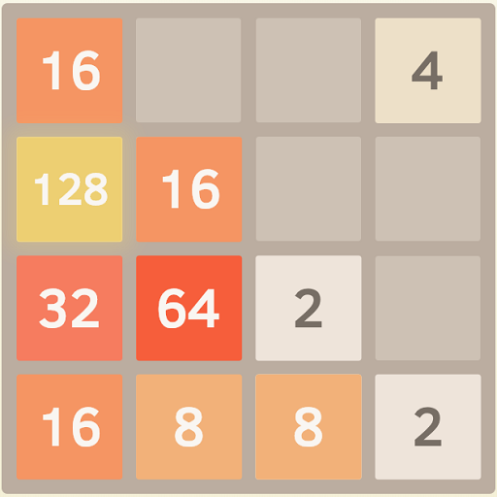
RL Formulation
Environment
4x4 Grid

Slide 5

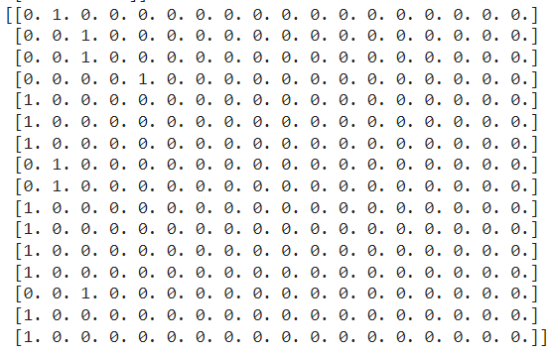
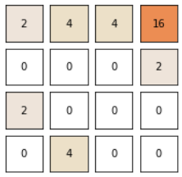
State
4x4 to 1x16 vector
1x16 vector to One-hot encoded vector (16 cells * 18 possible states for each)

Slide 6
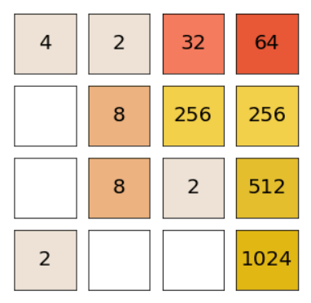
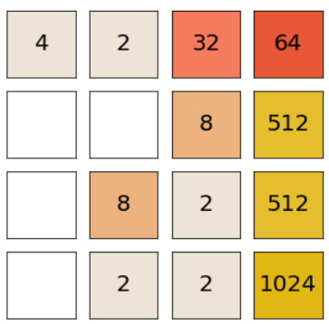
Action
Four Actions: Up, Down, Left, Right
Right
Random Tile Generated

Slide 7
Reward
Sum of log2 values ​​of collapsed cells on the board at the current step minus the penalty for moving the cell and the penalty for an incorrect move.
Log2 is used to bring the cell values to a uniform scale.
We penalized the agent at every move for all cells that have moved (that is, changed their position after the selected action. And the more cells were shifted, the higher the penalty was.
We took negative reward as -2 and penalty for moving the cell as 0.1

Slide 8
Literature Survey
In 2014 M. Szubert and W. Jaśkowski [1] Models the 2048 game as an MDP, and applied temporal difference learning (TD) on the MDP to learn the best policy. The model dwarfs the human performance by reaching 2048 with a rate of 97%.
In 2015 K. -H. Yeh, I. -C. Wu, C. -H. Hsueh, C. -C. Chang, C. -C. Liang and H. Chiang [2] Improves the model by applying multi-stage temporal difference learning with 3-ply expectimax search (game theory algorithm).
In 2017 Amar and Jonathon [3] uses policy network to learn the best strategy to play 2048 without human knowledge. The policy network is a neural network that contains two convolutional layers with ReLU as activation function.
In 2021 Li, Shilun, and Veronica Peng [4] They used two approaches deep Q-learning and beam search which is a greedy search algorithm that explores a tree and chooses most promising nodes, with beam search reaching 2048, 28.5% of time.

Slide 9
Gaps and Challenges
Very few have worked on deep reinforcement learning techniques especially DQN and its variants.
Challenges
Environment is stochastic.
For efficient computation GPU is required.
Lots of training time.

Slide 10
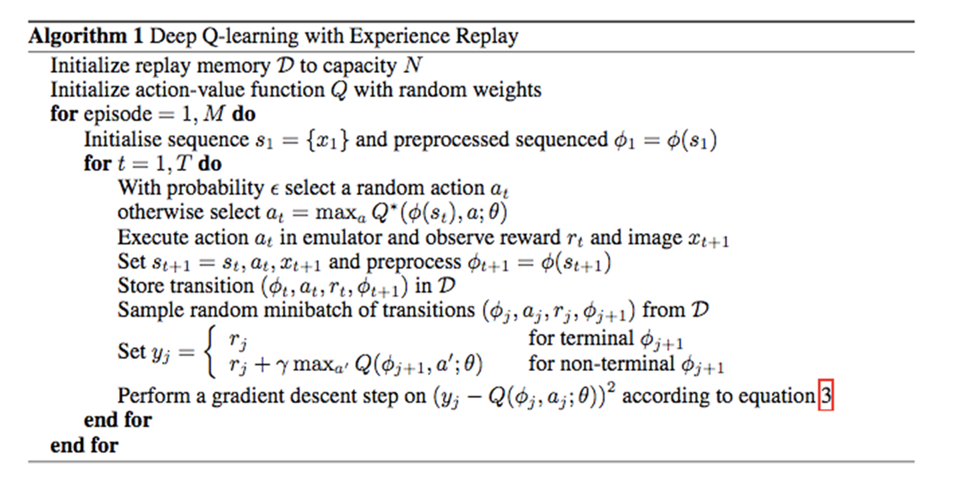
DRL Models
DQN
Dueling DQN

Slide 11
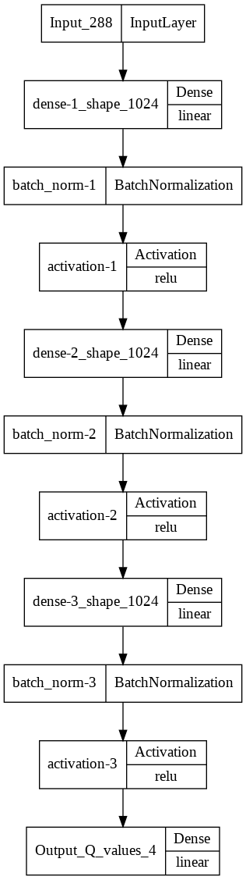
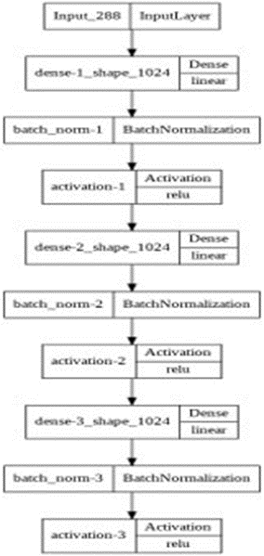
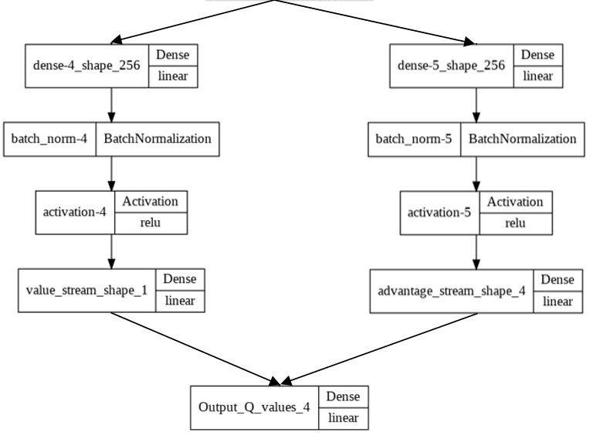
Neural Network Architecture
DQN
Dueling DQN
Input :
Pre-processed State which is one hot encoded vector
Output:
Q-values for 4 actions possible.

Slide 12
System Architecture
Q(S, Up)
Q(S, Down)
Q(S, Left)
Q(S, Right)
DQN
Dueling DQN
Agent
(One of the Above)
Q-Values for Actions
Environment:4x4 Grid
One-hot encoded vector (16 cells * 18 possible states for each)
1x16 Vector

Slide 13
Implementation Details
Environment is custom implemented.
Matplotlib is used for rendering game.
Py-Torch is used for implementing DQN and Dueling DQN agents.
Optuna is used for Hyper-parameter tuning for agents used.
Trained the agents for about 80000 episodes.
Best Game-play is rendered after training the agent.

Slide 14
Hyper-parameters
Gamma
Epsilon
Replay memory buffer
Learning rate
Batch Size
Notes:
Discount factor gamma is used in Q-learning update.
For epsilon we have two values initial value and final value
Maximum steps of an episode.
Replay memory buffer : Size of the previous calculated transitions
Mini batch size : Size of batch taken from replay buffer used for updating weights.
The frequency with which the model is trained.
The frequency with which the target network is updated.

Slide 15
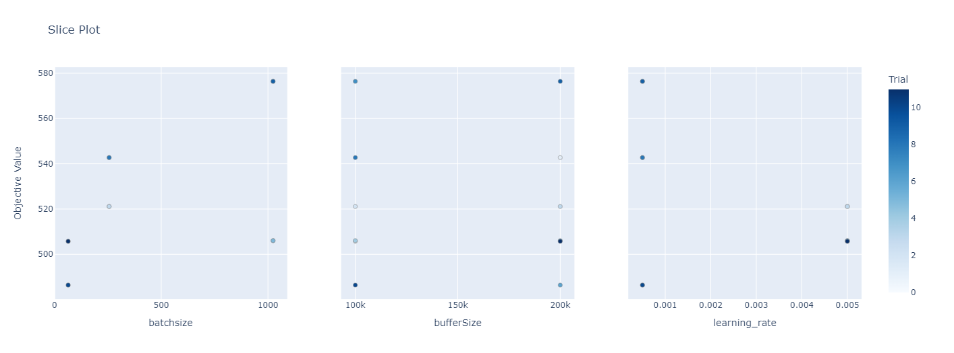
Hyper-parameters Tuning for DQN

Slide 16
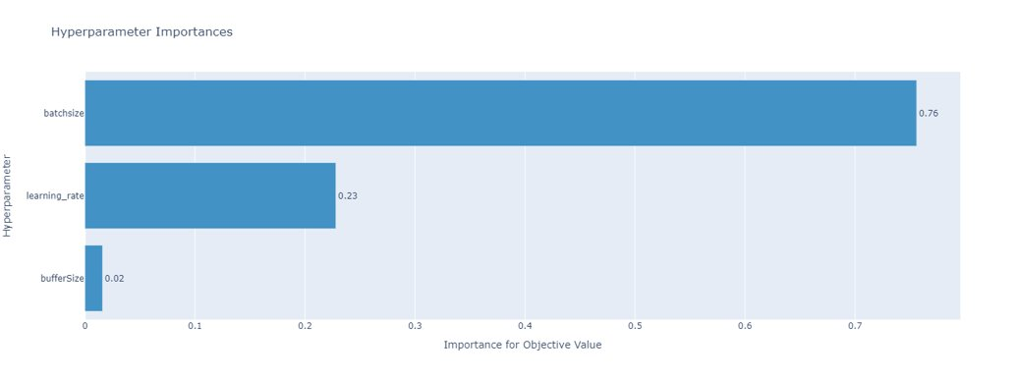
Hyper-parameters Tuning for DQN

Slide 17
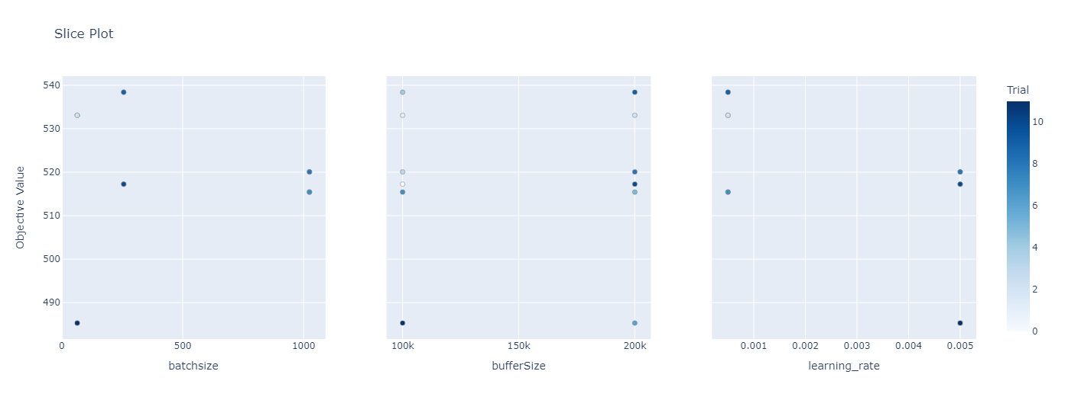
Hyper-parameters Tuning for Dueling DQN

Slide 18
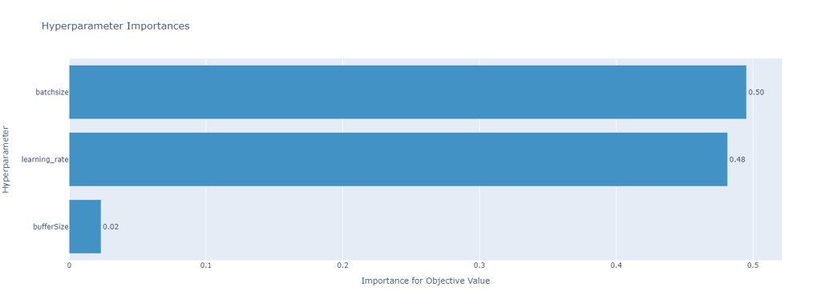
Hyper-parameters Tuning for Dueling DQN

Slide 19
Final Hyper Parameters
Gamma - 0.99
Batch Size - 1024
Learning Rate - 0.0005
Buffer Size – 100000
Epsilon (Start) - 0.05
Epsilon Decay factor – 0.999
Epsilon (End) - 0.00001
Target Model Update Factor - 100

Slide 20
Training
The training is done for 80000 episodes.
DQN - A nine-layer neural network is trained with batch size of 1024, learning rate of 0.0005, Buffer size of 100000, epsilon is initially kept as 0.05 and then gradually decreased to 0.00001 with a decay factor 0.009.
Dueling DQN - A thirteen-layer neural network is trained with batch size of 1024, learning rate of 0.0005, Buffer size of 100000, epsilon is initially kept as 0.05 and then gradually decreased to 0.00001 with a decay factor 0.009.
The time it took is about 50 hours on a machine with 8GB RAM and i5 8th Gen processor.

Slide 21
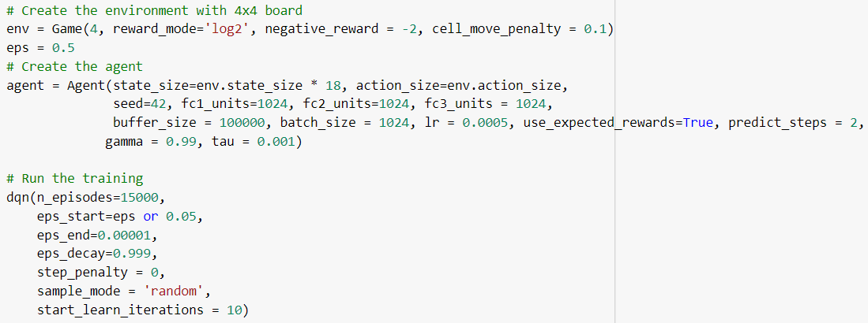
Demo Code

Slide 22
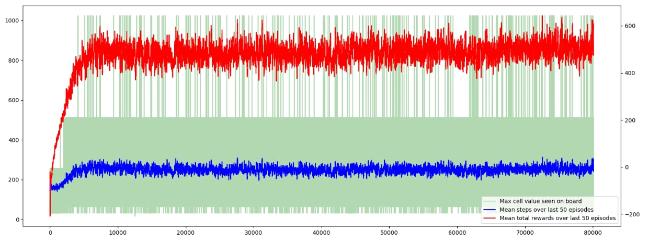
Results
DQN

Slide 23
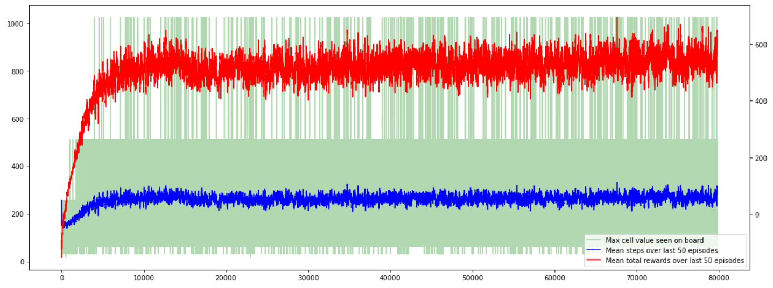
Results
Deuling DQN -

Slide 24
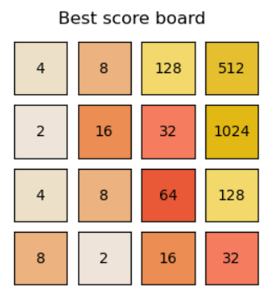
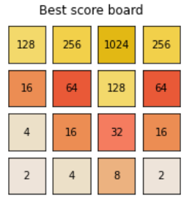

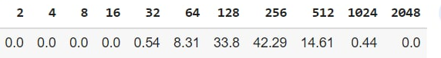
Results
DQN
Deuling DQN
24

Slide 25
Conclusion and Future Scope
DRL agents are implemented to reach higher tile values.
We achieved 1024 tile after training the model for 80000 episodes.
With higher GPU we can reduce time and train the model for better results while maintaining higher scores.
We can train the model to reach higher tiles like 2048, 4096, 8192 and so on.

Slide 26
References
[1] M. Szubert and W. Jaśkowski, "Temporal difference learning of N-tuple networks for the game 2048," 2014 IEEE Conference on Computational Intelligence and Games, 2014, pp. 1-8, doi: 10.1109/CIG.2014.6932907.
[2] K. -H. Yeh, I. -C. Wu, C. -H. Hsueh, C. -C. Chang, C. -C. Liang and H. Chiang, "Multistage Temporal Difference Learning for 2048-Like Games," in IEEE Transactions on Computational Intelligence and AI in Games, vol. 9, no. 4, pp. 369-380, Dec. 2017, doi: 10.1109/TCIAIG.2016.2593710.
[3] H. Guei, L. -P. Chen and I. -C. Wu, "Optimistic Temporal Difference Learning for 2048," in IEEE Transactions on Games, doi: 10.1109/TG.2021.3109887.
[4] Li, Shilun, and Veronica Peng. "Playing 2048 With Reinforcement Learning." arXiv preprint arXiv:2110.10374 (2021).

