Slide 1

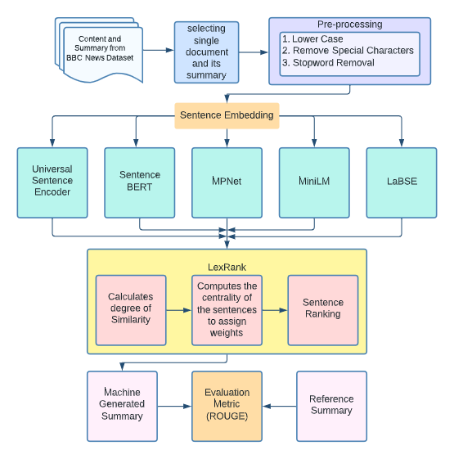
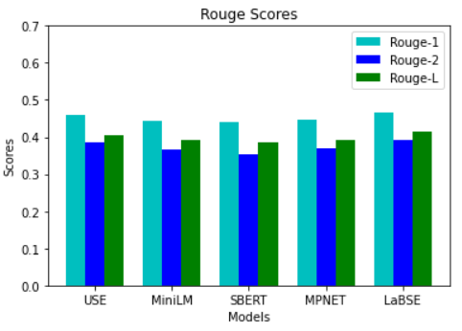
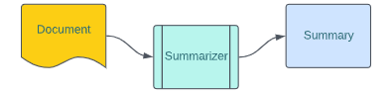
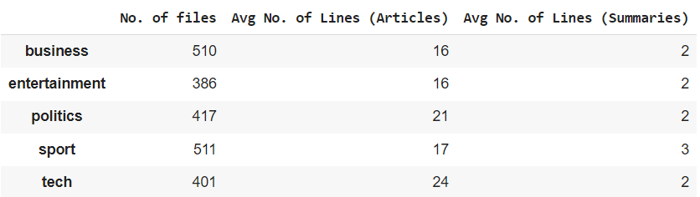
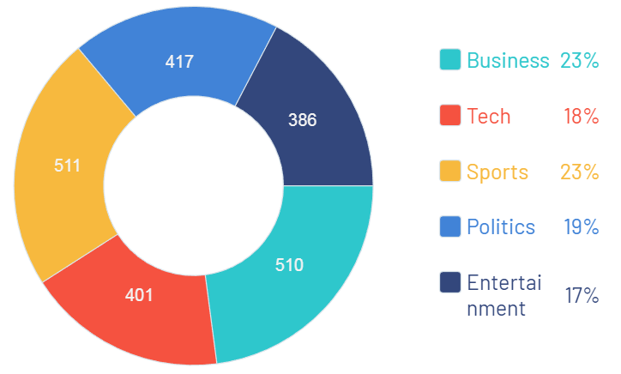
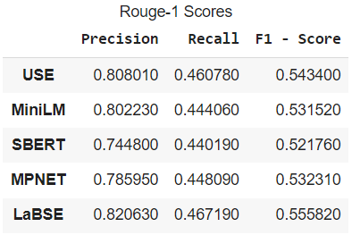
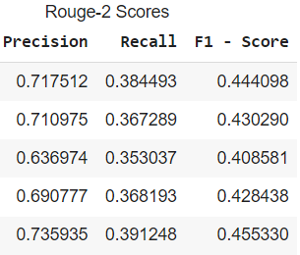
Comparative Study of Sentence Embedding techniques on News Summarization
K. Vishnu Sainadh, K. Satwik, V. Ashrith and Deepa Gupta
Department of Computer Science, Amrita School of Engineering, Bengaluru, Amrita Vishwa Vidyapeetham, India
Introduction
Methodology
People's lives are so busy that they rarely have time to read large texts. This irritates them because these lengthy texts are frequently required reading for them.
Creating a summary by hand is an expensive and time-consuming operation, automated methods to generate them are required.
The purpose of text summary is to create a concise and intelligible version of a big text, such as an article or a review.
We performed Extractive Summarization on our dataset
Extractive summarization aims at identifying the salient information that is then extracted and grouped together to form a concise summary
We propose a comparative study of sentence Embedding techniques performing extractive summarization on BBC News Dataset
Fig.5. Comparison of ROUGE-1,2 and L with different Embeddings
Fig.1. Visualisation for Summarization
Dataset Description
Results
Conclusion
In the proposed work the main is to summarize the news article from the BBC news Summarization dataset from kaggle.
We used five sentence transformers which are Universal Sentence embedding, MiniLM, Sentence-BERT, MPNet and LaBSE for LexRank.
From our study we observed that when LaBSE sentence representation is used for sentence similarity in LexRank we achieved a better Rouge-1, Rouge-2 and Rouge-L scores.
Fig.3. Methodology
Results
References
[1] Barman, Utpal, et al. "Graph Based Extractive News Articles Summarization Approach leveraging Static Word Embeddings." 2021 International Conference on Computational Performance Evaluation (ComPE). IEEE, 2021
[2] Krishnan, Devi, Preethi Bharathy, and Manju Venugopalan. "A supervised approach for extractive text summarization using minimal robust features." 2019 International Conference on Intelligent Computing and Control Systems (ICCS). IEEE, 2019
[3] S. R. K. Harinatha, B. T. Tasara and N. N. Qomariyah, "Evaluating Extractive Summarization Techniques on News Articles," 2021 International Seminar on Intelligent Technology and Its Applications (ISITIA), 2021, pp. 88-94, doi: 10.1109/ISITIA52817.2021.9502230.
Fig.2(a) and 2(b). Description of dataset and Visualisation
Fig.4. Comparison of ROUGE-1 and ROUGE-2 Scores with different Embeddings
Contact: bl.en.u4aie19028@bl.students.amrita.edu, bl.en.u4aie19034@bl.students.amrita.edu, bl.en.u4aie19066@bl.students.amrita.edu, g_deepa@blr.amrita.edu

