Slide 1

LAWN-MOVER ROBOT
TEAM PERFECT DEALERS
K.Vishnu Sainadh - BL.EN.U4AIE19028
K.Satwik - BL.EN.U4AIE19034
V.Ashrith - BL.EN.U4AIE19066

Slide 2
PROBLEM STATEMENT
Design and implement an lawn mowing robot using a custom built differential drive robot. The robot should traverse to all the locations of the environment, the boundaries of the environment should be exclusively given as inputs in terms of boundary coordinated, also assume some static objects placed in the environments. The total number of laps should be taken as input. The type of sensors can be team’s choice but the reason to use the sensor should be clear in the report and the presentation.

Slide 3
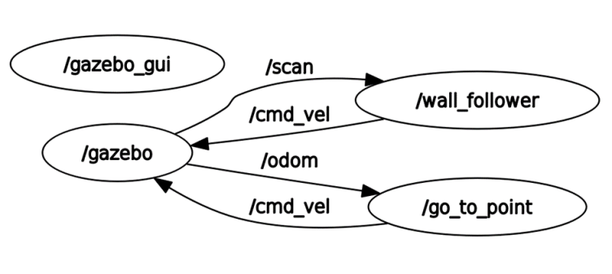
RQT GRAPH

Slide 4
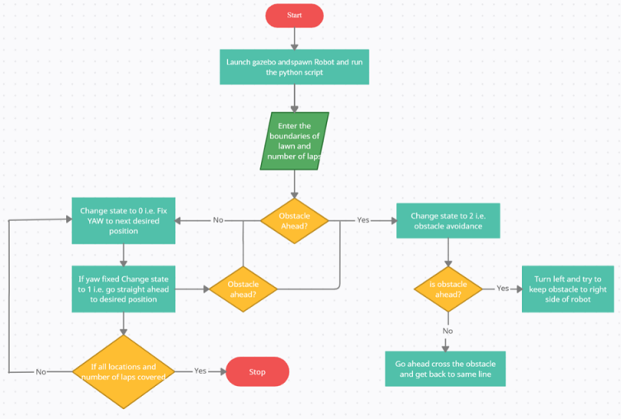

Slide 5
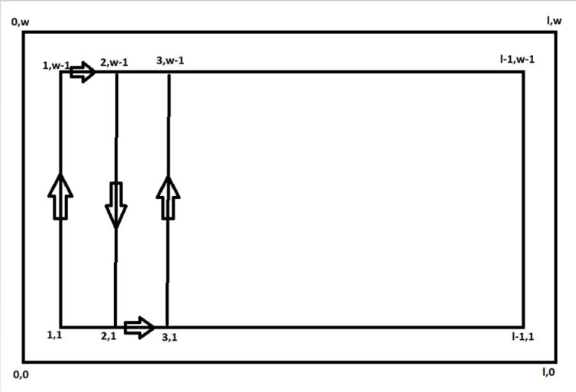
THE PATH

Slide 6
HOKUYO SENSOR
720 samples
Angle = -pi/2 to pi/2
Range = 0.1 to 30
Update rate = 40

Slide 7
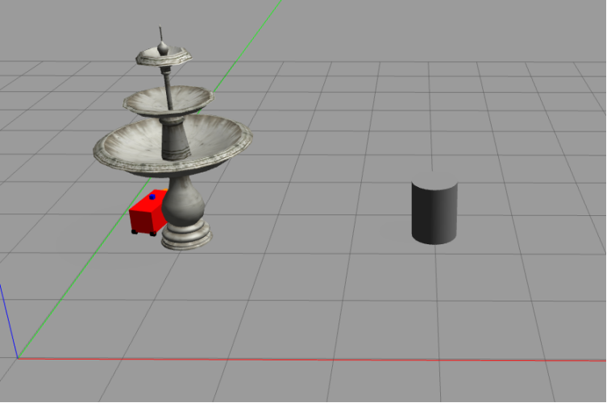
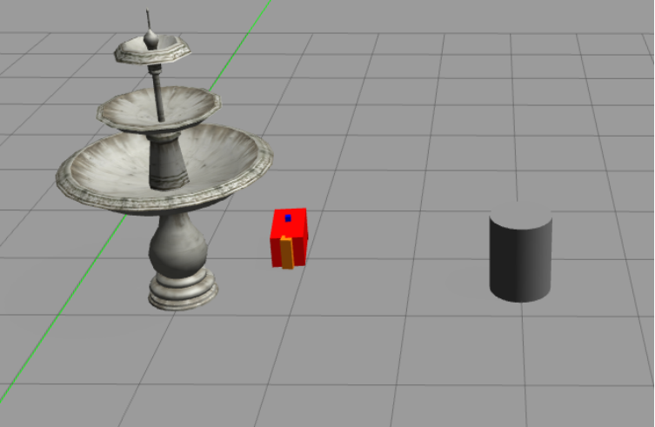
OUTPUT

Slide 8
LET'S SEE OUR IMPLEMENTATION

