Slide 1

PLAYING MAZE USING VOICE COMMANDS
Team – Perfect Dealers
K.Vishnu Sainadh – AIE19028
K.Satwik - AIE19034
V.Ashrith - AIE19066

Slide 2
INTRODUCTION
Problem Statement : Recognizing and classifying speech commands using CNN on our dataset.
The main aim of our project is to build a CNN model to recognize and classify speech commands with high accuracy.
Speech Recognition is a software which enables a program to process human speech into a written format.

Slide 3
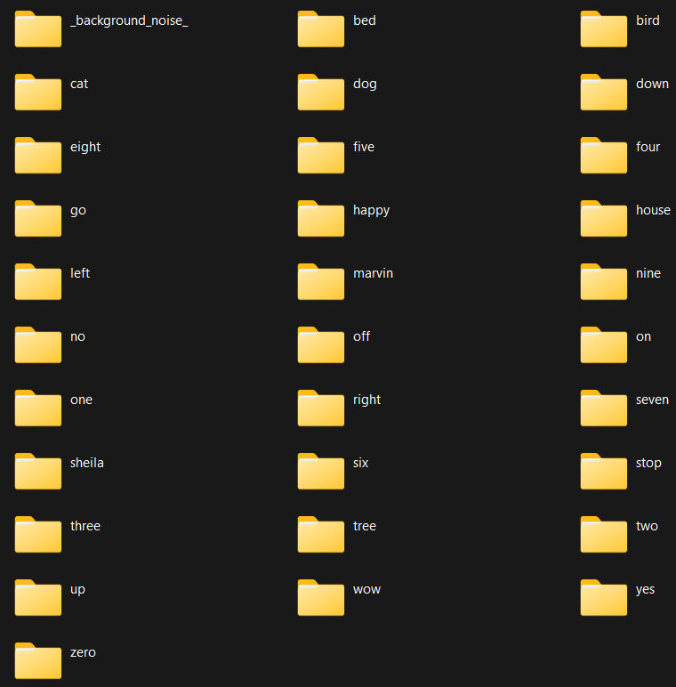
DATASET
http://download.tensorflow.org/data/speech_commands_v0.02.tar.gz
We have used the speech commands dataset
It contains 31 folders : 1700 – 1800 voice samples in each folder
30 speech commands and background noise

Slide 4
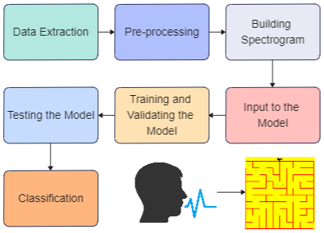
MODEL ARCHITECTURE

Slide 5
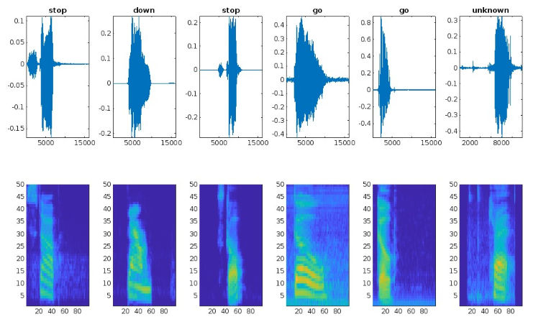
Sample Spectrogram

Slide 6
CNN (Convolutional neural network)
A CNN is a class of artificial neural network, most applied to analyze visual imagery.
They have an input layer, an output layer and many hidden layers and millions of parameters, which allows them to learn patterns.
They have three main types of layers, which are:
Convolutional layer
Pooling layer
Fully-connected (FC) layer

Slide 7
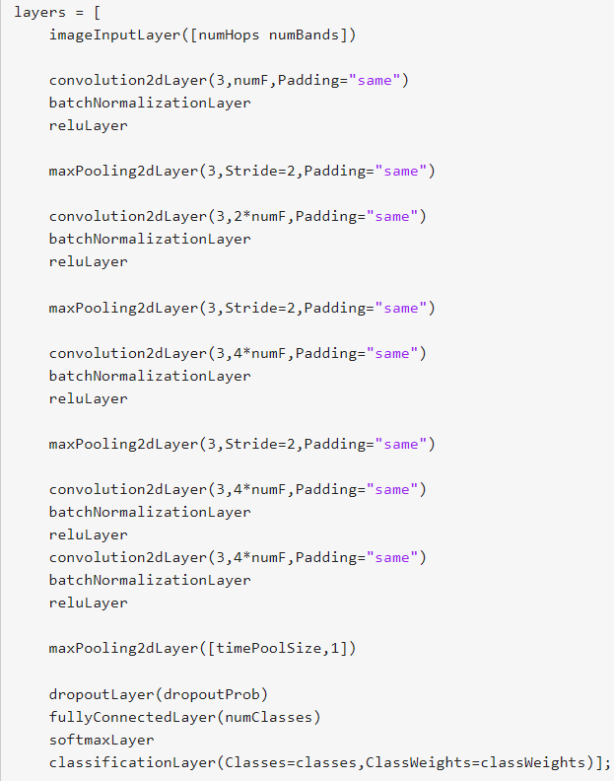
CNN Model
Our Model has
5 blocks of convolution, Batch normalization, Relu activation function and Max pooling layers
1 Dropout, 1Dense and 1Softmax layer
We got a training accuracy of 95.34% and a validation accuracy of 94.57%

Slide 8
CHALLENGES
The speech commands may contain background noise and recognizing the correct commands sometimes becomes difficult
The accent varies from country to country. It is hard to get correct results all the time.

Slide 9
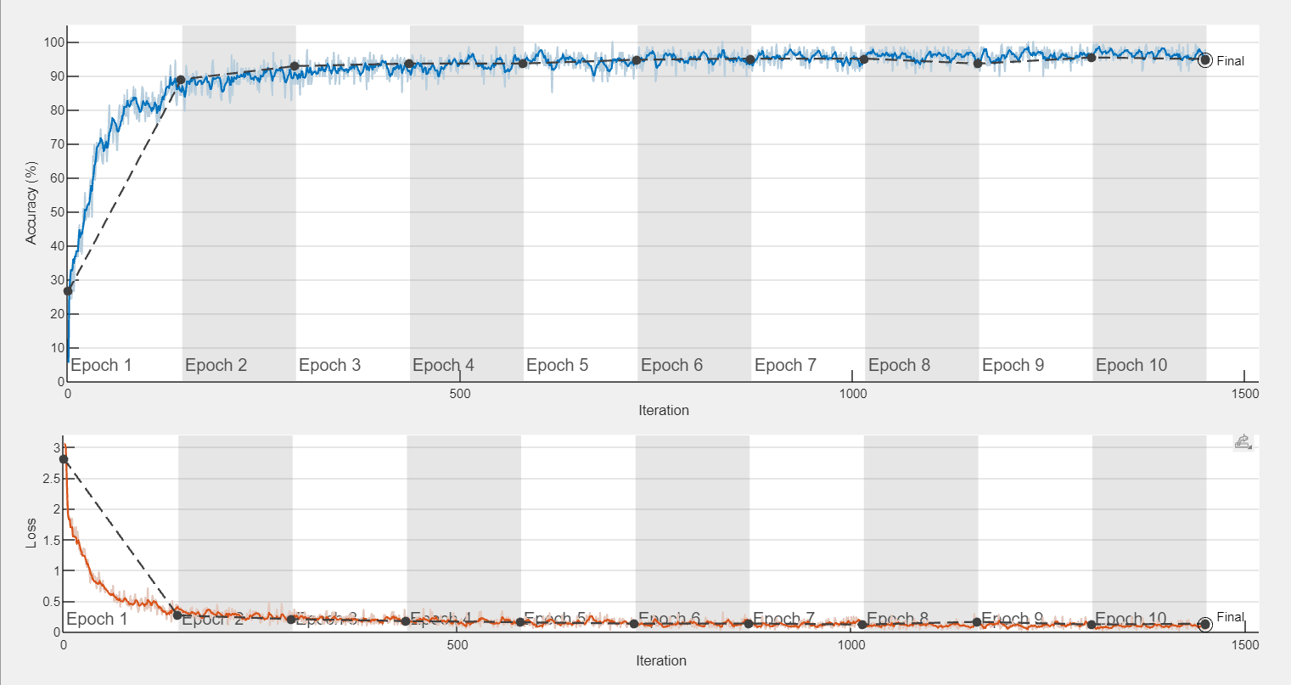
RESULTS
Training Accuracy :
95.34
Validation accuracy :
94.57

Slide 10
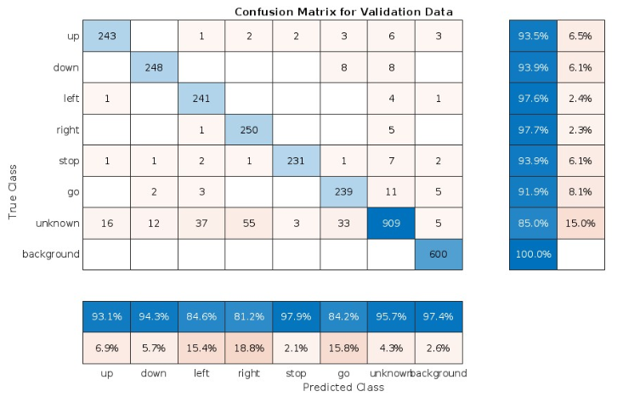
RESULTS

Slide 11

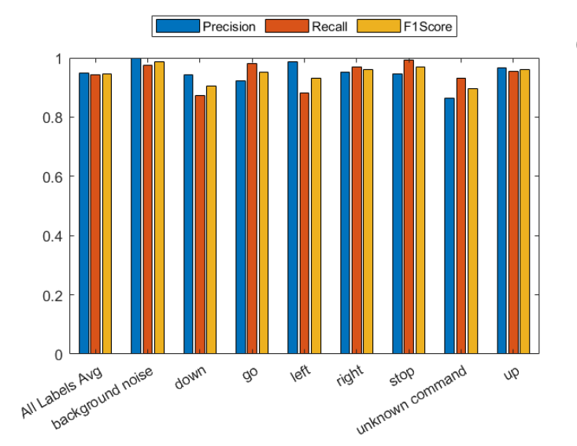
Performance Metrics

Slide 12
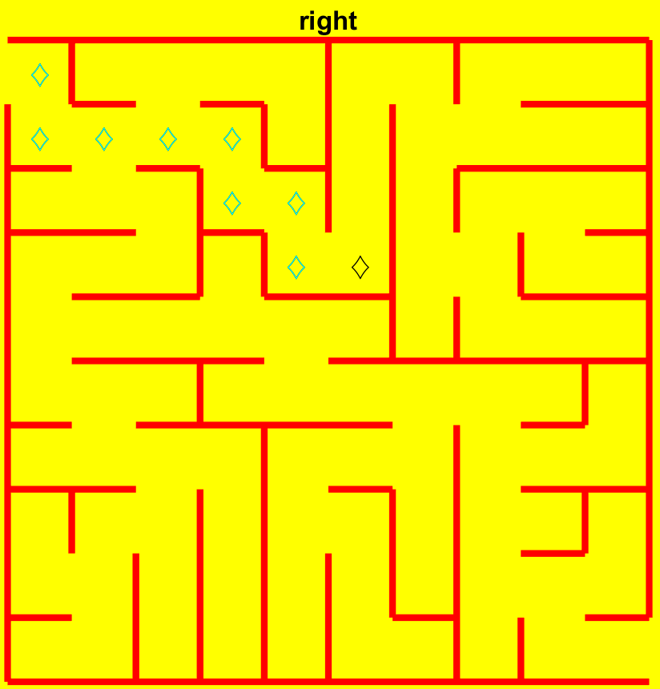
Maze
The maze generates randomly by giving the number of rows and columns as input.
We start from top-left of the maze and must reach bottom-right of the maze to win the game.
The blue diamonds represents the traversed path in past moves.
The black diamond tells the current position where we are in the maze.

Slide 13
CONCLUSION & FUTURE SCOPE
We have achieved a validation accuracy of 94.57% with our existing model.
In the future, we could use these speech commands to play more games.
We can also use this speech commands recognition in smart homes where appliances are controlled using voice commands.

Slide 14
THANK YOU

