Slide 1
Solar Energy Potential Analysis
1M1B Green Internship – Batch 5
Intern Name: Ashritha Reddy Annareddy
ID: 1M1BGI050029
Student ID: 22R61A0508
Email: ashritha03102004@gmail.com
AICTE Internship Student Registration ID: STU6815a52f2f6591746249007

Slide 2
Introduction
Solar energy plays a crucial role in achieving sustainable development by providing a clean, renewable, and reliable alternative to fossil fuels. It not only reduces greenhouse gas emissions but also strengthens energy security, creates green jobs, and supports community resilience.
However, assessing solar energy viability at the community level comes with challenges such as variations in sunlight due to local geography and climate, limited access to accurate geospatial and meteorological data, rooftop suitability issues, and fluctuating economic feasibility based on tariffs.
To address these challenges, this project aims to develop a data-driven tool that can map solar potential and predict energy output, thereby enabling informed decisions and promoting wider adoption of solar power.

Slide 3
Data Collection & Tools
Geospatial Data: Land use, rooftop areas, solar irradiance
Meteorological Data: Sunlight hours, temperature, cloud cover
Economic Data: Local electricity tariffs for cost–benefit analysis
Tools Used:
  Python → Data processing & machine learning modeling
  QGIS → Geospatial mapping & visualization

Slide 4
Geospatial Analysis
Imported & processed multiple geospatial layers in QGIS
Applied Elevation Models to account for shading, slope, and terrain impact
Identified high-potential solar zones using irradiation and rooftop suitability criteria
Automated workflow with Python scripts to ensure accuracy and repeatability

Slide 5
AI Regression Model
Features used:
  Rooftop area
  Solar irradiation
  Ambient and module temperature
  Local electricity tariffs
Model selected:
  Gradient Boosting Regressor for robust nonlinear regression and good handling of complex feature interactions
Data preparation:
  Split dataset into training (80%) and testing (20%) sets
  Ensured representative sampling for reliable evaluation
Model performance:
  Achieved Mean Absolute Error (MAE) indicating precise average prediction accuracy
  Obtained Root Mean Squared Error (RMSE) reflecting low prediction variance

Slide 6
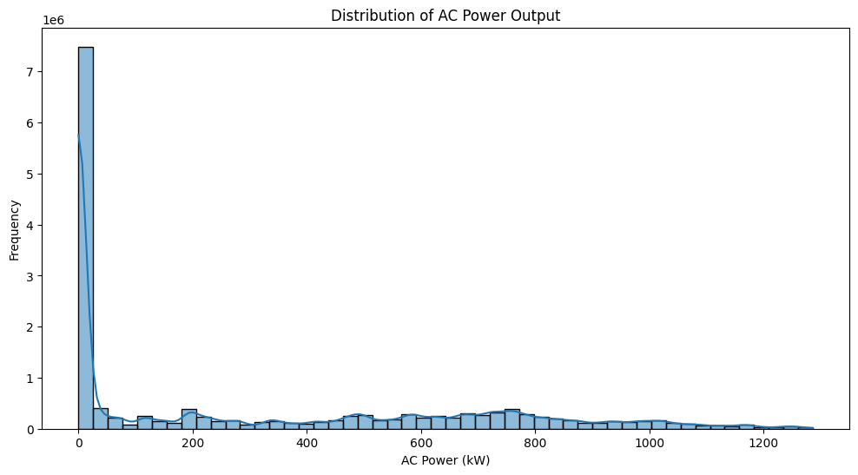
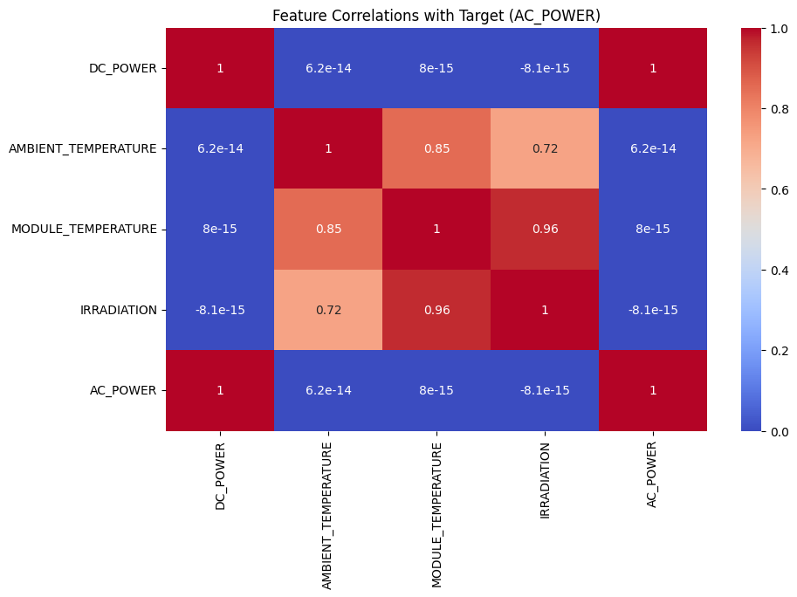
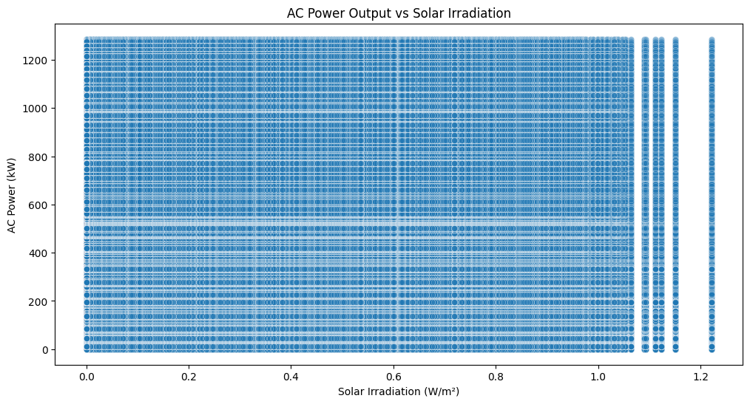
Results & Visualizations

Slide 7
Stakeholder Engagement
Key Stakeholders: Local communities, policymakers, and NGOs
Workshops Conducted: Shared site-specific solar potential reports to raise awareness
Feedback Collection: Gathered insights to improve the tool and plan for future scaling

Slide 8
Challenges & Learnings
Data Challenges: Handling fragmented and multi-source geospatial datasets
Modeling Challenge: Balancing prediction accuracy with interpretability
Visualization Challenge: Creating clear outputs for non-technical audiences
Key Learnings: Improved skills in Python, GIS, ML modeling, and reporting

Slide 9
Future Roadmap
Integration: Collaborate with municipal planning and renewable energy programs
Accessibility: Develop a web-based dashboard for wider public and stakeholder use
Continuous Updates: Incorporate new datasets and add advanced features regularly
Outreach: Promote solar adoption through targeted awareness and engagement programs

Slide 10
Acknowledgments & Contact
Thanks to 1M1B Green Internship Team and Mentors
Contact: ashritha03102004@gmail.com | +91 90363 71972
AICTE Internship Student Registration ID: STU6815a52f2f6591746249007

