Slide 1
A Visual History of Popular Music
Group 3
Ashritha Achutharaman, Peter Harlan, Jason Letrago
Notes:
Hello everyone, I'm Ashritha, and with my teammates, Peter and Jason we'll be presenting our project, A Visual History of Popular Music. Our question is how the sound of music has changed over time. To answer it, we used the Spotify Dataset 1921 to 2020, which has 586,672 tracks and about 1.16 million artists, with audio features such as danceability, energy and acousticness for every song.

Slide 2
Agenda
1.
Dataset Intro and Motivation
2.
Data Cleaning and Processing
3.
EDA
4.
Preliminary ML Direction
5.
Tableau Dashboard
Notes:
Here is what we'll cover. First, I'll introduce the dataset and our question. Second, I'll go through the four fixes we made to clean the data: dates, re-releases, spoken word and structure. Third, I'll walk through two figures from our exploratory analysis. One shows how often artists collaborate, and the other shows where popular artists come from. After that, my teammates will take you through the four chapters of our story: artists, sound, tempo and meaning.

Slide 3
A visual history of popular music: An Introduction
How has the sound of music changed over time?
586,672
1.16M
20
~100
tracks, each with Spotify audio features
artists with followers and popularity
columns: track details plus audio features
years of music, 1920s to early 2021
OUR STORY IN FOUR CHAPTERS
1 Artists
2 Sound
3 Tempo
4 Meaning
Who makes music, and how has that changed?
From quiet acoustic to loud and produced.
Did music get faster and more danceable?
How do songs feel, and what do listeners reward?
Source: Kaggle · Spotify Dataset 1921-2020, 600k+ Tracks · tracks.csv and artists.csv (Spotify Web API)
Notes:
Our project asks one question: how has the sound of music changed over time?
To answer it, we used the Spotify Dataset 1921 to 2020 from Kaggle, which comes from the Spotify Web API. It has two files. The first has 586,672 tracks, each with Spotify's audio features, such as danceability, energy, valence and acousticness, plus details like release date and popularity. The second has about 1.16 million artists, with their followers, genres and popularity. Together they cover roughly a hundred years of music, from the 1920s to early 2021.
We tell the story in four chapters. First, artists: who makes music, and how has that changed? Second, sound: how music moved from quiet and acoustic to loud and produced. Third, tempo: did music get faster and more danceable? And fourth, meaning: how do songs feel, and what do listeners reward?
Before we get to those chapters, I'll walk you through how we cleaned the data, and then what we found in our exploratory analysis.

Slide 4
Data Cleaning
Dates fixed
Re-releases removed
138,591
Year-only dates would be blanked by default parsing. We read the year directly.
59,992
Same song and artist repeated across years. We kept the earliest release.
Spoken word excluded
New columns
22,430
+22
Parsed artist lists, joined artist data, added year, decade and mood.
Audiobooks and comedy (speechiness above 0.66) are left out of the EDA.
Also: 71 unnamed tracks dropped · impossible values set to missing · genre treated as a subset (74% of artists untagged)
Notes:
We made four fixes before any analysis.
First, dates: release dates come in three formats, and default date parsing blanks 138,591 of them, or 23.6%. About 60% of 1920s tracks have only a year, so we read the year from the first four characters and lost no valid years.
Second, re-releases: 59,992 rows repeat a song title and artist, such as remasters and deluxe editions, so we kept the earliest release, and results with and without this step differ by less than 0.01 in the correlation with release year.
Third, spoken word: 22,430 tracks have speechiness above 0.66, mostly audiobooks and comedy, and we excluded them because our question is about music.
Fourth, structure: artist and genre fields were stored as text that looks like a list, so we parsed them, joined the artist table, which matched 97.8% of tracks, and added 22 columns, including year, decade and mood. We also dropped 71 unnamed tracks and set impossible tempo, time signature and loudness values to missing instead of deleting them. About 74% of artists have no genre tags, so genre results cover a subset.
In total, 586,672 raw tracks became 526,608 clean tracks, a drop of 10.2%.

Slide 5
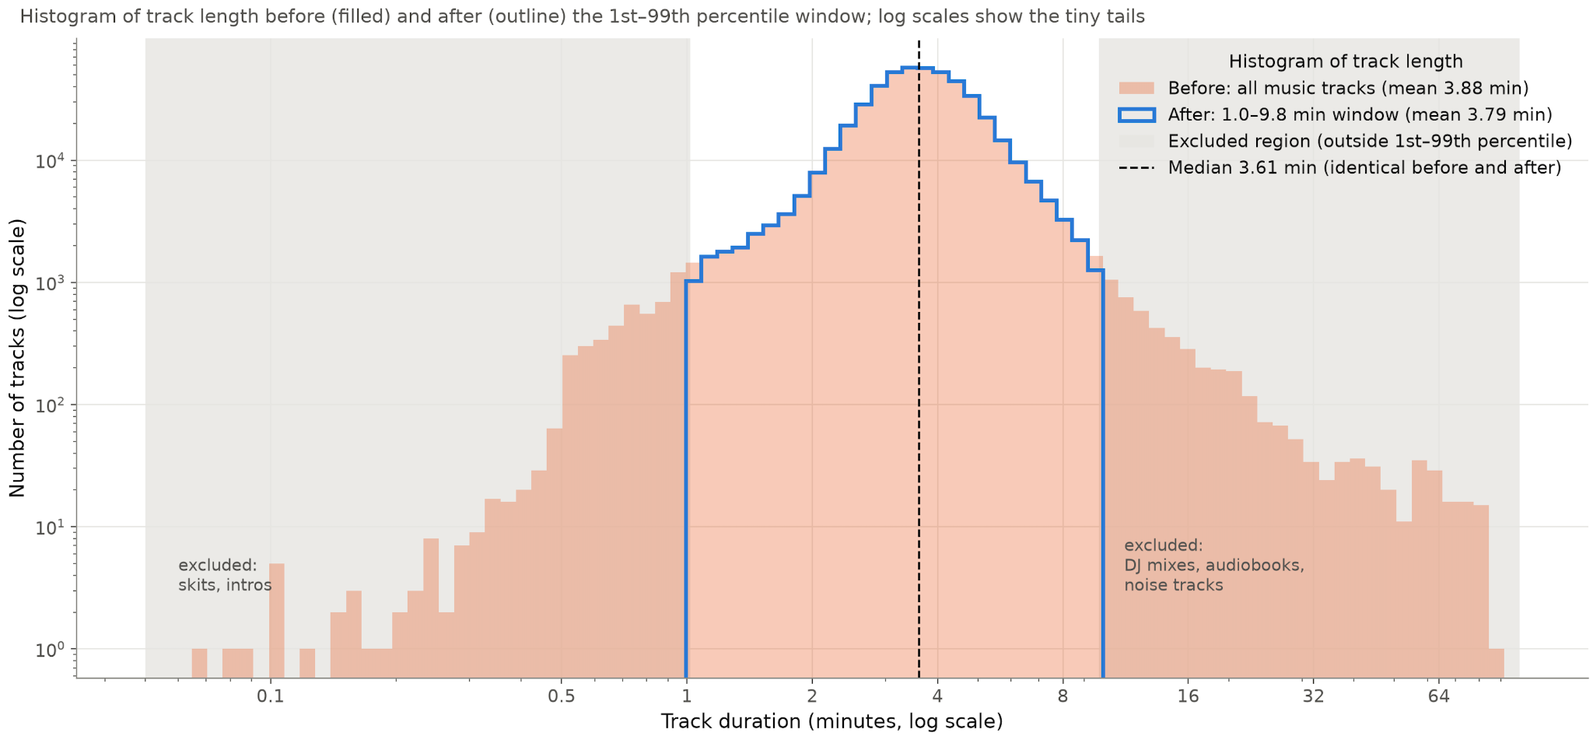
Data Cleaning
Removing Audiobooks, DJ mixes, skits, and noise tracks before/after
Notes:
Before - mean song duration - 3.88 mins
The 1st 99th percentile - between 1 and 9.8 mins
We excluded skits, intros, dj mixes, audiobooks, and noise tracks making up the area outside the 99th percentile
Removing 10,084 extreme duration tracks

Slide 6
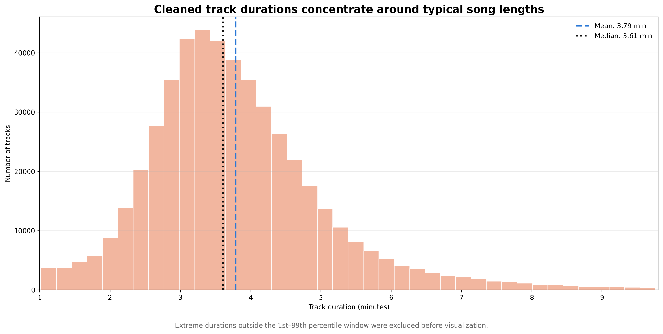
Data Cleaning
Removing Audiobooks, DJ mixes, skits, and noise tracks before/after
Notes:
The mean changed slightly from 3.88 min to 3.79 min - but median stayed the same at 3.61min - so the typical track stayed the same
Most tracks cluster around 3–4 minutes, but a smaller number of longer tracks create a remaining right tail. Because the mean is 3.79 minutes and the median is 3.61 minutes, the longer tracks pull the mean upward

Slide 7
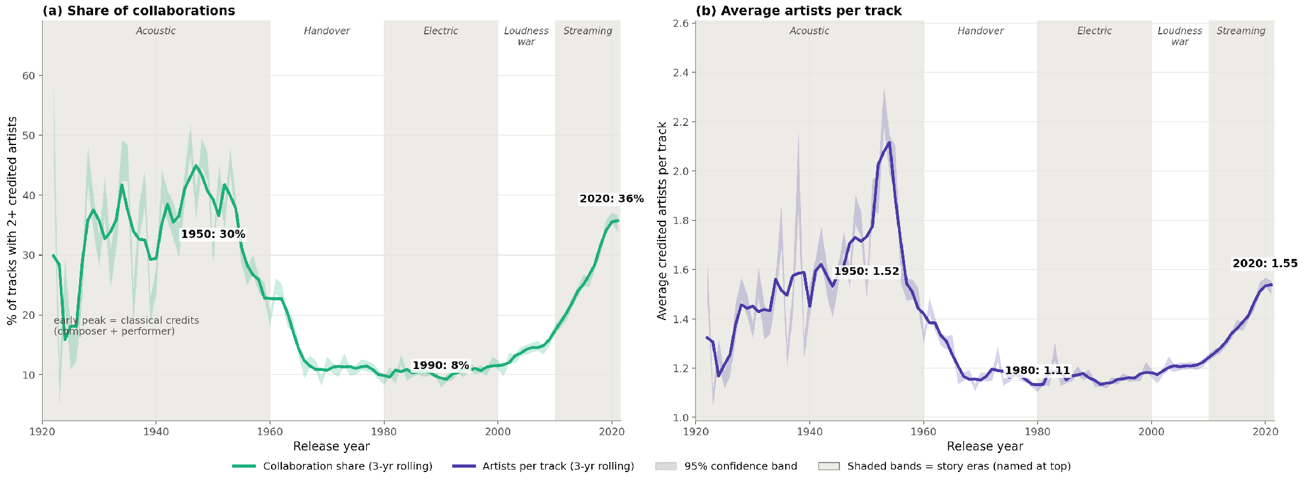
EXPLORATORY ANALYSIS · COLLABORATION
Collaboration is back: 8% of tracks in 1990, 36% by 2020
HOW TO READ IT
(a) Share of tracks with 2+ credited artists. (b) Average artists per track. Shaded bands show 95% confidence.
8%
36%
of tracks in 1990
of tracks in 2020
WHAT WE FOUND
WHAT IT MEANS
Collaboration fell from 30% of tracks in 1950 to 8% in 1990, then climbed to 36% by 2020. Artists per track rose from 1.11 in 1980 to 1.55.
Working together is a streaming-era shift. The early peak is classical credits (composer plus performer), and wide bands before 1940 mean few tracks.
Figure 9 from our EDA · 3-year rolling averages · Source: Spotify tracks dataset (Kaggle)
Notes:
In our exploratory analysis, one question we asked was whether artists work alone or together, and how that has changed.
These two charts show it by release year. On the left is the share of tracks that credit two or more artists. On the right is the average number of artists per track. The shaded bands show our uncertainty, so a wider band means fewer tracks that year.
What we found is a U shape. In 1950, about 30% of tracks had multiple artists. By 1990 that dropped to 8%, roughly one track in twelve. Then it climbed back to 36% by 2020, more than one in three. Artists per track tell the same story, going from 1.11 in 1980 to 1.55 in 2020.
Two things to keep in mind. The early peak is mostly classical recordings, where the credits list both a composer and a performer, so it reflects how credits were written, not more collaboration. And the wide bands before 1940 mean very few tracks, so we read those years with care.
The takeaway: working together is a streaming-era shift. Next, we'll look at where popular artists come from."

Slide 8
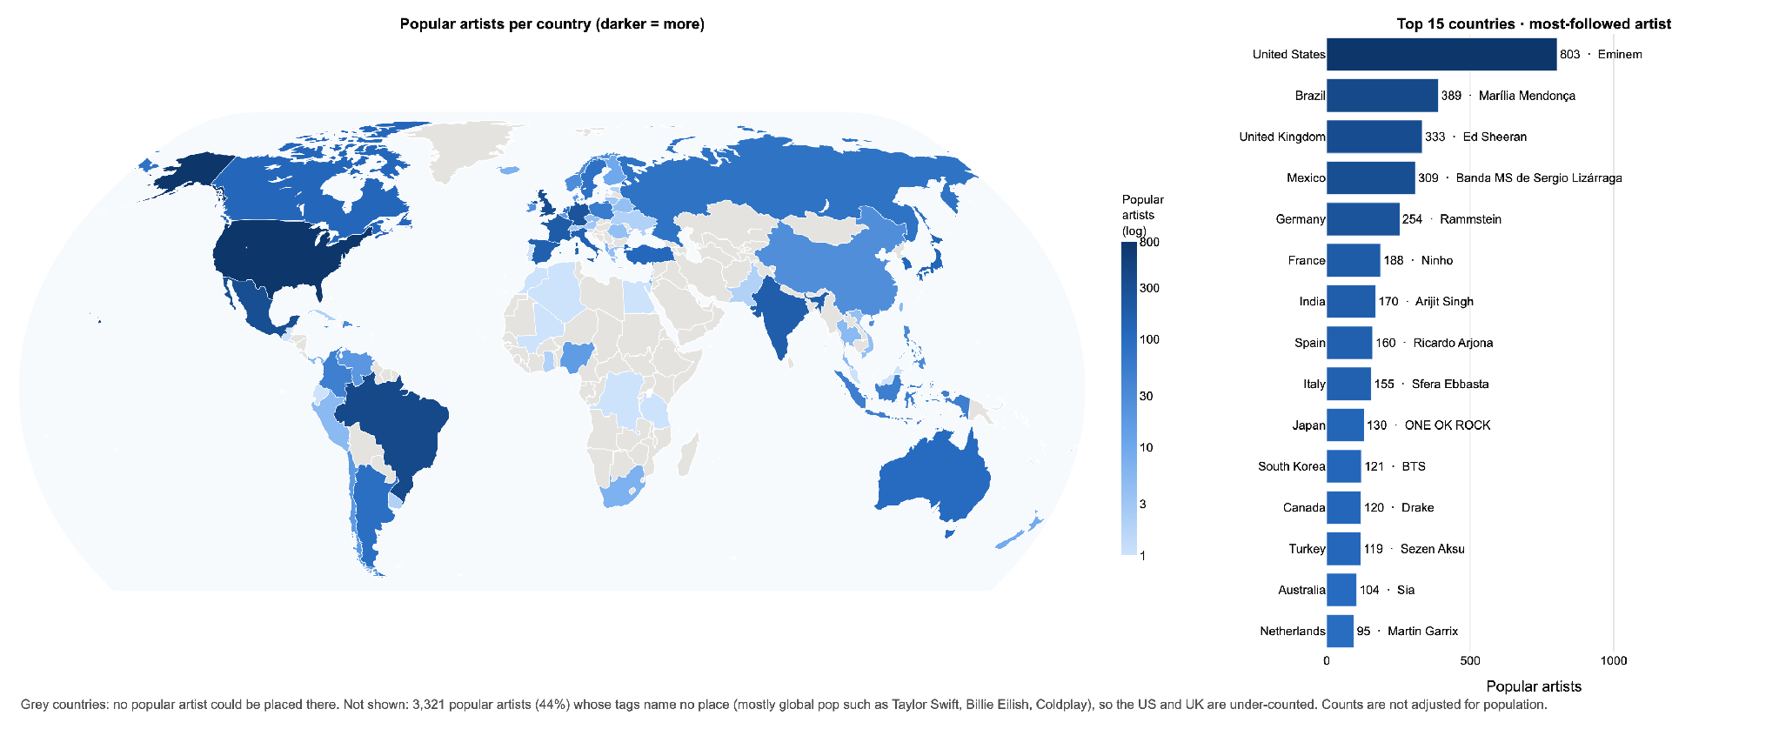
EXPLORATORY ANALYSIS · GEOGRAPHY
Popular artists come from 72 countries, led by the US and Brazil
HOW TO READ IT
Popular means Spotify popularity of 60 or more. Darker countries have more such artists.
72
44%
countries placed
of artists not placed
WHAT WE FOUND
WHAT IT MEANS
The United States leads with 803 popular artists, then Brazil (389), the United Kingdom (333), Mexico (309) and Germany (254).
Country is inferred from genre tags and not adjusted for population. 44% of popular artists name no place, so the US and UK are under-counted.
Figure 16 from our EDA · Grey countries: no popular artist placed · Source: Spotify artists data (Kaggle)
Notes:
This figure from our exploratory analysis asks one question: where do the artists people stream today come from?
The dataset has no country field, so we inferred each artist's country from their genre tags. For example, k-pop maps to South Korea. Then we counted the artists with a Spotify popularity of 60 or more in each country.
On the map, darker blue means more popular artists, and the scale is logarithmic so smaller countries stay visible. Grey countries are ones where we couldn't place any popular artist. The bar chart on the right ranks the top 15 countries and names the most-followed artist in each, such as Eminem for the United States and Ed Sheeran for the United Kingdom.
What we found is that popular artists come from 72 countries. The United States leads with 803, followed by Brazil with 389, the United Kingdom with 333, Mexico with 309 and Germany with 254. Brazil, Mexico, India, Spain, Japan and South Korea all make the top 15, so popular music is not only English-language.
However, about 44% of popular artists, 3,321 of them, have genre tags that name no place. They are mostly global pop acts like Taylor Swift, Billie Eilish and Coldplay. That means the United States and the United Kingdom are under-counted. The counts also aren't adjusted for population, so larger countries naturally have more.
So the takeaway is that we can show where popular artists are visibly placed, so we treat this as a picture of geographic spread, not a final count.

Slide 9
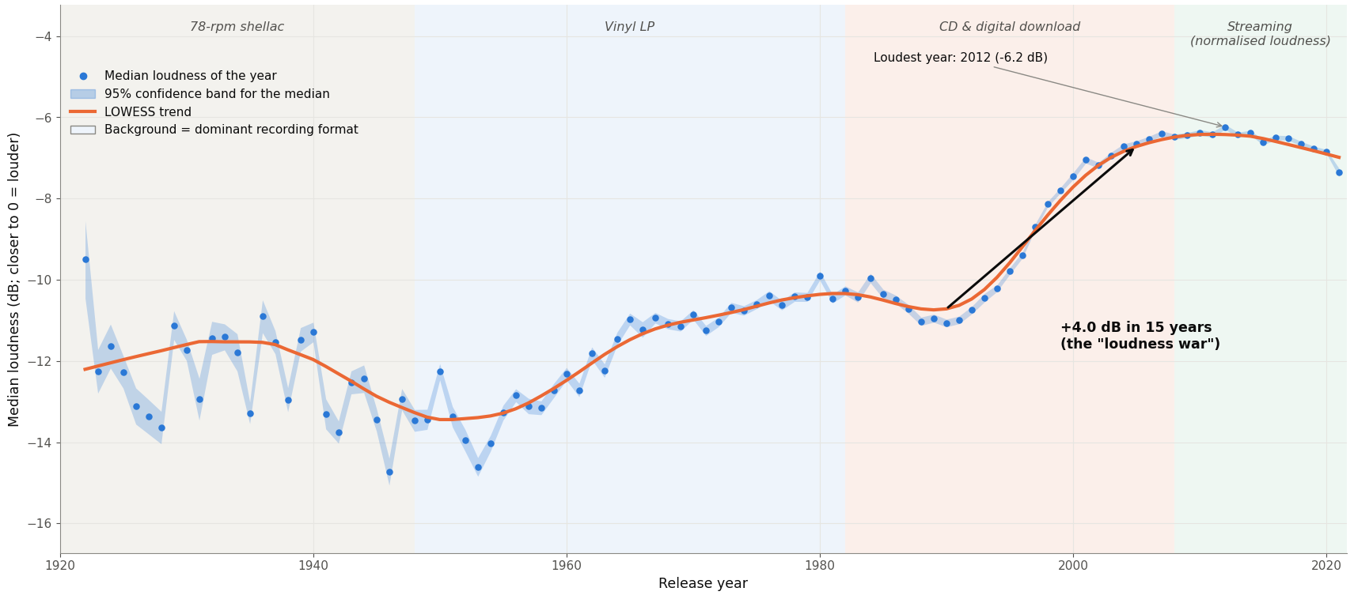
EXPLORATORY ANALYSIS · LOUDNESS
Music got about 7 dB louder, steepest in the CD era
HOW TO READ IT
Yearly median loudness (dots) with a LOWESS trend. Backgrounds mark the dominant recording format.
+4 dB
2012
in 15 years (1990 to 2005)
loudest year (-6.2 dB)
WHAT WE FOUND
DECISION
Median loudness rose from about -13 dB in the 1950s to -6.2 dB in 2012, then eased slightly under streaming.
Loudness separates the CD and streaming eras from earlier ones, so it stays a key feature. It is flat after 2005, so recent eras overlap.
Figure 20 from our EDA · Yearly medians · Source: Spotify tracks dataset (Kaggle)
Notes:
Loudness is a good way to see how music was made and sold over time.
Each dot is a year's median, the line is the trend, and the colored bands show the main recording format.
Overall, music got about 7 decibels louder, with the biggest jump in the CD era.
It peaked in 2012, then dipped a bit once streaming took over.
Loudness is a good clue for dating a song, since newer music is much louder than older music. So we'll keep it as a key feature
But loudness stopped rising after 2005, so it can't separate recent years from each other.

Slide 10
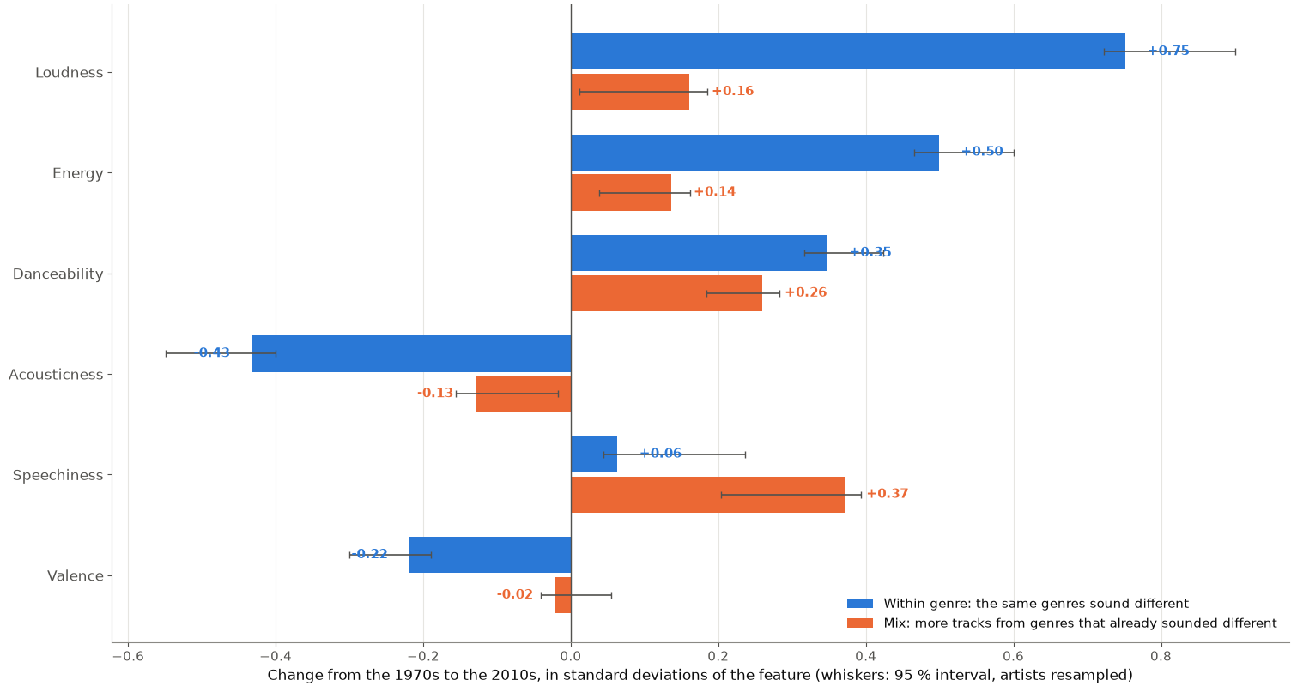
EXPLORATORY ANALYSIS · GENRE MIX
Loudness changed within genres; speech is mix
HOW TO READ IT
1970s to 2010s change in standard deviations. Blue: within genres. Orange: genre mix.
68%
+0.37
of the pooled change is within genres
speechiness change from genre mix
WHAT WE FOUND
DECISION
Loudness (+0.75), energy (+0.50) and acousticness (-0.43) moved mostly within genres. Speechiness is mostly genre mix.
The shift to loud, electric sound is real, so audio can separate eras. Genre is linked to era, so we will test it as a control.
Figure 59 from our analysis · 1970s vs 2010s, genre-tagged artists, 95% intervals from resampled artists · Source: Spotify tracks dataset (Kaggle)
Notes:
A question we asked is whether music itself changed, or whether we just started listening to different genres.
This chart splits the change into two parts. Blue is change within genres, so the same genres sounding different.
Orange is change from the genre mix.
For loudness, energy and acousticness, most of the change happened within genres, so that shift toward louder, more electric music is real.
Speechiness is the exception. That's mostly the genre mix, probably from hip hop growing.
Overall, about 68 percent of the change is within genres. So audio features should help us separate eras, and we'll test genre as a control.

Slide 11
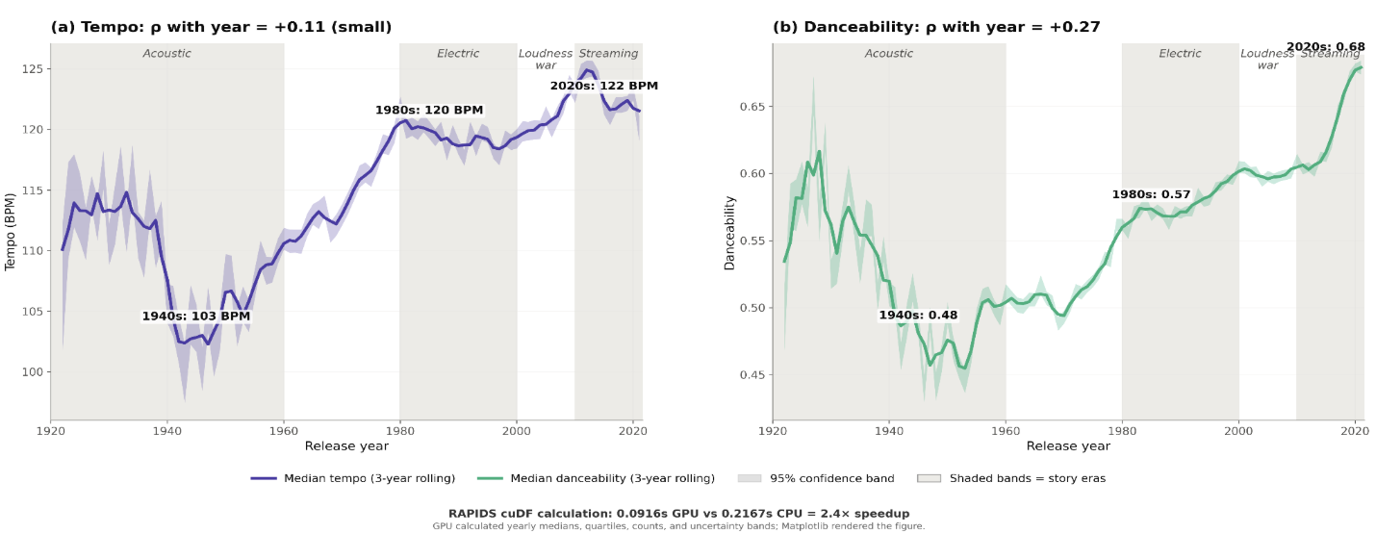
EXPLORATORY ANALYSIS · AUDIO FEATURES
Tempo and Danceability Share Similar Movement
HOW TO READ IT
The change in tempo (BPM) and danceability (0-1) over time. Both Staying within 95% confidence interval band.
125 BPM
0.68
Tempo reaches its peak in the ‘streaming era’
Songs are becoming more ‘danceable’
WHAT WE FOUND
DECISION
Both Tempo and Danceability decline in the ‘40s before increasing through the ‘80s. Tempo increase was uneven and much less consistent than the rise in danceability.
Danceability is a strong indicator of rhythmic change, while Tempo is more uneven and era-dependent.
GPU Figure 33 from our EDA · Source: Spotify tracks dataset (Kaggle)
Notes:
Tempo did not rise steadily across the entire period. It fell to about 103 BPM in the 1940s, then increased to approximately 120 BPM by the 1980s and 122 BPM in the 2020s. That 19 BPM increase is meaningful, but the pattern is uneven. Danceability shows the clearer long-term shift because it rises more consistently after the 1950s.
3-year rolling median- reducing year-to-year noise - we can focus on the trend
Danceability - measured algorithmically - 0-1 scale -measured using-
Tempo: The overall speed or pace of the song.
Rhythm stability: How consistent and steady the rhythm is throughout the track.
Beat strength: The intensity and clarity of the beat.
Overall regularity: How predictable and uniform the musical elements are
0.0916 seconds on the GPU, compared with 0.2167 seconds on the CPU, a 2.4× speedup
RAPIDS cuDF calculated the yearly medians, quartiles, counts, and uncertainty bands on the GPU. The GPU and CPU produced matching results, and the measured GPU speedup is shown on the figure.

Slide 12
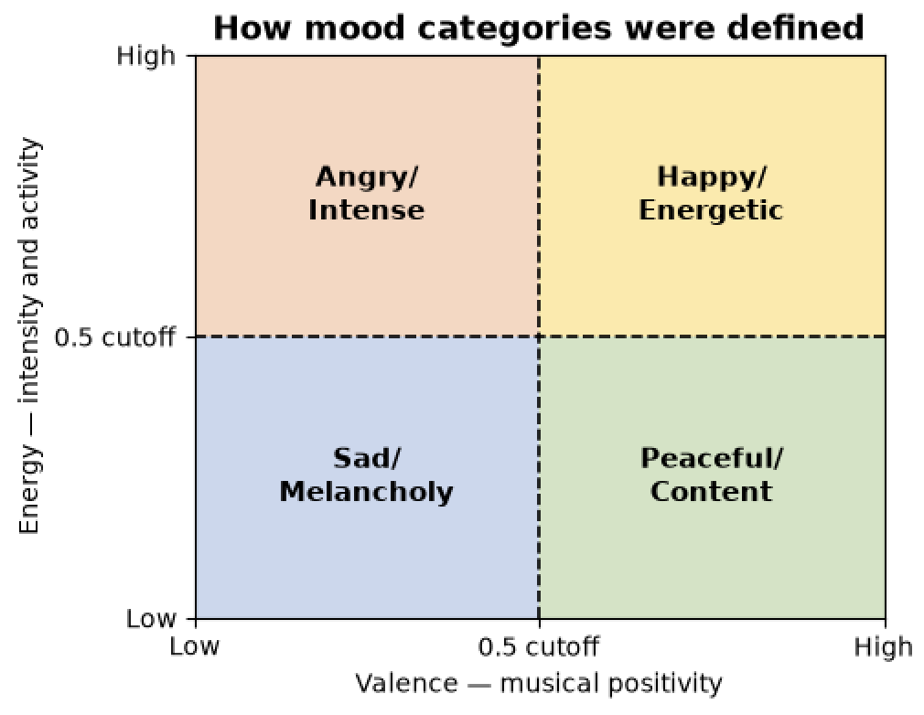
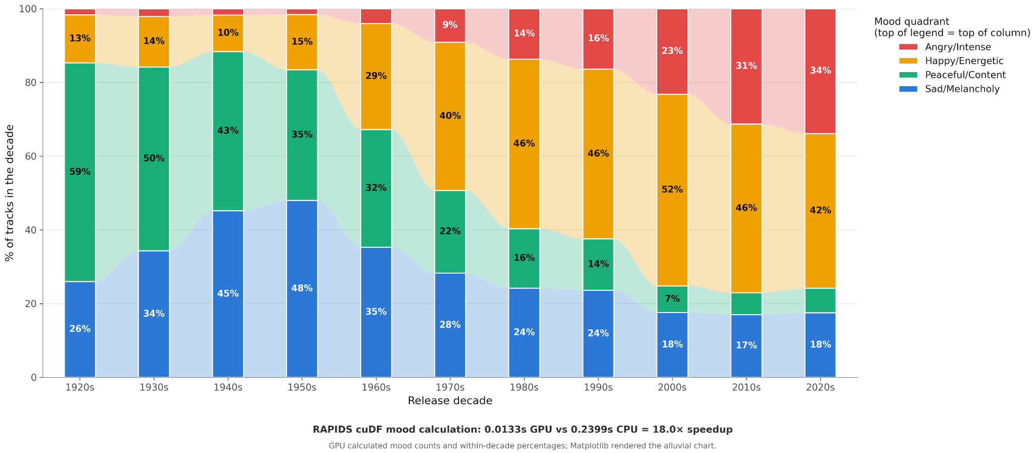
EXPLORATORY ANALYSIS · MOOD
Song ‘Mood’ Change Over the Decades
WHAT WE FOUND
DECISION
There’s a clear shift in ‘Mood’ of tracks in the 1950s where ‘Happier’ /more energetic song styles start to increase and the lower energy ‘Mood’ categories trend downward.
We should use energy and valence for detailed analysis/modeling but use the mood quadrants to communicate broad decade-level patterns.
GPU Figure 52 and Mood chart from our EDA · Source: Spotify tracks dataset (Kaggle)
Notes:
Spotify provides energy and valence scores rather than literal mood labels. We used those scores as proxies and divided the songs into four mood quadrants using a 0.5 cutoff. These categories describe the musical character of the tracks, not their lyrical meaning or the listener’s actual emotion.
These mood categories simplifie the data - allowing for easier comparison of decade change but they do not capture subtle mood changes in songs and lyrics arent measrued
RAPIDS cuDF calculated the mood counts and within-decade percentages on the GPU. The alluvial ribbons were rendered afterward using the small aggregated table.
RAPIDS reasoning-
GPU acceleration was then used for filtering, duplicate removal, conditional classification, and groupby aggregation

Slide 13
Preliminary ML Direction
Can a song's sound predict its era?
Proposed task: multiclass classification of release era (4 classes) from Spotify audio features.
Four eras we would predict
Pre-1960
1960–79
1980–99
2000+
Notes:
For our machine learning direction
Our question is: can a song's sound alone tell us what era it came from?
We frame it as a four-way classification: pre-1960, 1960 to 79, 1980 to 99, and 2000 plus.
We haven't tuned anything yet. This is just a quick check that the idea works.

Slide 14
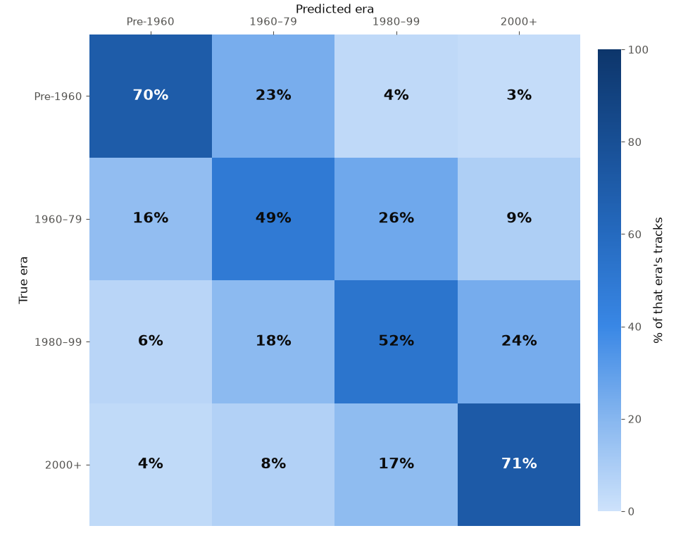
PRELIMINARY ML DIRECTION · FEASIBILITY CHECK
Sound predicts era; mistakes are mostly one era off
HOW TO READ IT
Each row is a true era, each column the predicted era. Random forest, tested on artists it never saw during training.
0.59
79%
macro-F1, guessing 0.14
of errors one era off
WHAT WE FOUND
DECISION
1960-79 (49% recall) and 1980-99 (52%) are hardest. About 92% of tracks land in the right or next era.
Era prediction is feasible. Eras are 12% to 37% of tracks, so we use class weights and macro-F1.
Figure 58 from our analysis · 5-fold artist-grouped macro-F1 0.60 · logistic regression 0.53 · Source: Spotify tracks dataset (Kaggle)
Notes:
For that check, we trained a random forest and tested it on artists it had never seen, so it couldn't just memorize them.
Each row is the true era and each column is what the model predicted. We got a macro-F1 of 0.59, compared to 0.14 for just guessing.
And the mistakes aren't random.
About 79 percent are only one era off, so roughly 92 percent of songs land in the right era or the one next to it.
The middle eras are the hardest, at around 50 percent recall.
Since the eras are only mildly imbalanced, class weights and macro-F1 are enough for now.

Slide 15
Planned Approach
How we would build it
01
02
03
04
05
Features
Split
Rebalance
Model
Evaluate
Acousticness, energy, loudness, danceability, valence and more
Hold out whole artists so none appear in both train and test
4 era classes. Class weights first, then SMOTE on training data only
Baselines run: logistic 0.53, forest 0.59 macro-F1. Next: tune, try boosting
Macro-F1, per-class recall and a confusion matrix, not accuracy alone
WATCH-OUTS
Neighbouring eras blur (79% of errors)
Energy, loudness, acousticness overlap
2020s is only a partial year
Notes:
So here's how we'd build it.
We use the Spotify sound features, and we can keep all of them since the highest VIF is only 4.6.
We split train and test by artist, so the model learns sound and not artists. We start with class weights and only try SMOTE if we need it.
We already have two baselines, logistic regression at 0.53 and random forest at 0.59, and next we'll tune and try gradient boosting.
We'll judge everything by macro-F1 and per-era recall.
A few watch-outs: neighboring eras blur together, some features overlap, and the 2020s are only a partial year.

Slide 16
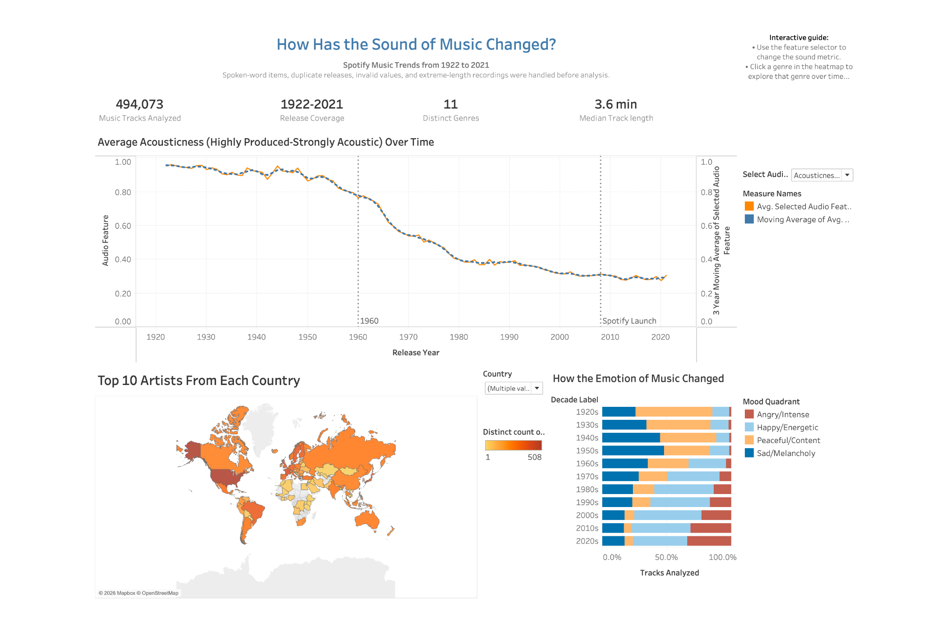
Dashboard
Notes:
DASHBOARD
NUll values in genre -
**(b) Why it matters.** Spotify assigns genres mainly to artists who have enough listeners. Genre is therefore missing *not at random*: it is biased toward established, more-followed artists, as the median follower counts above show. There are also about 5,000 distinct tags (for example "deep latin alternative" and "canadian contemporary r&b"), which is far too many to plot.
**(c) What I did.** I mapped every tag to one of **10 broad families** (Pop, Rock, Hip hop/Rap, Electronic/Dance, R&B/Soul, Jazz, Classical, Country/Folk, Metal, Latin), plus **Other**, using keyword rules applied in priority order. The order handles hybrids: "pop rap" becomes Hip hop/Rap and "country rock" becomes Country/Folk. Each artist then gets the family that most of their tags fall into, and ties are broken by the priority order. Genre is used **only** for tracks whose primary artist has at least one tag. Every genre chart says so.
The null in the dashboard represents artists with no genre assigned to them
We use 1960 as the beginning of the transition because the data shows acousticness and energy converging through the 1960s, with the actual crossover occurring around 1975. Therefore, 1960 is an analytical boundary—not a claim that music changed instantly that year.
The 1920s contain only 1.3% of the tracks.
The 1990s contain 18.6%.
The 2020s are incomplete because they include only 2020 through April 2021

Slide 17
Thank you!

