Slide 1





k8 cluster failure issue prediction using xgboost
Done By
Ashritha Arunkumar
B Dhivya
Manasvini V
Pranati Biswal

Slide 2
Overview
Introduction
Problem
Dataset & Data Preprocessing
Model Selection – LightGBM vs. XGBoost
Results
Conclusion

Slide 3
Introduction
Kubernetes clusters face various operational challenges, such as node failures, resource exhaustion, network disruptions, and pod evictions. Identifying these issues early helps in proactive management, reducing downtime and improving system stability.
This project leverages Machine Learning (ML) models, to classify six types of cloud issues based on system metrics

Slide 4

Problem
Node or Pod Failures
Resource Exhaustion
Network Issues
Detect when nodes/pods are likely to crash.
Predict CPU, memory, or disk running out.
Identify failures, packet loss, or high latency.
Service Disruptions
Pod Evictions
Slow Response Times
Detect anomalies in logs indicating failures.
Predict pod evictions due to resource pressure.
Identify high latency caused by contention.

Slide 5

Dataset:
Synthetic data generated for training and testing.
Covers key Kubernetes infrastructure metrics to simulate real-world failures
Features Included:**
System Metrics: CPU usage, memory consumption, disk usage.
Network Metrics: Latency, packet loss, connectivity status.
Logs & Events: System logs, pod status, failure events.
Dataset & Data Preprocessing
Data Preprocessing Steps:
One-Hot Encoding: Converts categorical variables into numerical format.
Feature Scaling: Used StandardScaler to normalize feature distributions.
Class Balancing: Applied SMOTE (Synthetic Minority Over-sampling Technique) to handle imbalance.
Outcome:
Improved model performance by ensuring well-processed and balanced data.

Slide 6

Model Selection – LightGBM vs. XGBoost
LightGBM
XGBoost
Pros
Faster training on large datasets due to leaf-wise tree growth.
Handles categorical features efficiently.
Lower memory consumption, making it suitable for large-scale cloud environments.
Cons
Can overfit small datasets.
Less interpretable than XGBoost
Pros
High accuracy with robust regularization techniques.
Handles missing values and imbalanced data effectively.
Well-optimized and widely used in ML competitions.
Cons
Slower than LightGBM for large datasets.
Higher memory usage

Slide 7

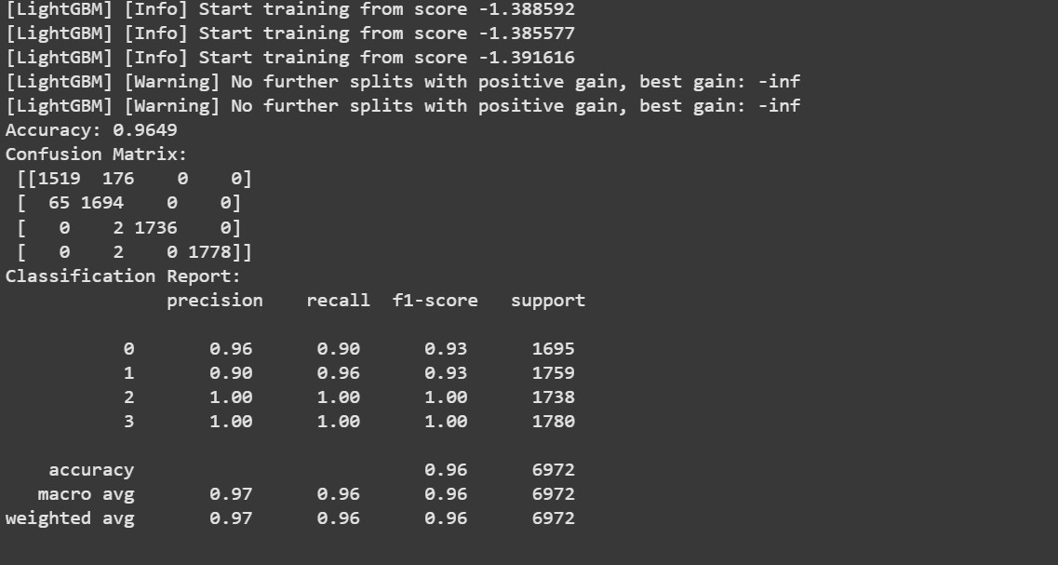
Results
LightGBM

Slide 8
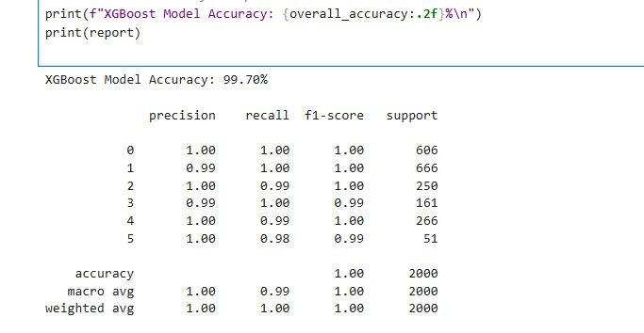
Results
XGBoost

Slide 9
Results
Conclusion
XGBoost outperformed LightGBM with higher accuracy (99%) and better recall for rare failure events.
The model ensures better reliability in Kubernetes failure prediction.

Slide 10
Conclusion
This project used XGBoost (99% accuracy) to predict six Kubernetes failures, outperforming LightGBM. Techniques like feature engineering, SMOTE, and model tuning improved accuracy, enabling proactive issue resolution and reducing downtime.
Future improvements include real-time integration, automated remediation, and cloud deployment, enhancing AI-driven Kubernetes monitoring for greater reliability and efficiency.

Slide 11
Thank You So Much

