Slide 1

2XXX
Crowd-Sourced Road Hazard Detection & Driver Alert System
ALGOMATH DATATHON 2026
Review-2: Mathematical Foundation & Implementation

Slide 2
Problem Statement
  Drivers often encounter:
  Sudden road blocks
  Construction zones
  Accident-prone roads
  These hazards are known to locals or recent drivers, but not to others.

Slide 3
Proposed Solution
(What Our App Is)
A Road Intelligence App that:
  Collects hazard reports from users
  Analyzes risk mathematically
  Alerts upcoming drivers in advance
🧠 Focus: Prevention through information

Slide 4
Inputs to the Model
User-provided data:
  Hazard Type (Construction / Blocked / Accident)
  Severity Level (1–5)
  Time of Day (Day / Night)
📌 These inputs directly affect road safety risk.

Slide 5
Output of the Model
The system predicts:
  🟢 Green – Safe
  🟡 Yellow – Caution
  🔴 Red – High Risk
Also generates:
  Confidence score (0–1)
  Driver alert message

Slide 6
Why Mathematics Is Needed
Raw user reports are:
  Subjective
  Inconsistent
Math helps us:
  Convert opinions → numbers
  Compare different hazards fairly
  Generate consistent decisions

Slide 7
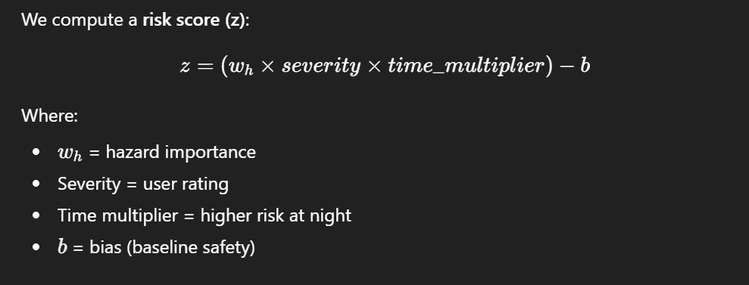
Core Risk Equation

Slide 8
Why Bias (b) Is Used
Bias shifts the decision boundary.
Without bias:
  Every road looks risky
With bias:
  Only serious hazards become 🔴 Red
📌 Bias ensures realistic risk prediction

Slide 9
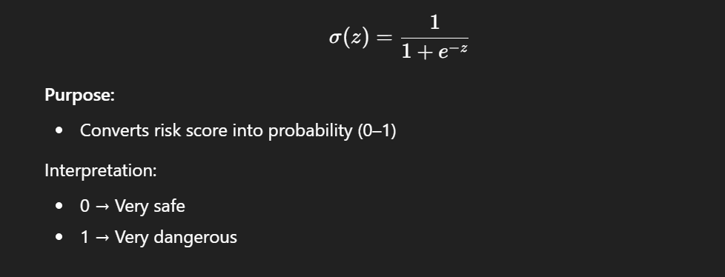
Sigmoid Function

Slide 10
Why Sigmoid Is Needed
Risk is not binary.
Sigmoid allows:
  Smooth decision making
  Gradual increase in alert strength
  Confidence estimation

Slide 11
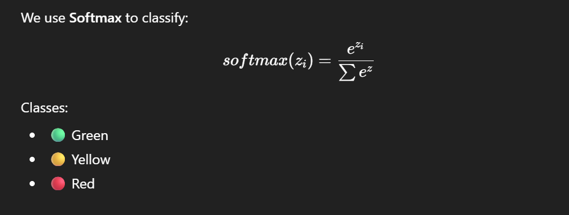
Multi-Class Risk Classification (SoftMax)

Slide 12
Working Mechanism (Step-by-Step)
  User reports road condition
  Hazard weight is selected
  Risk score z is calculated
  Sigmoid estimates danger probability
  Softmax selects risk category
  Alert is sent to driver

Slide 13
Python Implementation
Language: Python
Libraries Used: math
Key functions:
  sigmoid(z)
  softmax(z)
  analyze_safety()

Slide 14

Loss Function (Conceptual Training Phase)
To convert the rule-based model into a learning system, we use a loss function during training.
The loss function compares the predicted risk probability with the true risk label provided in historical data.
Binary Cross Entropy Loss is used to measure prediction error.

Slide 15
Future Scope
  Train weights using real data
  Add GPS & map integration
  Emergency service alerts
  Wearable device integration

Slide 16
Thank You

