Slide 1
PERFORMANCE PREDICTION FOR PORTING ALGORITHMS AND APPLICATIONS TO ARCHITECTURES
KARAN SAPRA, ASHRIT SHETTY & Dr. Melissa smith

Slide 2
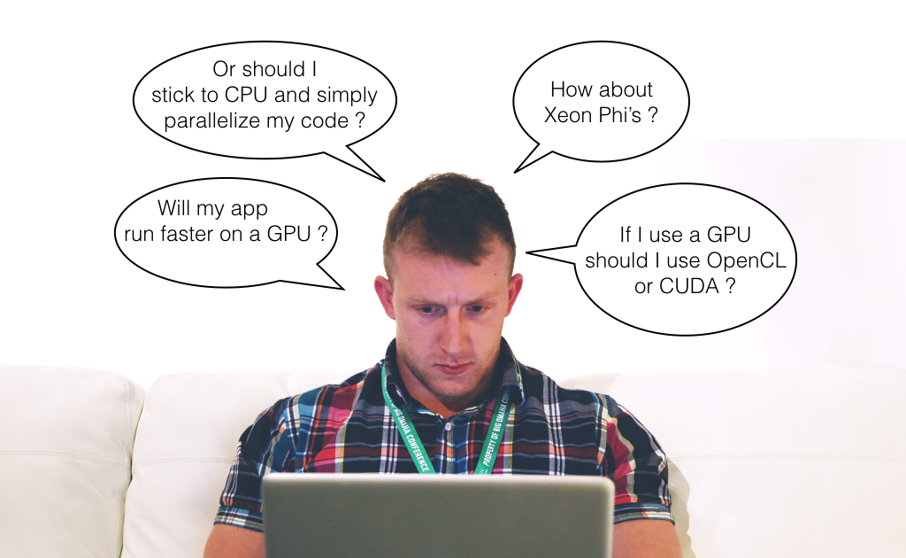
motivation

Slide 3
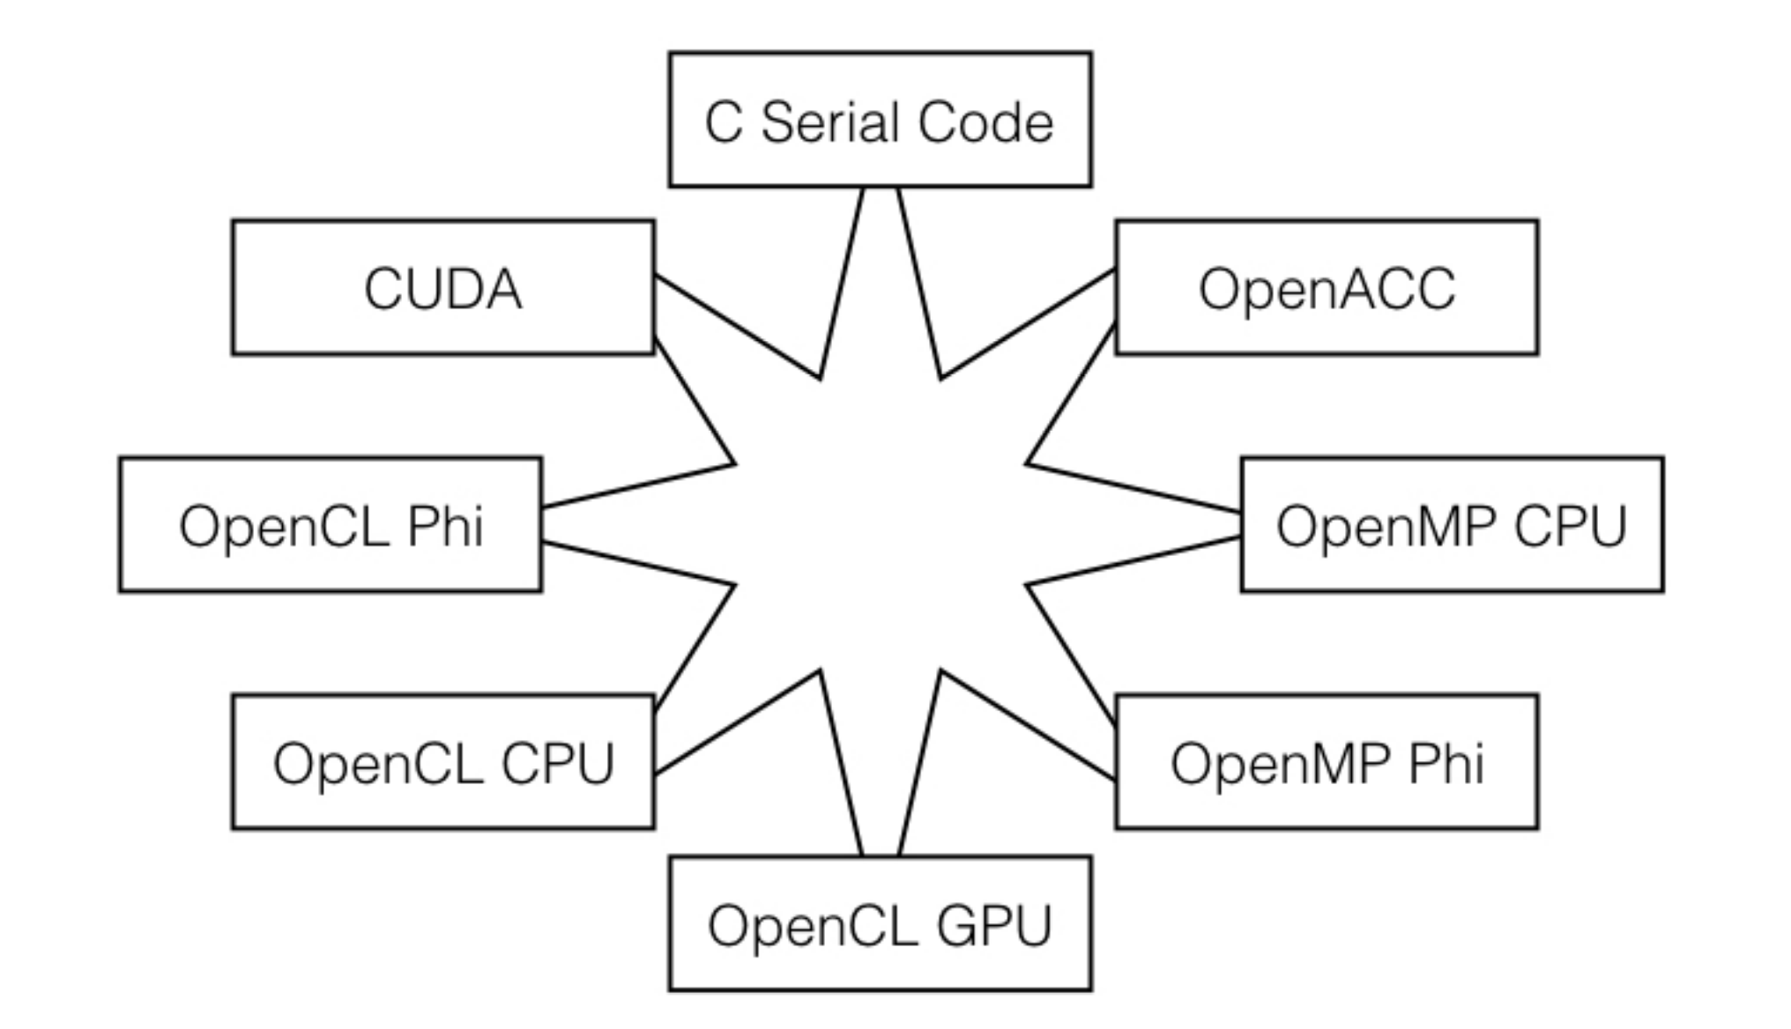
motivation
Performance mapping from one architecture to another

Slide 4
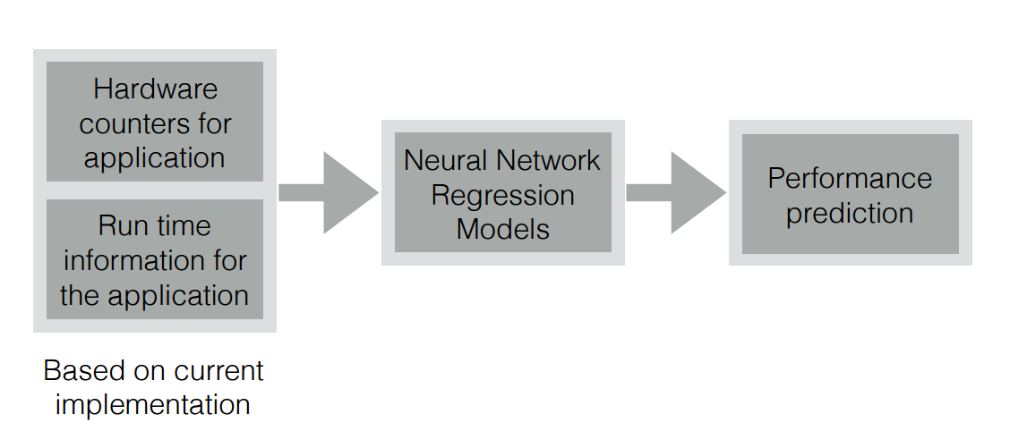
Model architecture
Block diagram of our prediction model

Slide 5
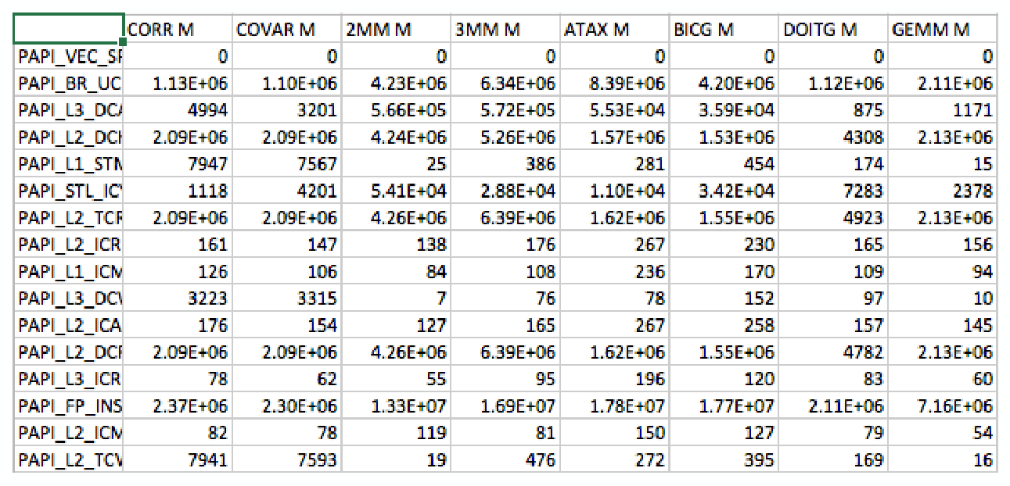
dataset
Sample values of hardware counters for serial C implementation

Slide 6
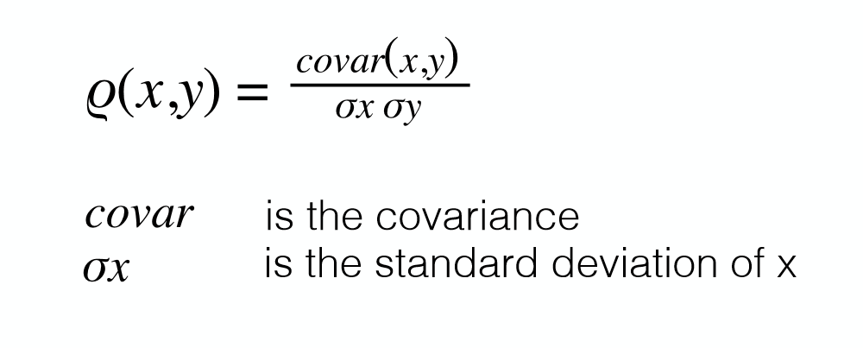
Feature selection
Pearson Coefficient (r)
Pearson coefficient gives a value between -1 and +1 where 1 is most correlated,
0 is no correlation and -1 is most negatively correlated

Slide 7
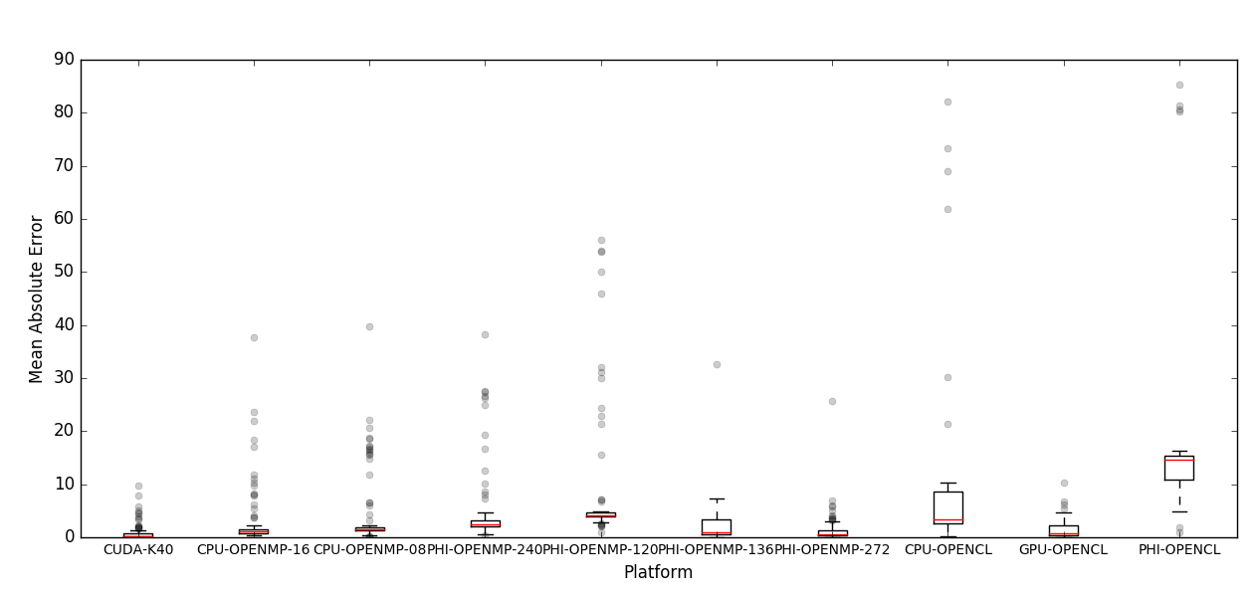
Quantitative results
Performance prediction for 10 different platform and conﬁgurations
using serial implementation in C and PAPI hardware counters

Slide 8
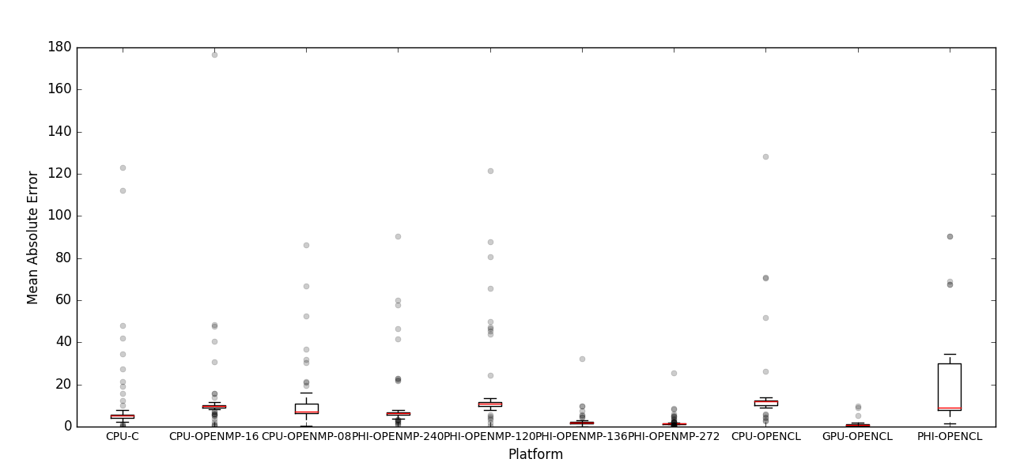
Quantitative results
Performance prediction for 10 different platform and conﬁgurations using
parallel implementation in CUDA and CUPTI hardware counters

Slide 9
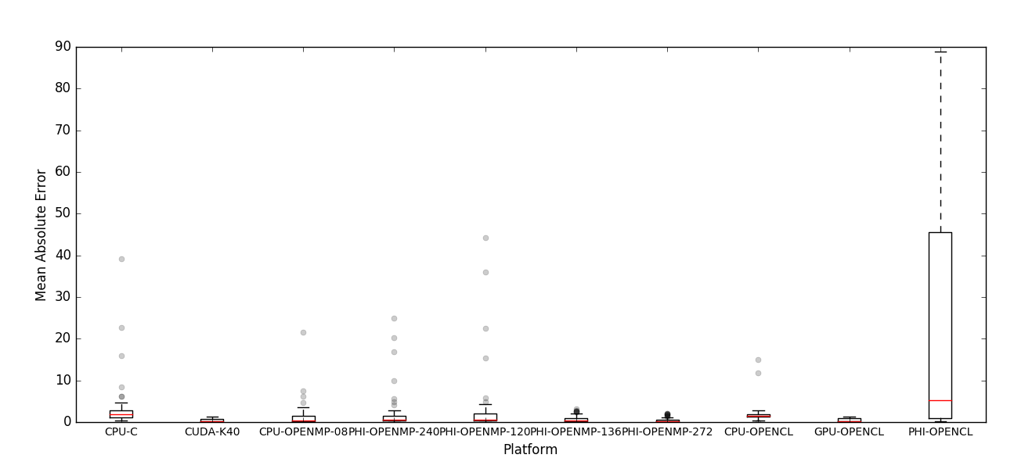
Quantitative results
Performance prediction for 10 different platform and conﬁgurations using
parallel implementation in OpenMP (CPU) and PAPI hardware counters

Slide 10
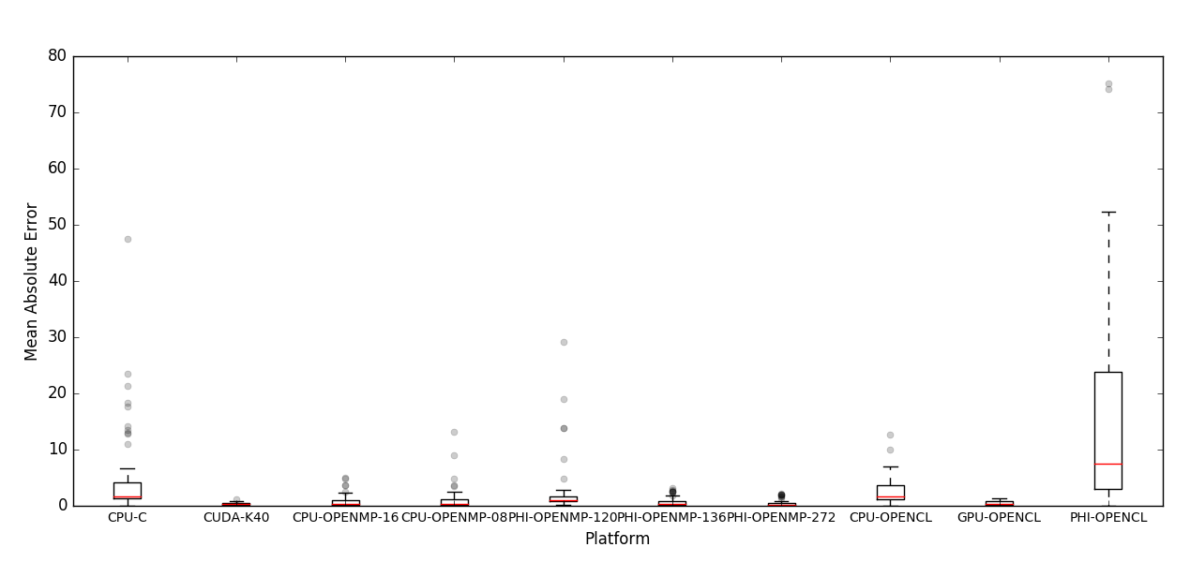
Quantitative results
Performance prediction for 10 different platform and conﬁgurations using
parallel implementation in OpenMP (Xeon Phi) and PAPI hardware counters

Slide 11
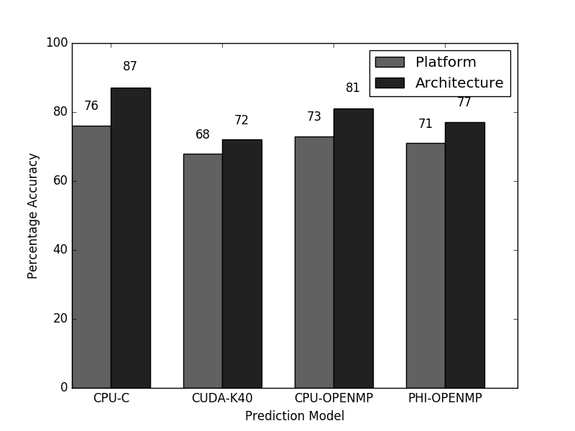
Qualitative results
Architecture and platform prediction using
serial implementation in C and PAPI hardware counters

Slide 12
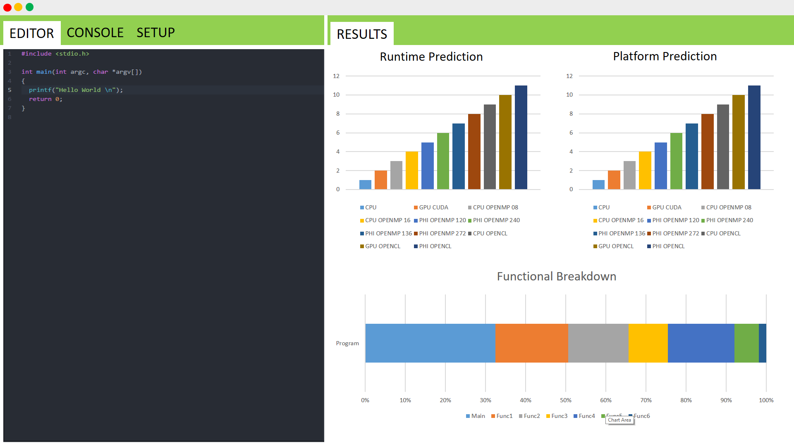
Pacube gui
4
5
1
2
3
6
1
This is where the
user enters his/her
code
2
The console can be
used to monitor
STDOUT and STDERR
3
The Setup window is
used to select
programming model
and architecture for
the code written in
the editor
4
This graph plots the
predicted run-time
for each supported
implementation
5
The platform prediction
graph showcases the
confidence with which
our model predicts
the right architecture
for the application
6
The Functional Breakdown
graph can be used as a guide
to study the most time
intensive parts of the program
to further optimize them

