Slide 1

PERFORMANCE PREDICTION FOR PORTING ALGORITHMS AND APPLICATIONS TO ARCHITECTURES
Karan Sapra, Ashrit Shetty and Dr. Melissa Smith

Slide 2
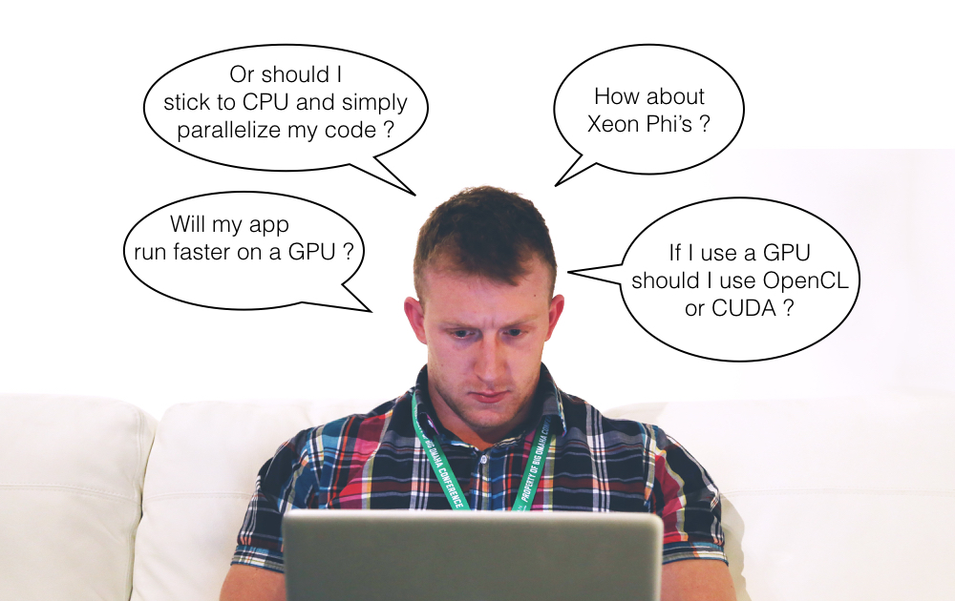
MOTIVATION

Slide 3
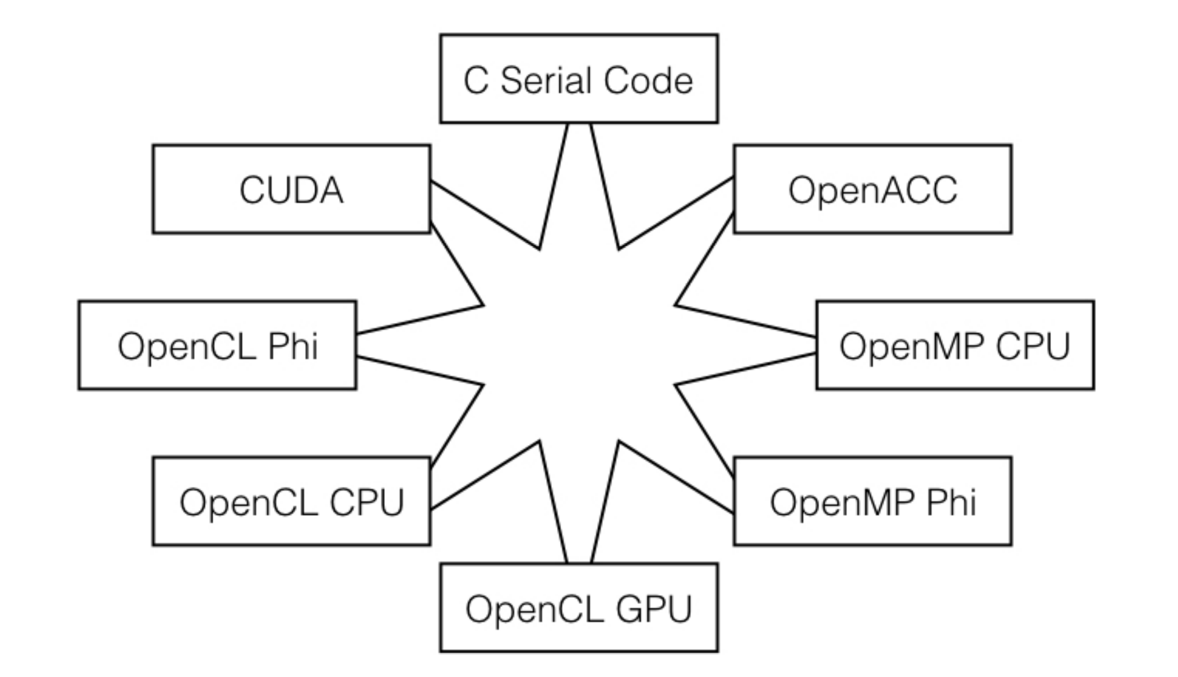
MOTIVATION
Performance mapping from one architecture to another

Slide 4
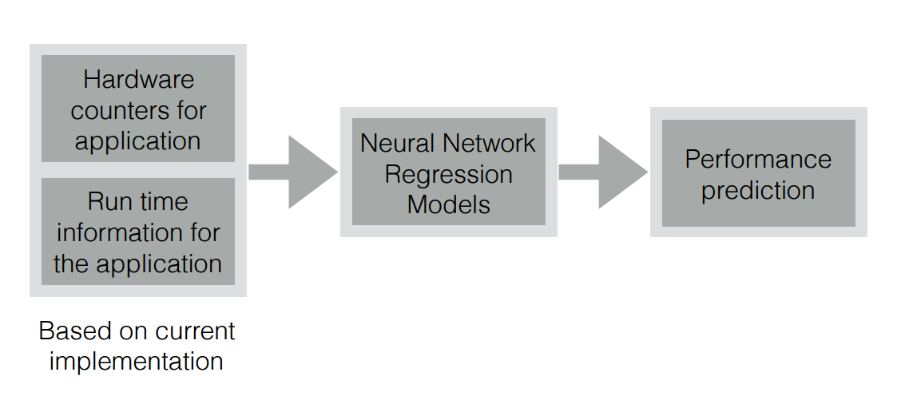
MODEL ARCHITECTURE
Prediction
Model
Block diagram of our prediction model

Slide 5
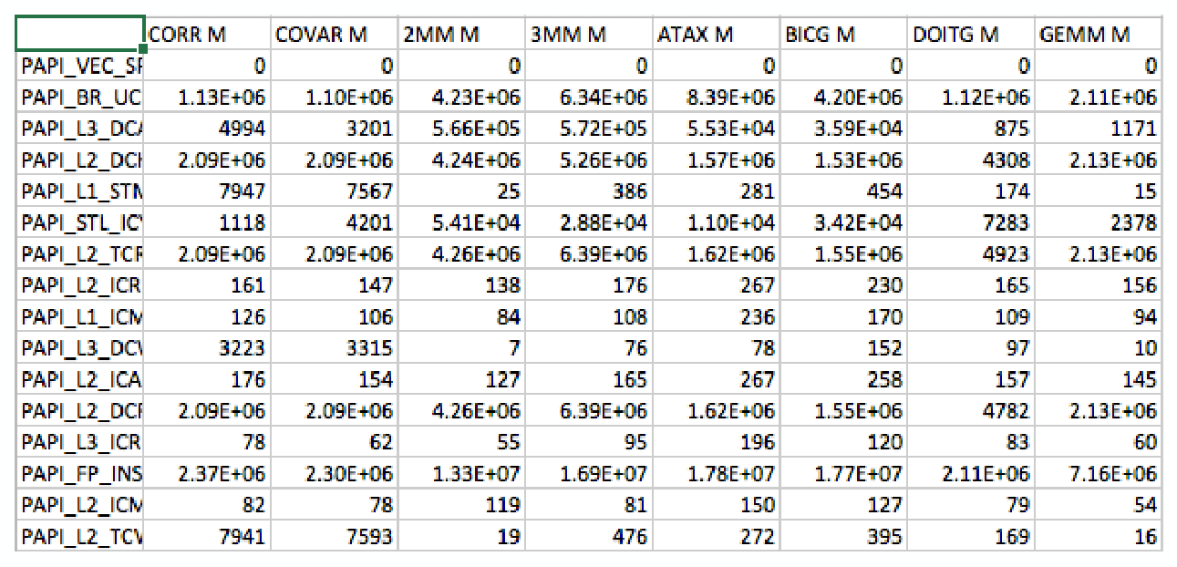
DATASET
Sample values of hardware counters for serial C implementation

Slide 6
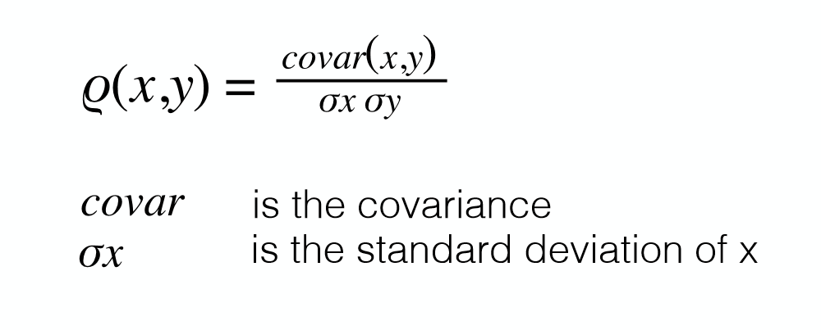
FEATURE SELECTION
Pearson Coefficient (r)
Pearson coefficient gives a value between -1 and +1 where 1 is most correlated,
0 is no correlation and -1 is most negatively correlated

Slide 7
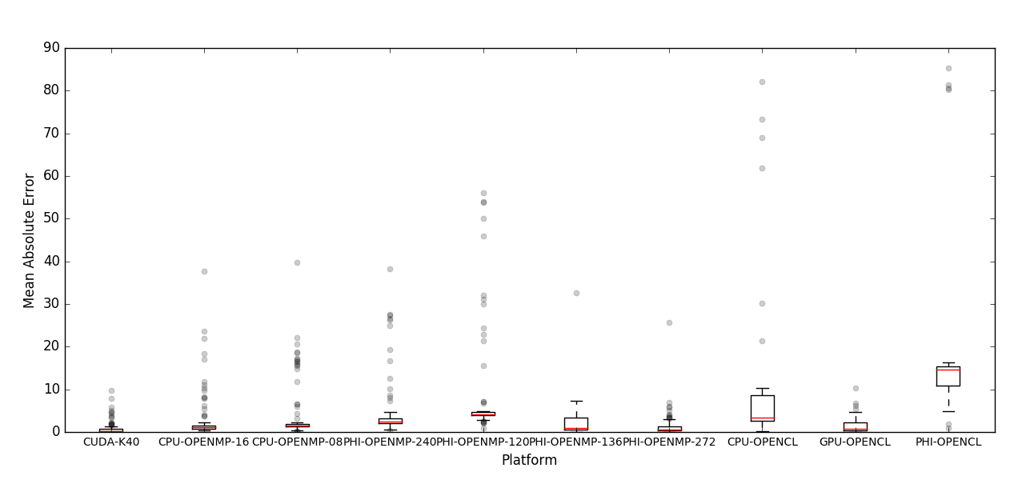
QUANTITATIVE RESULTS
Performance prediction for 10 different platform and conﬁgurations
using serial implementation in C and PAPI hardware counters

Slide 8
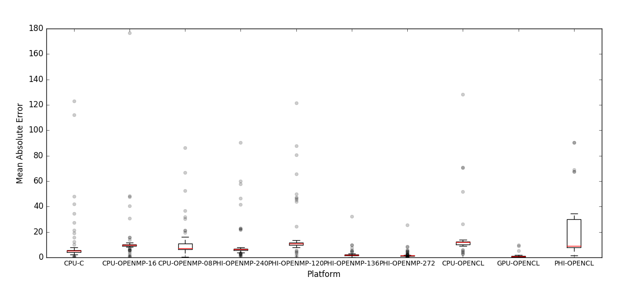
QUANTITATIVE RESULTS
Performance prediction for 10 different platform and conﬁgurations using
parallel implementation in CUDA and CUPTI hardware counters

Slide 9
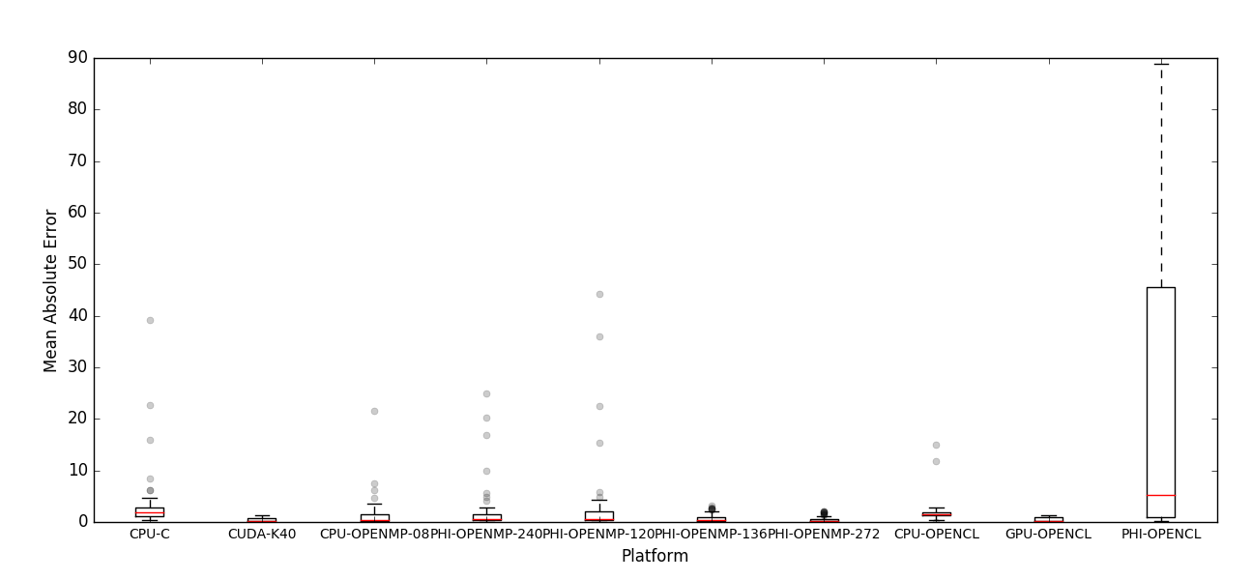
QUANTITATIVE RESULTS
Performance prediction for 10 different platform and conﬁgurations using
parallel implementation in OpenMP (CPU) and PAPI hardware counters

Slide 10
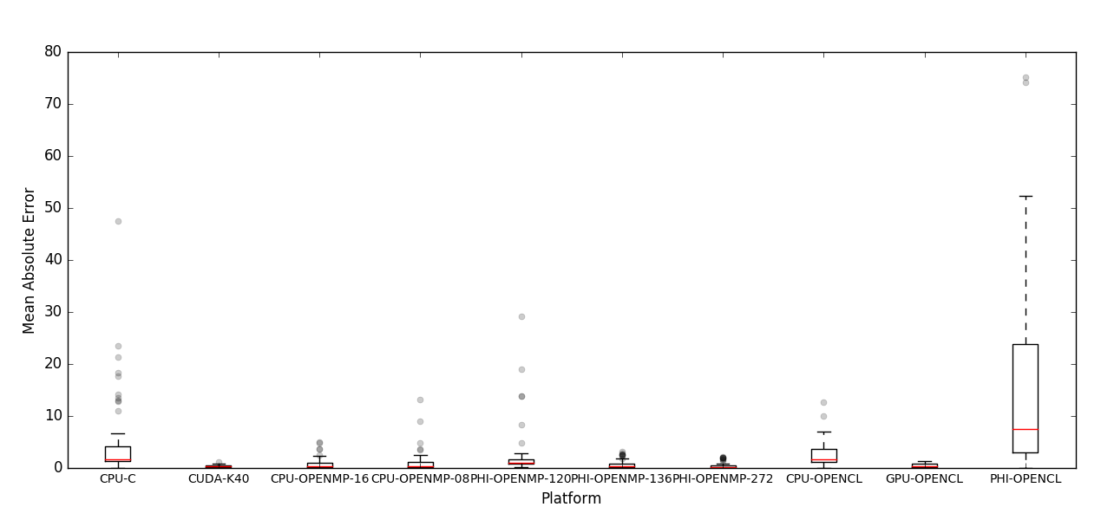
QUANTITATIVE RESULTS
Performance prediction for 10 different platform and conﬁgurations using
parallel implementation in OpenMP (Xeon Phi) and PAPI hardware counters

Slide 11
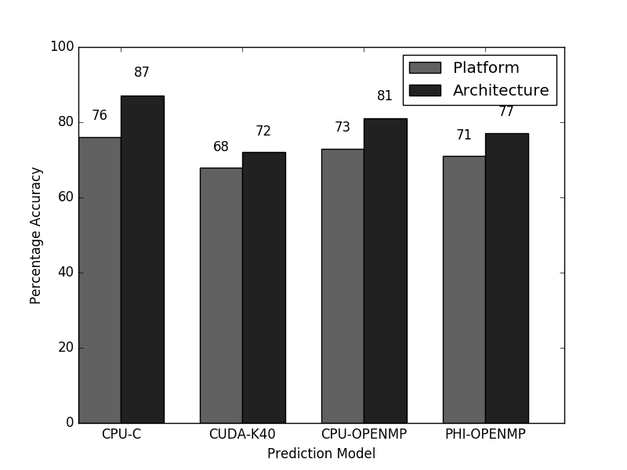
QUALITATIVE RESULTS
Architecture and platform prediction using
serial implementation in C and PAPI hardware counters

Slide 12
COLABORATION SCOPE
Predicting power requirements for applications
Train our prediction model with power metrics
Find architecture with minimum power requirement
Find programming language leading to low power
consumption
Find the best platform for optimal balance between
performance and power

