Slide 1
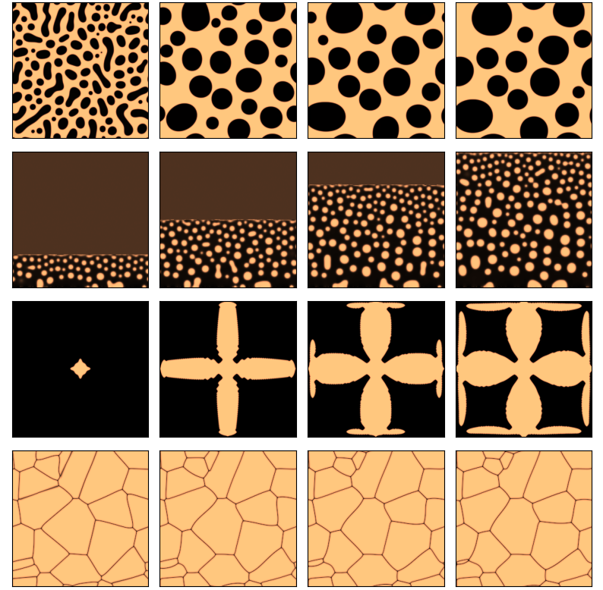
Time evolution
(a)
(b)
(c)
(d)
Notes:
Wanted to start by asking the question <TITLE>
Broad approach: Identify property of interest, identify which microstructures would help achieve that, and work backwards to design processing conditions that can achieve that desired microstructure
Example: If we want to design smart window coatings that (heat cool), we are looking for a material with temp dependent IR properties. One such material is Vox, which shows a temp-induced MIT that not only alters its conductivity but also its IR properties. Our efforts would then go into designing Vox films with MITs that makes them usable at a desired temp range, say by optimizing film thickness, composition etc.
Example: If we want to design solar cells high energy conversion efficiencies: looking for materials with bandgap properties which depends on material composition. Optimizing composition, we have found that GaAs and perovskite thin film solar cells allow conversion efficiencies much higher than Si based cells
Example: gears with high surface roughness, XXXX
The common thread across these applications is that <BOX> | <Composition, crystal structure, higher level microstructure

