Slide 1
Analyzing Residential Zoning in the United States
Ayush Adhikari, Brendan Verspohl
CS455: Distributed Systems
Computer Science Department, Colorado State University

Slide 2
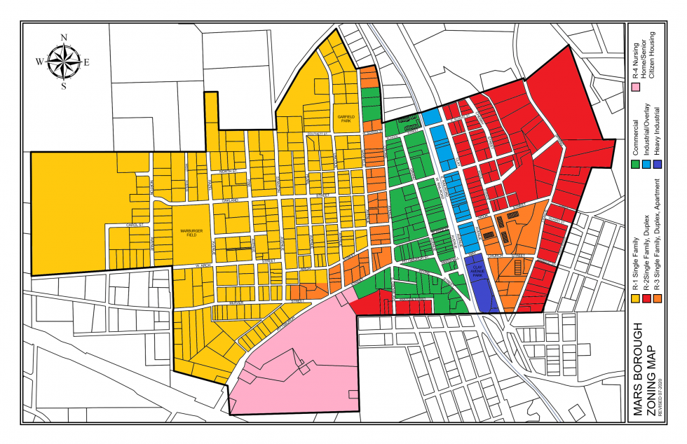
Background Information
Zoning has been used for many decades in the United States to separate industrial, commercial, and residential sectors. It was also once a motivation to segregate people of different races and classes, referred to as “redlining”
Suburban development, which often prohibited multi-family homes and imposed a minimum lot size, was appealing to middle class white households
Families with lower income could not afford to live in these areas and were pushed towards red-lined areas
Most developed European and Asian cities have a longer history than the United States and employ a more inclusive zoning where buildings are not strictly used for one purpose

Slide 3
Problem Characterization
Question: How does the type of zoning such as: single-family or multi-family, affect the community?
With an effective zoning policy, governments can incentivize subsidized housing, public transportation, better land use, and policies that discourage displacement of people with low incomes.
As we recognize the ways that our neighborhoods and cities could be improved, then—by encouraging less segregation by income and race; reducing travel times by bringing destinations closer together; encouraging more walking and physical exercise; and creating more public places where people can gather and build community—it seems only reasonable to look at what’s different in the places that may do some of those things better [1].
We look to compare the effects on quality of life and standard of living because of single-family housing in different areas of the United States
We considered aspects such as unemployment, commute, poverty, mental health, occupancy, lot sizes, rent, income, occupancy by race, etc.

Slide 4
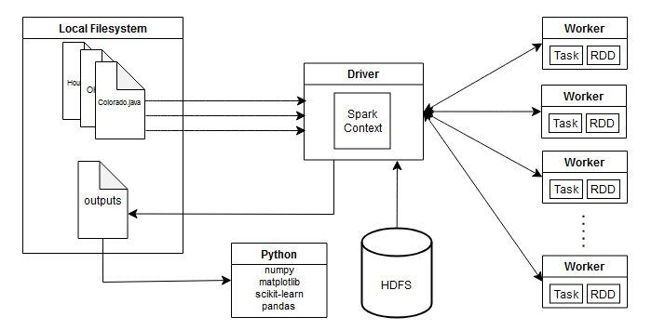
Methodology
We decided to employ Apache Spark using Java and Gradle and the data itself was stored using HDFS. Outputs would then be analyzed using Python.
Our final data directory consisted of the parcel data of each place as well as files for quality of life, totaling 3.2 GB.
Spans 95 counties in the US: Denver, Jefferson, and Weld County in CO; Dallas County and Houston in TX; Detroit, MI; Placer County in CA; rest in Ohio
Data retrieved from US Census, EPA, Kaggle, MIQOLS, Koordinates, County website

Slide 5
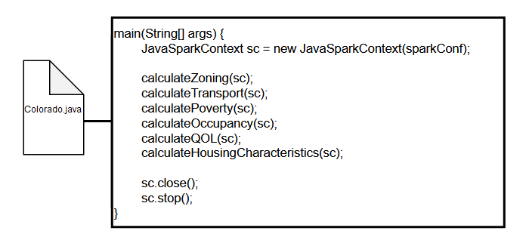
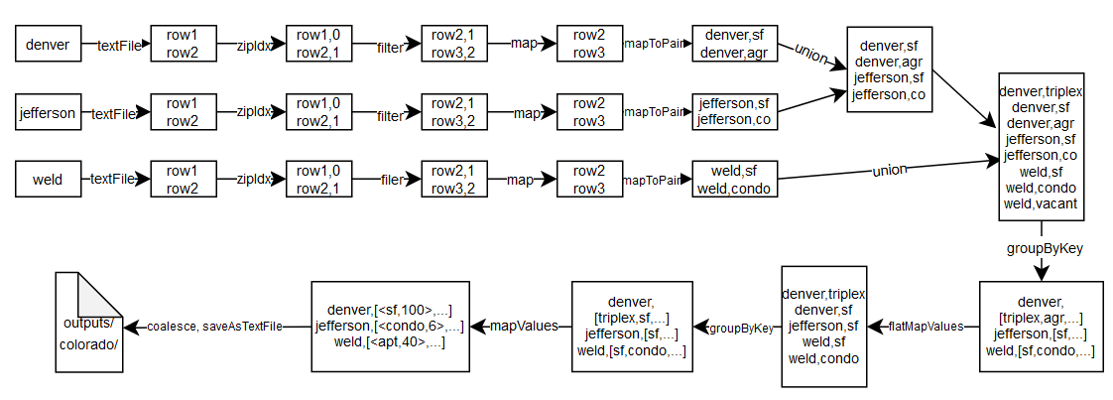
Methodology (cont.)
Spark jobs for the Colorado.java file:
Lineage graph of calculateGraph(sc) from above:

Slide 6
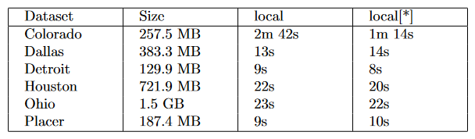
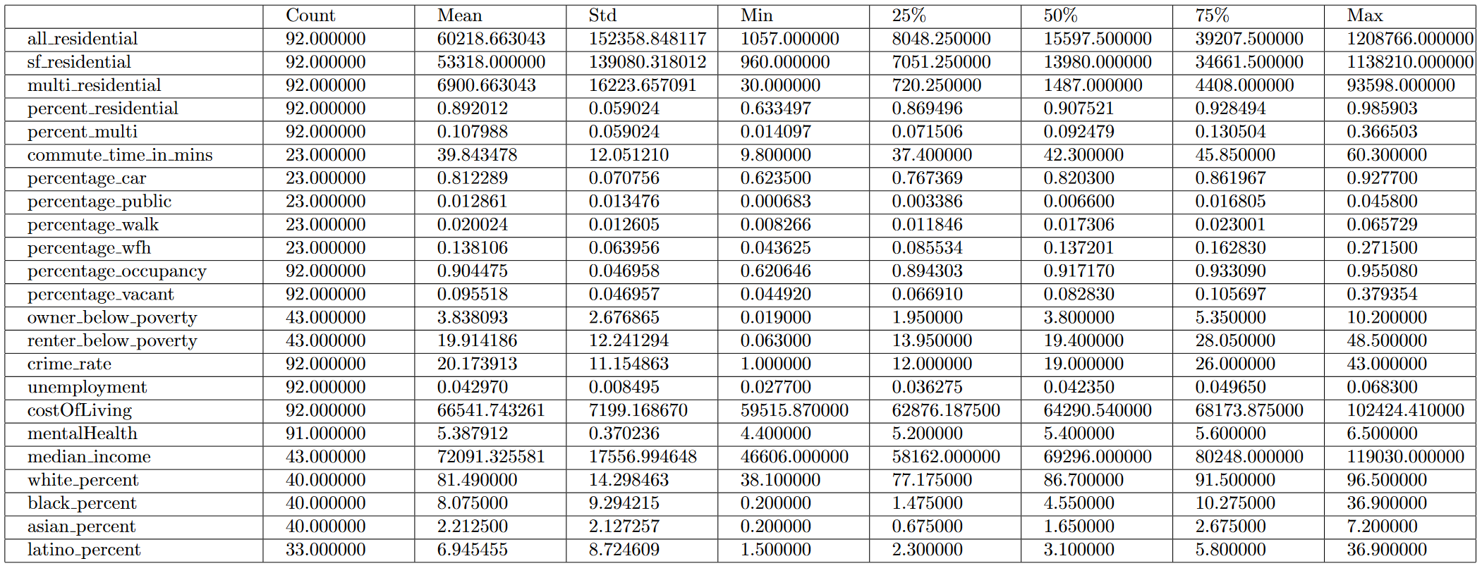
Performance benchmarks (cont.)
Benchmarks for Spark jobs using Salem as local node:
Analysis results using outputs of Spark jobs as inputs to Pandas:

Slide 7
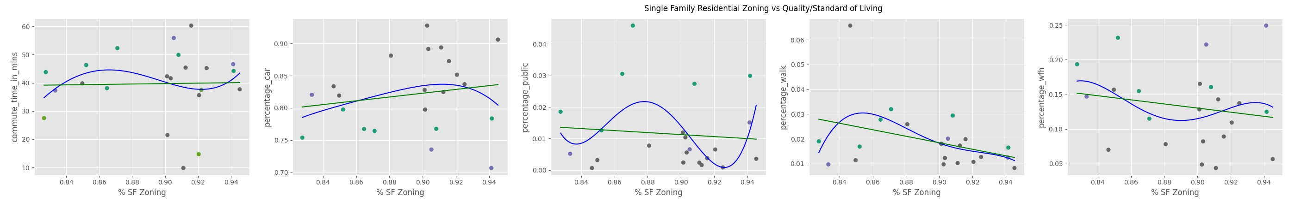
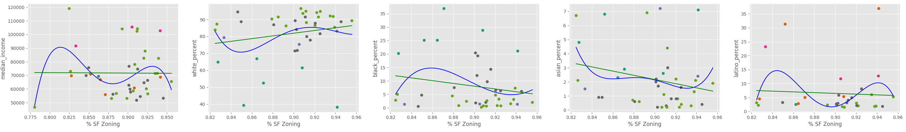
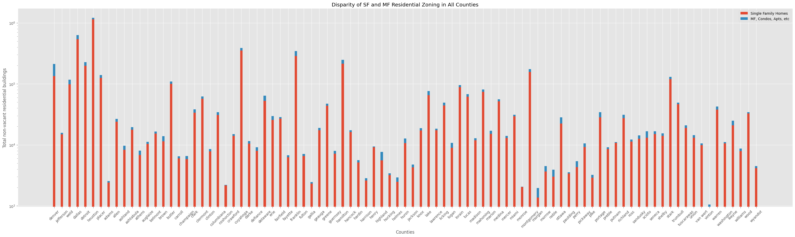
Performance benchmarks (cont.)

Slide 8
Insights & Conclusions
Spark performance and setup: we found that while we used Apache Spark that is supposed to dispatch the work across the cluster of computers; the computing was done on the local node.
Things we could have done better:
Getting more data on quality of life/standard of living (closeness to parks/commerce/businesses, lot sizes)
Some, like lot sizes and rent prices, were harder to measure since most apartment/condos measured in terms of the building rather than units
Comparison to other countries that have multi-zoning laws
This project offered a lot in terms of learning to use distributed tools to do analytics as well as applying our past experiences to a problem that interests us.
Our question was formed with the intention of helping neighborhoods, and we think we were able to have a part in that.

