Slide 1
Project 4
A.Sheikh - C Mafavuke - M Ansah - M Amjad

Slide 2
AIM
The aim is to clean the data, utilizing columns that we need and uploading to a SQL database. We will use machine learning models to create a binary supervised algorithm to make predictions for unseen data in the future.

Slide 3
RESOURCES
Kaggle
Jupyter Notebook
PG Admin

Slide 4
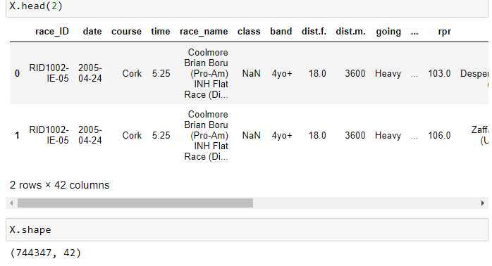
RAW DATA PROCESSING & CLEANING
Initial review of the CSV file showed that there were over 700K rows across 42 columns.

Slide 5
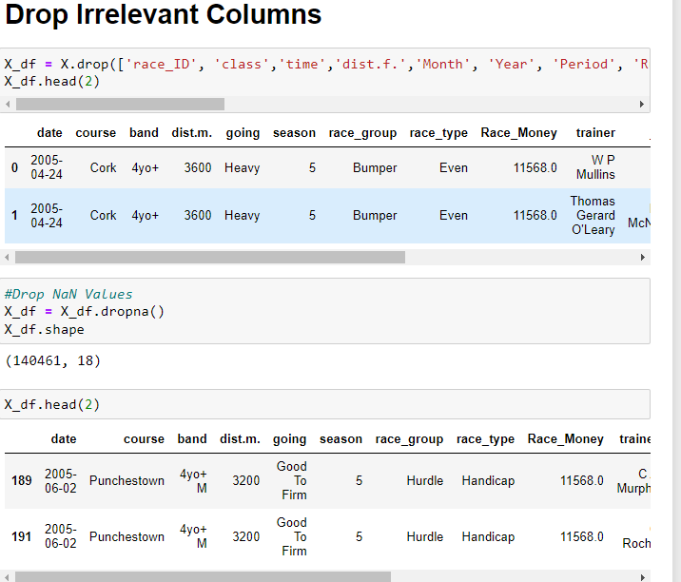
DROPPED COLUMNS

Slide 6
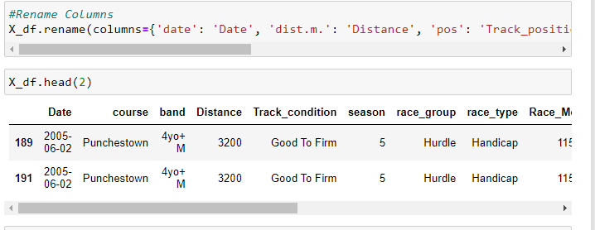
RENAME FEATURES

Slide 7
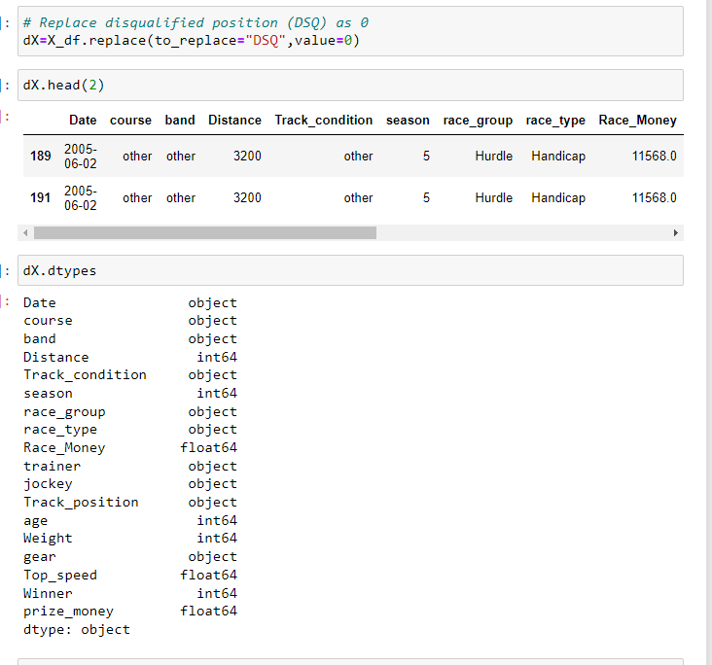
CONVERSION TO NUMERICAL DATA

Slide 8
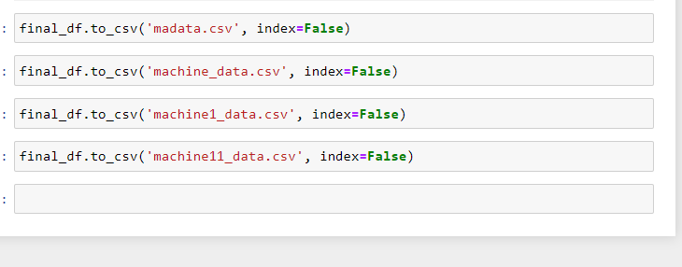
EXPORT TO CSV FILE

Slide 9
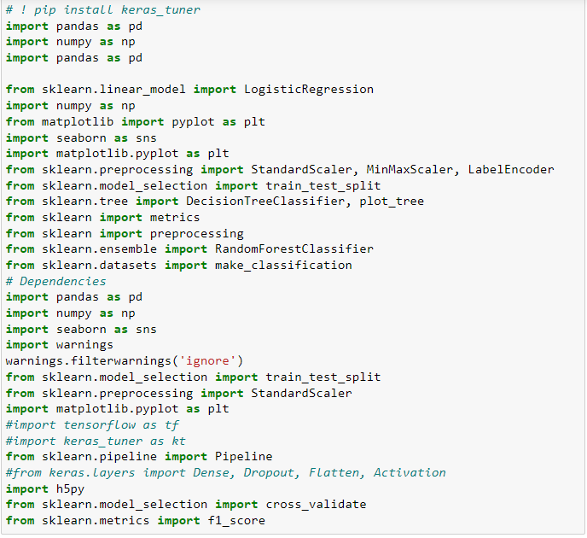
MACHINE LEARNING
Dependencies Imported

Slide 10
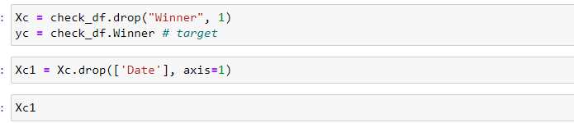
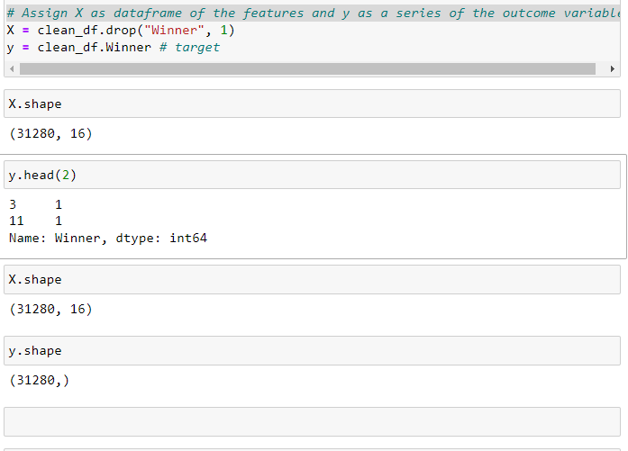

PREDICTION AND X,Y LABELS

