Slide 1
My Choice
FP2020 Quarterly Meeting
March 20, 2015

Slide 2







My Choice
Supported by Gates Foundation and Tahir Foundation
Data strengthening
Demand
creation
MY CHOICE
Private sector contribution
SCM
Health facility strengthening for PPFP

Slide 3






Partners
Technical assistance:
MY CHOICE

Slide 4
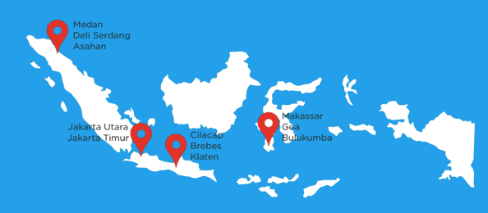
Working areas
Gowa
Average mCPR 55,5%
Source: Susenas, 2013

Slide 5
Expected results
Increase mCPR by 5 percentage points in 11 districts.
Double the percentage of women who adopt postpartum family planning in selected facilities before leaving a birthing facility by improving high volume facility readiness to provide quality, immediate post partum contraceptive methods appropriate to life stage.
Strengthen supply chain to ensure full access and choice by reducing stockouts in 11 selected districts
Create a culture that promotes and expects data-informed decision making by increasing the percentage of SDPs and FP offices in targeted districts regularly submitting complete, on-time reports on FP and receiving routine feedback on performance
Notes:
TAMBAH sdm, mekaniems koordinasi

Slide 6
Update on activities
National and provincial level socializations conducted
Starting assessments at the district level Supply Chain Management and Facility Readiness
Formative research and base line to happen March-May
Communication and Leadership Training for BKKBN National, Provincial, and District
Smartphone App development

Slide 7

SKATA App

Slide 8
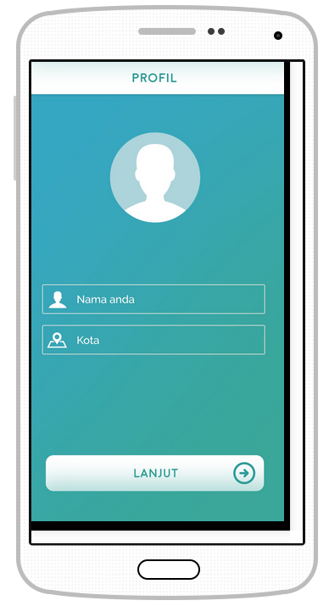

Slide 9


Slide 10
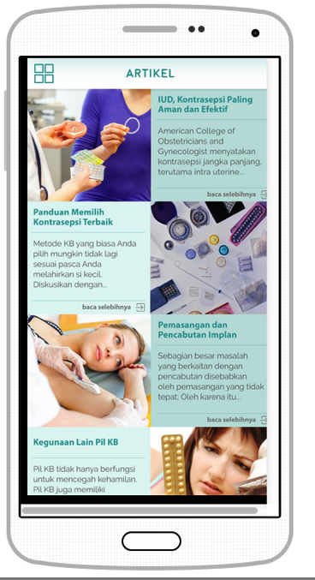

Slide 11
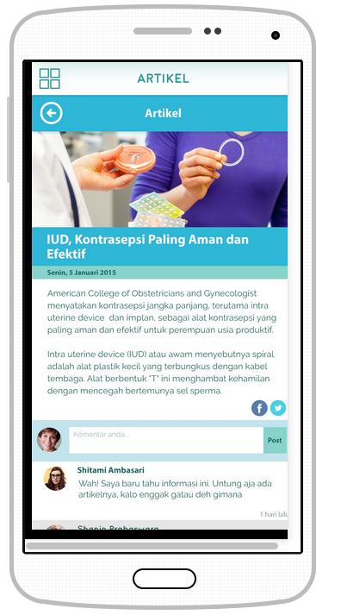

Slide 13
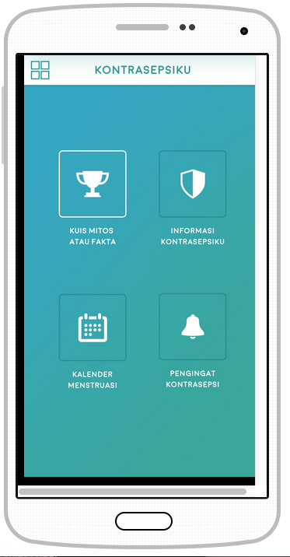

Slide 14
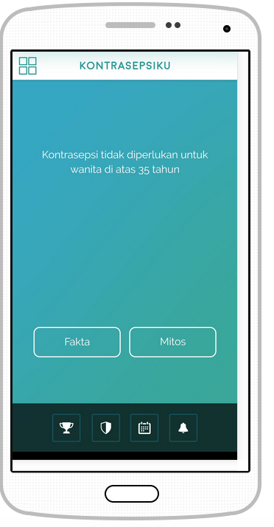

Slide 15
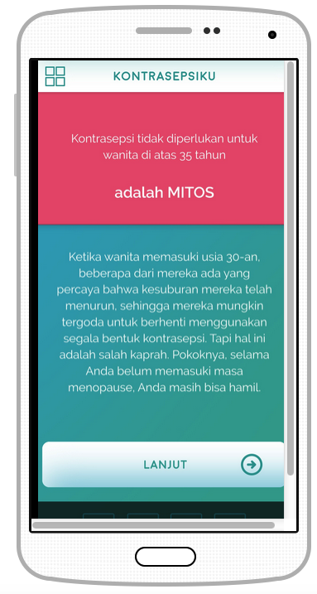

Slide 16
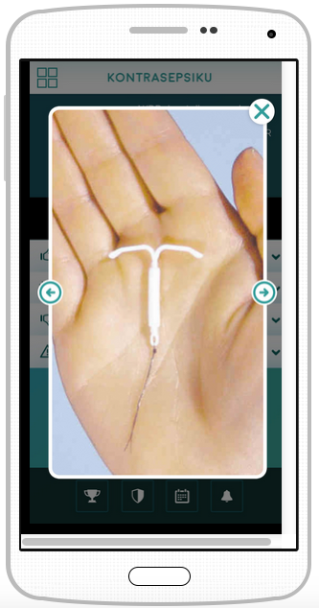
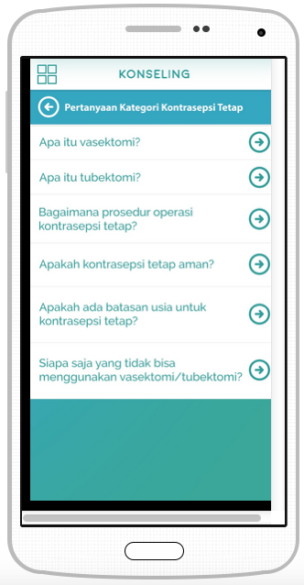

Slide 17
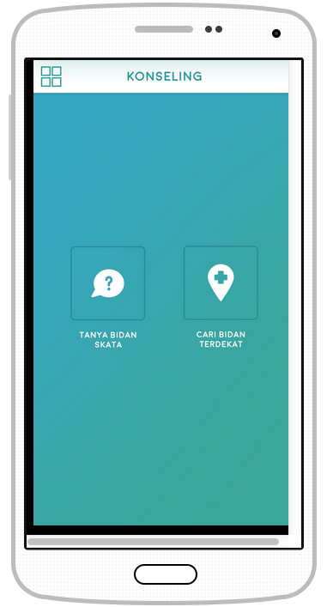

Slide 18
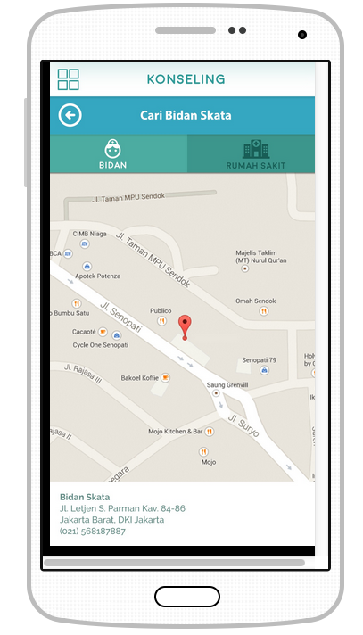

Slide 19
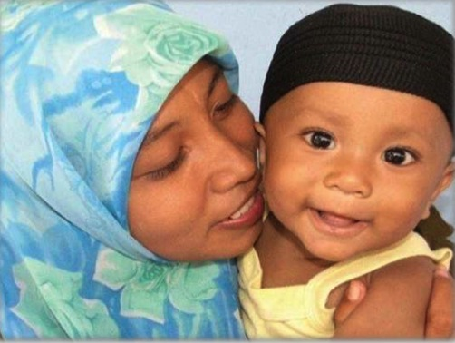
THANK YOU

