Slide 1
EXPENSIO
BY: APURVA BANKA 01FB16ECS070
ASHWIN SIDDHARTH S 01FB16ECS079
B R YOGESH 01FB16ECS084

Slide 2
INTRODUCTION
Expensio is one place to record all your expenses on a monthly basis.
Expensio also helps you set financial reminders.
Expensio helps you save monthly with the help of a monthly budget calculator.
Secure Login and authentication to promote trust amongst the users.
Analytics with interactive visualisations of Expenses and user savings.

Slide 3
Expenses and Reminders
User can Add and Delete Expenses,Reminders on a monthly basis, the above 4 implementations done using REST API with the help of a Node Server.
All Expenses and Reminders are fetched for that user and for that month.All fetch functions are implemented via REST API.
Once the Reminder is up , A notification is sent to the user with the help of Server Sent Events.
The User can search for any expense , search is implemented as a Predictive Fetch operation again the request is a REST API call to the Node server.

Slide 4
Login and Authentication
Since the website involves financial data , user security and integrity is of utmost importance.
Secure Login authenticator with email verification implemented with the help of Swift Mailer.
Secure session handling to prevent XSS attack on the user.
User authentication and registration is managed with the help of PHP Sessions.
User password encrypted before being stored on the database.
Foolproof user authentication to ensure that the user is the right user.

Slide 5
Analytics and Statistics
Use of interactive visualisations to help the user to understand his expenses and how he can cut down expenses and maximise his savings.

Slide 6
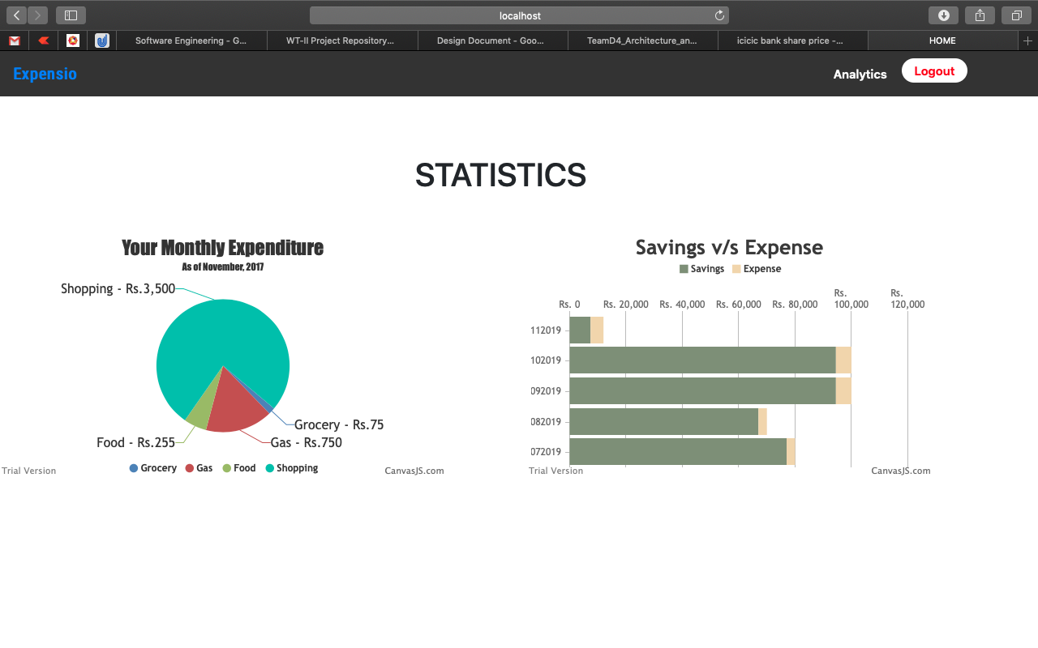

Slide 7
Monthly budget Calculator
Helps the user set monthly limit and income , which helps in tracking his savings and overspents

Slide 8
TechStack
Bootstrap
AJAX
HTML
CSS
NodeJS
Particle.js
PHP
Swift Mailer

Slide 9
THANK YOU !!!

