Slide 1
General Assembly Data Science Final Project
Ashley Brown
May 22, 2018

Slide 2
Social media engagement
The Problem: Tipping Point posts tweets on Twitter but it is not clear to our communications team what content drives the greatest engagement. This information will be helpful to inform our social media strategy and identifying the best use of media resources.
Data: Twitter data in a .csv file from the last year showing Tweet content, attribute, and engagement stats.
Hypotheses: With a tool that codes social media content to content areas and then analyzes the relationship between the content area and engagement level, Tipping Point will be better positioned to increase the number of people that learn about and interact with the organization.

Slide 3
Problem
What do these stats mean?
Which tweets are generating these likes?
Are there particular categories that generate more likes or follows?
How should the social media lead allocate his time and attention to generate greatest engagement?

Slide 4
What’s in the data
Twitter
Utilized reporting features provided by Twitter
Includes
335 individual Tweets from 10/1/17 through 5/18/18
Engagements: total number of times a user interacted with a Tweet which includes clicks anywhere on the Tweet (retweets, replies, follows, likes, links, cards, hashtags, embedded media, username, profile photo, or Tweet expansion).
Impressions: times Tweet showed up in a person’s feed
Url clicks: number of times an individual clicks on embedded link
Attribute: category of tweet

Slide 5
Data cleaning and prep
Limited data cleaning
Define attributes and manually assign to training data
For exploratory analysis, created dummy variables for ’Attribute’
For model, split into training and test data (90/10 split)
Challenges
Training data required manually assigning attributes, time consuming process
Uneven attribute distribution
Small dataset → limited model accuracy

Slide 6
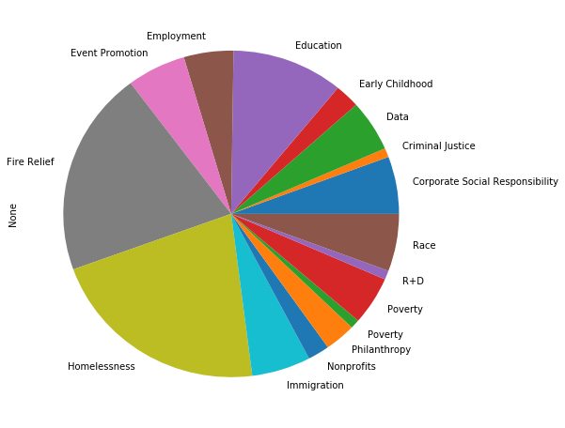
What is the distribution of assigned categories?
Underrepresented categories, indicated challenge for model
Top categories
Homelessness
Fire Relief
Education
Immigration
Category distribution is in line with where Tipping Point focused external communication

Slide 7
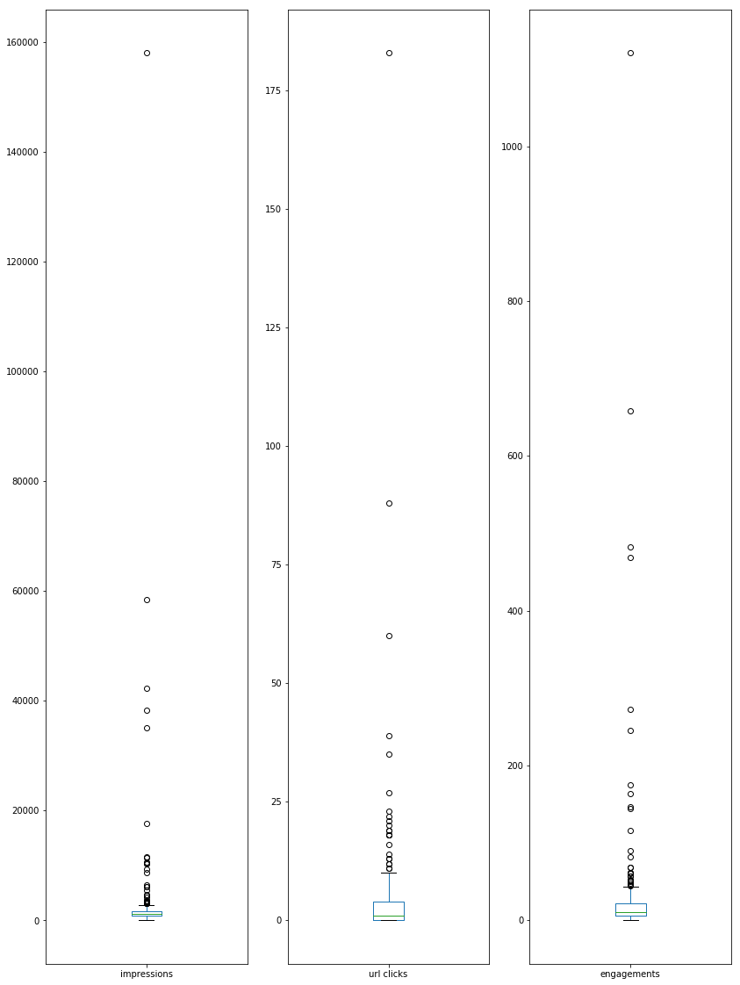
What is the distribution of impressions, url clicks and engagements?
One outlier in each category
Low number of url clicks
Impressions are inclusive and low touch --> higher volume

Slide 8
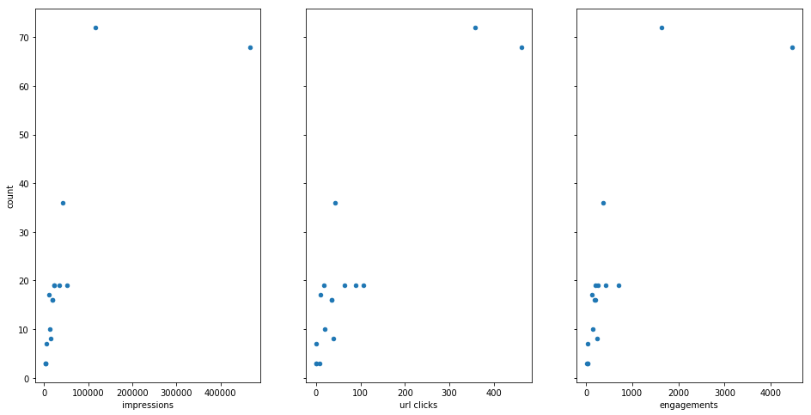
Is there a relationship between the number of posts per category and engagement?

Slide 9
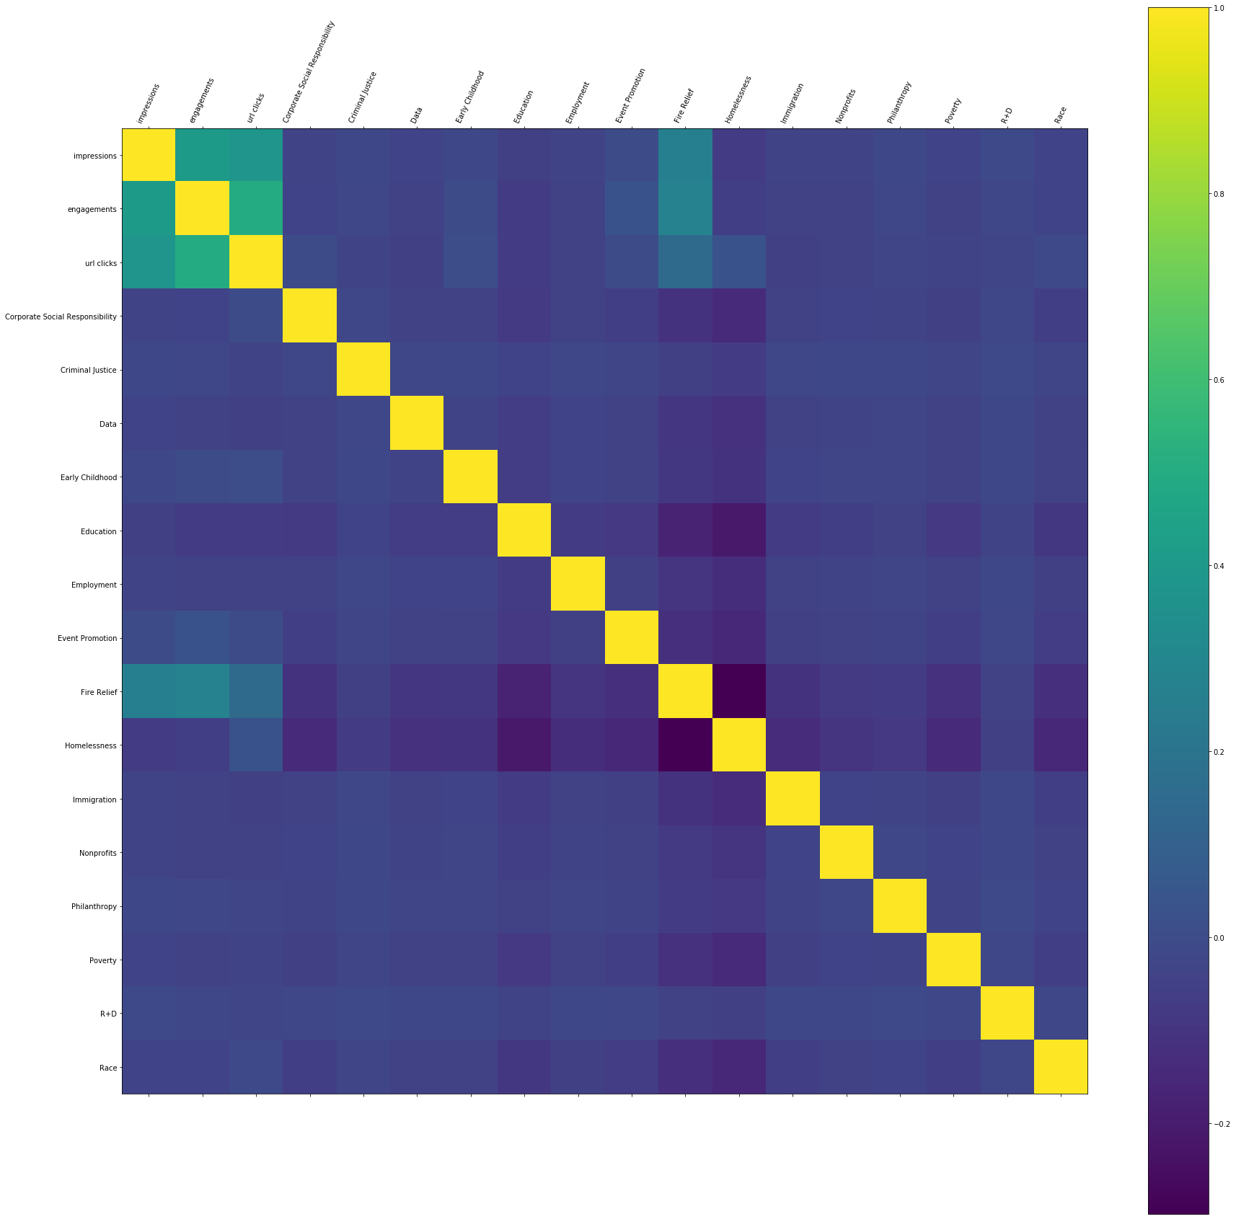
Is there a relationship between engagement and assigned categories?

Slide 10
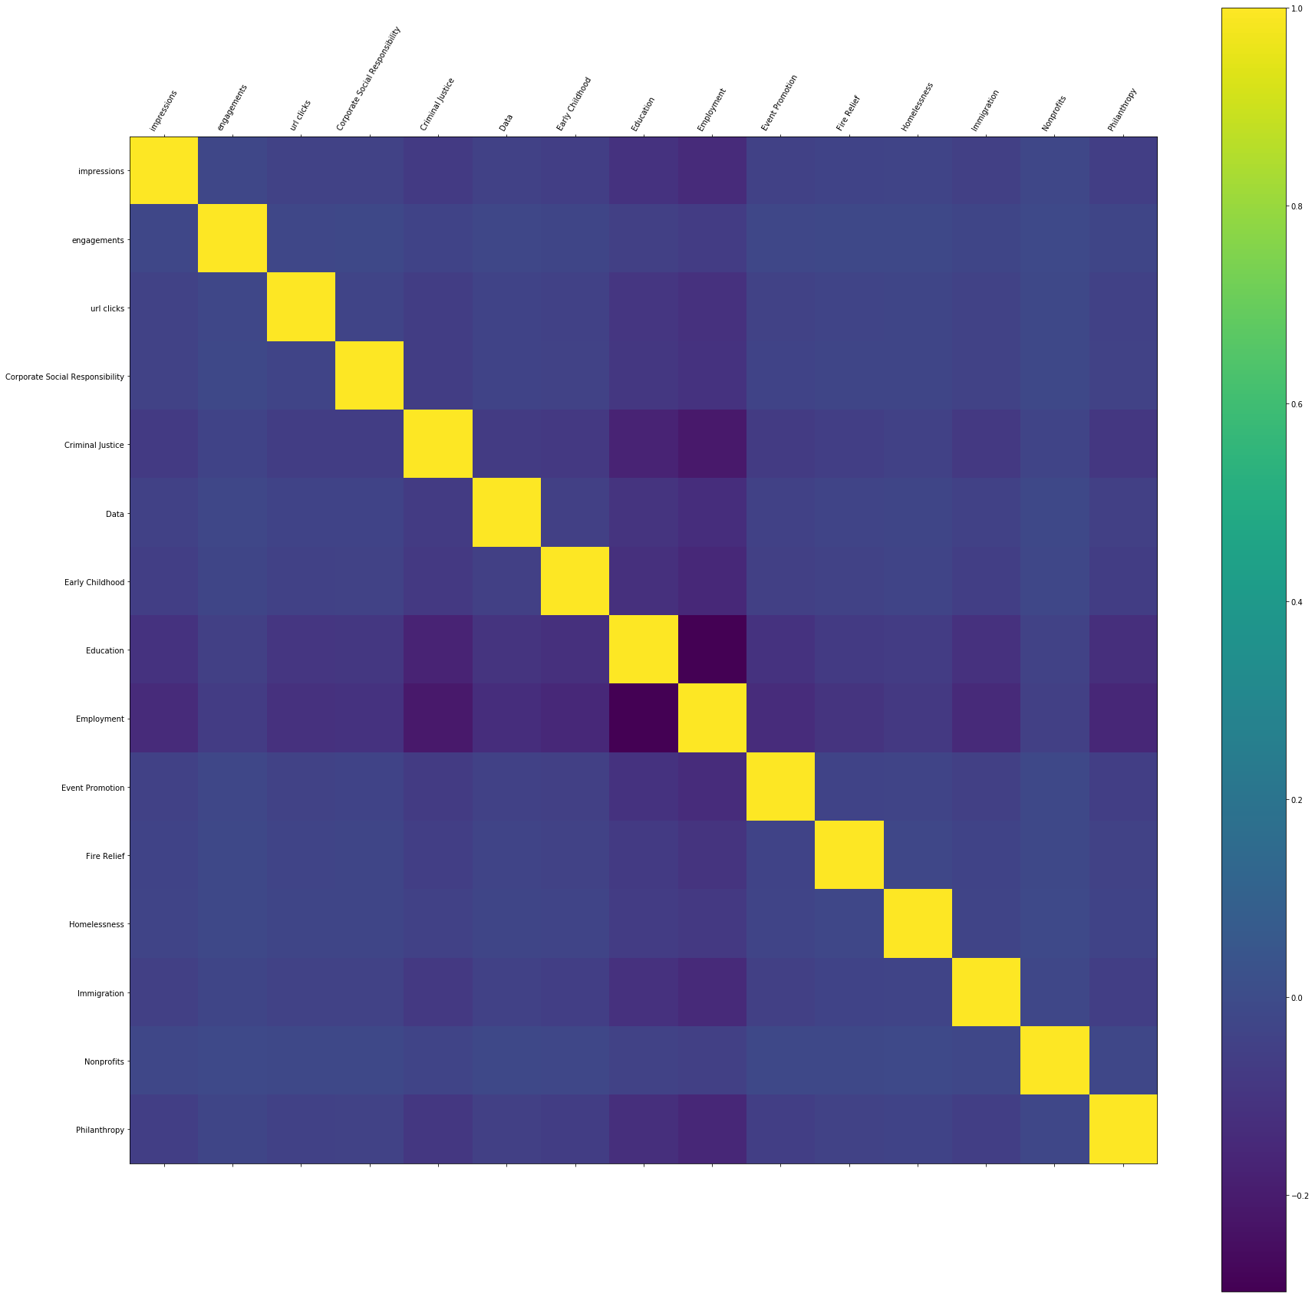
Is there a relationship between assigned attributes?

Slide 11
How could we avoid manually assigning categories to each tweet?
Build a classifier!

Slide 12
Preparing to train the classifier: bag of words anf Tf-idf
Split data into train and test (90/10 split)
Tokenized tweet text
Bag of words: count how many times a word appears
Count- matrix generated
Transform count-matrix into weighted frequencies using TfidfTransformer
Tf-idf = term-frequency times inverse document-frequency
My best friend
My | best | friend
Notes:
Tokenizing: the process of breaking a stream of text up into words, phrases, symbols, or other meaningful elements called tokens.”
Why not just bag of words:
longer documents will have higher average count values than shorter documents, even though they might talk about the same topics.
Tf-idf
divide the number of occurrences of each word in a document by the total number of words in the document: these new features are called tf for Term Frequencies.
downscale weights for words that occur in many documents in the corpus and are therefore less informative than those that occur only in a smaller portion of the corpus.
The goal of using tf-idf instead of the raw frequencies of occurrence of a token in a given document is to scale down the impact of tokens that occur very frequently in a given corpus and that are hence empirically less informative than features that occur in a small fraction of the training corpus.
After the BoW is completed, what is obtained would be a vector for each individual document. These documents will then be passed through different machine learning algorithms to determine the features that separates the different documents.
That is where the actual “machine learning” comes in. BoW is basically just a tool to convert text documents into a vector that describes its features and content.
Bag of words
ssign a fixed integer id to each word occurring in any document of the training set (for instance by building a dictionary from words to integer indices).
for each document #i, count the number of occurrences of each word w and store it in X[i, j] as the value of feature #j where j is the index of word w in the dictionary

Slide 13
Train the classifier, test and evaluate performance
Bayes classifier
Tested by trying to predict the outcome on the data set that was set aside at the beginning
57% accuracy
Linear support vector machine (SVM):one of the best text classification algorithms
79% accuracy

Slide 14
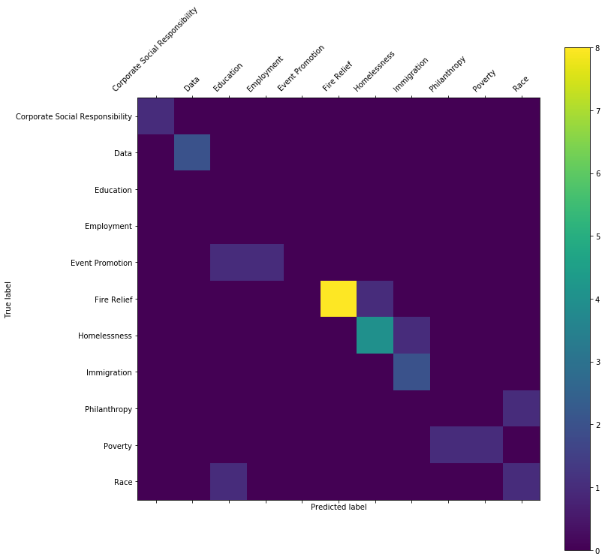
Confusion matrix

Slide 15
Next steps
Twitter data
Additional questions for Twitter data
Does time of day, day of the month or day of the week affect impressions, engagements or url clicks?
Multivariate analysis (example: engagements relationship to attributes and time of day)
Continue to refine the model and improve accuracy
Parameter tuning using grid search
Perform similar analysis on Facebook data

