Slide 1
Approach
By problem statement, It is clear that this is the predictive analysis problem in which we need to create a model by using Ml algorithm for the prediction of target variables.
It is also clear that there are two outputs in target variable i.e, 0 & 1.
Event- 1 (Strong Lead – High Probablity of conversion).
As It is classification problem, I had created models by using three ML algorithms i.e, Random Forest, Logistic Regression and XG Boost.
I also found out that number of events(occurances of ‘1’) is very few as compare to non-event(occurances of ‘0’. It means there is some imbalance in dataset.
Due to imbalance I used weight balancing techniques like smote and weigh – balance in some of modals.
The Evaluation Criteria for this problem is AUC_ROC . I found it more reliable while solving this case(Imbalanced data).
After imputation, I also performed visualization on dataset and tried to get some findings.
Created dummy variables of all categorical features.
Perform Scaling before creating models.
Every preprocessing step for Train & Test data has performed separately.

Slide 2
Process
Data cleaning:
Removed NaN in some variables, created new category for Nan’s in categorical Variables.
Used KNN imputer to impute missing data in some variables
Cretaed new variables using ‘DOB’ and ‘Lead generation date’.
2. Performed visualization after Data Cleaning.
3. Removed outliers from train and test both dataset variables while performing Vizualization.
4. Created dummy variables of all categorical variables.
5. If there are many categories in single variable then replaced categories with frequencies.
6. Performed Label Encoding for Discrete variables.
7. Ave target variable in ‘y’.
8. Deleting all variables from train and test which is not present in anyone of datasets.
9. Performed scaling on both Train and test dataset. Fit_transform on Train data and transform on Test data.

Slide 3
Process (Cont.)
10. Convert transformed arrays(train & test) into datasets .
11. Modal Creation:
Random forest Basic model- Cross Validation Score= 0.81
Random Forest with Hypertuning parmeter- Cross Validation Score= 0.81
Random Forest with balanced weights- Cross Validation Score= 0.82
Selected top 20 variables before creating logistic regression.
Logistic Regression with balanced weights and penalty- Cross Validation Score= 0.78
Logistic Regression with class weight- Cross Validation Score= 0.77
Random Forest with Smote- Cross Validation Score= 0.81
None of these models performed well and gave good AUC_ROC score so I choose to perform XG boosting.
XG Boost- Cross Validation Score= 0.82
AUC_ROC score- 0.92
Accuracy- 0.98
I have combined the output of XG boost modal’s test data predictions and ‘ID’ variable of test data. So that anyone can download this dataframe in csv and test it directly. Final test data has around 27000 columns(left after outlier removal).

Slide 4
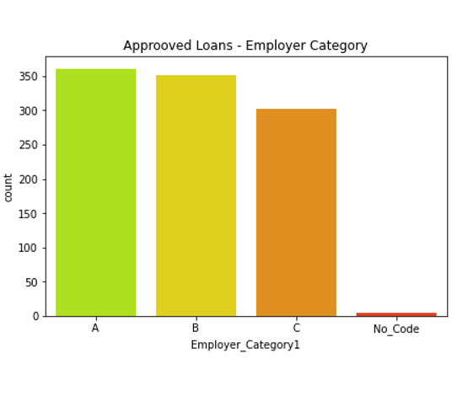
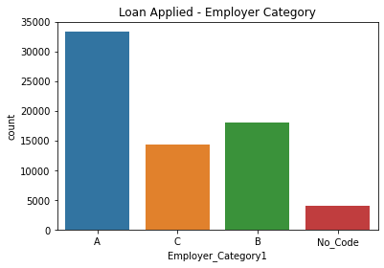
Visualization
People from group ‘B’ are getting loans in equal amount as of ‘A’ but group ‘A’ people are applying in huge
number as compare to ‘B’.

Slide 5
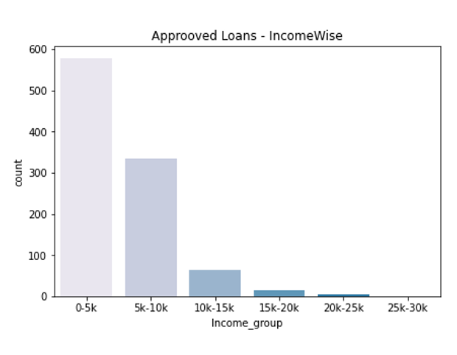
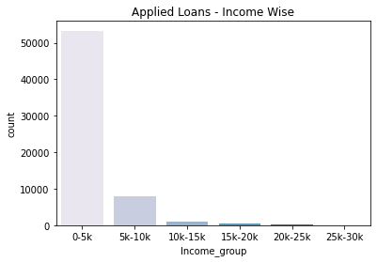
Mostly, People who are earning in range of 0-5k are applying for the loan. People In 5k-10k range are also getting many approvals. Ratio of approved/applies is very high as compare to 0-5k. Same thing is with 10-15k. It means as monthly income increases it becomes easier to get loan.

Slide 6
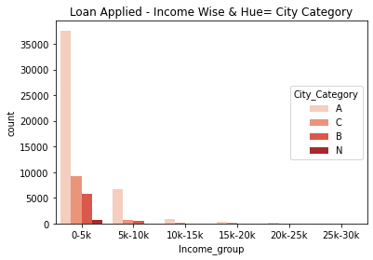
People from city category ‘A’ are applying loan the most. It means most of the leads are coming from City_Category ‘A’. It indicates that digital payment institution runs its operation mainly in that area. Also, most people are earning in 0-5k range.

Slide 7
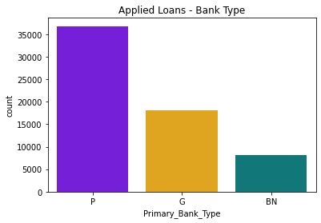
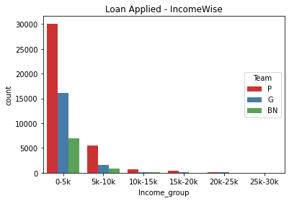
Many people who have applied for loan haven’t mentioned their bank type. Most of them are earning in range of 0-5k. Both these things indicates that these people have no bank accounts.

Slide 8
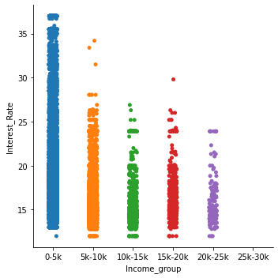
People who earns in range of 0-5k are getting the highest interest rates. Higher income groups are getting lower interest rate as compare to lower ones. It shows that bank beleives that higher income groups are less risky.

Slide 9
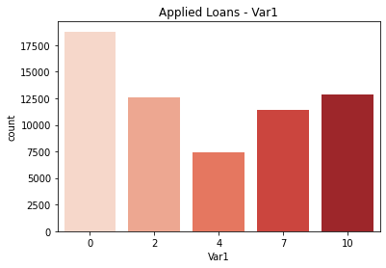
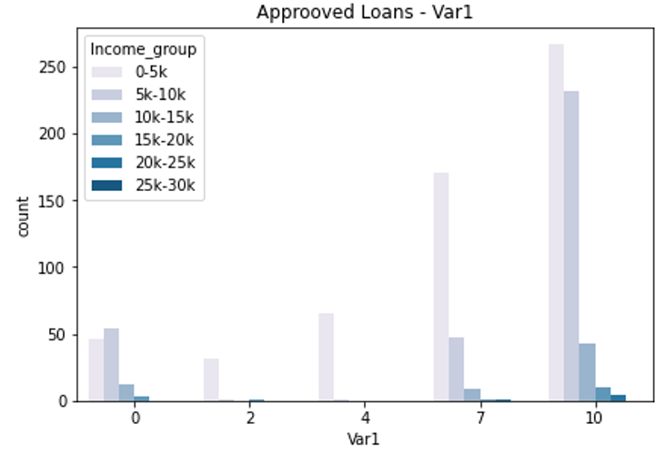
People with category ‘0’ are applying the most but getting the least laon approval. Group ‘10’ is getting maximum loans. Second image clearly shows that group ‘10’ contains members of high income group.

