Slide 1
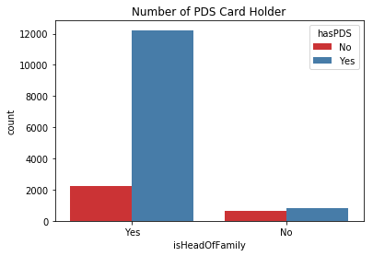
Worker Outreach
They should encourage labourers to get PDS card because there are many head of family’s present in this survey dataset who doesn’t have PDS card. If they can get it then they will be able to avail the benefits of government food schemes. Getting food grains at low cost would increase the financial health of their family because they will get the food at low prices.

Slide 2
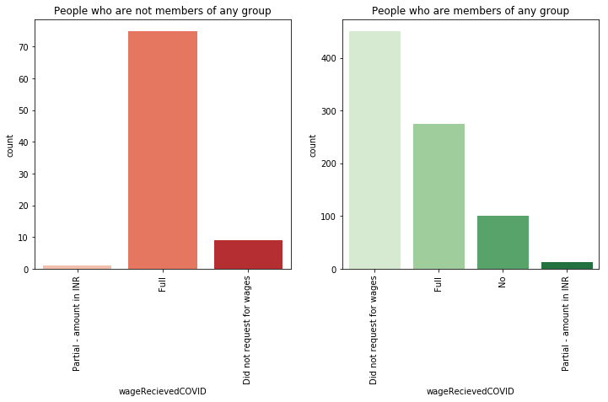
Worker should go to the community and encourage the people to join groups like SHG because it seems like people who are connected with some group are financially stable.

Slide 3
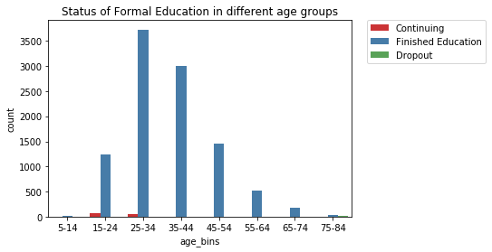
They should try to find out the reason of why many labourers of age group 15 to 24 are not pursuing higher education. Below plot indicates that most people of age group 15-24 years have finished their education.

Slide 4
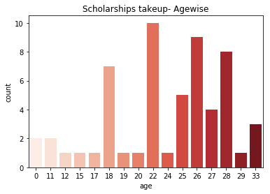
Indicators of Scholarship Benefit Take-up
People from 18 to 28 are more likely to apply for Scholarship. It indicates that students applies for scholarship when they want to pursue higher education.

Slide 5
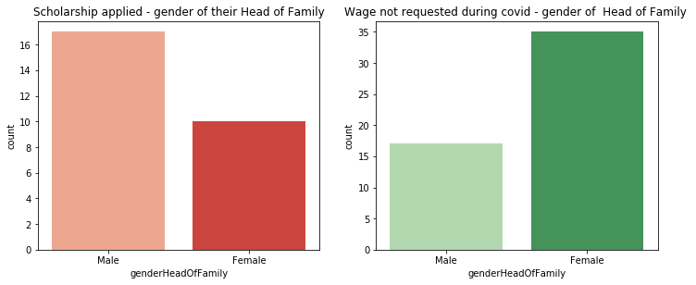
Person whose Head of Family is female is less likely to apply for Scholarship. It is because family with ‘female’ head of family is more financially stable as compare to ‘male’ head of family.

Slide 6
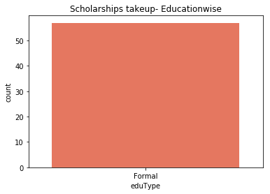
Person with only Formal education applies for the Sponsorship.

Slide 7
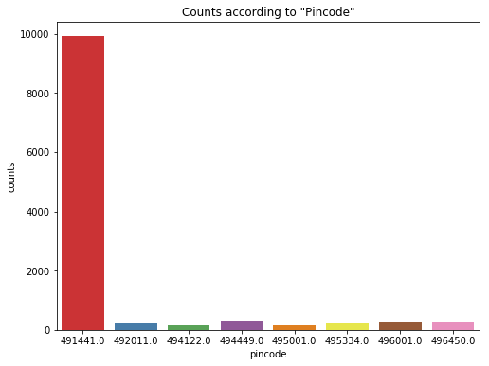
Survey Design
Most of the entries are from one city (491441). Government should conduct it in other states as well in the same amount because this survey is designed for developing some solutions that will apply on all country not on a city. One fact is that most of the mining takes place in one or two states. Atleast, they can conduct it in different cities of same states.

Slide 8
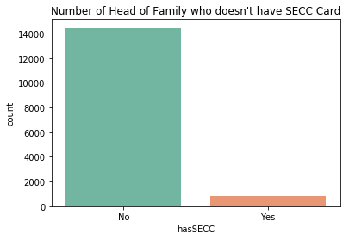
.Some of the students who applied for sponsorship but couldn’t get it received a feedback that they belong to general class or they don’t have their caste certificate. If caste is one of factor that decides Scholarship then this survey should also have a ‘caste’ column that capture that information. If SECC captures that information then Outreach worker should motivate them to make their SECC card because more than 90 percent has no SECC card.

Slide 9
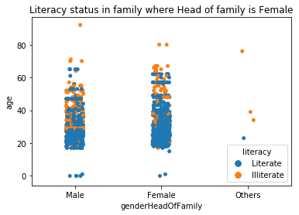
Other Findings
People in age range 20-40 years are more likely to be ‘literate’ if the head of family is ‘female’ as compare to ‘male’.

Slide 10
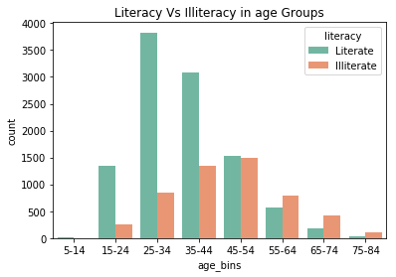
In higher age groups, more persons are ‘illiterate’ and as we move towards lower age groups from higher age groups the number of ‘literates’ are increasing gradually as compare to ‘illiterates’ which is a good thing. The difference between literates and illiterates is highest in age group 15-24.

Slide 11
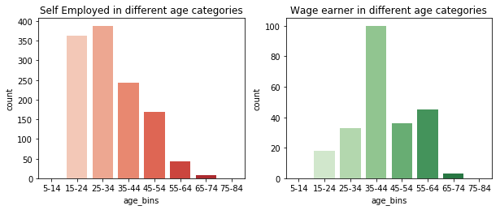
In age groups 15-34 years number of Self Employed are more in percentage as compare to Wage earner.
Most Wage earners belong to age group 35-44 years.
This analysis shows that older population were mostly doing work for wages but Younger generation is more likely to start their own work. It might be due to lack of employment opportunities or younger population like to be self employed. If its second case then government should find a way to show that in Employment data.

