Slide 1

SMART HELMET
By Neha Ahlawat
&
Ashutosh Singh Dengri

Slide 2
INDEX
Problem Statement
Statistics
Causes Of Problem
Existing Solution
Proposed Solution
Device Description
Commercializing it as a Product
Conclusion

Slide 3
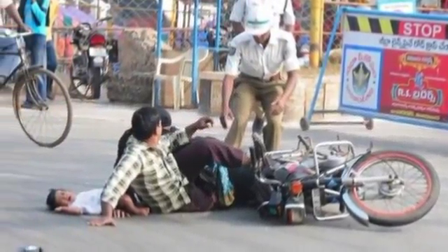

Slide 4
PROBLEM STATEMENT
Road accident is one of the major man made tragedies, killing millions of people across the world every year.
The most important today is the human’s life. And we are loosing those precious lives for a very poor cause i.e. road accidents.
Around 4 person die in about an hour because of road accidents, and most of the time it found to be a 2-wheeler accident.
According to NCRD(National Crime Record Bureu) about 96 two wheeler rider’s deaths are reported on every single day in India.

Slide 5
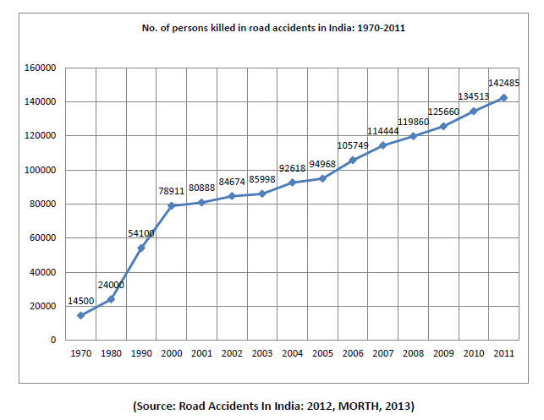
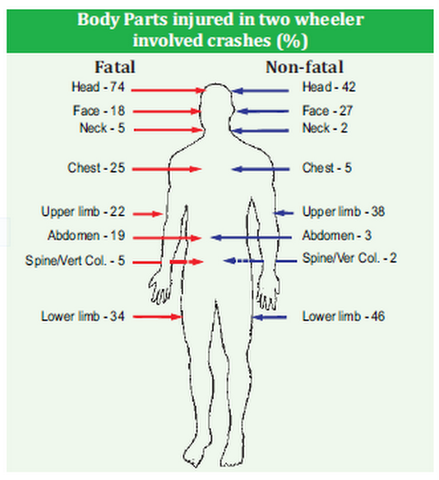
Statistics

Slide 6
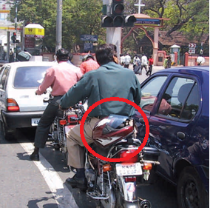
Existing Solution
Indian Government had made it mandatory to wear helmets for a two wheeler rider. Also recently govt. made mandatory to wear helmet otherwise you won’t be able to get petrol from any petrol pump.
When the rider travels to new areas he has to look for the area Maps, it is to be assisted by someone. Some satellite navigations are available but they are very costly as well as rider has to compromise with his safety as he has to observe it regularly while riding the two wheeler.

Slide 7
Proposed Solution
We have developed a smart system as the ultimate solution to the above described problems :
Rider’s Safety: A modified Helmet is used by installing our safety device on it as well as to the Two wheeler vehicle which refuses to start until or unless he wears the Safety Helmet.
Ease of Navigation: Wireless speaker is installed to Rider’s helmet which can be connected to Rider’s phone via bluetooth. By using Google’s voice Navigation services he could navigate anywhere by following the voice instructions only.

Slide 8
DEVICE DESCRIPTION & WORKING

Slide 9
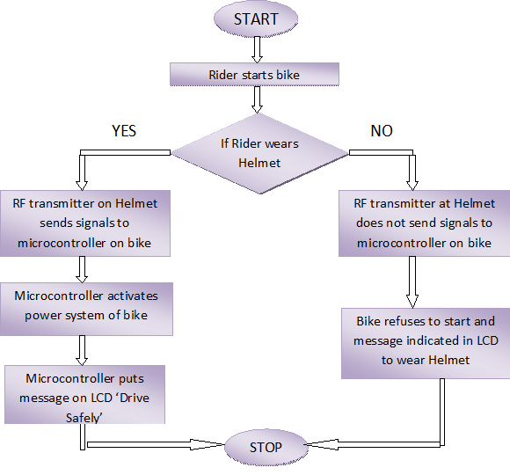

Slide 10
Smart Start Device
The Smart Start Device connects the rider’s helmet wirelessly using RF Transmitter and Receiver.
The system on two wheeler contains a Microcontroller, RF receiver, LCD Display, Audio Buzzer and a Solid State Relay switch.
When the rider starts the bike without wearing the helmet it refuses to start and showing message signal on LCD “Wear Your Helmet”.
If he is wearing the helmet the RF Transmitter on helmet sends signals to microcontroller and it sends signals to the Solid State relay switch to activate the power system of bike and now the bike can be started safely. Thus safety of rider is ensured.

Slide 11
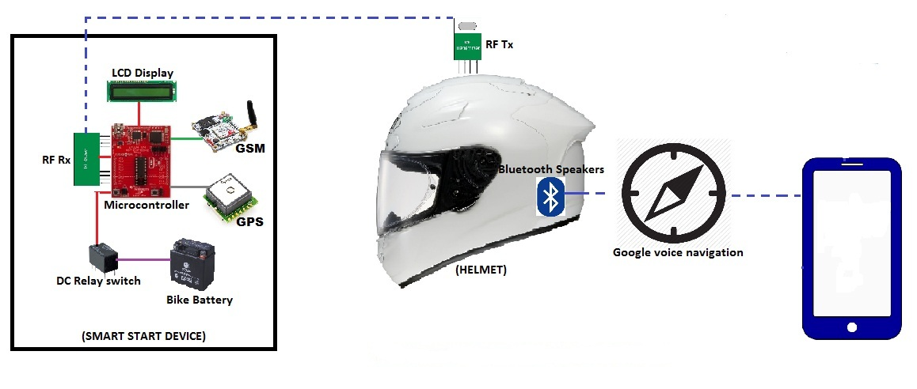
Block diagram

Slide 12
Commercializing it as a Product
The system can be commercialized and brought up as a product in the market.
It would be very cost effective as compared to hi-fi GPS tracking devices.
It could be sold with Motorcycles as the bike is dependent on it. Also projecting it as a mandatory product with bikes, it has a good market scope.

Slide 13

Conclusion
The “Biker’s Safety System” is a complete solution for problems faced by rider of a two wheeler.
Thus we have developed a effective smart system which would be capable of stopping the injuries caused to rider , solving navigation problem and providing him emergency help on time.
This system if applied to a two wheeler could definitely reduce the number of injuries as well as deaths rates during an accident.

Slide 14
THANK YOU !!
THANK YOU!!

