Slide 1

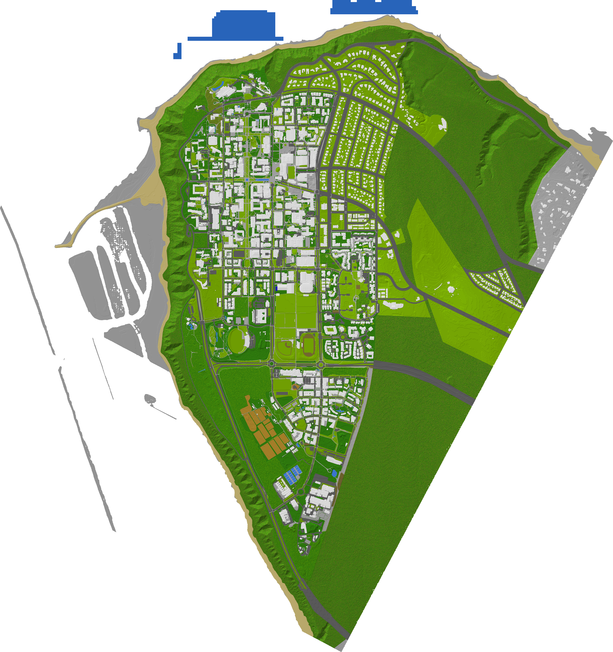
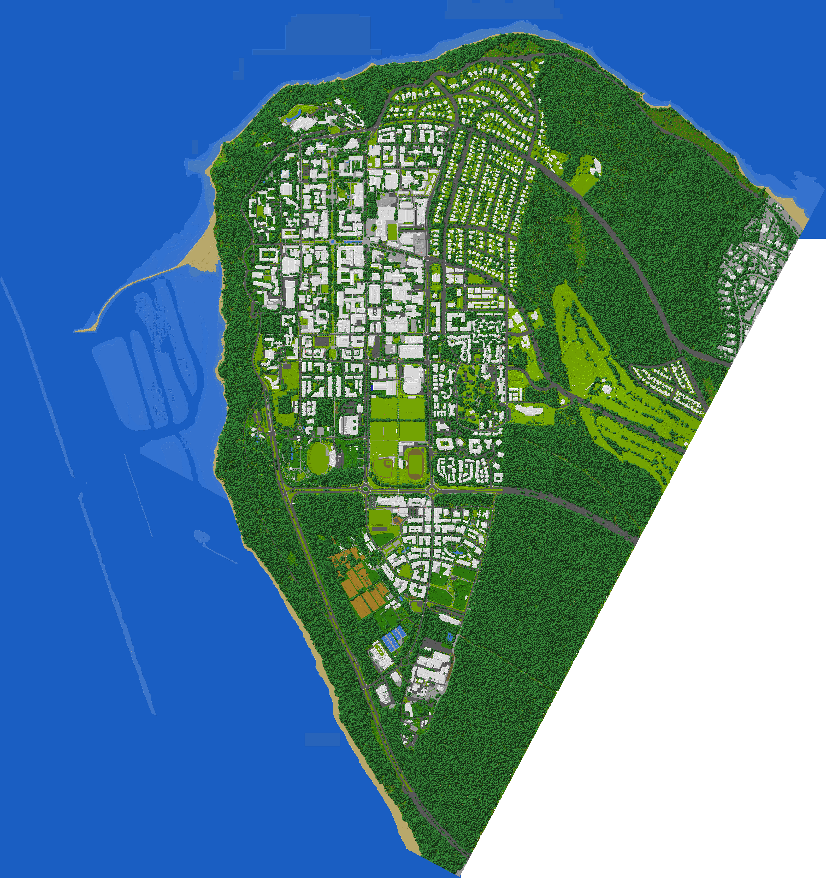
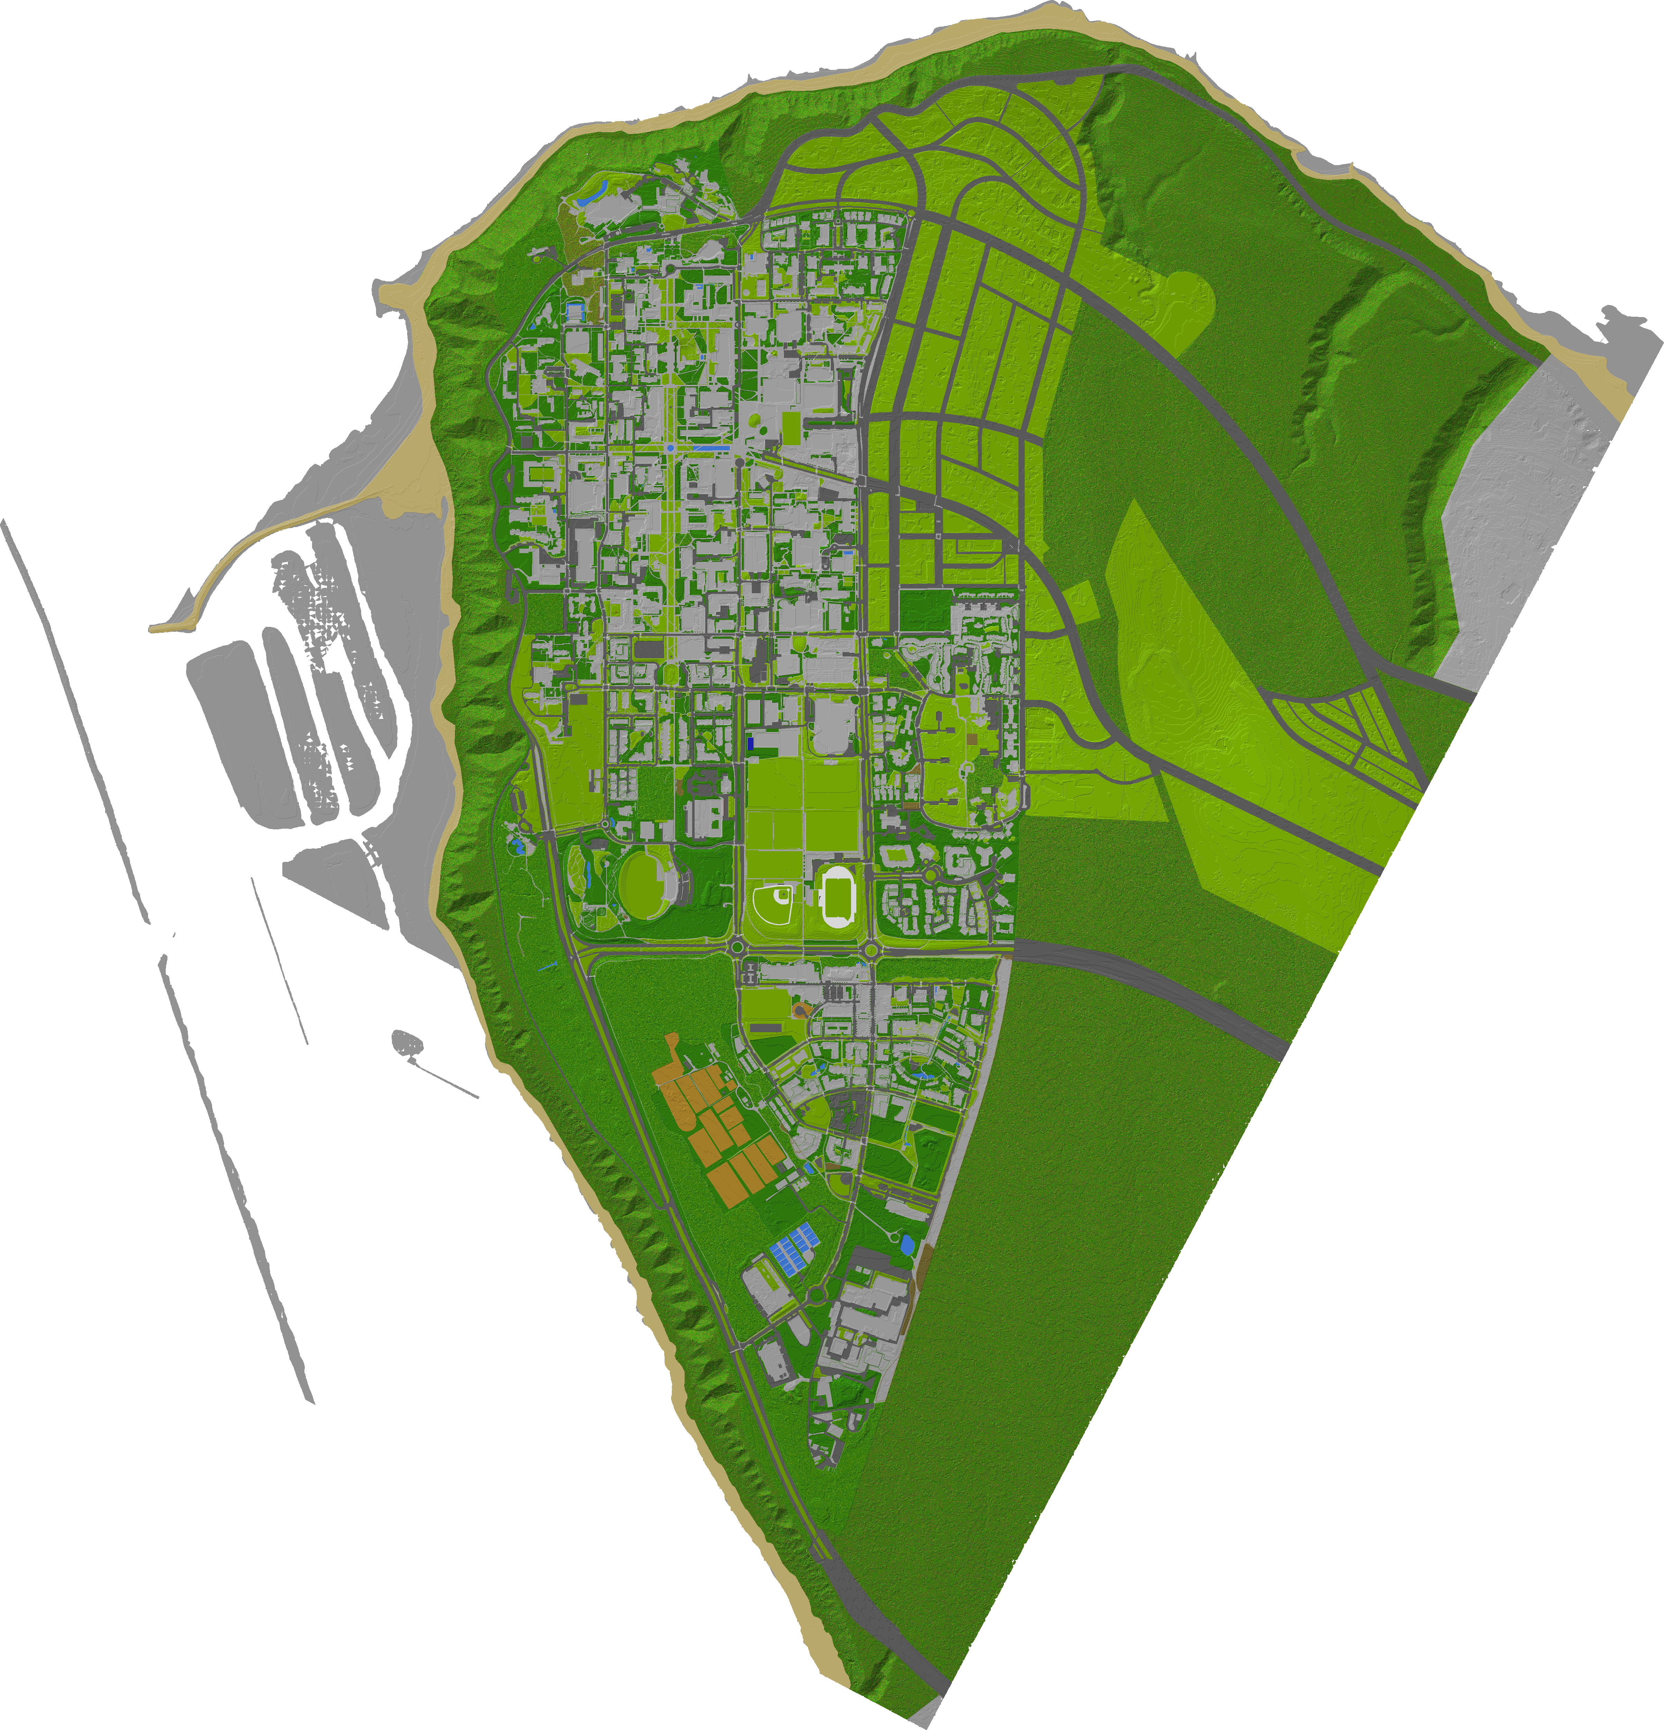
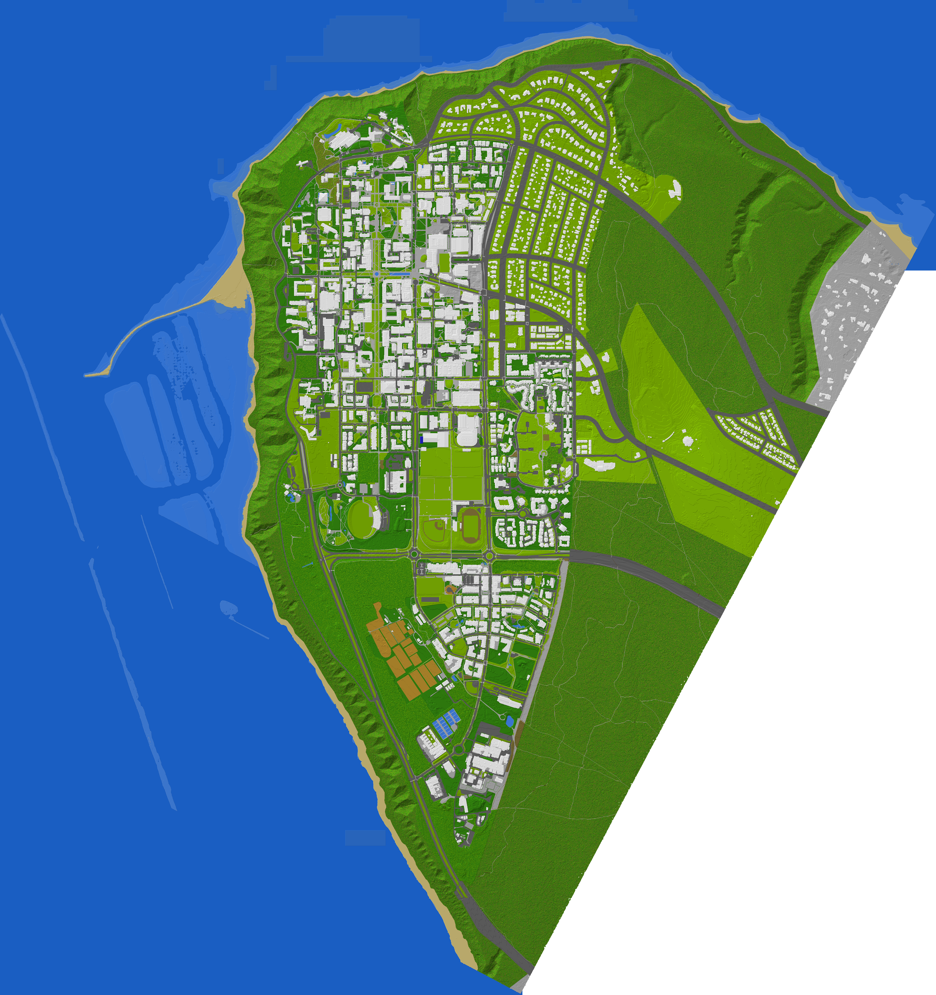
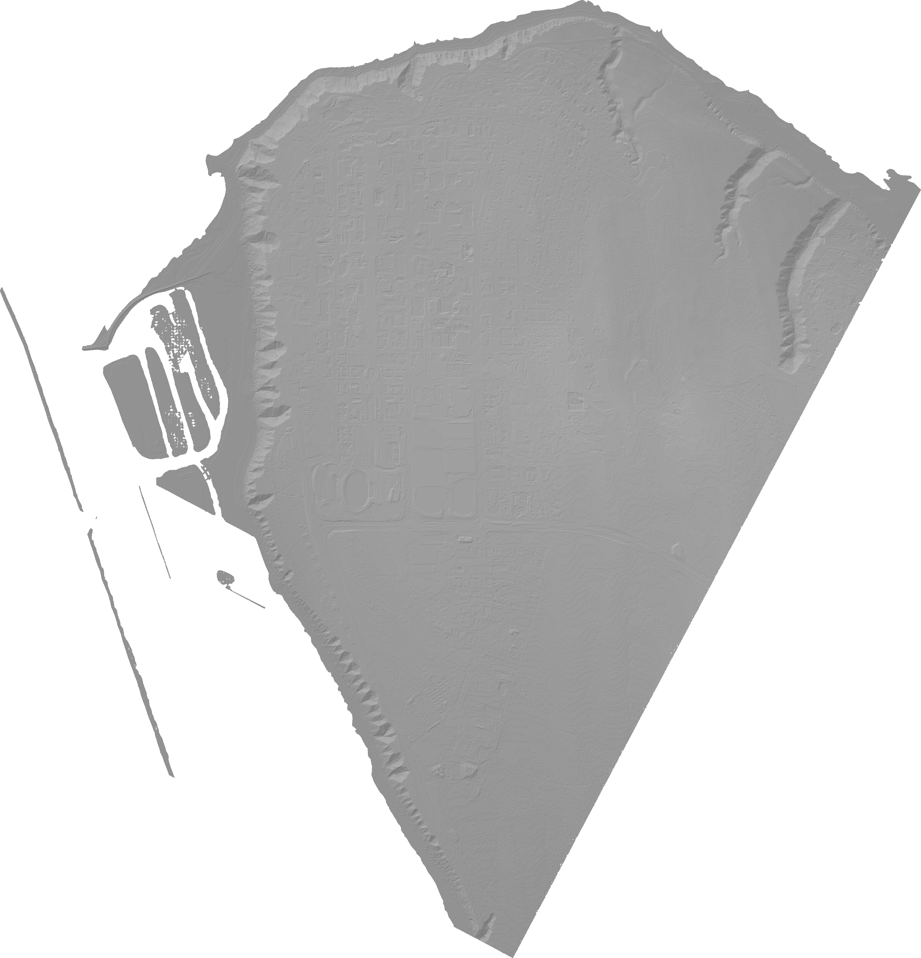

3. Place grayscale buildings from LiDAR data
6. Place trees, estimating trunk and branch positions using ML
2. Colorize DEM based on GeoJSON polygons
5. Add ocean, and traffic impactors + outdoor lights from various street data
1. Surface reconstruction of DEM from LiDAR ground data
4. Add hiking trails from GeoJSON data

