Slide 1


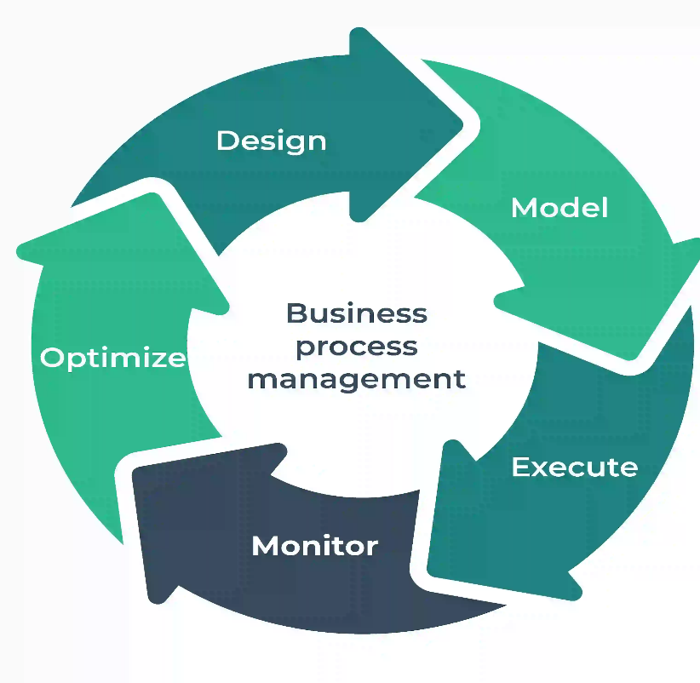
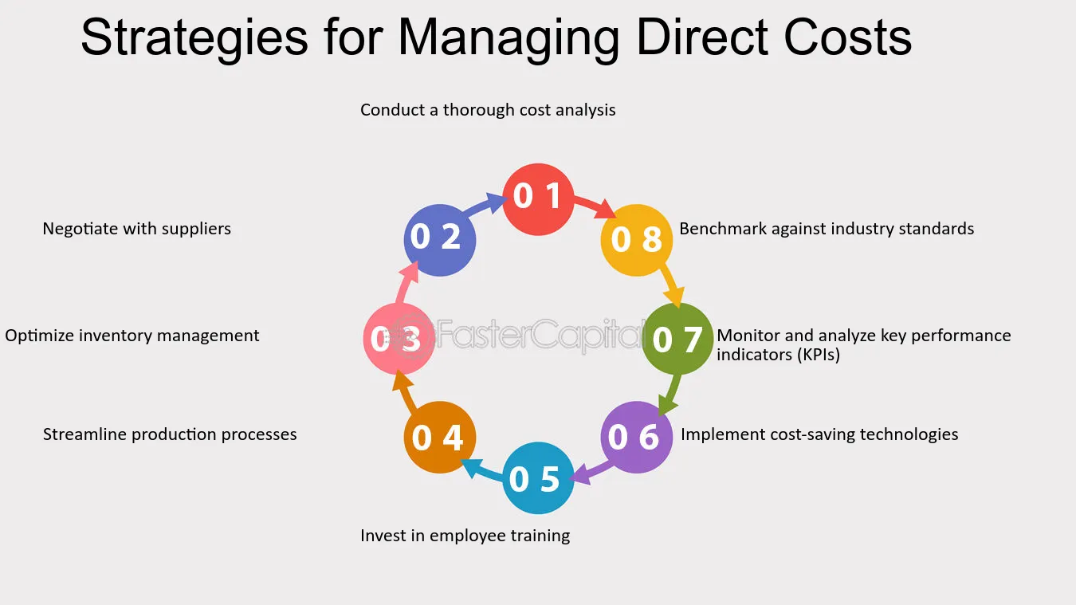
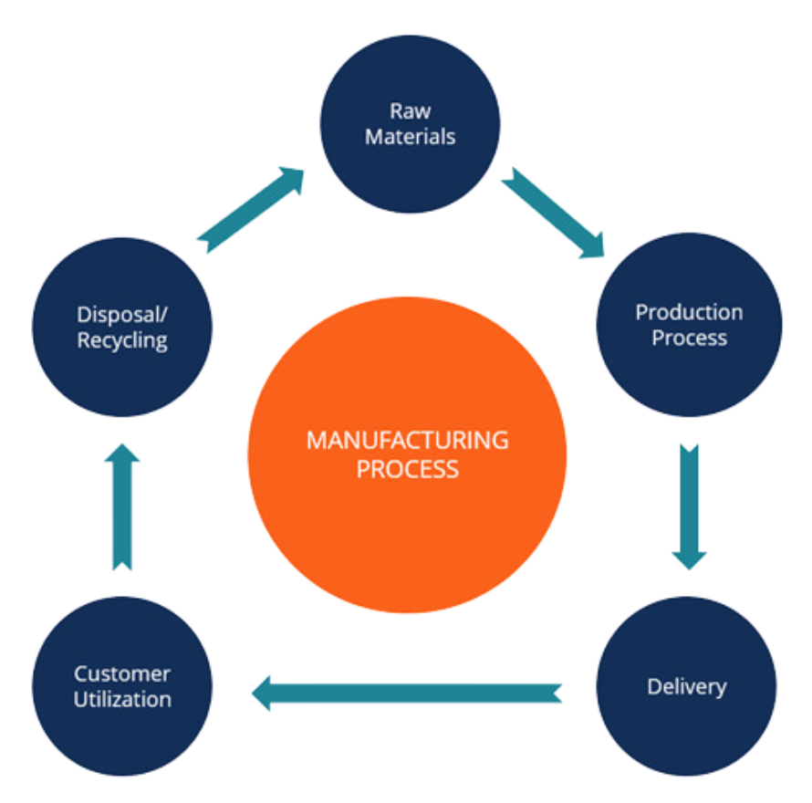
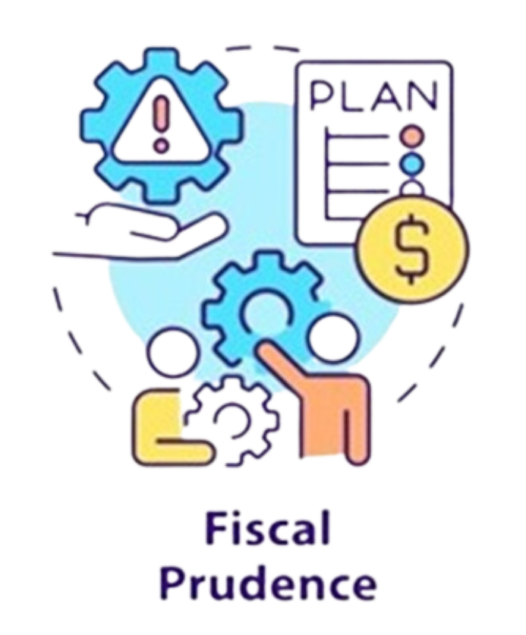
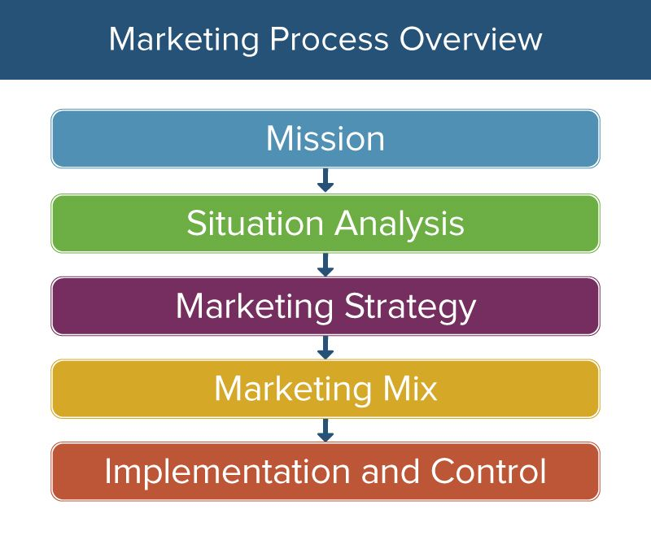
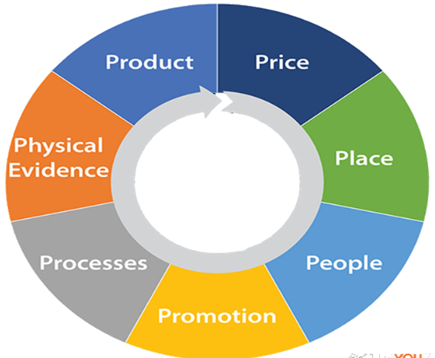
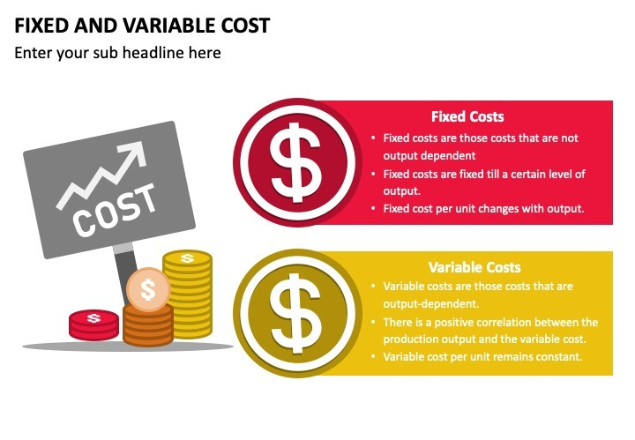
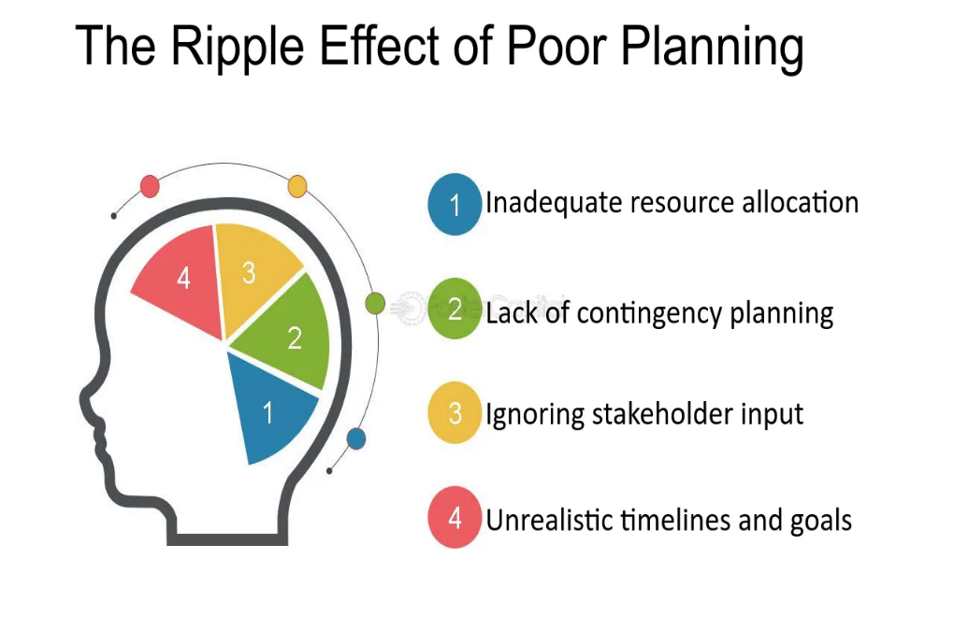
eight strategies for managing direct costs, which are expenses directly tied to producing goods or services
Human Resources including leadership, training, performance, potential, and research.
careful financial planning (gear) is key to fiscal responsibility
how fixed and variable cost change with production output
eight strategies for managing direct costs, which are expenses directly tied to producing goods or services
marketing mix model divided into seven sections labeled product, price, place, physical evidence, processes, people, and promotion

